Slide 1
A tour of our Solar System

Slide 2
Milky Way Galaxy
Age: 16 million years
Type: Spiral
Contains 200 – 400 billion stars
1,000
Light
years
100,000 light years
Image source

Slide 3
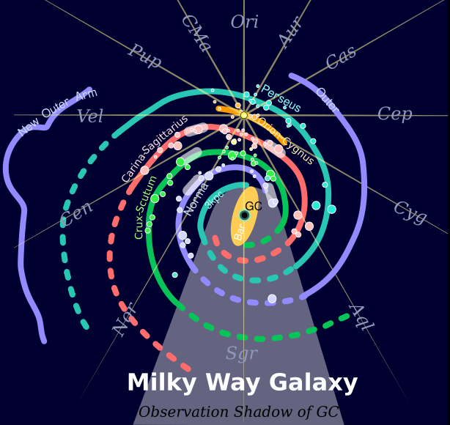
You are here!
color | arm(s)
cyan | 3-kpc and Perseus Arm
sky-blue | Norma and Cygnus Arm (Along with a newly discovered extension)
chlorine-green | Crux and Scutum Arm
pink | Carina and Sagittarius Arm
There are at least two smaller arms or spurs, including:
orange | Orion Arm (which contains the solar system and the Sun)
source

Slide 4
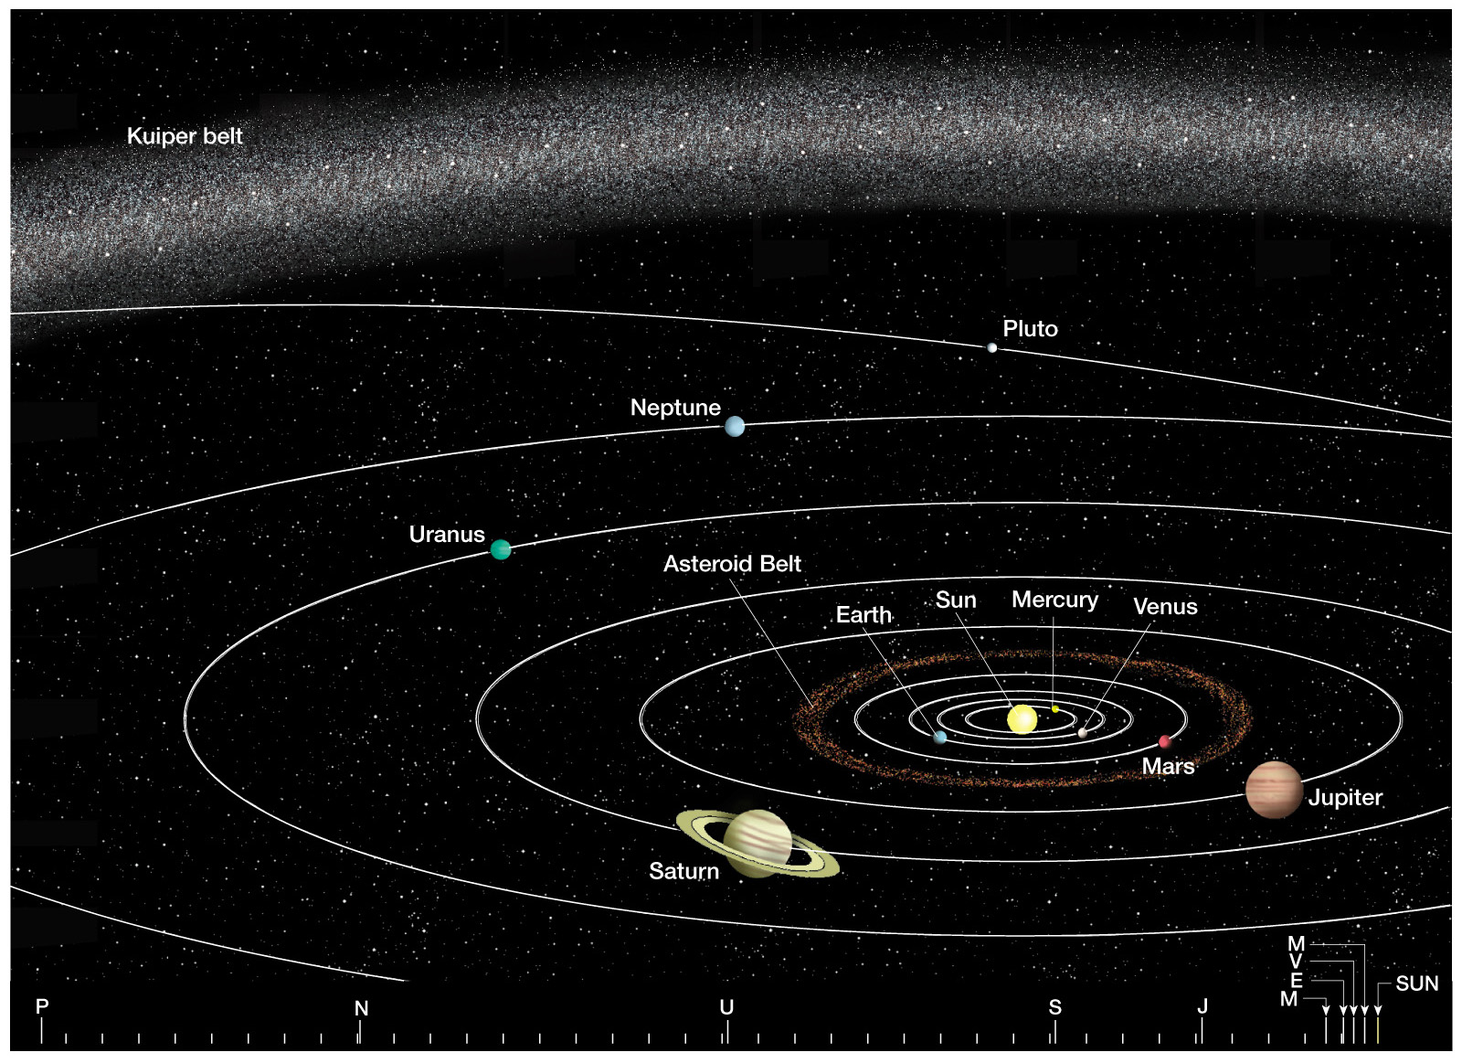
The solar system

Slide 5
Orbital Planes
Similar to a flat sheet of paper
The orbital planes of the planets are inclined
Planes of seven planets lie within 3 degrees of the Sun's equator
Mercury's is inclined 7 degrees
Pluto's is inclined 17 degrees

Slide 6
Compositions
Gases
Hydrogen
Helium
Rocks
Silicate minerals
Metallic iron
Ices
Ammonia (NH₃)
Methane (CH₄)
Carbon dioxide (CO₂)
Water (H₂O)

Slide 7
Solar System Tour

Slide 8
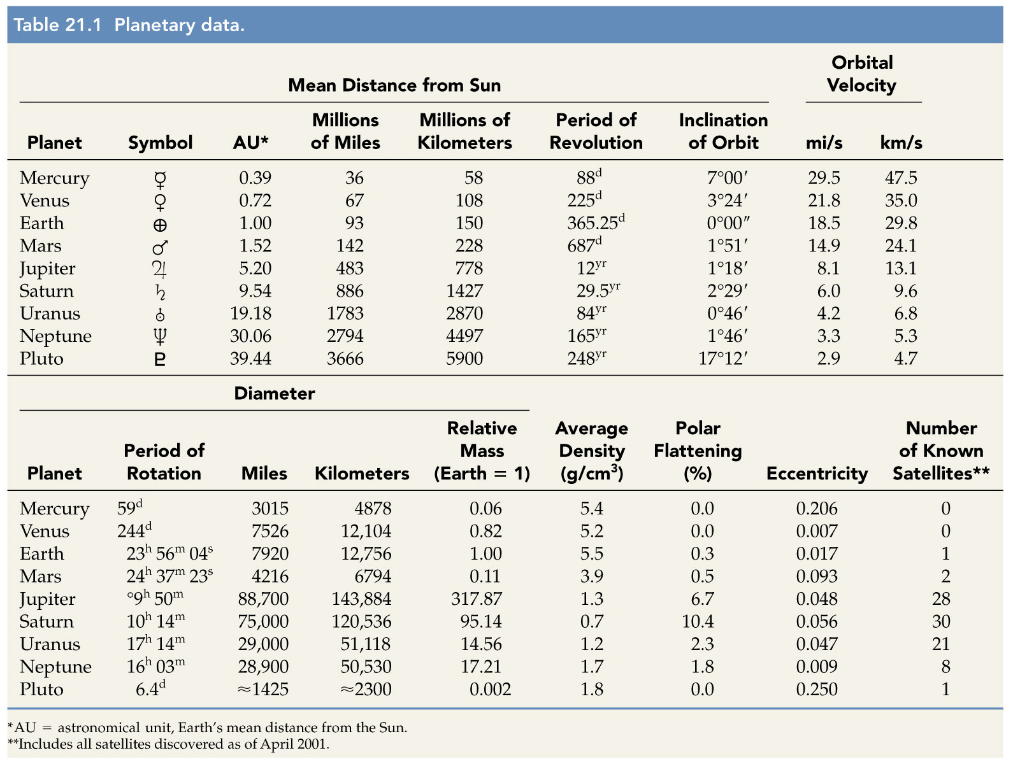

Slide 9
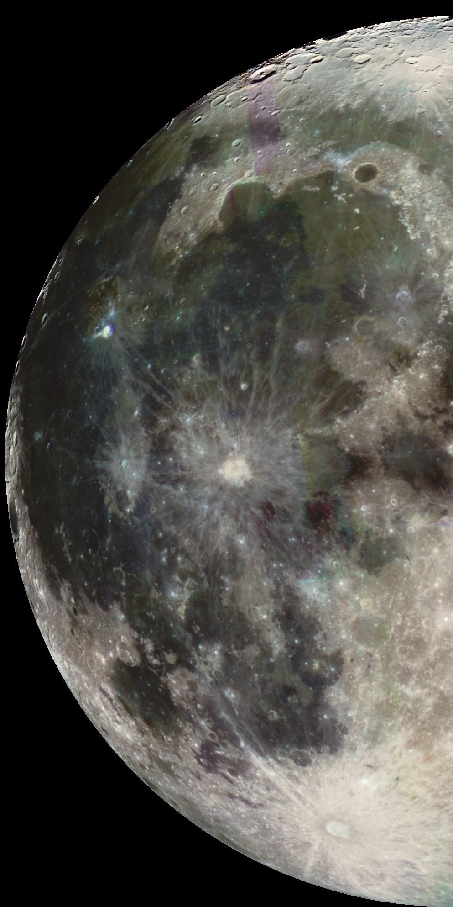
Our Moon
Distance from Earth | 384,400 km
Radius | 1737.4 km
Length of Day | 27.3 Earth days
Temperature | -233 / 123 ºC
Atmosphere | none
source
Image source

Slide 10
Our Moon
Lunar evolution
Original crust (highlands)
As Moon formed, its outer shell melted, cooled, solidified, and became the highlands
About 4.5 billion years old

Slide 11
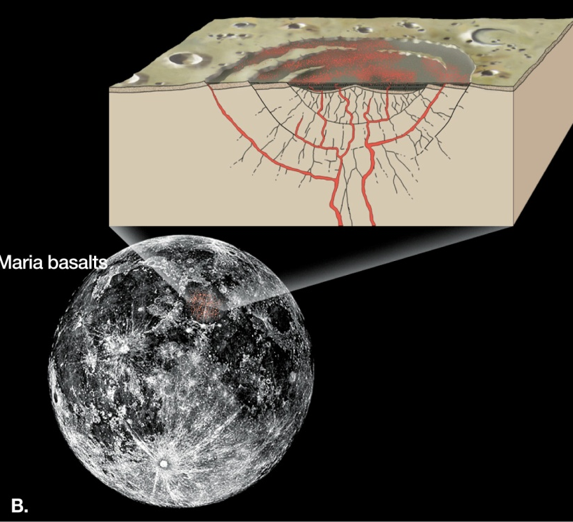
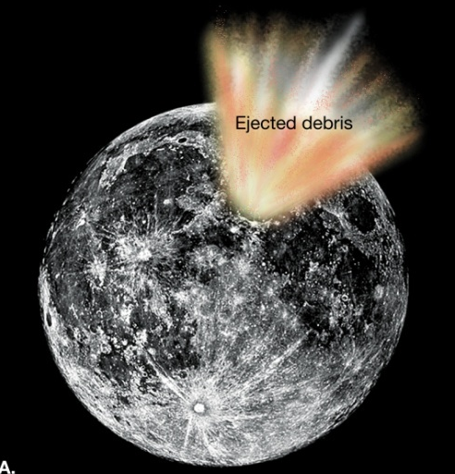
Our Moon
Lunar evolution
Formation of maria basins
Younger than highlands
Between 3.2 and 3.8 billion years old

Slide 12
Our Moon
Lunar evolution
Formation of rayed craters
Material ejected from craters is still visible
Ejecta forms lunar regolith (Composed of: igneous rocks, breccia, glass beads, & fine lunar dust )

Slide 13
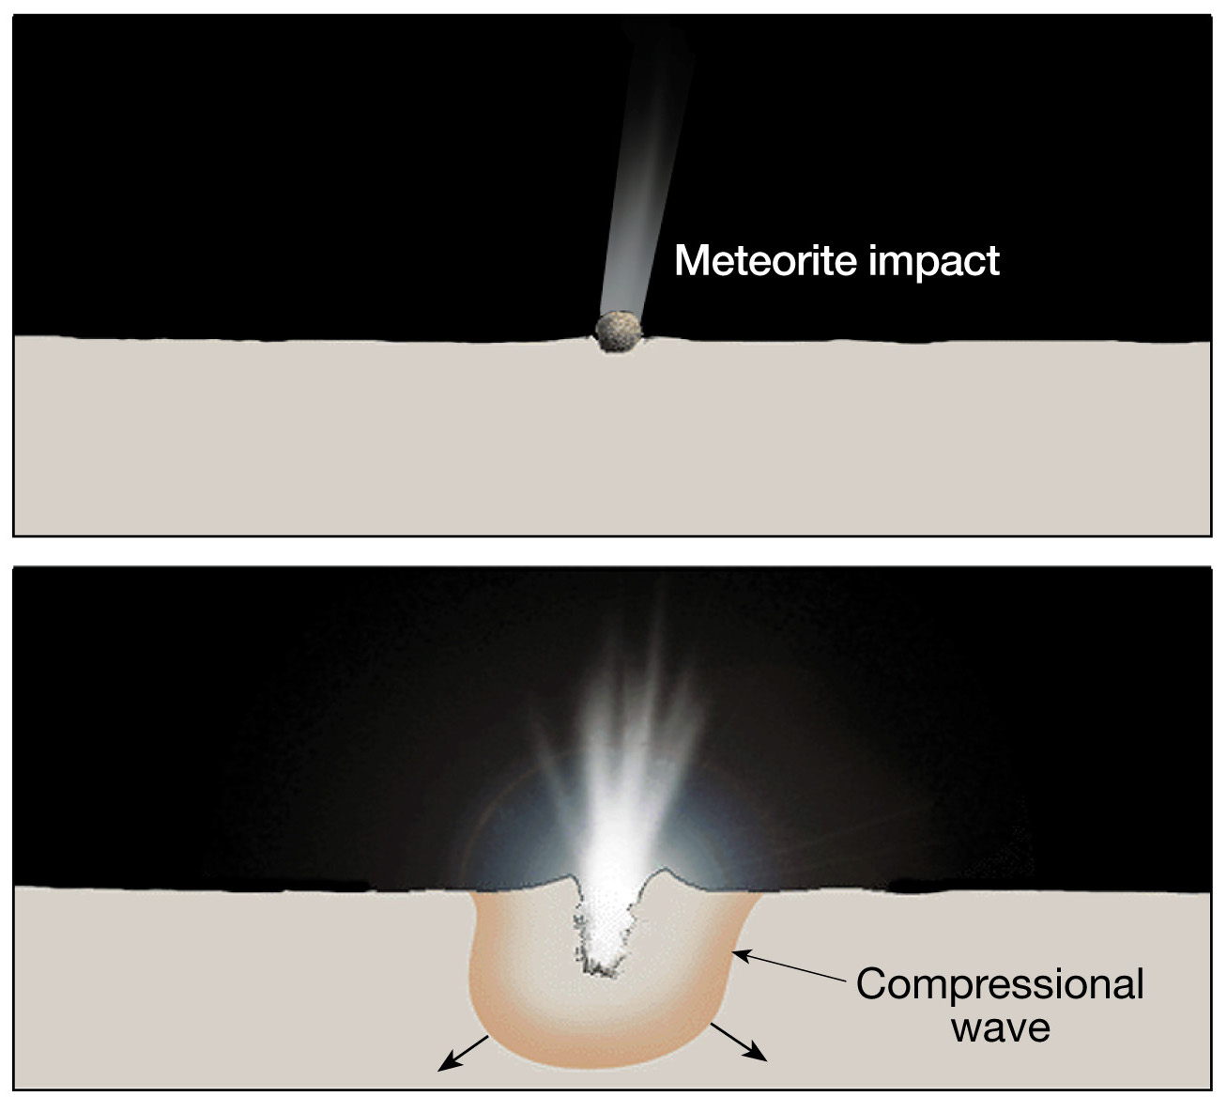

Slide 14
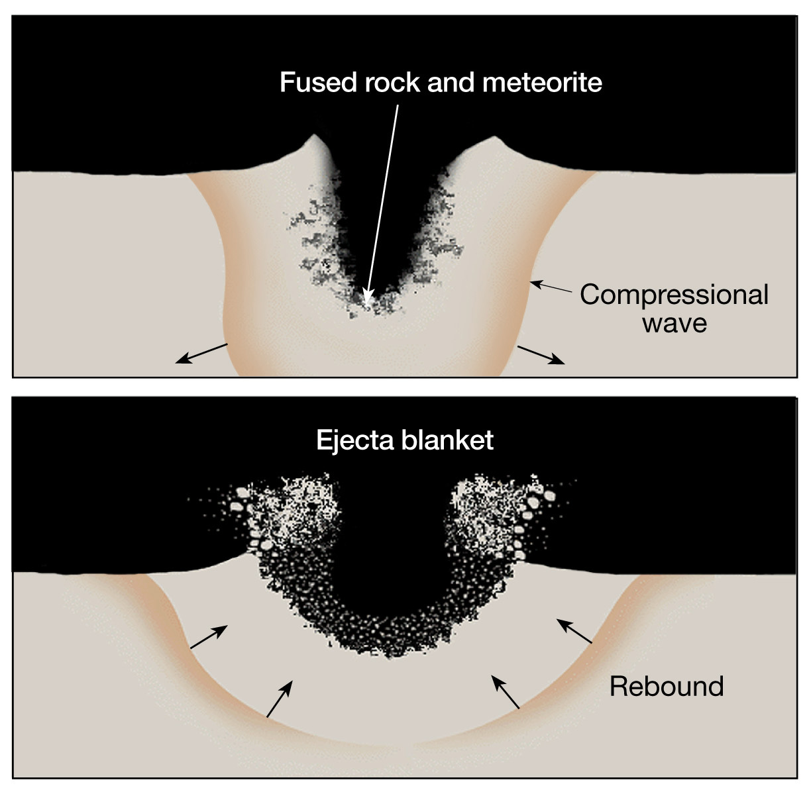

Slide 15
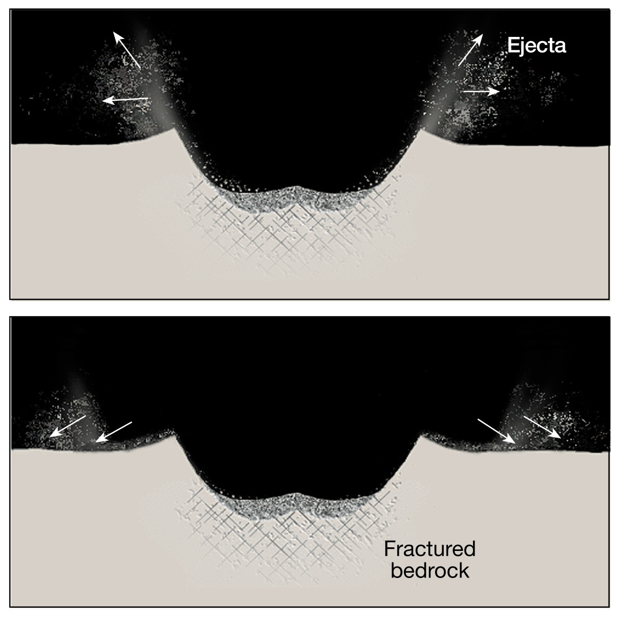

Slide 16
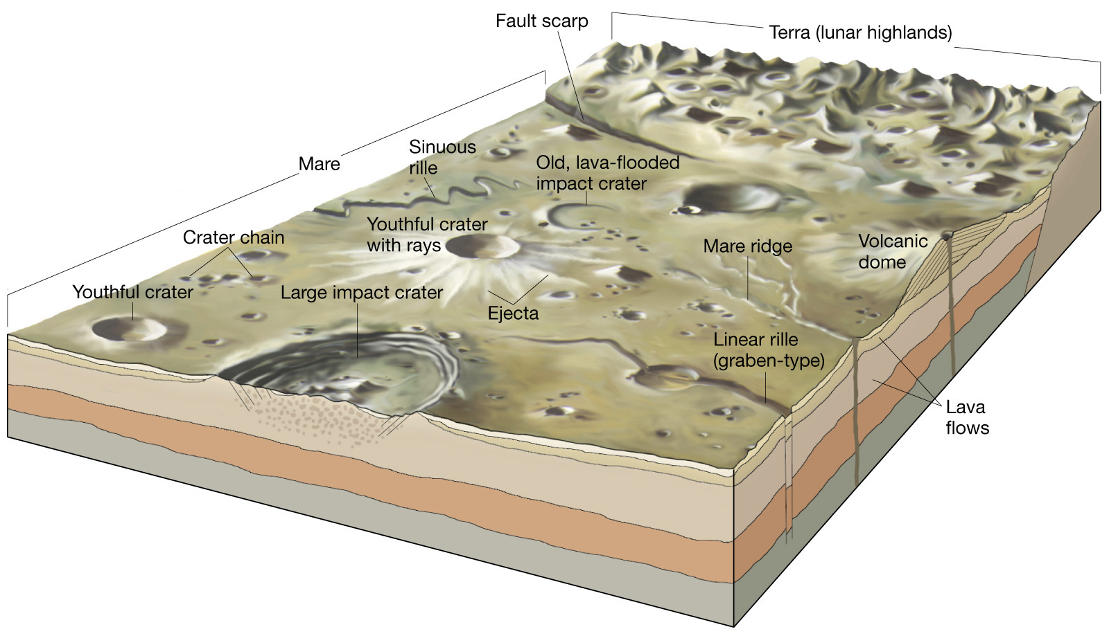
Major topographic features on the lunar surface

Slide 17
The Sun
Type: Yellow Giant
Age: 4.6 Billion Years
Composition: 92.1% Hydrogen
7.8% Helium
source

Slide 18
The Sun
Distance from Earth | 149,599,900 km
Radius | 695,500 km
Length of Day | 25.38 Earth days
Length of Year | 0.241 Earth years
Temperature | 5,500 ºC / 10,000 ºF
Volume | 1,412,200,000,000,000,000 km3
Mass | 1,989,000,000,000,000,000,000,000,000,000 kg
source

Slide 19
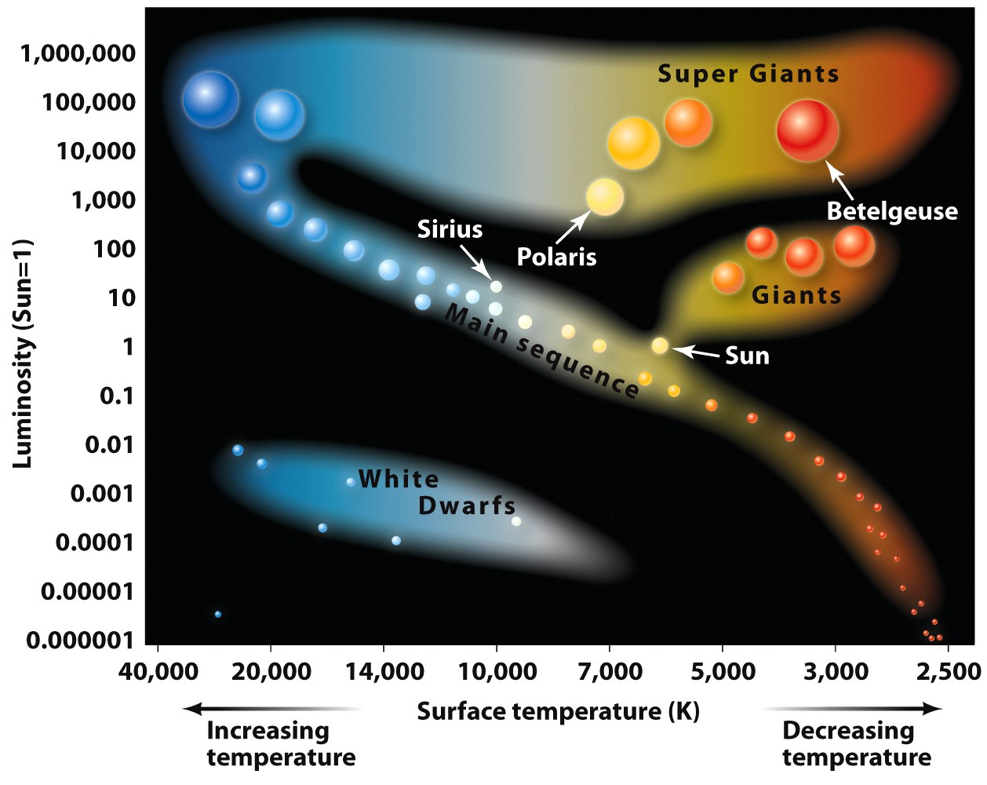

Slide 20
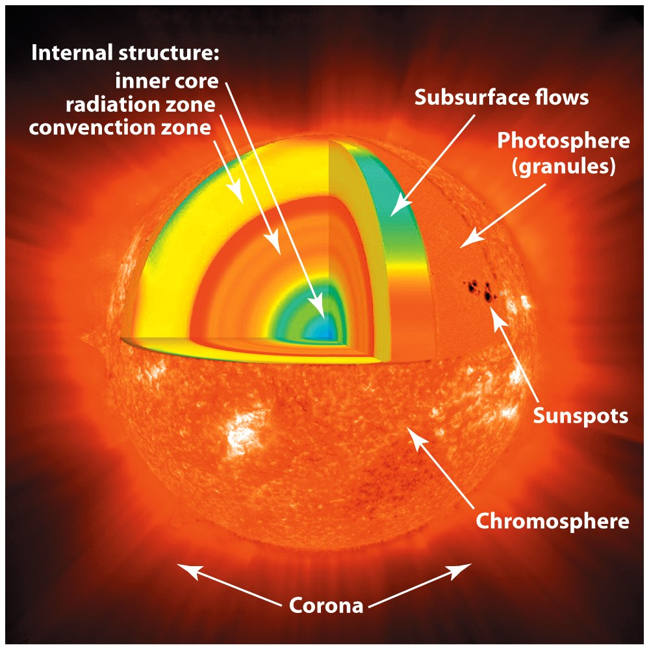
The Sun
The core
Extreme temperatures + Extreme pressures = Nuclear reactions
Radiation Zone
Convection Zone (energy transfer)
Photosphere (surface)

Slide 21
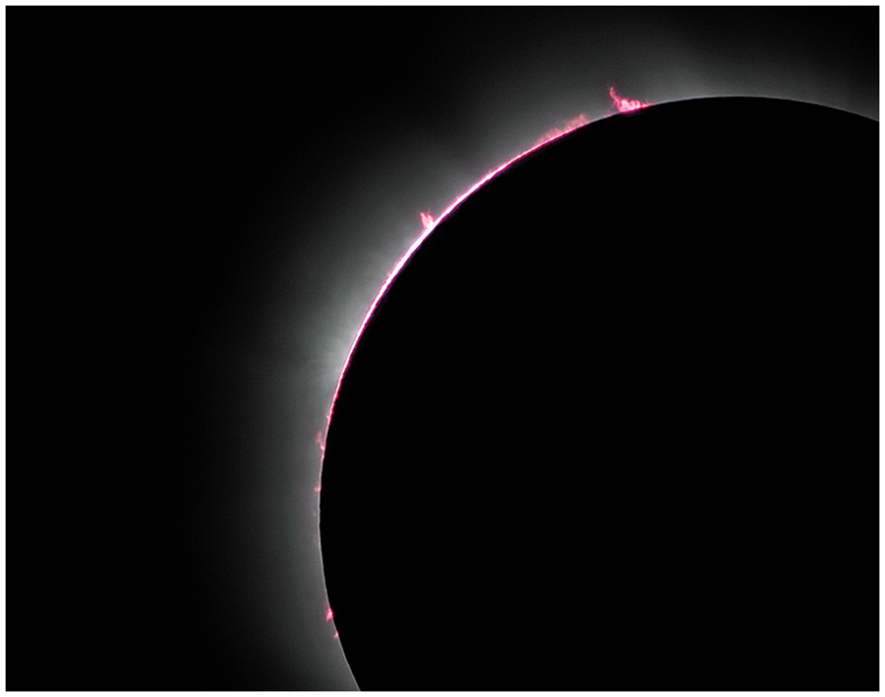
The Sun
Chromosphere
looks reddish when viewed during an eclipse

Slide 22
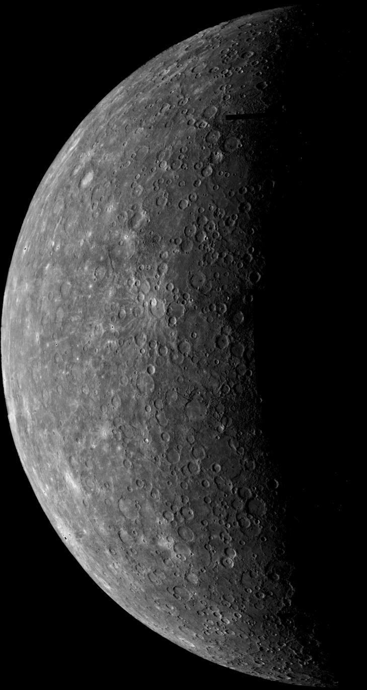
Mercury
Distance from Sun | 57,909,175 km
Radius | 2,439.7 km
Length of Day | 58.646 Earth days
Length of Year | 99 Earth days
Temperature | 467 ºC / -170 ºC
Atmosphere | Basically none
Moons (known) | none
source

Slide 23
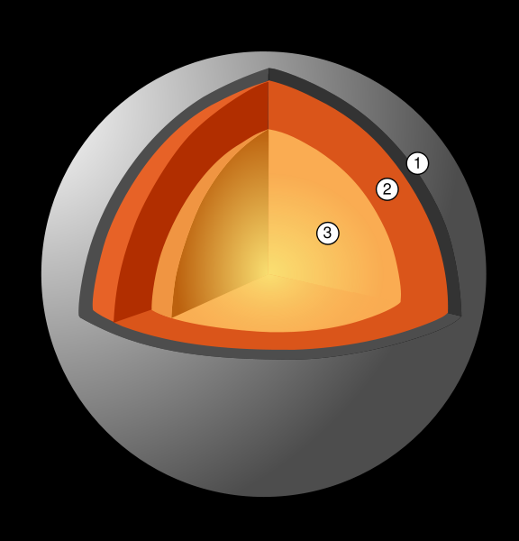
Mercury
Surface | Heavily cratered due to numerous impacts from meteoroids and comets.
Tectonics: | None
Magnetic Field: | None
Crust - 100-200km thick
Mantle - 600km thick
Nucleus - 1,800km radius
source
source

Slide 24
Venus
Distance from Sun | 108,208,930 km
Radius | 6,051.8 km
Length of Day | 117 Earth days (retrograde, west to east)
Length of Year | 225 Earth days
Temperature | 462 ºC
Atmosphere | Thick, composed of CO₂, N₂ Impenetrable by light, Surface atmospheric pressure is 90x that of Earth's
Moons (known) | none
source

Slide 25
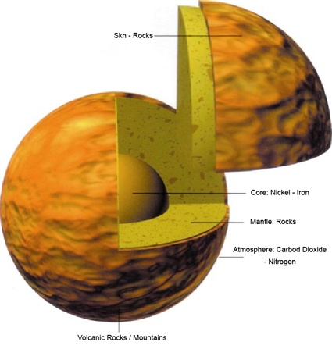
Venus
Surface | 80% of surface is subdued plains that are mantled by volcanic flows; Low density of impact craters; Thousands of volcanic structures
Tectonics: | None apparent.
Magnetic Field: | None
source

Slide 26
Mars
Distance from Sun | 227,936,640 km
Radius | 3,399 km
Length of Day | 24.62 Earth hours
Length of Year | 686.9 Earth days
Temperature | -87 to -5 ºC
Atmosphere | Thin, composed of CO₂, N₂, Ar 1% as dense as Earth's
Moons (known) | 2 – Phobos & Deimos (Captured asteroids)
source

Slide 27
Mars
Surface | Numerous large volcanoes – largest is Mons Olympus Less-abundant impact craters Several canyons, some larger than Earth’s Grand Canyon (Valles Marineras – the largest canyon). Polar caps of water ice, covered by a thin layer of frozen carbon dioxide
Tectonics: | None
Magnetic Field: | None
Weather: | Extensive dust storms with winds up to 270 kph (170 mph)
source

Slide 28
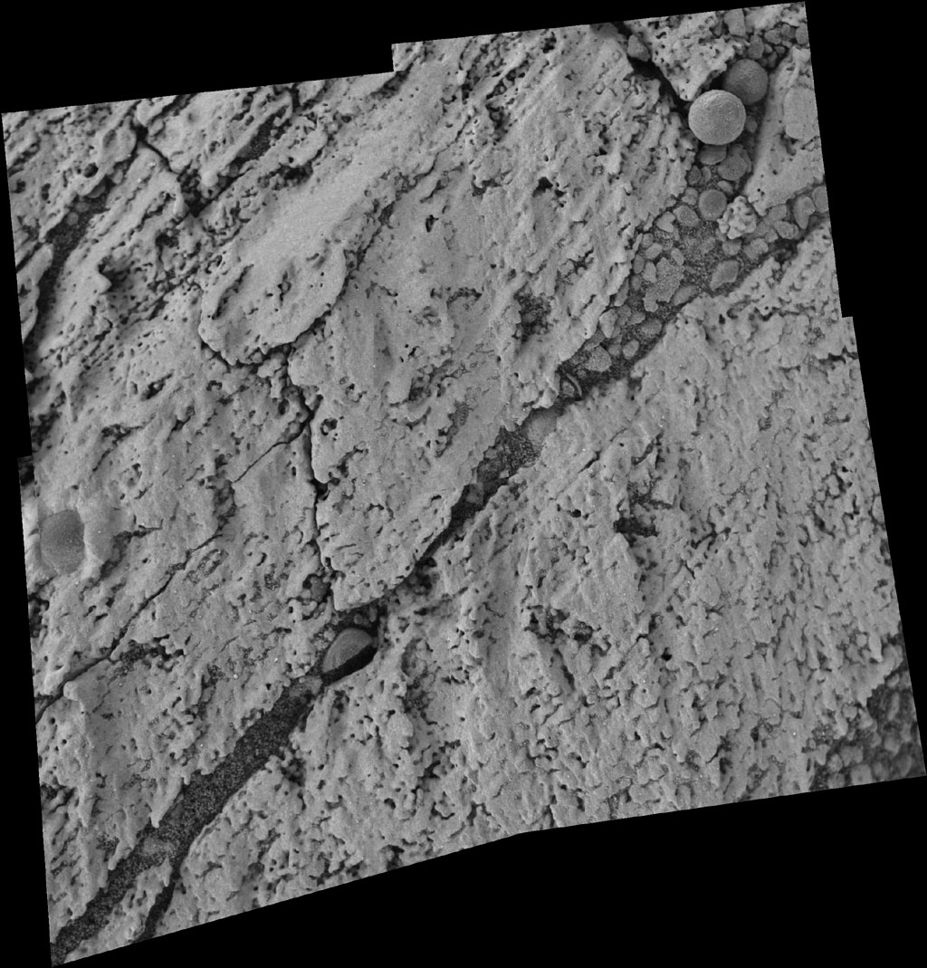
“Blueberries”
Bedding
Microscopic Image Inside 'Endurance‘
http://marsrovers.jpl.nasa.gov/gallery/press/opportunity/20040622a.html

Slide 29
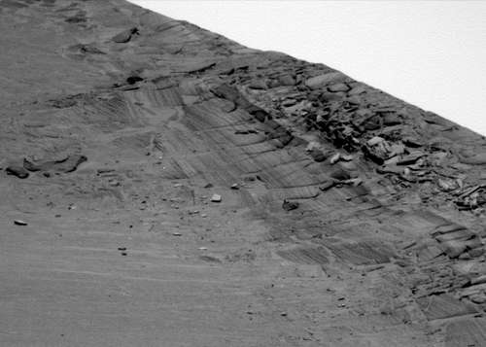
Left Panoramic Camera Non-linearized Sub-frame EDR acquired on Sol 145 of Opportunity's mission to Meridiani Planum at approximately 11:53:26 Mars local solar time (link)

Slide 30
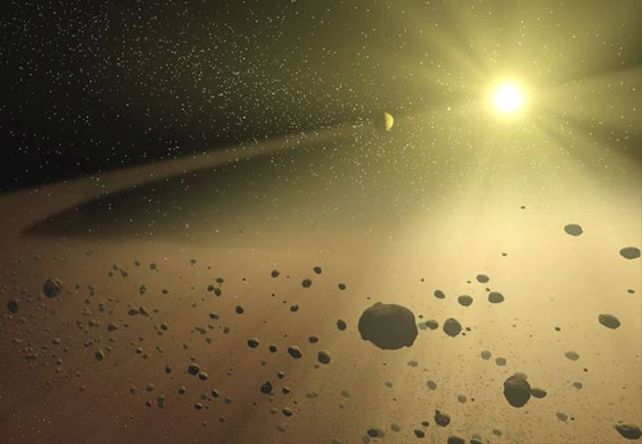
Asteroid Belt
Distance from Sun | 403,914,303 km
Radius | 1 - 940 km (400 km average) for individual asteroids
Length of Day | n/a
Length of Year | varies
Temperature | -73 to -108 ºC
Atmosphere | none
Moons (known) | none
Sources: 1, 2
Image source

Slide 31
Asteroid Belt
C-type or carbonaceous asteroids (75%) | Have same chemical composition as the Sun, but lack hydrogen, helium, and other volatiles. Most commonly found in the outer regions of the main asteroid belt.
S-type or silicate asteroids (15%) | Orbits within the inner regions of the main asteroid belt Composed of rocky materials plus a small amount of metallic iron.
M-type or metallic asteroids (10%) | Composed of metallic iron, like the iron meteorites.
V-type, or basaltic asteroids | rare
source

Slide 32
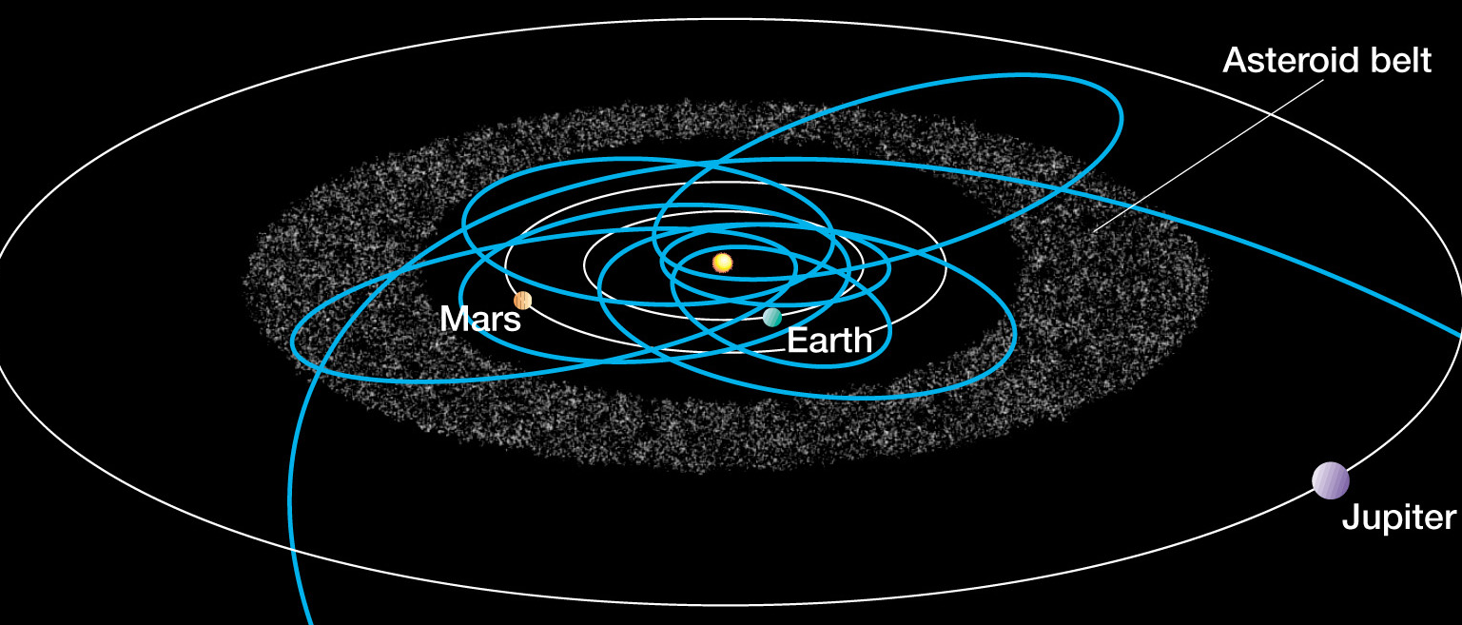

Slide 33
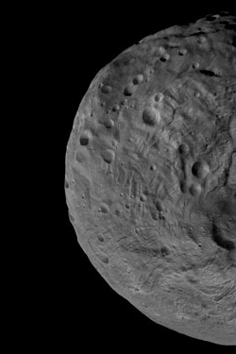
DAWN mission (NASA/JPL)
Launch: September 27, 2007
Dawn, the first spacecraft ever planned to orbit two different bodies after leaving Earth, will orbit Vesta and Ceres, two of the largest asteroids in the solar system.
Animation of Dawn's Path Through the Solar System
Vesta - False Color Shape Model
source

Slide 34
Jupiter
Distance from Sun | 778,412,020 km
Radius | 71,492 km
Length of Day | 9.9 Earth hours
Length of Year | 11.9 Earth days
Temperature | -148 ºC
Atmosphere | VERY thick, composed of H₂, He
Moons (known) | 62!
Sources: 1, 2
Image source

Slide 35
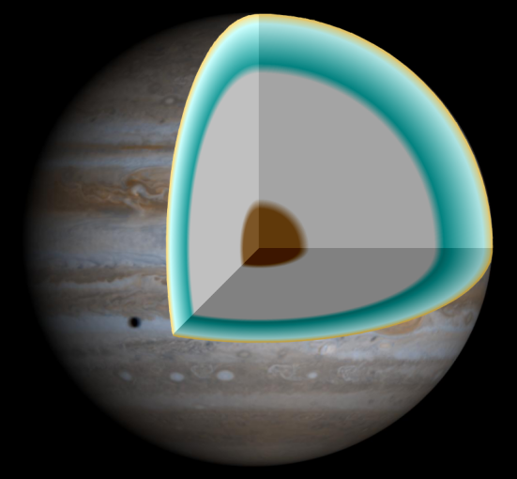
Jupiter
Surface | composed of hydrogen with a small proportion of helium; it may also have a rocky core of heavier elements under high pressure
Tectonics: | unknown
Magnetic Field: | Very strong
Weather: | Clouds composed of ammonia crystals and possibly ammonium hydrosulfide. Wind belts at different latitudes; interaction between belts causes storms and turbulence
source

Slide 36
"The first color movie of Jupiter from NASA's Cassini spacecraft shows what it would look like to peel the entire globe of Jupiter, stretch it out on a wall into the form of a rectangular map, and watch its atmosphere evolve with time.
"The brief movie clip spans 24 Jupiter rotations between Oct. 31 and Nov. 9, 2000.”
source

Slide 37
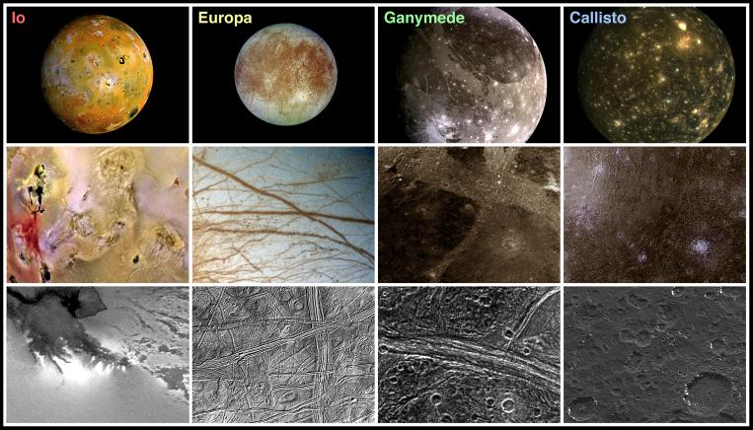
Landscape Comparisons - Galilean Satellites
volcanic
caulderas
tidally induced cracks in ice
fractured & pulled apart grooved terrain
heavily eroded & mantled craters

Slide 38
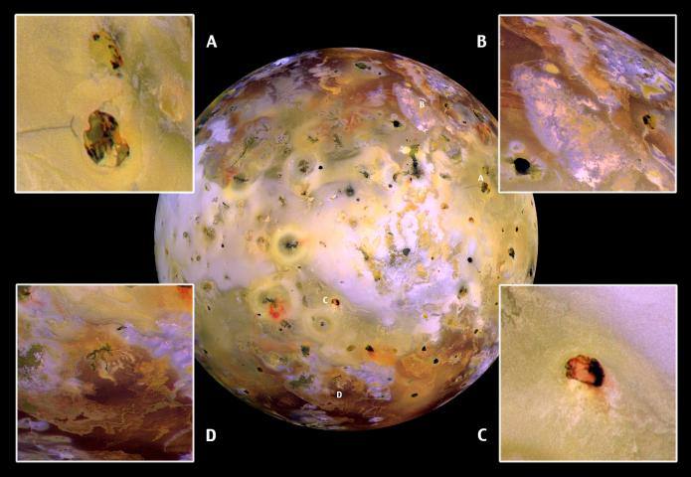
Close-ups of Io (false color)
Galileo spacecraft on July 3, 1999 (link)

Slide 39
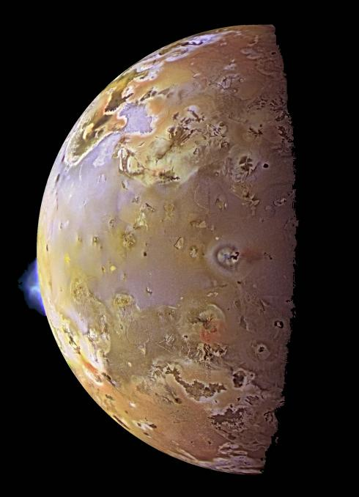
A volcanic eruption on Io June 28, 1999 (Galileo spacecraft)

Slide 40
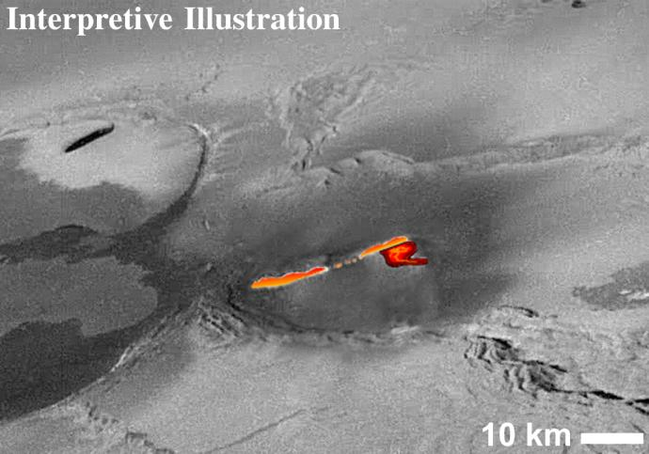
This mosaic of images collected by NASA's Galileo spacecraft on November 25,1999 shows a fountain of lava spewing above the surface of Jupiter's moon Io.

Slide 41
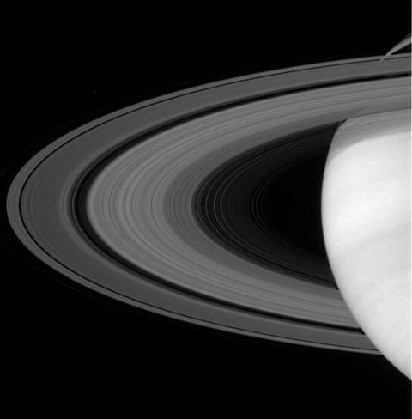
Saturn
Distance from Sun | 1,426,725,400 km
Radius | 60,268 km
Length of Day | 10.7 Earth hours
Length of Year | 29.4 Earth years
Temperature | -178 ºC
Atmosphere | VERY thick, composed of H₂, He
Moons (known) | 60!
Sources: 1, 2
Image source

Slide 42
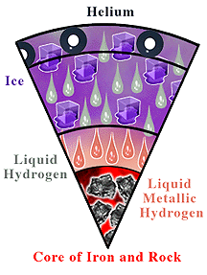
Saturn
Surface | Similar to Jupiter’s Atmosphere, Composition & Internal structure
Tectonics: | unknown
Magnetic Field: | Very strong
Weather: | Dynamic atmosphere with large cyclonic storms similar to Jupiter's Great Red Spot. The upper clouds are composed of ammonia crystals, while the lower level clouds appear to be composed of either ammonium hydrosulfide (NH₄SH) or water.
Image source
Sources: 1, 2

Slide 43
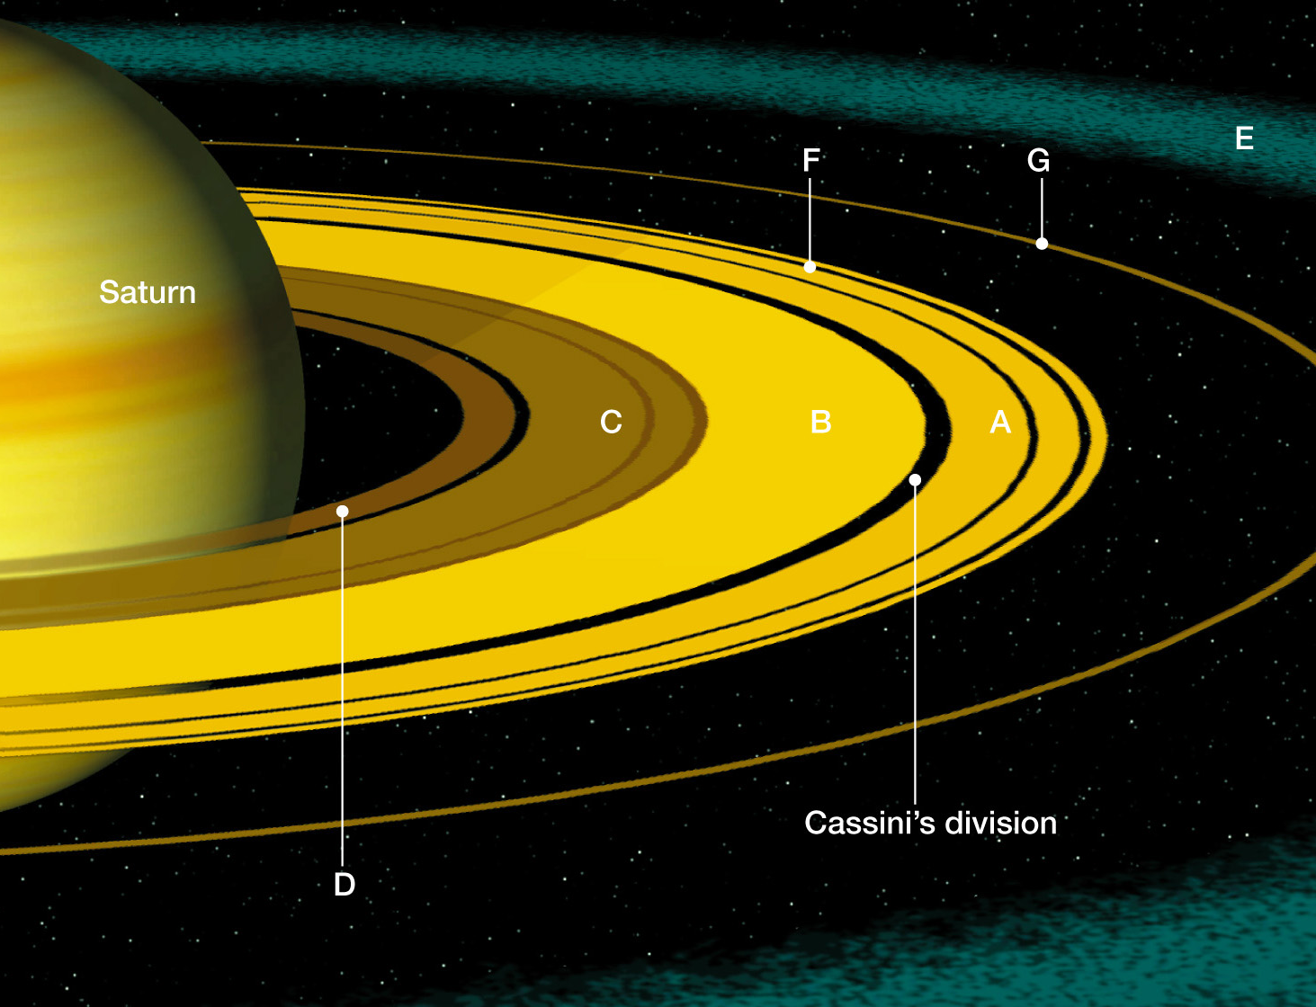
The ring system of Saturn

Slide 44
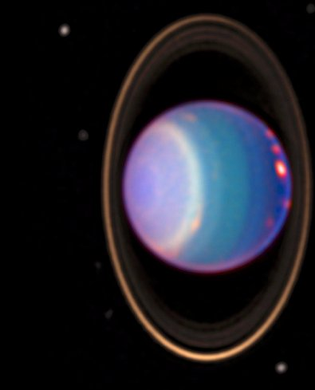
Uranus
Distance from Sun | 2,870,992,200 km
Radius | 25,559 km
Length of Day | 17 Earth hours
Length of Year | 84 Earth years
Temperature | -216 ºC
Atmosphere | VERY thick, composed of H₂, He, CH₄
Moons (known) | 27!
Sources: 1, 2
Image source

Slide 45
Uranus
Surface | a rocky core in the center, an icy mantle in the middle and an outer gaseous hydrogen/helium envelope
Tectonics: | unknown
Magnetic Field: | yes
Weather: | Wispy clouds
Sources: 1, 2

Slide 46
Neptune
Distance from Sun | 4,498,252,900 km
Radius | 24,764 km
Length of Day | 16 Earth hours
Length of Year | 164.8 Earth years
Temperature | -214 ºC
Atmosphere | VERY thick, composed of H₂, He, CH₄
Moons (known) | 13!
Sources: 1, 2
Image source

Slide 47
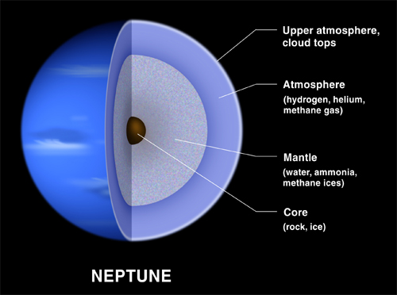
Neptune
Surface | a rocky core in the center, an icy mantle in the middle and an outer gaseous hydrogen/helium envelope
Tectonics: | unknown
Magnetic Field: | yes
Weather: | One of the windiest places in the solar system: Great Dark Spot; White cirrus-like clouds above the main cloud deck
Sources: 1, 2

Slide 48
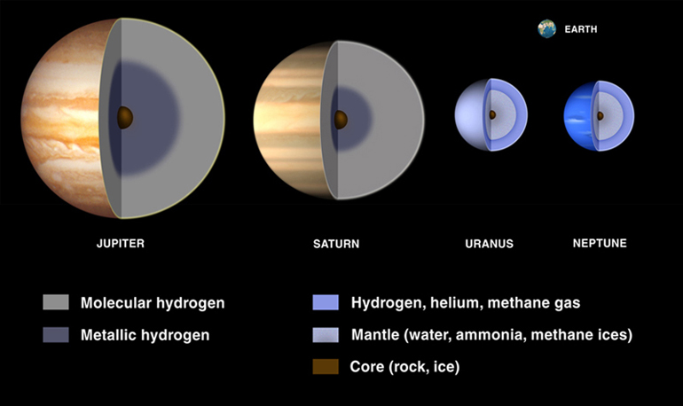
Image source

Slide 49
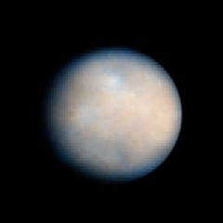
Dwarf Planets: Ceres
Distance from Sun | 403,914,303 km (Asteroid Belt Object)
Radius | 950 km
Length of Day | 9.1 Earth hours
Length of Year | 4.6 Earth years
Temperature | ~167 K
Atmosphere | none
Moons (known) | none
Ceres as seen by Hubble Space Telescope (ACS)
Sources: 1, 2
Image source

Slide 50
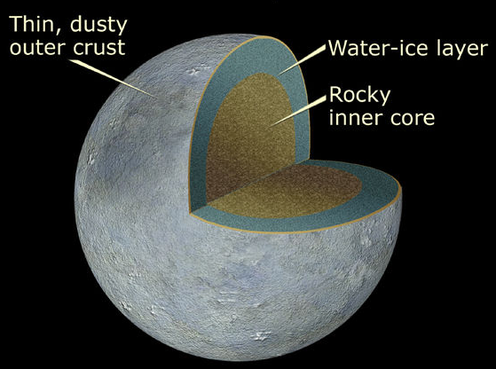
Dwarf Planets: Ceres
Surface | Similar to that of C-type asteroids, also contains hydrated materials
Tectonics: | unknown
Magnetic Field: | unknown
Weather: | unknown
Sources: 1, 2
Image source

Slide 51
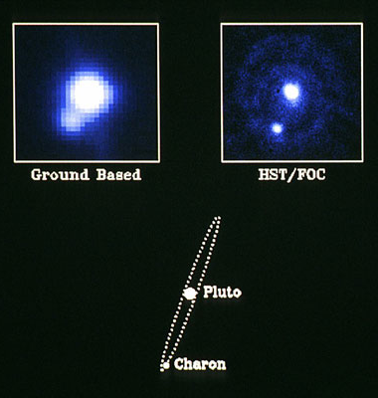
Dwarf Planets: Pluto
Distance from Sun | 5,906,380,000 km
Radius | 1,151 km
Length of Day | 16 Earth hours
Length of Year | 248 Earth years
Temperature | 44 K (-233 ºC)
Atmosphere | Thin, composed of N, CH₄, & CO
Moons (known) | 3 (Charon, Nix, & Hydra)
Sources: 1, 2
Image source

Slide 52
source

Slide 53
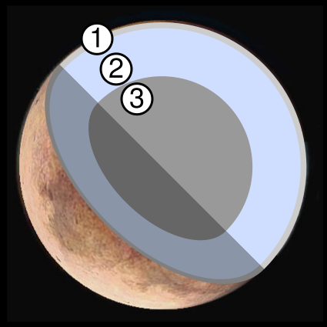
Dwarf Planets: Pluto
Surface | Possible structure of Pluto: 1. Frozen methane 2. Water ice 3. Silicate and water ice
Tectonics: | unknown
Magnetic Field: | unknown
Weather: | unknown
New Hubble Maps of Pluto Show Surface Changes
Sources: 1, 2
Image source

Slide 54
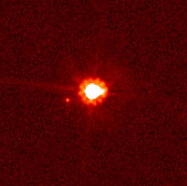
Dwarf Planets: Eris
Distance from Sun | 14,466,115,963 km (Kuiper Belt Object)
Radius | ~1300 km
Length of Day | 8? Earth hours
Length of Year | 557 Earth years
Temperature | 42.7 K
Atmosphere | none
Moons (known) | 1 (Dysnomia)
Eris (centre) and Dysnomia (left of centre).
Hubble Space Telescope.
Sources: 1, 2
Image source

Slide 55
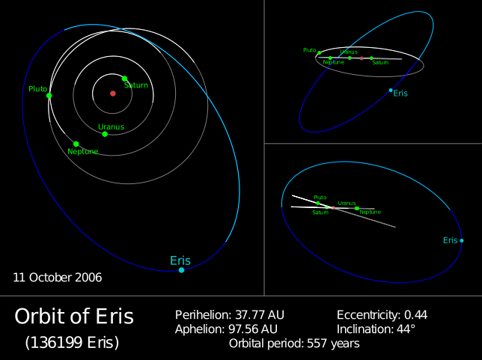
source

Slide 56
Trans-Neptunian Objects
“…any object in the solar system that orbits the sun at a greater distance on average than Neptune.”
Includes:
The Kuiper belt,
the Scattered disk,
and the Oort cloud
source

Slide 57
Kuiper Belt
Distance from Sun | 4.5 to ~6.9 billion km
Radius | ~100 km+ average of individual Kuiper Belt Objects
Composition | Ices of Methane (CH₄), Ammonia (NH₃), and water (H₂O) – similar to that of comets.
Origins | Thought to be remnants from the solar system’s formation & the source of most comets There are over 70,000 know KBOs
Notable KBOs | Pluto, Quaoar, 136472 (“Easterbunny”), 136108 (“Santa”) and Ixion
Sources: 1, 2

Slide 58
Image source

Slide 59
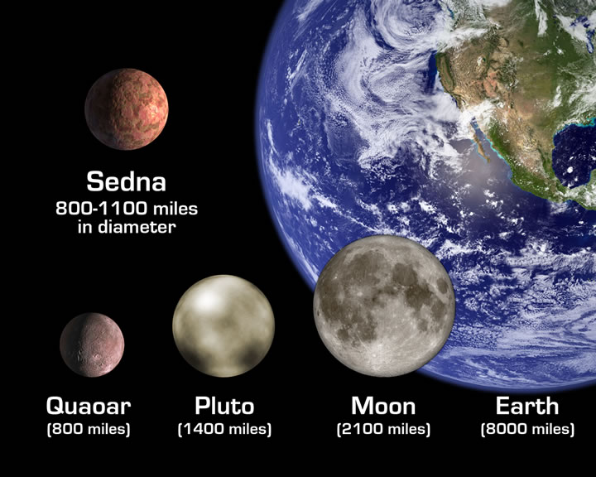
Image source

Slide 60
The Scattered Disk
Distance from Sun | ~6.9 to ~7.5 billion km
Radius | ~100 km+ average of individual Scattered Disk Objects
Composition | Uncertain, perhaps similar to KBOs
Origins | Thought to have “formed when Kuiper belt objects (KBOs) were "scattered" by gravitational interactions with the outer planets, principally Neptune, into highly eccentric and inclined orbits. ”
Notable SDO | Eris
Sources: 1

Slide 61
The Oort Cloud
Distance from Sun | ~750 billion km
Radius | Uncertain, but small (1 – 100 km for individual objects)
Composition | Uncertain, perhaps similar to KBOs & comets
Origins | “thought to be a remnant of the original protoplanetary disc that formed around the Sun approximately 4.6 billion years ago. Its outer part is only loosely bound to the solar system, and thus easily affected by the motions of passing stars or other forces”
Notable Oort Cloud Object | Sedna
Sources: 1

Slide 62
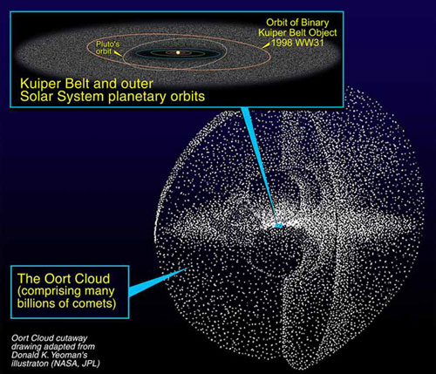
Image source

Slide 63
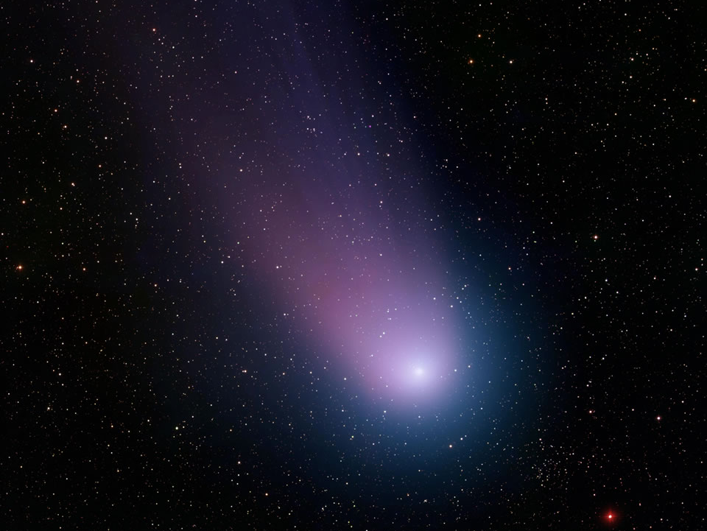
Just Passing Through
Comets & Meteors
Image source

Slide 64
Comets
Thought to be remnants from the formation of our solar system
AKA “dirty snowballs”
KBOs or TNOs

Slide 65
Image source

Slide 66
The Sun Rips Off a Comet's Tail
On April 20, 2007, the comet had just dipped inside the orbit of Mercury, perilously close to the sun, when a solar eruption struck and literally tore the comet's tail off. This surely has happened to comets before, but for the first time in history a spacecraft was watching. NASA's STEREO-A probe recorded a fantastic movie of the collision. source
Click image to play!

Slide 67
Meteoroids
What’s in a name?
Meteoroids are called meteors when they enter Earth's atmosphere
A meteor shower occurs when Earth encounters a swarm of meteoroids associated with a comet's path
Meteoroids are referred to as meteorites when they are found on Earth

Slide 68
Meteoroids
Sand to boulder-sized particles
Larger = asteroid / Smaller = “space dust”
Origins
Collisions between asteroids/large objects
Comet trails

Slide 69
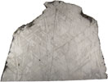
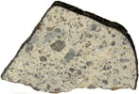
Irons | Mostly iron, 5-20% nickel
Stony | Silicate minerals with inclusions of other minerals
Stony-irons – mixtures | Mix of iron and stony compositions
Chondrites | Rare; composition = simple amino acids and other organic material
Click images to enlarge

Slide 70
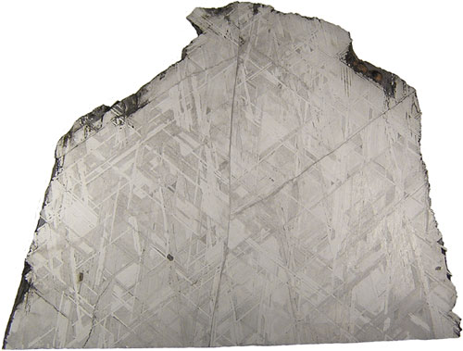
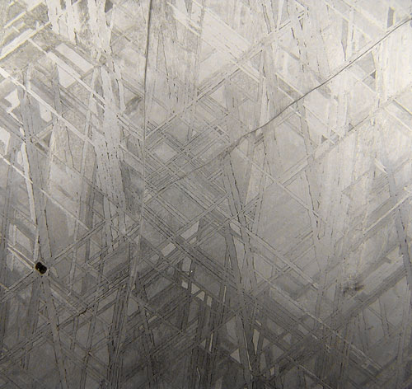
source

Slide 71
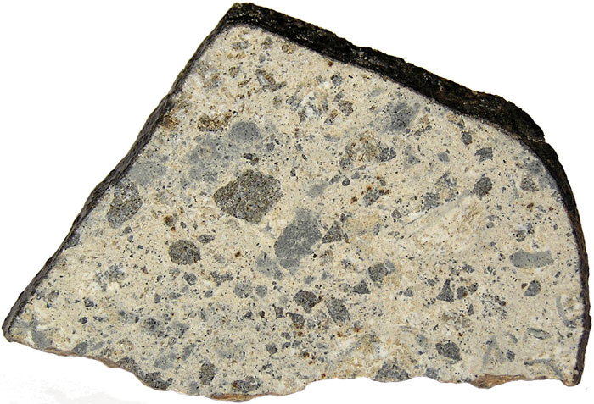
source

Slide 72
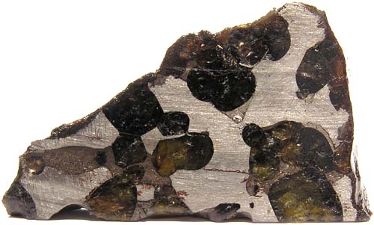
The Brenham Pallasite is one of the most famous stony-iron meteorites ever discovered. Brenham was found in Kiowa County, Kansas, USA with the initial find date listed as 1992, but it was known before that time. A massive 2.4 tonnes is recorded for this find however a huge 635kg Oriented Individual was recovered during October/November 2005 and is now the Main Mass. Many of the Brenham specimens have been found in relatively damp soil which has severely weathered them to oxides. Dr. Harvey Nininger searched at length for Brenham pieces and in 1929, excavated a large crater and obtained many pieces. This story is well described in his 1992 book, Find A Falling Star. The specimen below is part of the Meteorites Australia Collection (MA.03.0065)
source

Slide 73
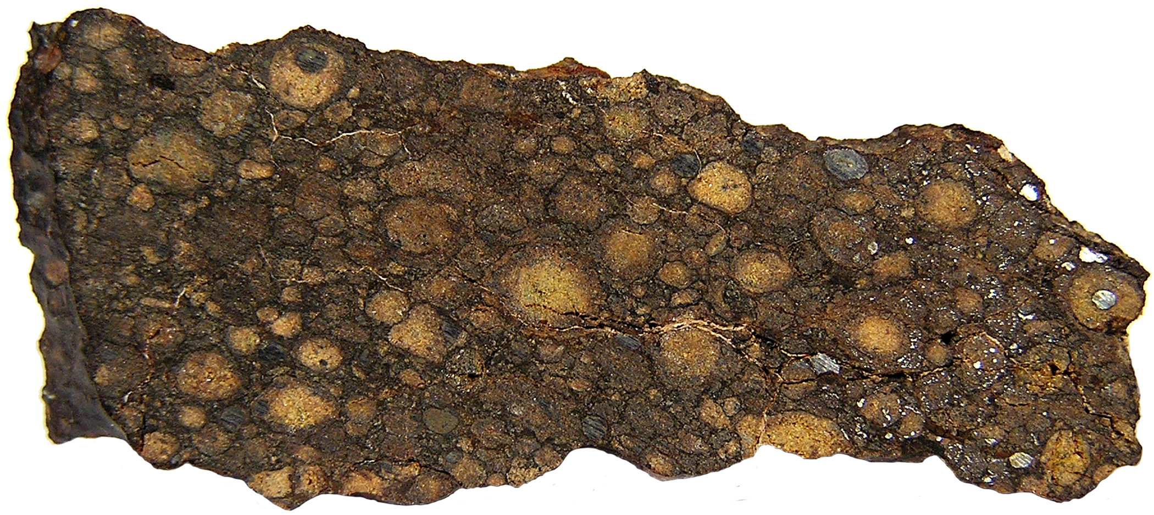
NWA 801 (CR2 Chondrite) Approx Image Size: 7" x 3.1" Resolution: 300 DPI File Size: 1.83MB Copyright © Meteorites Australia

Slide 74
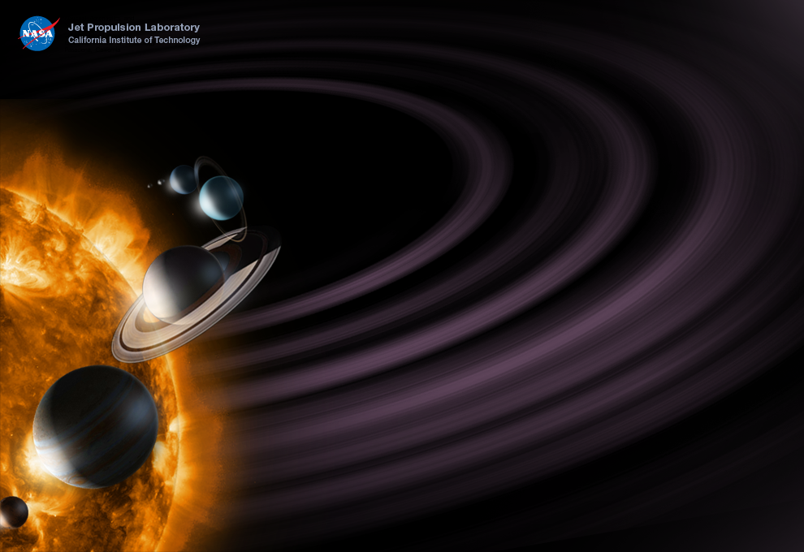
enter

Slide 75
~ End ~

