Slide 1
Weathering and Erosion
1 / 74

Slide 2
Weathering and Erosion: Content Standards Addressed
2nd | 3 | Earth is made of materials that have distinct properties and provide resources for human activities. As a basis for understanding this concept:
 | 3b | Students know smaller rocks come from the breakage and weathering of larger rocks.
 | 3c | Students know that soil is made partly from weathered rock and partly from organic materials and that soils differ in their color, texture, capacity to retain water, and ability to support the growth of many kinds of plants.
2 / 74

Slide 3
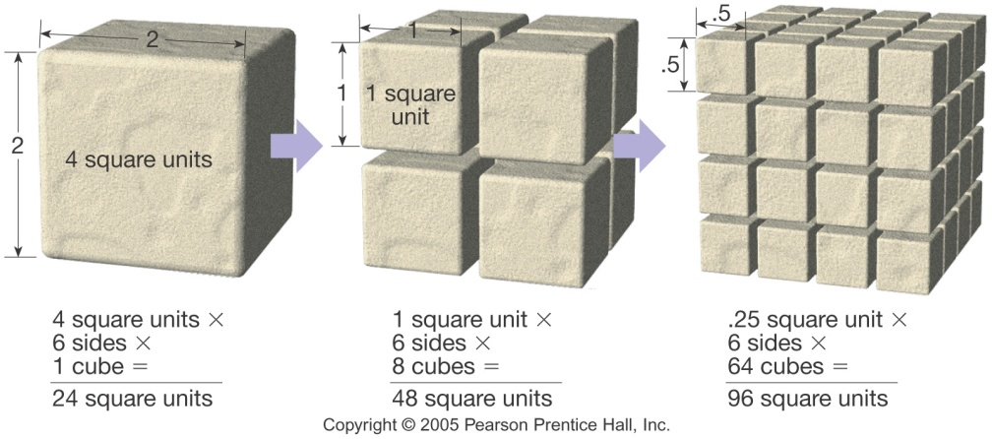
Weathering of Rocks
Sediments are the end products of weathering
Mechanical – the physical breaking apart of Earth materials
Chemical – alters the internal structure of minerals by removing and/or adding elements
3 / 74

Slide 4
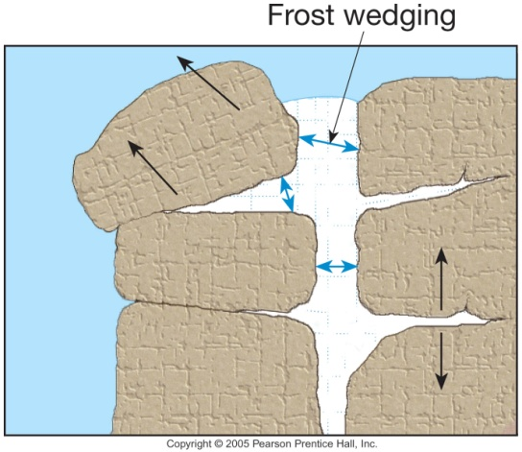
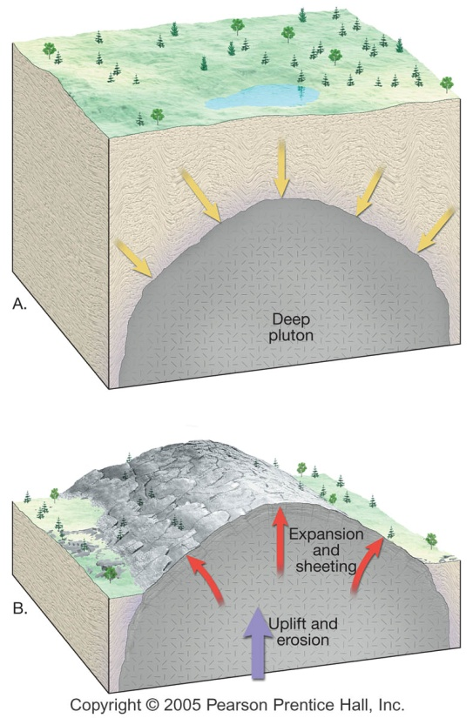
Weathering of Rocks
Mechanical weathering
Frost wedging
Unloading
Biological activity
4 / 74

Slide 5
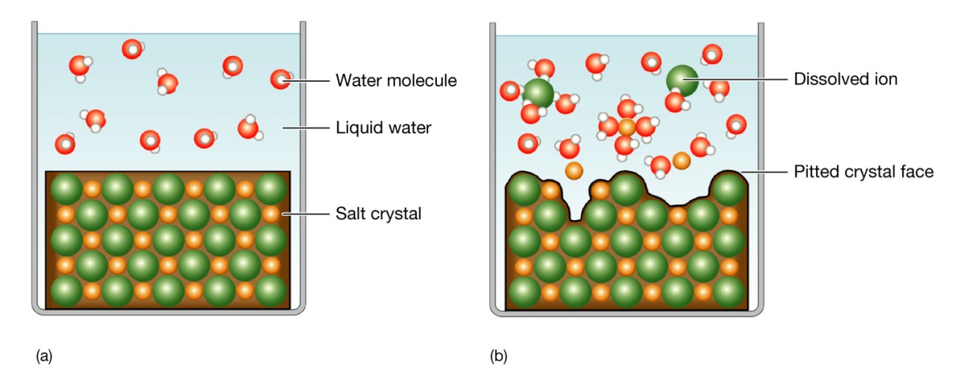
Weathering of Rocks
Chemical weathering
Water is the most important agent
Reactions such as oxidation or dissolution by acids serve to decompose rocks
Clay minerals are the most abundant and stable product of chemical weathering
5 / 74

Slide 6
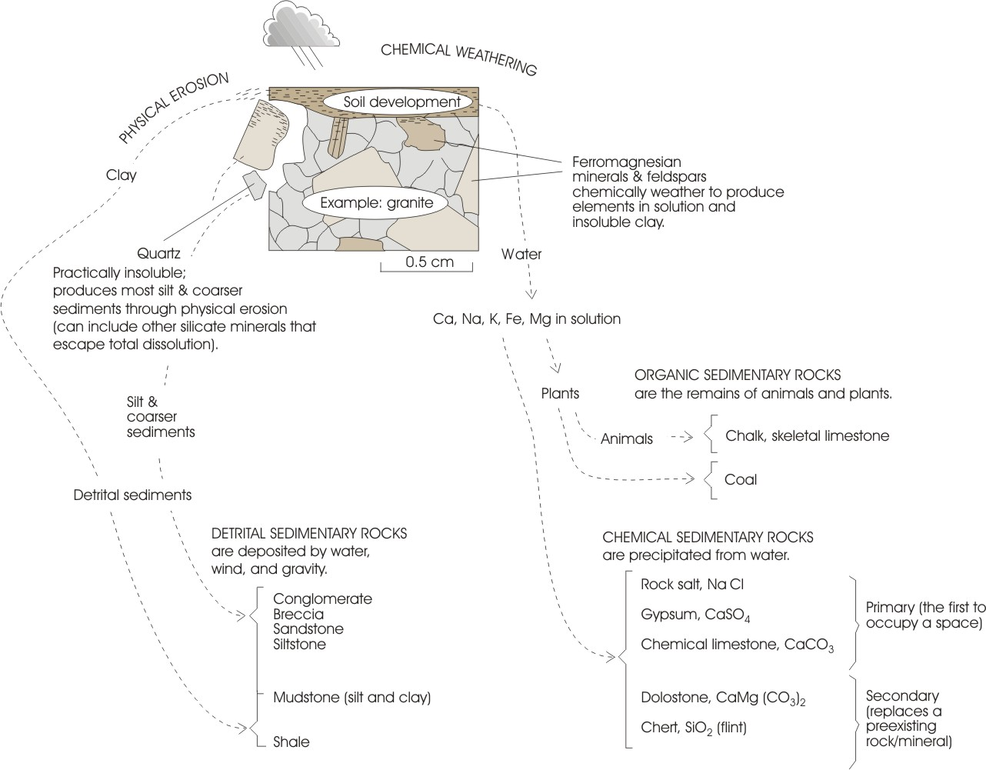
6 / 74

Slide 7
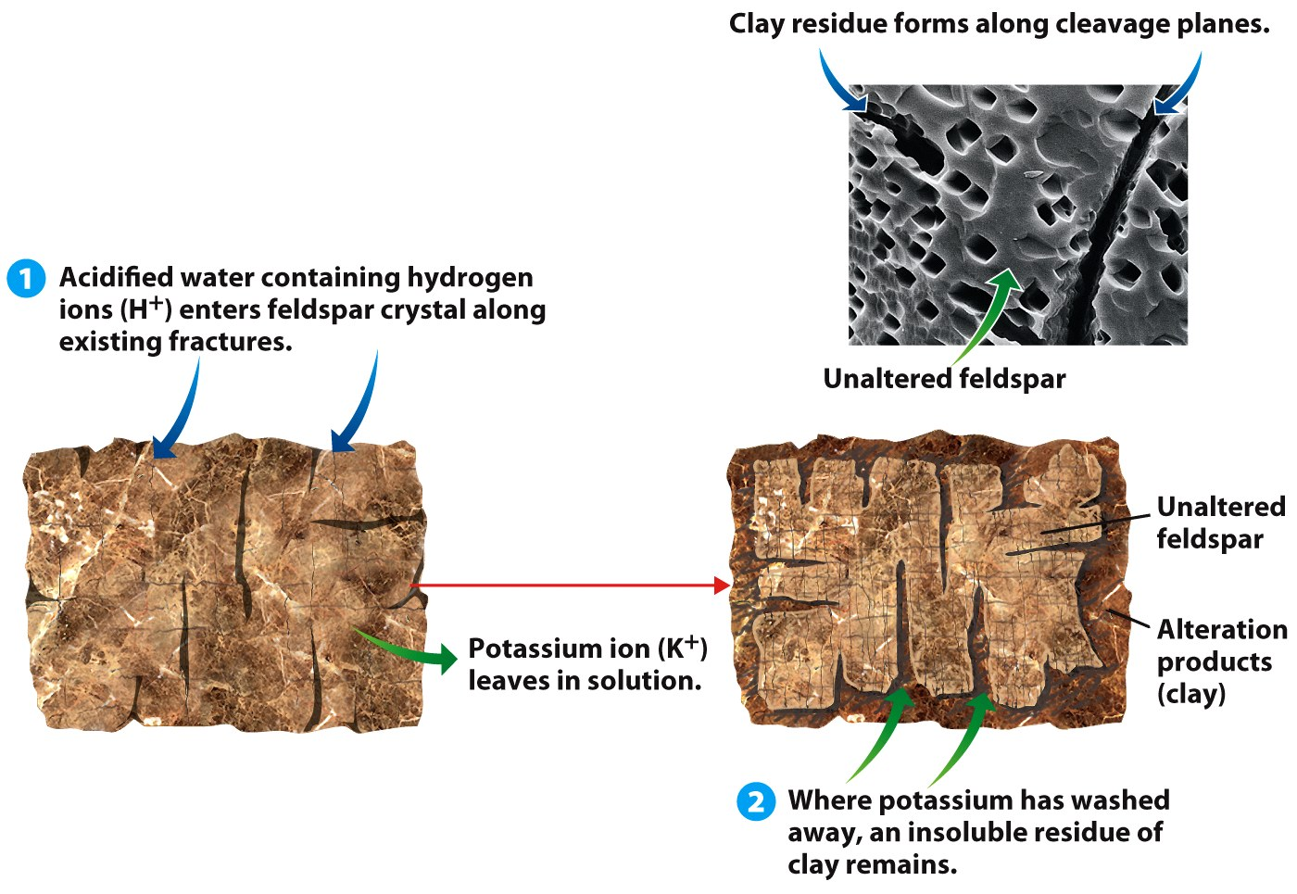
Weathering
Two kinds of weathering
Chemical weathering
7 / 74

Slide 8
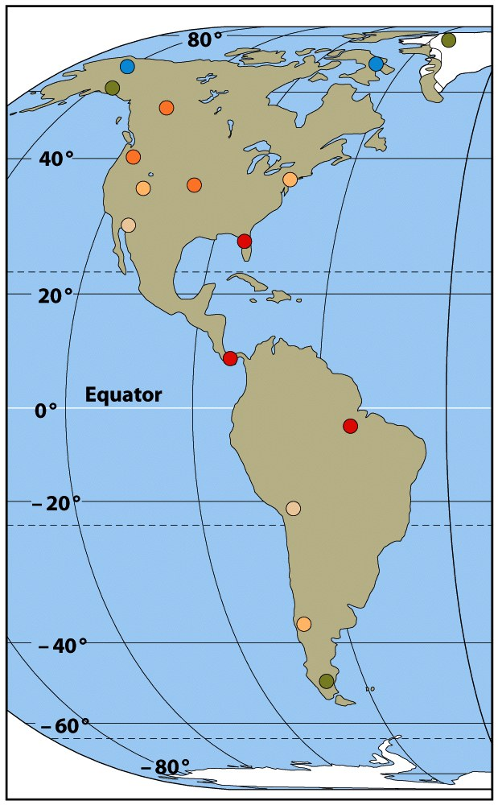
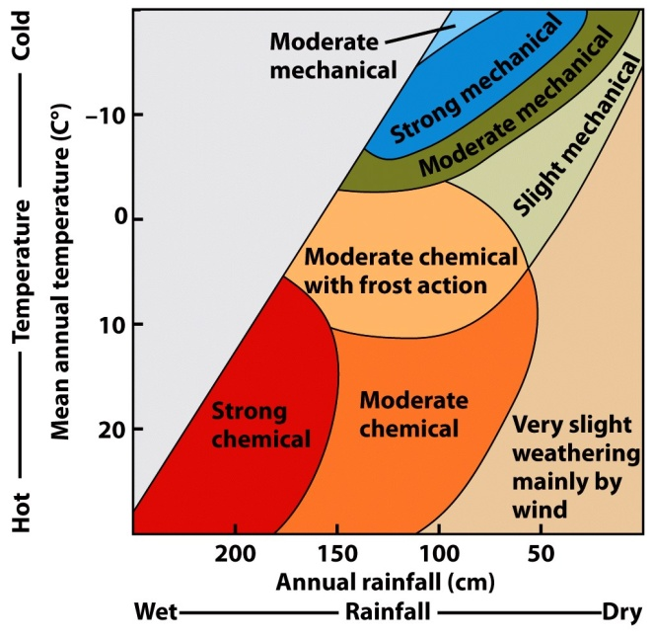
Rates of weathering
Important factors
Climate
Topography and Physical Setting
Organic processes
Rock Composition
8 / 74

Slide 9
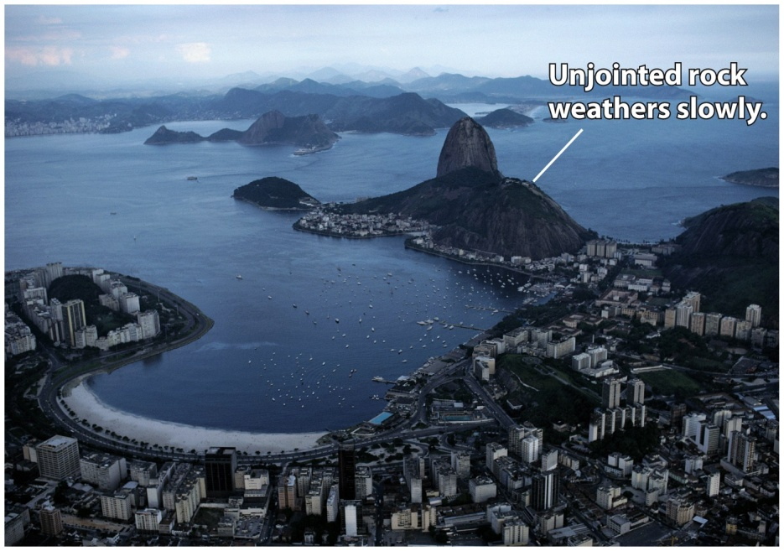
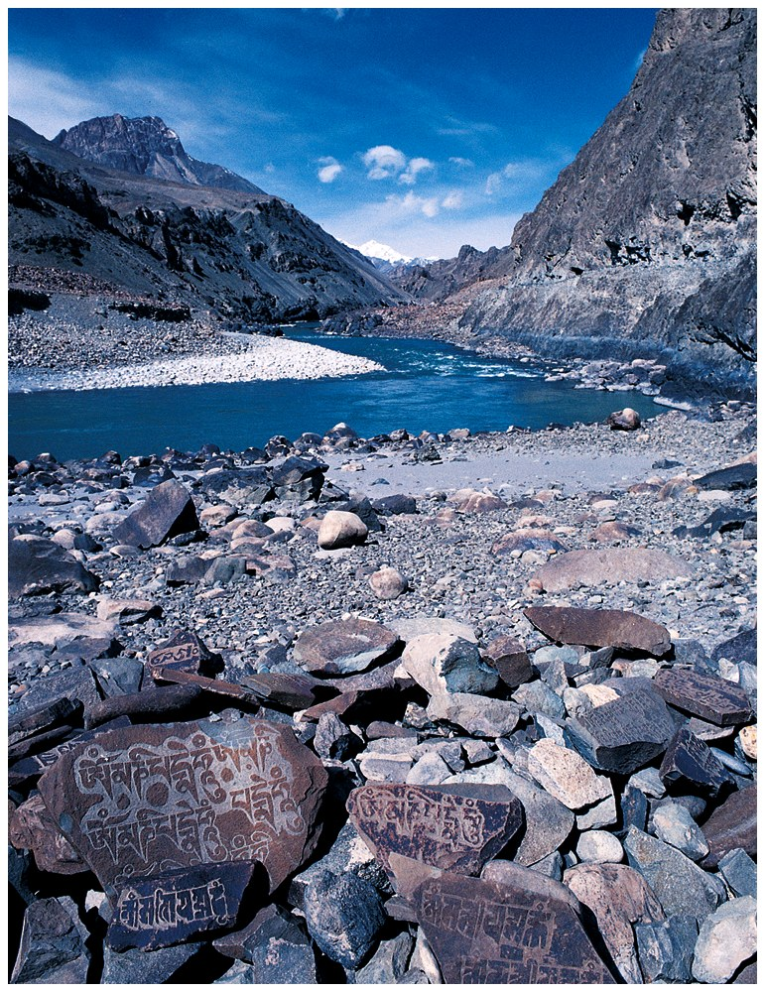
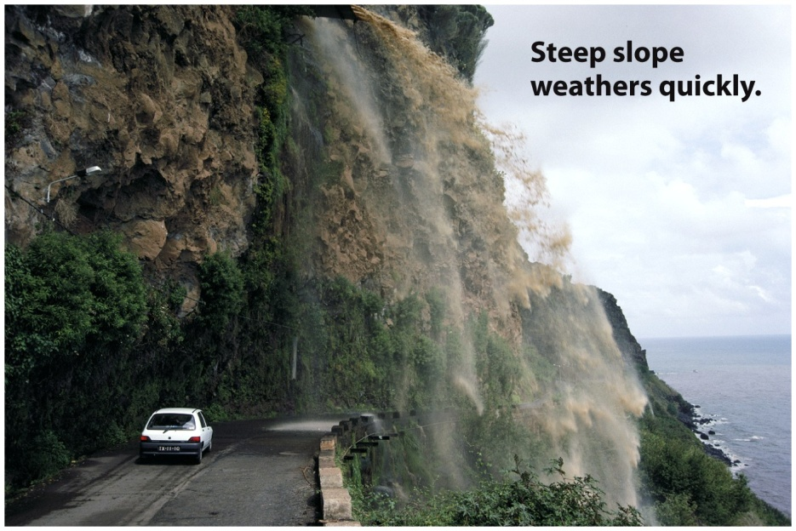
Factors affecting rate of weathering
9 / 74

Slide 10
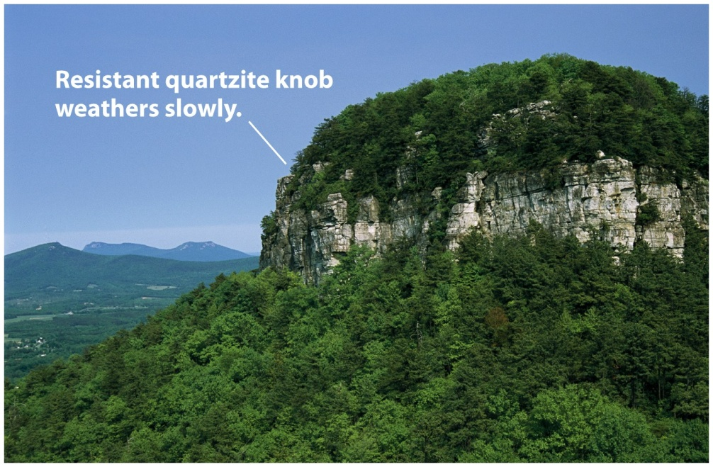
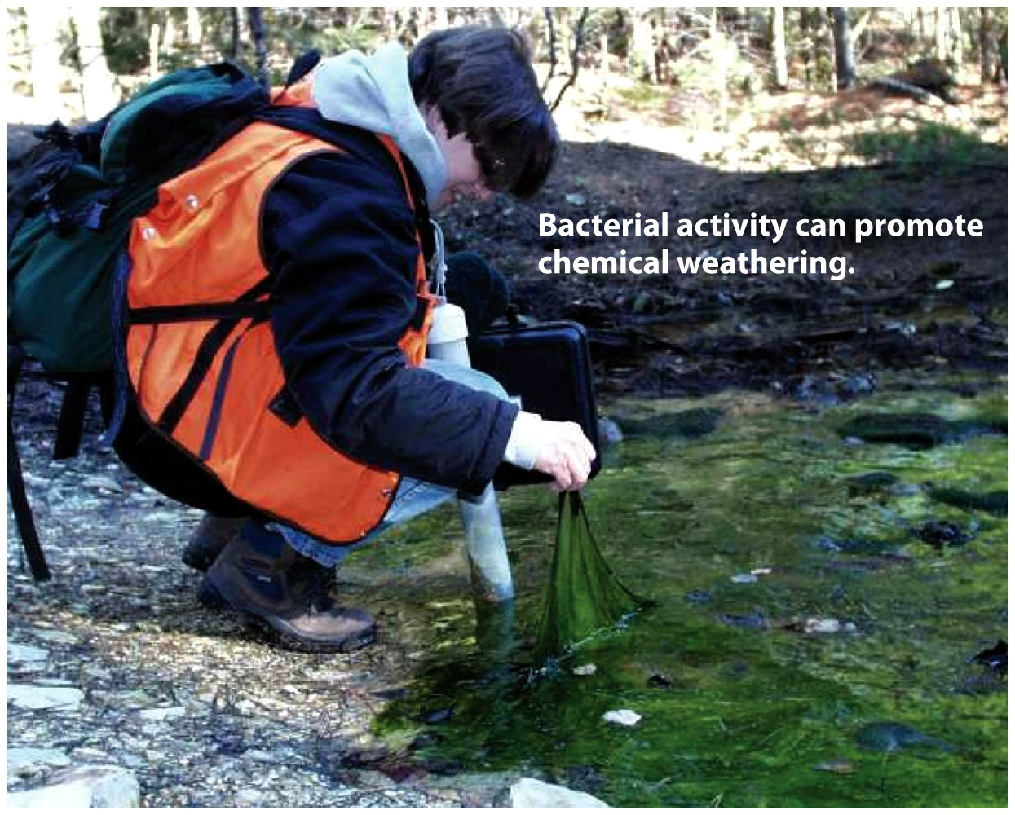
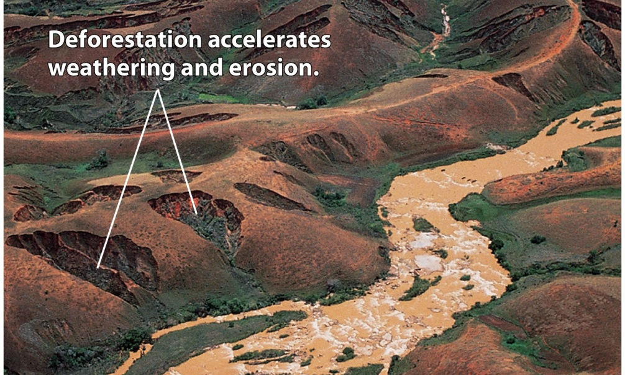
Factors affecting rate of weathering
10 / 74

Slide 11
Weathering
Products
Soil
Sediments
11 / 74

Slide 12
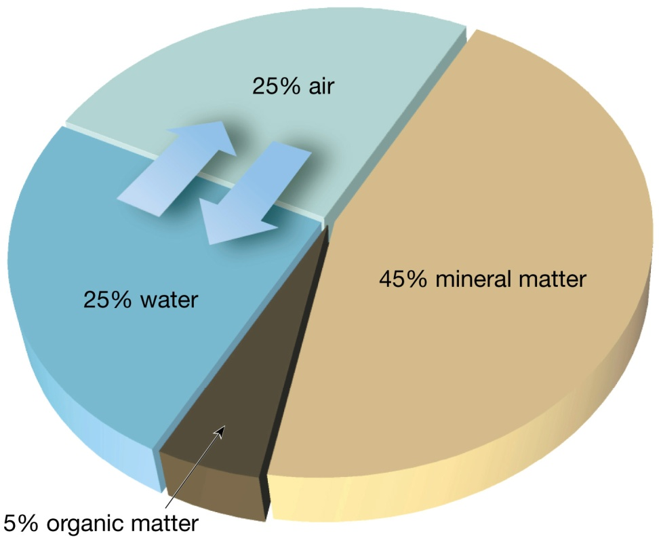
Soil
An interface in the Earth system
Soil is a combination of mineral matter, water, and air – that portion of the regolith that supports the growth of plants
12 / 74

Slide 13
Soil
Soil texture and structure
Texture refers to the proportions of different particle sizes
Sand (large size)
Silt
Clay (small size)
Loam (a mixture of all three sizes) is best suited for plant life
13 / 74

Slide 14
Soil
Soil texture and structure
Structure
Soil particles clump together to give a soil its structure
Four basic soil structures
Platy
Prismatic
Blocky
Spheroidal
14 / 74

Slide 15
Soil
Controls of soil formation
Parent material
Residual soil
Transported soil
Time
Climate
Plants and animals
15 / 74

Slide 16
Soil
Controls of soil formation
Slope
Angle
Steep slopes = poorly developed soils
Orientation (direction the slope is facing) influences
Soil temperature
Moisture
16 / 74

Slide 17
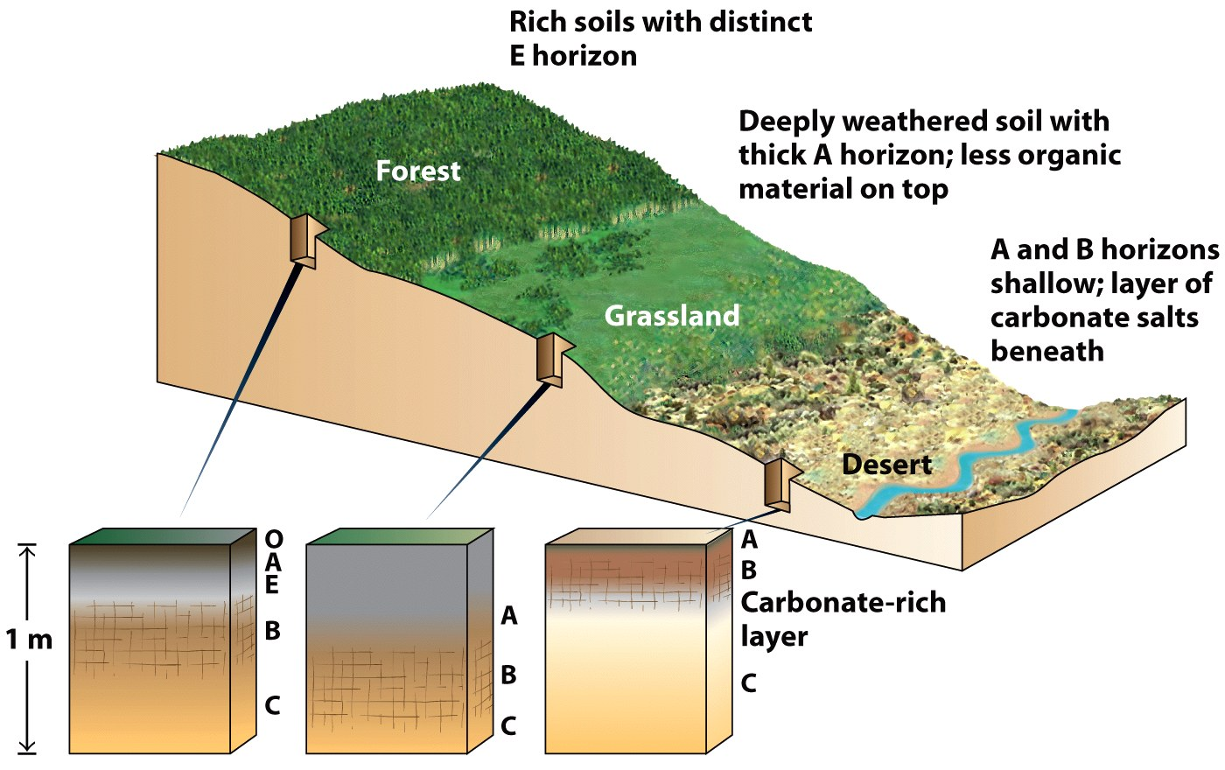
17 / 74

Slide 18
Soil
Soil Profile
Soil forming processes operate from the surface downward
Horizons – zones or layers of soil
18 / 74

Slide 19
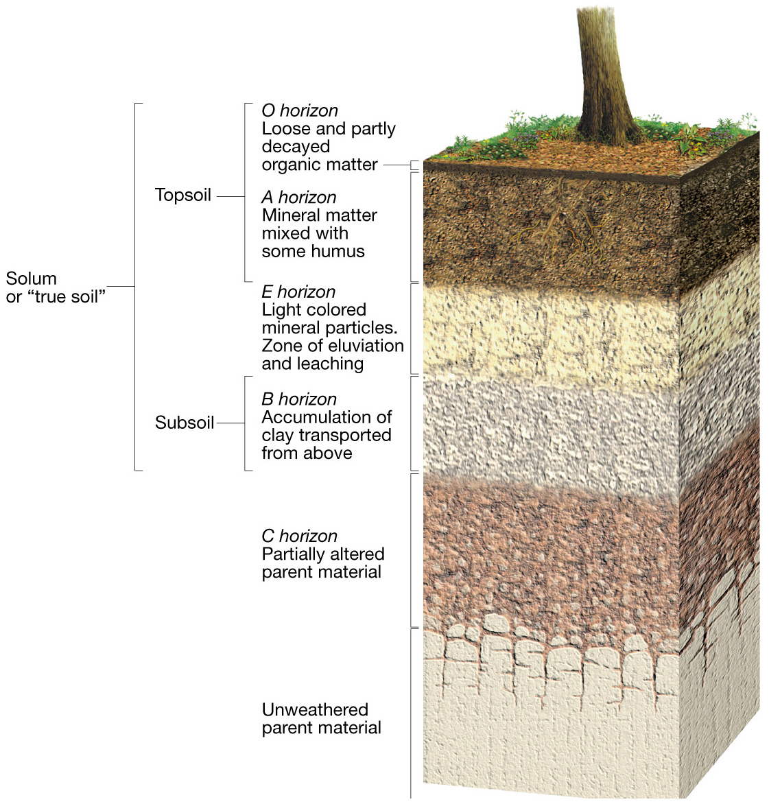
Soil Profile
19 / 74

Slide 20
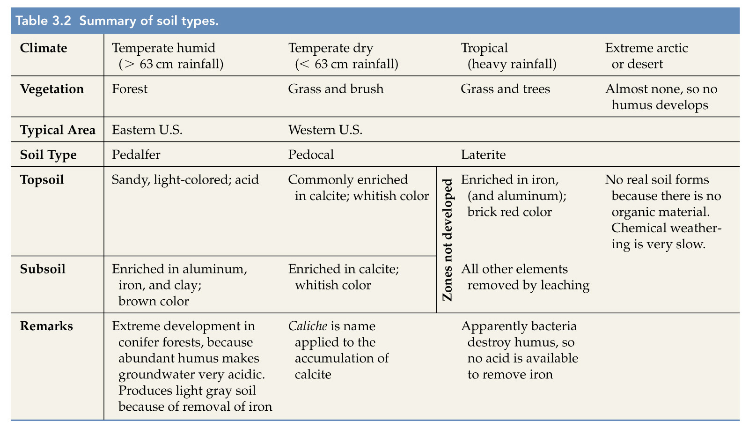
Soil Types
20 / 74

Slide 21
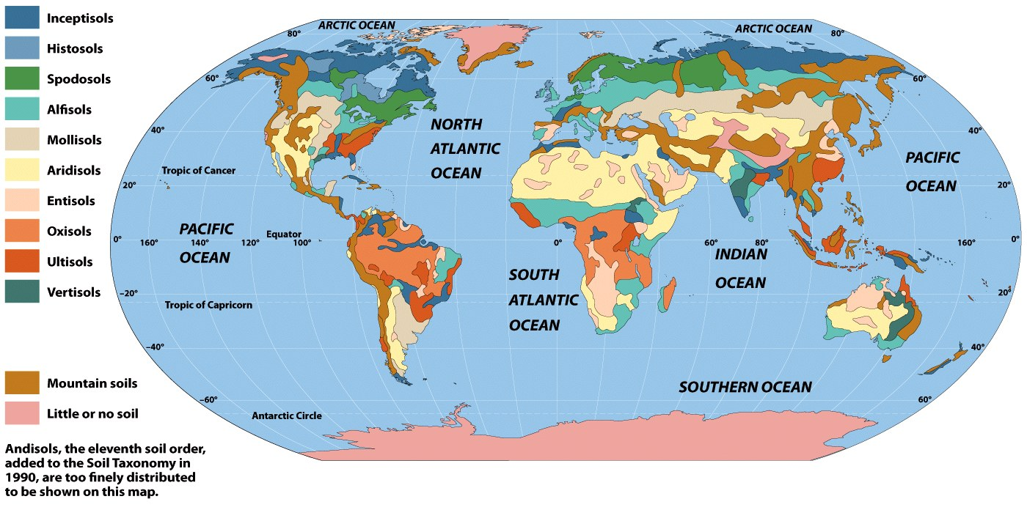
21 / 74

Slide 22
Soil
Soil erosion
Recycling of Earth materials
Natural rates of erosion depend on
Soil characteristics
Climate
Slope
Type of vegetation
22 / 74

Slide 23
Soil
Soil erosion
Soil erosion and sedimentation can cause
Reservoirs to fill with sediment
Contamination by pesticides and fertilizers
23 / 74

Slide 24
Weathering creates ore deposits
Process called secondary enrichment
Concentrates metals into economical deposits
Takes place in one of two ways
Removing undesired material from the decomposing rock, leaving the desired elements behind
Desired elements are carried to lower zones and deposited
24 / 74

Slide 25
Weathering creates ore deposits
Examples
Bauxite, the principal ore of aluminum
Many copper and silver deposits
25 / 74

Slide 26
Erosion
“The wearing away of bedrock and transport of loosened particles by a fluid, such as water.”
How is this different from weathering?
Weathering occurs in place
Both can occur at the same time
26 / 74

Slide 27
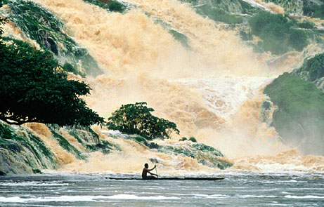
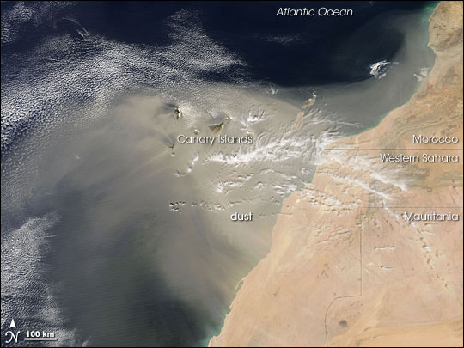
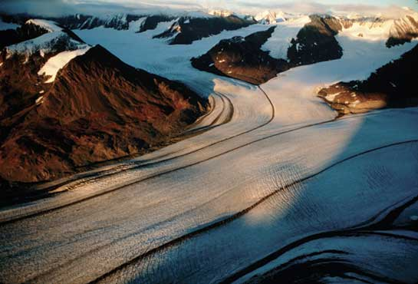
Sources of Erosion
Water
(Source)
Wind
(Source)
Ice
(Source)
27 / 74

Slide 28
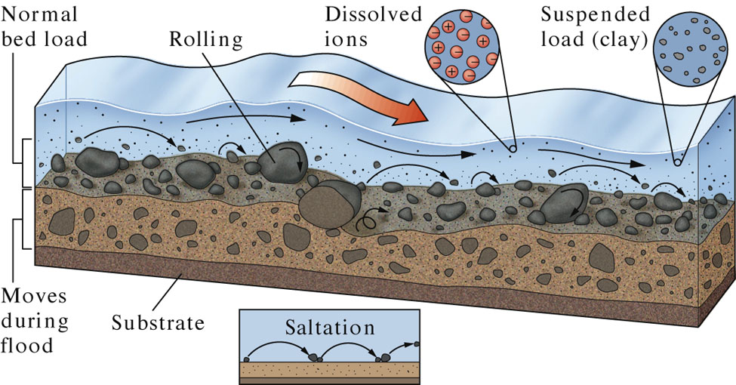
Erosion via Water
28 / 74

Slide 29
How Streams Move Sediment
29 / 74
Notes:
To view this animation, click “View” and then “Slide Show” on the top navigation bar.

Slide 30
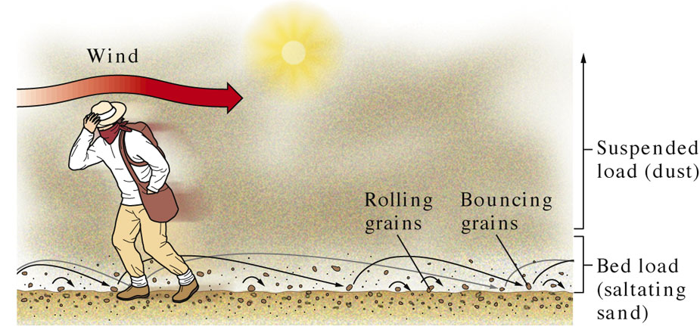
Erosion via Wind
30 / 74

Slide 31
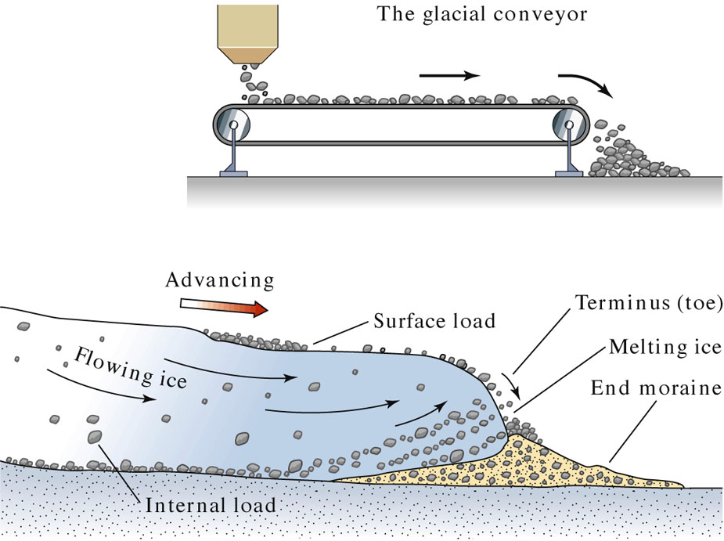
Erosion via Ice
Plucking
Abrasion
31 / 74

Slide 32
What is mass wasting?
The downslope movement of rock, regolith, and soil under the direct influence of gravity.
32 / 74

Slide 33
Mass Wasting
Location, Location, Location
Occur in every state and U.S. territory.
Nearly all occur in mountainous regions
Weak or fractured materials + steep slope = landslides.
33 / 74

Slide 34
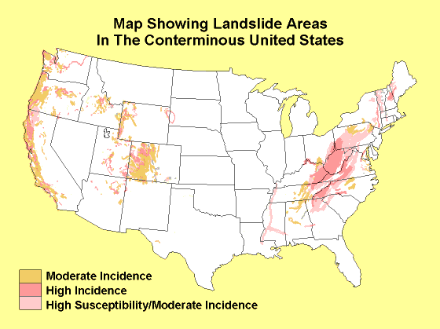
34 / 74
Notes:
from: Landslide Areas in the Contiguous United States (http://www.usgs.gov/themes/map3.html)

Slide 35
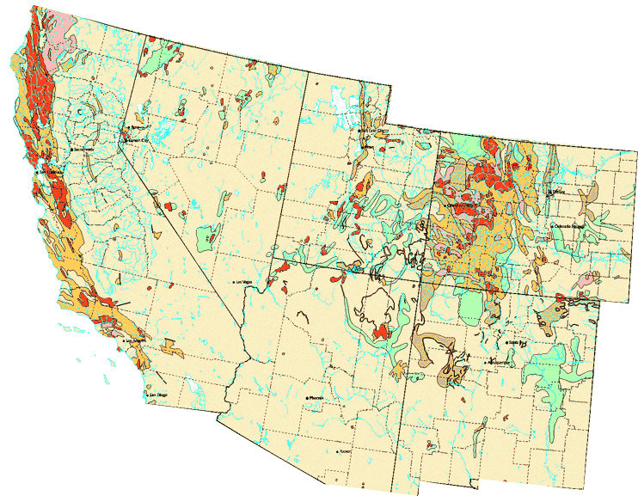
Map showing where landslides are likely to occur in the southwestern United States. Note that the areas with the highest rate of landslide incidents are located in mountainous terrain
35 / 74

Slide 36
The Origins of Landslides
Gravity
Other Factors:
Water
Steep Slopes
Vegetation
Geology
Earthquakes
36 / 74

Slide 37
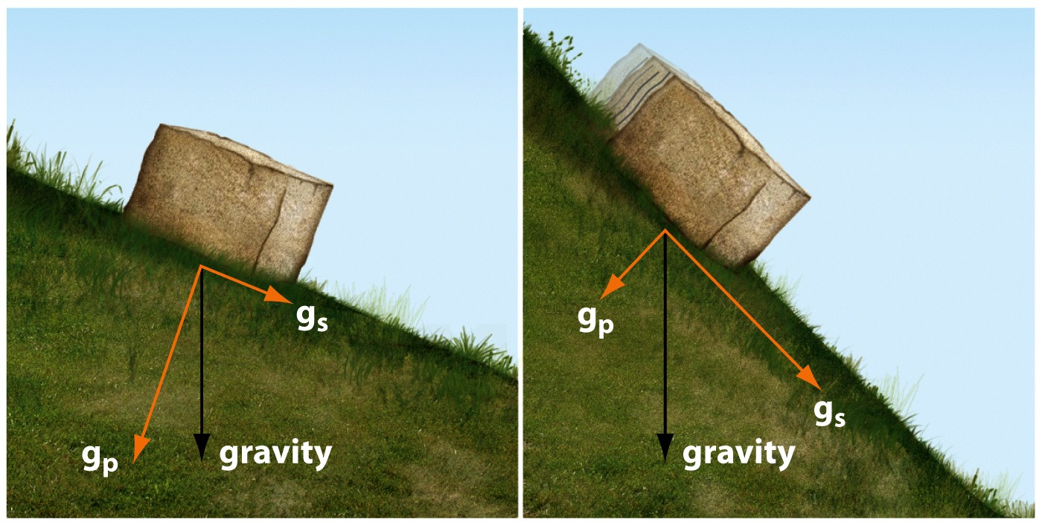
Causes - Gravity
Downslope forces = Gravity.
The weight of Earth materials.
The weight of added water.
The weight of added structures.
37 / 74

Slide 38
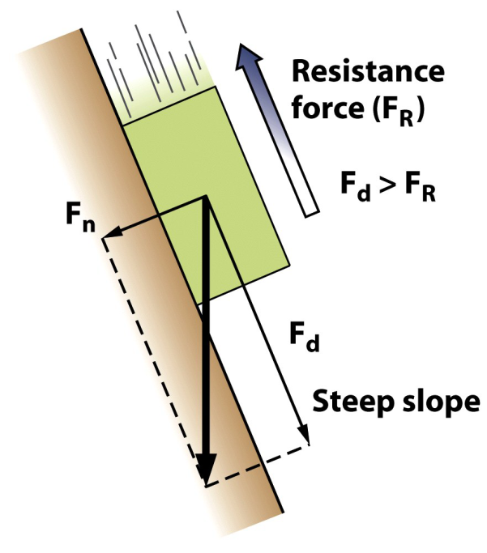
Causes - Gravity
Resisting forces = Material strength.
Cohesion.
Chemical bonds.
Electrical charges.
Surface tension.
Friction.
Steeper slopes = larger forces.
38 / 74

Slide 39
Causes – Water
Triggered when water builds up in the slope
heavy rains
snowmelt
poor drainage.
39 / 74

Slide 40
Causes – Water
When water builds up in a slope several things can occur.
First, water > the weight and < the strength of the material in the slope.
Pore pressure in the slope >, and clay minerals become hydrated and expand.
Minerals holding individual grains together may dissolve.
40 / 74

Slide 41
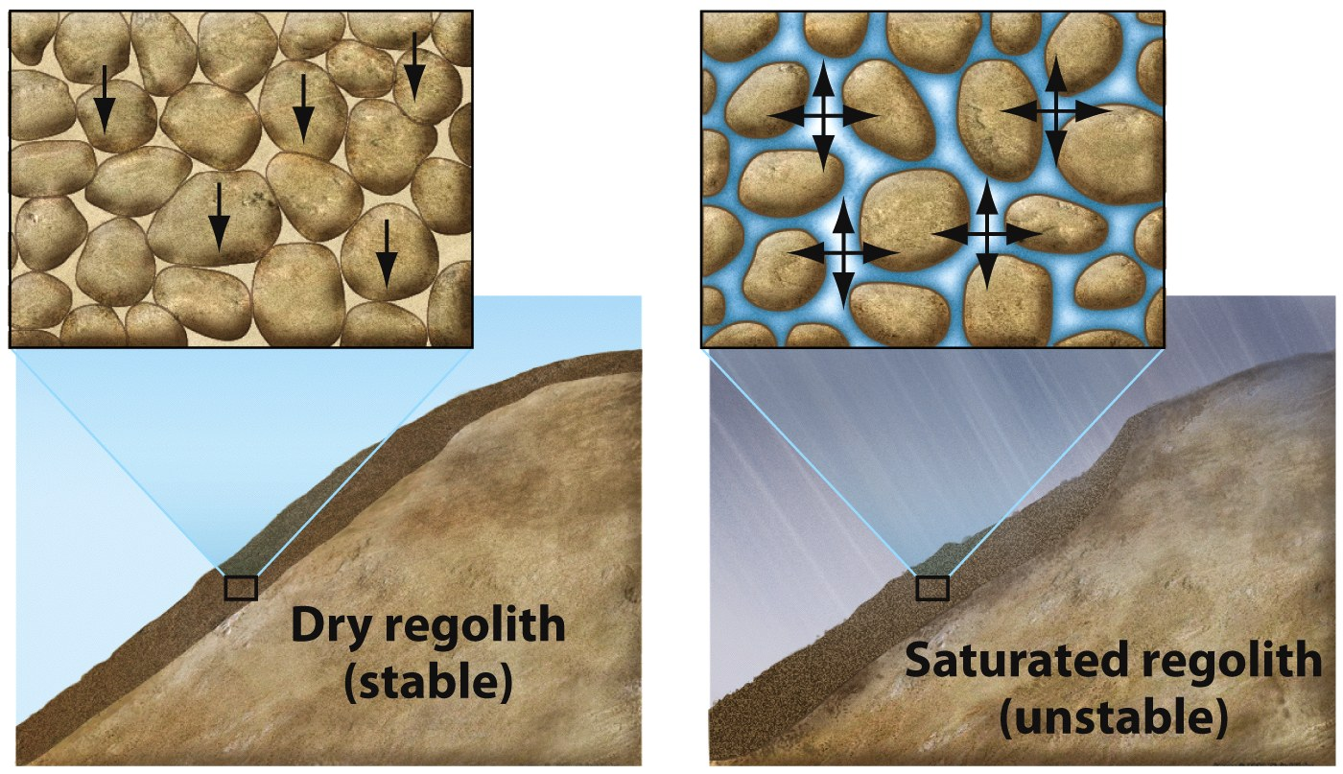
Water
41 / 74

Slide 42
42 / 74

Slide 43
Causes – Water
Piping: water flowing through rocks can physically erode away (remove) loose material
43 / 74

Slide 44
Causes – Water
Pore-water Pressure:
pressure on water in pore spaces of rocks increases with increasing weight of sediment piled on top of rocks,
if pore space water becomes over-pressurized, gives ‘lift’ to overlying sediments making them unstable
44 / 74

Slide 45
Dry Compaction and Liquefaction
45 / 74
Notes:
To view this animation, click “View” and then “Slide Show” on the top navigation bar.

Slide 46
Causes – Steep Slopes
Slope failure occurs when gravitational forces exceed the strength of the rock or soils that comprise the slope.
46 / 74

Slide 47
Causes – Steep Slopes
Loose granular material assumes a slope angle.
“Angle of repose” is a material property due to...
Particle size, shape, and surface roughness.
Typical angles of repose:
47 / 74

Slide 48
Causes – Steep Slopes
Occurs when
Slope is over steepened
A heavy load is placed at the top of the slope
Removing material at the base of the slope.
48 / 74

Slide 49
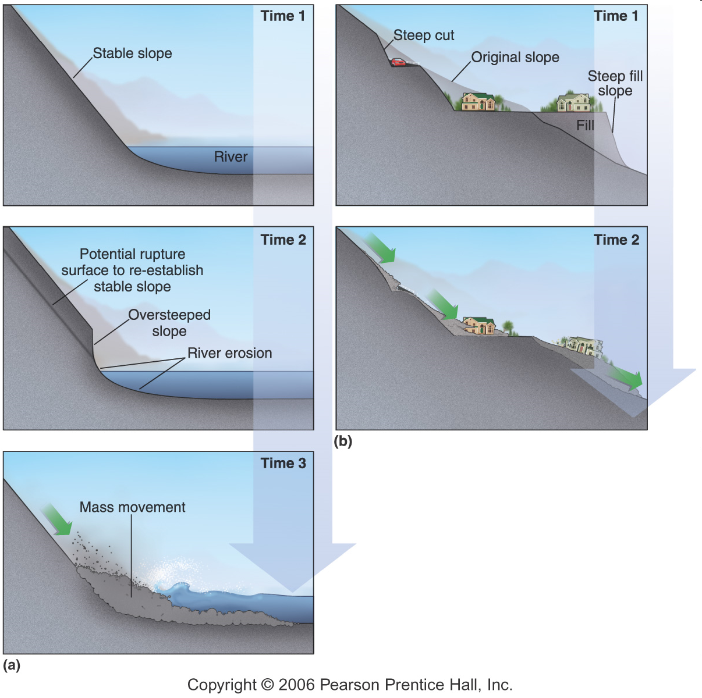
Landslides can be reactivated when the toe of the slope is removed
49 / 74

Slide 50
Causes – Vegetation
The type present (or not) on a slope can affect slope stability.
Plants with deep roots hold bedrock and loose materials together.
Shallow-rooted plants provide stability for soils and other surficial deposits.
Stability can be affected if vegetation is removed.
Reseeding or replanting slopes
50 / 74

Slide 51
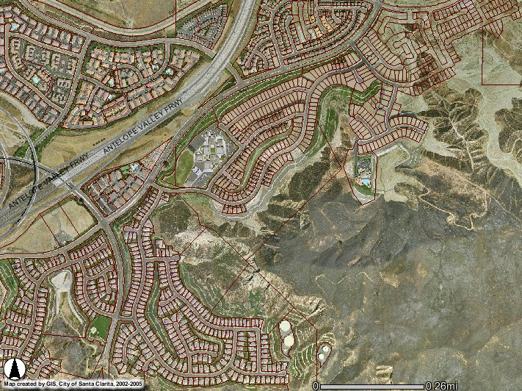
New Housing Development near Lost Canyon Road, Santa Clarita
http://arcims.santa-clarita.com
Notes:
http://arcims.santa-clarita.com/santaclarita/asp.htm?Title=City%20of%20Santa%20Clarita%20Map%20Viewer

Slide 52
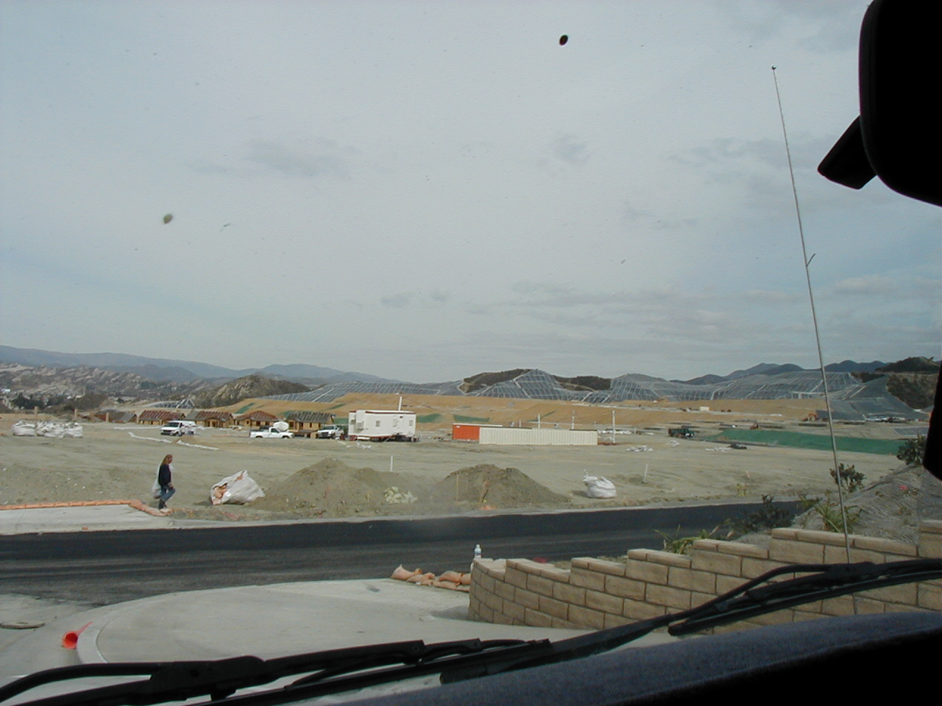
New Housing Development near Lost Canyon Road, Santa Clarita
Photo by S. Leyva © 2006

Slide 53
Causes – Geology
Adverse Geological Structure
Bedding surfaces of weak rocks dip downslope and are unsupported at the lower end
Similar problems with faults, joints, foliation etc
53 / 74

Slide 54
Causes – Geology
Inherently Weak Materials
Clays (most abundant of sedimentary minerals) form during chemical weathering of rocks
Clay crystals are very small, shaped like books
Chemical composition of clays can change, altering strength, size and water content, altering strength of rock
54 / 74

Slide 55
Causes – Geology
Weak Rocks
Many Southern California rocks are rich in clay or silt
Montmorillonite swells in water & disintegrates
Clay may cause instability on a 5º slope
Interbedding of sandstone and clay is a common problem
Serpentine, the state rock, causes many landslides
55 / 74

Slide 56
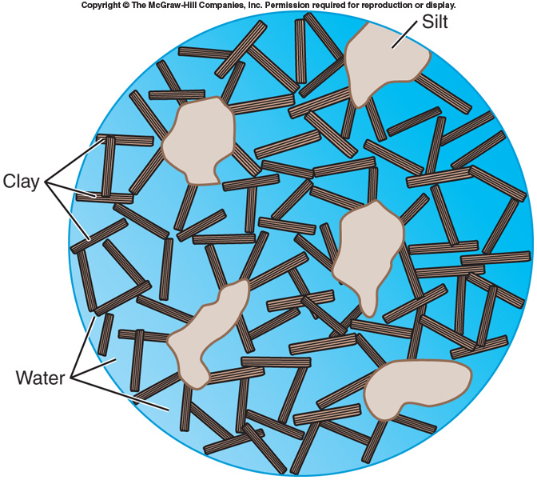
Causes – Geology
Quick Clays: Most mobile of all deposits – fine rock flour scoured by glaciers, deposited in seas and later exposed above water
Weak solid – loosely packed, ‘house of cards’ structure held together by salt
56 / 74

Slide 57
Causes – Earthquakes
Earthquakes, or any other type of strong vibrations, can trigger landsides on slopes which are already unstable.
In general, only earthquakes that are a magnitude 4.0 or greater will be strong enough to cause a slide.
57 / 74

Slide 58
Causes – Humans
Cut slopes produce removal of hill support and failure occurs
Uncontrolled fills may settle, erode, slough away or slip in mass
58 / 74

Slide 59
Causes – Humans
Four ways to make a stable slope unstable
Steepen slope angle
Increase the height of the slope
Saturate with water
Place an extra load on the slope
59 / 74

Slide 60
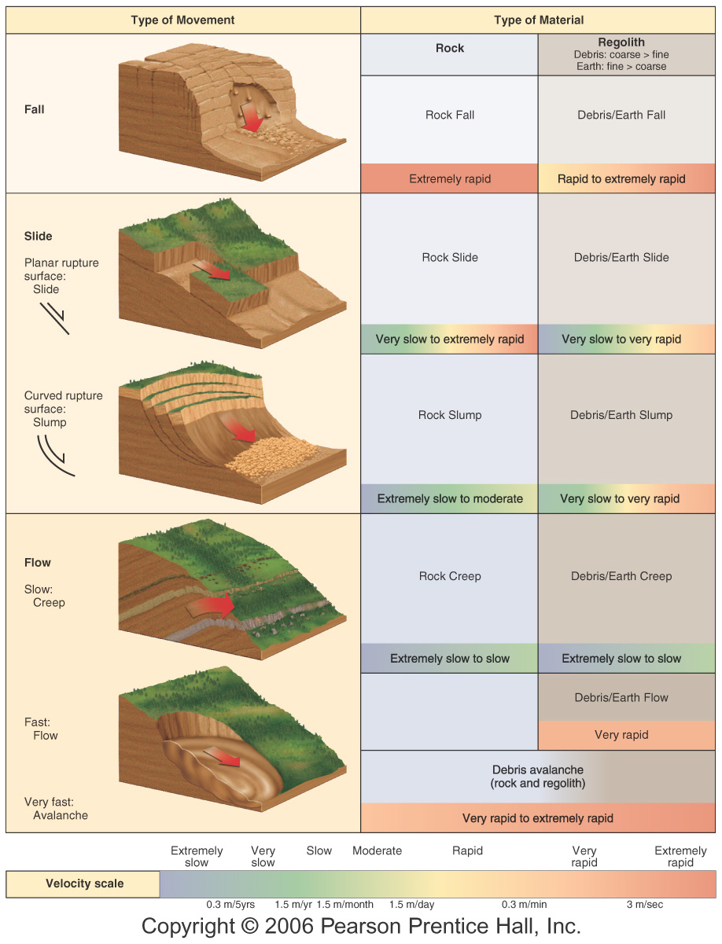
Classifying Mass Movements
60 / 74

Slide 61
Mass Movements
61 / 74
Notes:
To view this animation, click “View” and then “Slide Show” on the top navigation bar.

Slide 62
Rockfalls
62 / 74

Slide 63
Translational slide / lateral spreading
Debris Flow
63 / 74

Slide 64
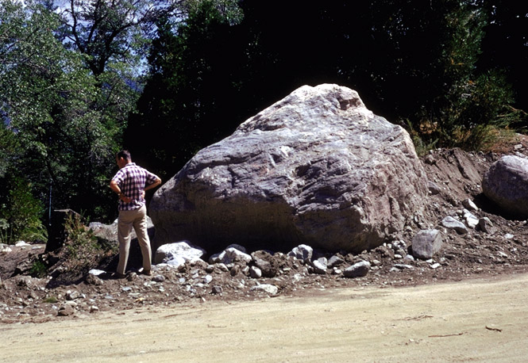
Huge boulder transported by a debris flow produced during an intense, short-duration summer rain ­ "cloud burst" ­ in the Barton Flats area of the San Bernardino Mountains, in the 1960s.
64 / 74
Notes:
http://geology.wr.usgs.gov/wgmt/elnino/scampen/examples.html

Slide 65
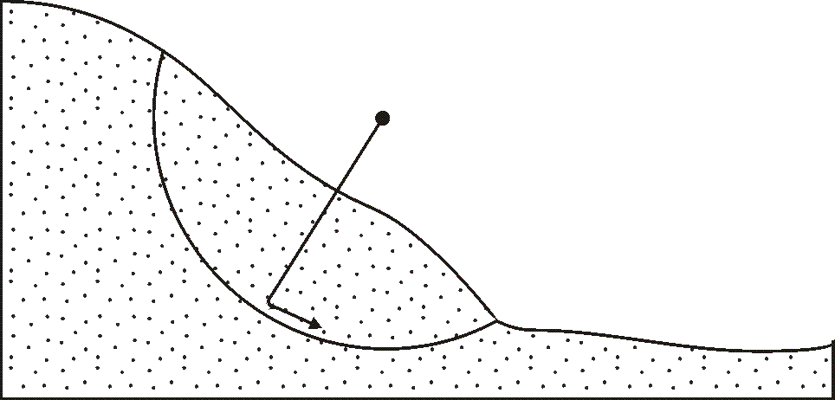
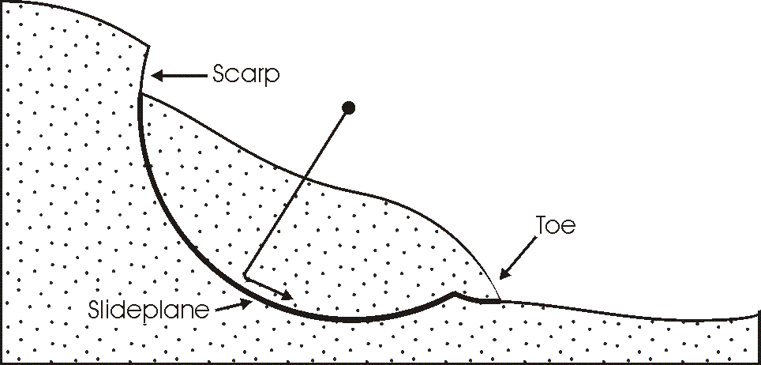
Types of Mass Wasting
Type - Slides
Rotational landslides
Occur in homogeneous material
Curved slide plane
65 / 74

Slide 66
66 / 74

Slide 67
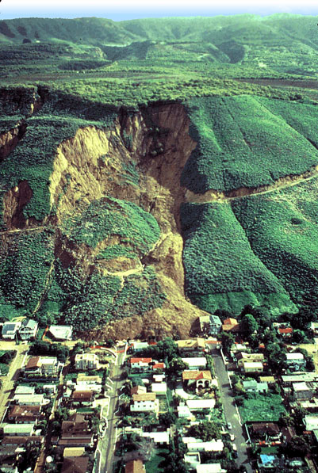
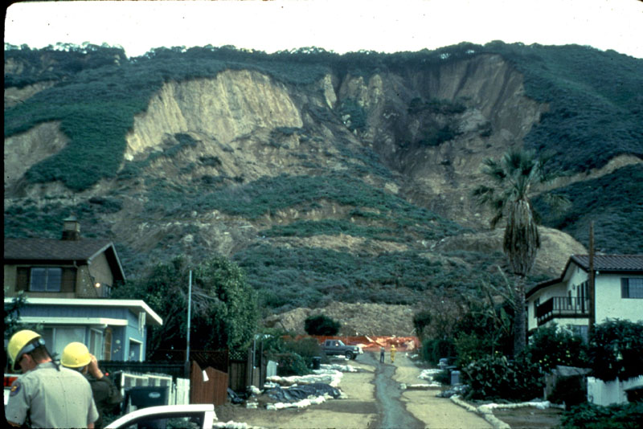
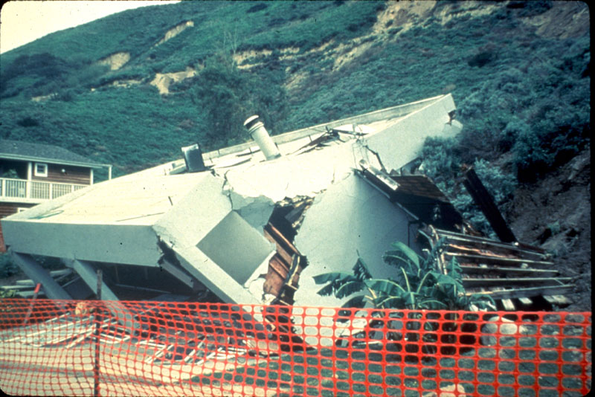
La Conchita, California. This landslide and debris flow occurred in the spring of 1995.
67 / 74
Notes:
http://landslides.usgs.gov/html_files/landslides/slides/landslideimages.htm

Slide 68
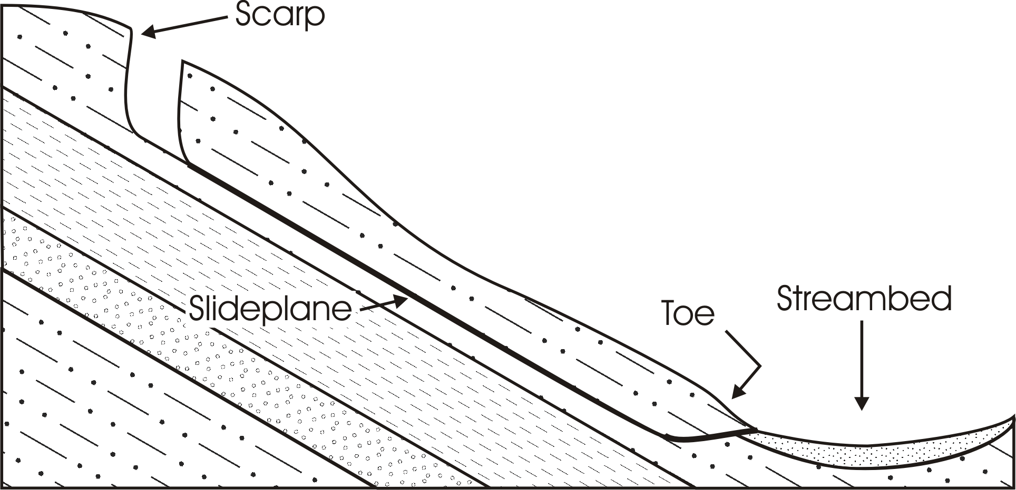
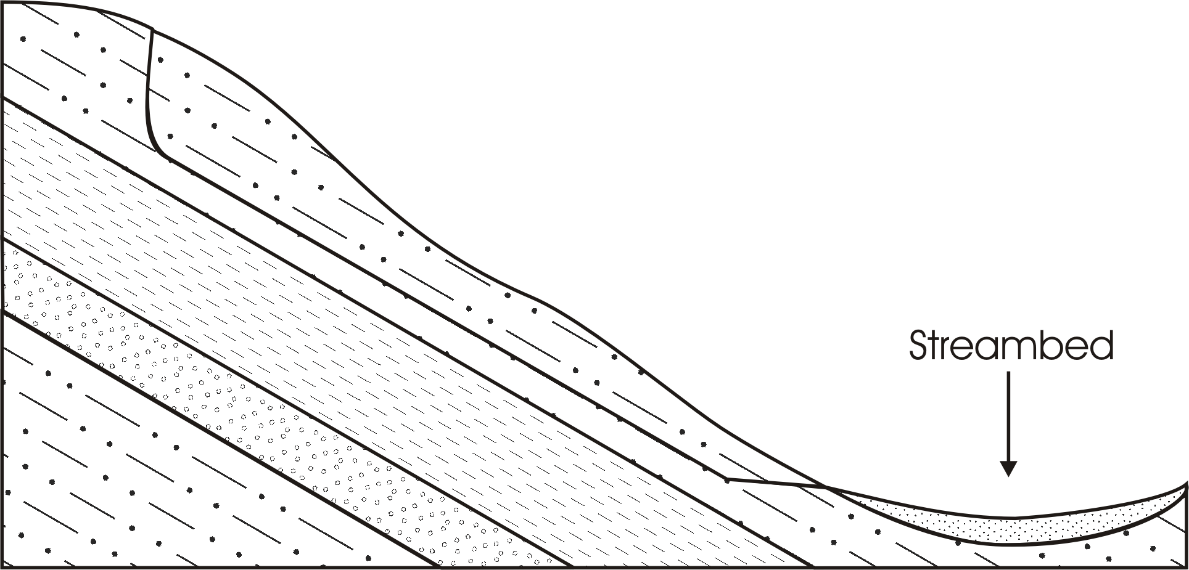
Types of Mass Wasting
Type - Slides (continued)
Translational landslide
Typically occurs along a planar surface
Common in S. California in Miocene-aged Formations
Puente, Topanga, Monterey, etc.
68 / 74

Slide 69
Classification – Rate of Movement
Fast
Slumps
Rockslides
Debris flows
Earthflows
69 / 74

Slide 70
Classification – Rate of Movement
Slow
Creep
Solifluction - the gradual flow of a saturated layer that is underlain by an impermeable zone.
70 / 74

Slide 71
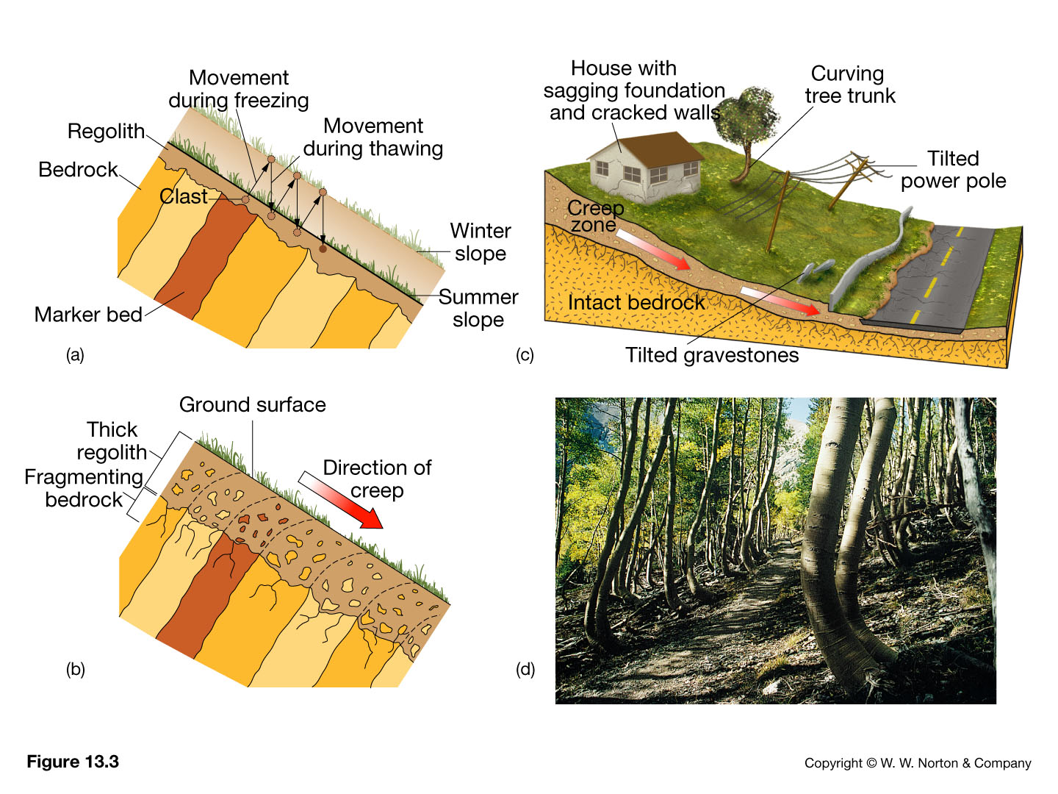
71 / 74

Slide 72
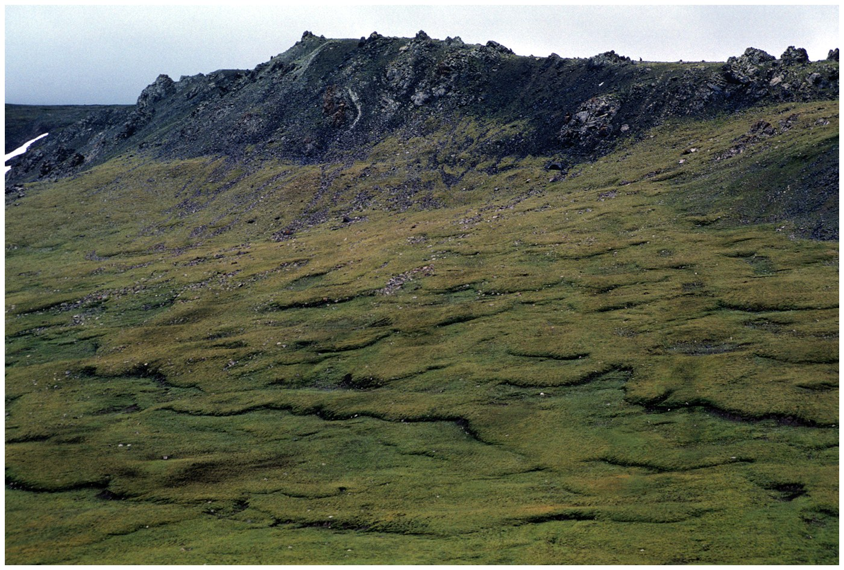
Solifluction
72 / 74

Slide 73
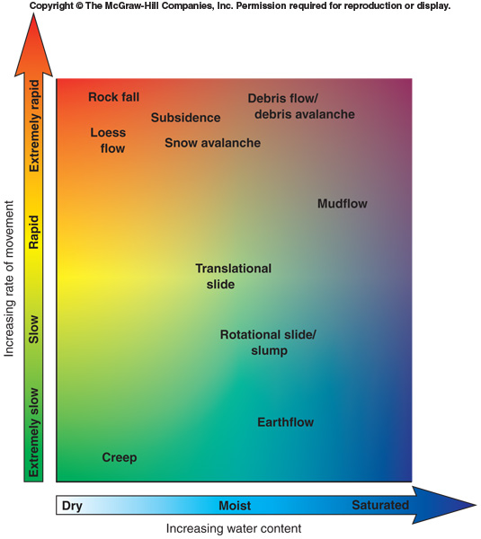
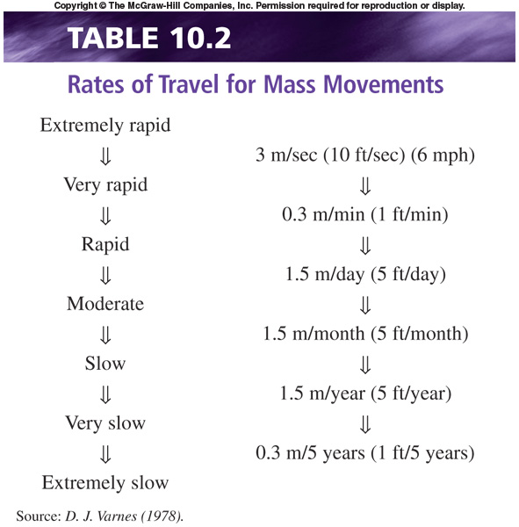
Classification of Mass Movements Speed of movement and water content
73 / 74

Slide 74
end
74 / 74

