Slide 1
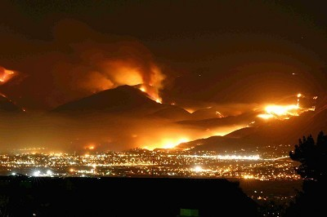
Wildfires
Nov 25, 2003 San Diego Wild Fire

Slide 2
Assessing the risk
How common is this disaster and where does this disaster normally occur?

Slide 3
Assessing the Risk
A form of combustion
Technically:
“an exothermic oxidation process by which heat and light energy are given out”
Source: http://en.wikipedia.org/wiki/Fire

Slide 4
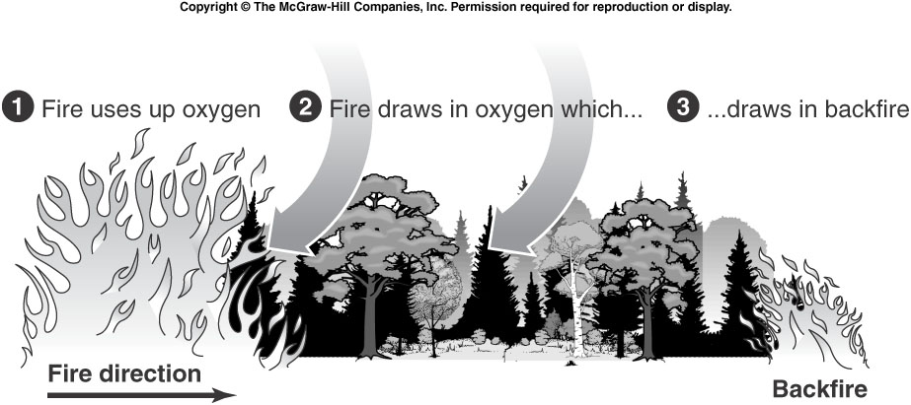
Assessing the Risk
The Fire Triangle

Slide 5
Assessing the Risk
Fuel | Oxygen | Heat
Living vegetation Dead vegetation Organic subsurface material Human built structures Also categorized by: Moisture content Size and shape Quantity (fuel loading) And the arrangement in which it is spread over the landscape | Air is about 21% O₂ Fire requires 16% to burn Oxidation: Fuel heats up Reacts with O₂ Releases heat + combustible products (gas, smoke, etc) | Required for Initial combustion Maintain fire Transfers energy from the initial to surrounding fuel Convection Radiation Conduction
Source: National Interagency Fire Center

Slide 6
Assessing the Risk
The Stages of Fire
Preheating/Smoldering stage
Heat oxidizes combustible material’s surface
Pyrolysis (Produces combustible gases)
Process is exothermic (produces heat)
Source: UC Davis Fire Department
Notes:
http://fire.ucdavis.edu/main/ucdfdfiresuppression.htm

Slide 7
Assessing the Risk
The Stages of Fire
Flaming combustion/Free or open burning
Temperature increases
Flames visible in area of origin
Increases temperature of surrounding area via:
Convection
Radiation
Conduction
Diffusion
Source: UC Davis Fire Department
Notes:
http://fire.ucdavis.edu/main/ucdfdfiresuppression.htm

Slide 8
Assessing the Risk
The Stages of Fire
Flashover
Combustible gases from earlier stages not completely consumed
Form superheated layer which sinks to the floor/ground
All combustible objects heated
If enough O₂, all objects burst into flame
Source: UC Davis Fire Department
Notes:
http://fire.ucdavis.edu/main/ucdfdfiresuppression.htm

Slide 9
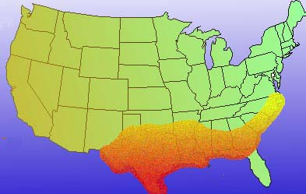
Normal Peak Fire Seasons January

Slide 10
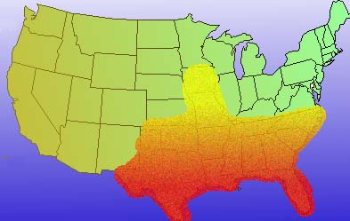
Normal Peak Fire Seasons February

Slide 11
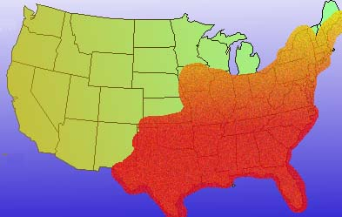
Normal Peak Fire Seasons March

Slide 12
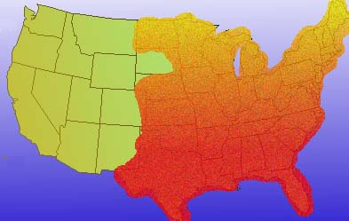
Normal Peak Fire Seasons April

Slide 13
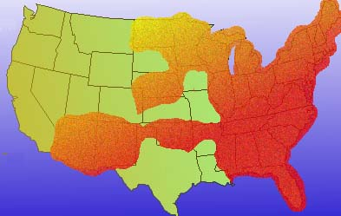
Normal Peak Fire Seasons May

Slide 14
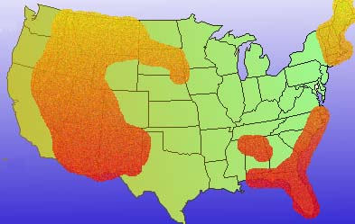
Normal Peak Fire Seasons June

Slide 15
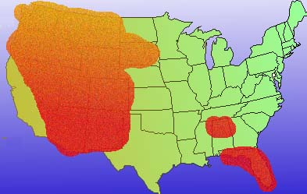
Normal Peak Fire Seasons July

Slide 16
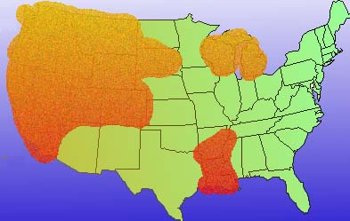
Normal Peak Fire Seasons August

Slide 17
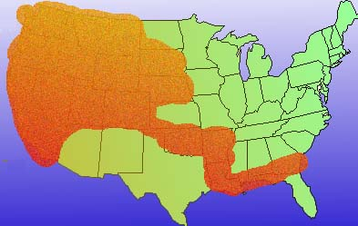
Normal Peak Fire Seasons September

Slide 18
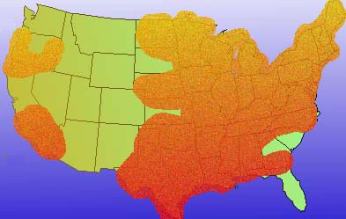
Normal Peak Fire Seasons October

Slide 19
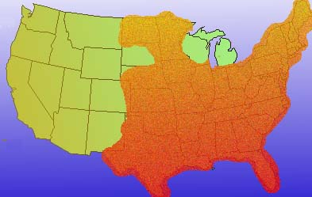
Normal Peak Fire Seasons November

Slide 20
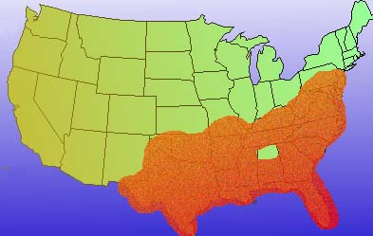
Normal Peak Fire Seasons December

Slide 21
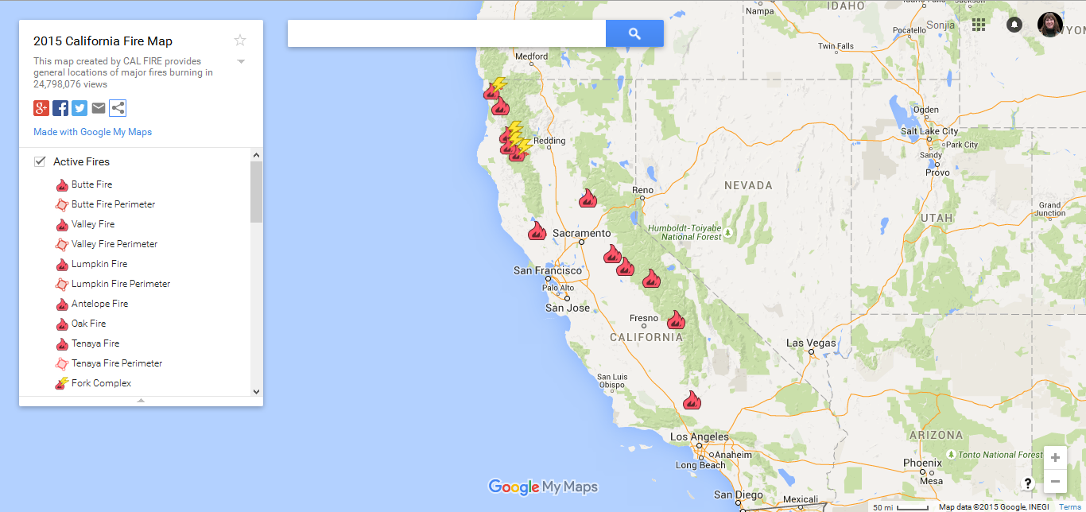
2015 California Active Fire Map
Source: http://tinyurl.com/ouf729q
Notes:
http://maps.google.com/maps/ms?ie=UTF8&hl=en&msa=0&msid=208523333872813891131.0004c02beb4f2788337d0&ll=37.055177,-120.454102&spn=17.505593,18.720703&z=5&source=embed

Slide 22
California Department of Forestry and Fire Protection Fire Suppression Expenditures
Source: http://www.fire.ca.gov/fire_protection/downloads/SuppressionCostsOnepage.pdf

Slide 23
Total Fires and Acres 1995 - 2004
These figures are based on end-of-year reports compiled by all wildland fire agencies after each fire season, and are updated by March of each year.
Source: National Interagency Fire Center
Notes:
These figures are based on end-of-year reports compiled by all wildland fire agencies after each fire season, and are updated by March of each year. The agencies include: Bureau of Land Management, Bureau of Indian Affairs, National Park Service, US Fish and Wildlife Service, USDA Forest Service and all State Lands.

Slide 24
Suppression Costs for Federal Agencies
These figures are based on end-of-year reports compiled by all wildland fire agencies after each fire season, and are updated by March of each year.
Source: National Interagency Fire Center
Notes:
These figures are based on end-of-year reports compiled by all wildland fire agencies after each fire season, and are updated by March of each year. The agencies include: Bureau of Land Management, Bureau of Indian Affairs, National Park Service, US Fish and Wildlife Service, USDA Forest Service and all State Lands.

Slide 25
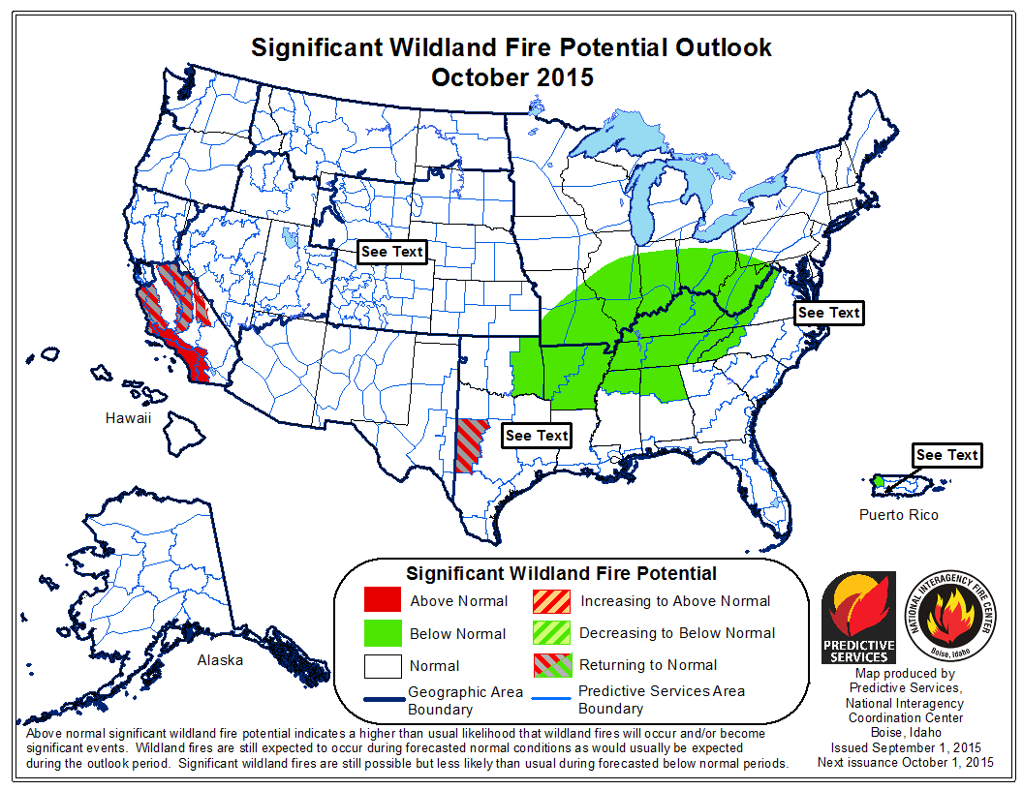
Source: http://www.predictiveservices.nifc.gov/outlooks/outlooks.htm
Notes:
http://www.predictiveservices.nifc.gov/outlooks/outlooks.htm

Slide 26
Assessing the risk
What are the major causes of damage, destruction, death associated with this disaster?

Slide 27
Assessing the Risk
Causes of damage, destruction, and/or death:
Exposure to flames
Inhalation of smoke
Heat exhaustion
Erosion of landscape

Slide 28
Assessing the Risk
Fire Classifications
Wildfires (natural and human caused)
Prescribed Fires (human caused)
Source: http://www.nps.gov/fire/wildland-fire/learning-center/fire-in-depth/classifications.cfm
Notes:
http://fire.ucdavis.edu/main/ucdfdfiresuppression.htm

Slide 29
Assessing the Risk
Ground fires | Surface fires | Crown fires
burn organic matter in the soil beneath surface litter and are sustained by glowing combustion | spread with a flaming front and burn leaf litter, fallen branches and other fuels located at ground level | burn through the top layer of foliage on a tree . . . [are] the most intense type of fire and often the most difficult to contain, need strong winds, steep slopes and a heavy fuel load to continue burning
Source: http://www.nps.gov/fire/wildland-fire/learning-center/fire-in-depth/fire-spread.cfm
Notes:
http://www.nps.gov/fire/wildland-fire/learning-center/fire-in-depth/fire-spread.cfm

Slide 30
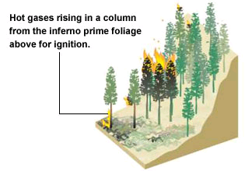
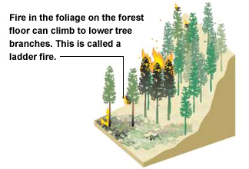
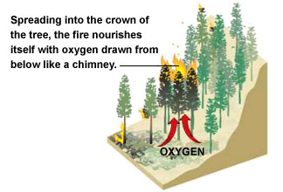
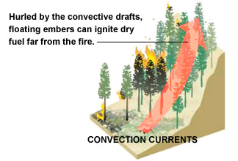
Assessing the Risk
The Spread of Fire
Fuel
Wind
Topography
Source: http://www.cnn.com/2003/US/West/10/27/california.wildfire/
Notes:
http://www.cnn.com/2003/US/West/10/27/california.wildfire/

Slide 31
Assessing the Risk
Wildfire Causes
Natural Causes
Lightning
Lava
Human Causes
Fires left unattended
The burning of debris
Negligently discarded cigarettes
Intentional acts of arson
Source: http://www.nps.gov/fire/wildland-fire/learning-center/fire-in-depth/wildfire-causes.cfm

Slide 32
Assessing the Risk
Other factors: Time between fires
Regional “fire seasons”
Large burns vs. small burns
Source: http://www.nps.gov/fire/wildland-fire/learning-center/fire-in-depth/fire-behavior.cfm

Slide 33
Assessing the Risk
Other factors: Time between fires (Southern California Chaparral)
The natural fire return interval for chaparral is 30 to 130 years plus (human involvement = every 20 years or less)
makes the chaparral dense, impenetrable, and prone to infrequent, huge wildfires
Most natural fires for our region are driven primarily by weather (wind)
Chaparral has a high-severity, crown fire regime
Source: http://www.californiachaparral.org/fire.html

Slide 34
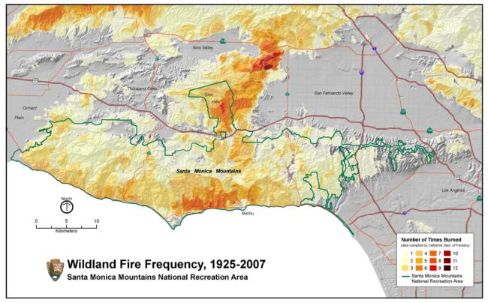
Source: http://ucanr.edu/sites/SAFELandscapes/Fire_in_Southern_California_Ecosystems/

Slide 35
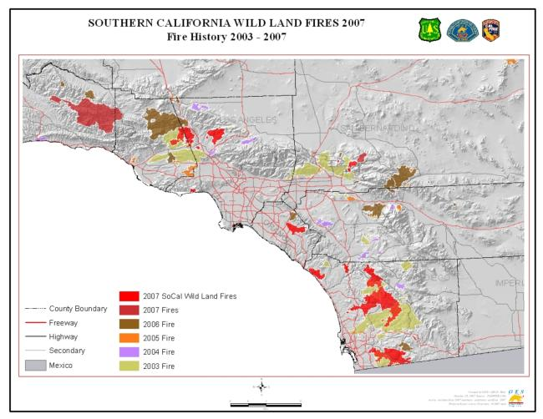
Source: http://ucanr.edu/sites/SAFELandscapes/Fire_in_Southern_California_Ecosystems/

Slide 36
Assessing the Risk
Other factors: Weather
Wind
Temperature
Humidity
Source: http://www.nps.gov/fire/wildland-fire/learning-center/fire-in-depth/fire-behavior.cfm

Slide 37
Assessing the Risk
Other factors: Fuel
Moisture level
Chemical makeup – some plants are more flammable than others
Soil - moisture content, the amount of organic matter present
Source: http://www.nps.gov/fire/wildland-fire/learning-center/fire-in-depth/fire-behavior.cfm

Slide 38
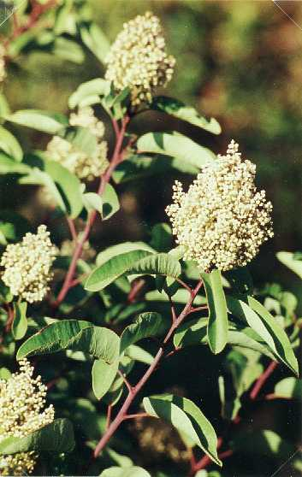
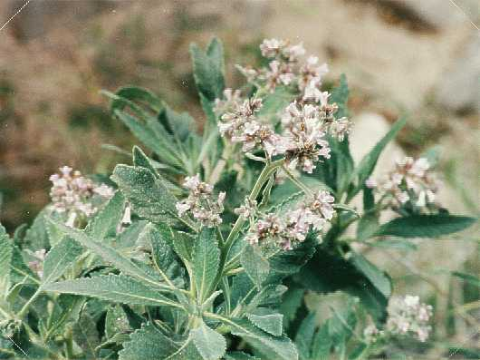
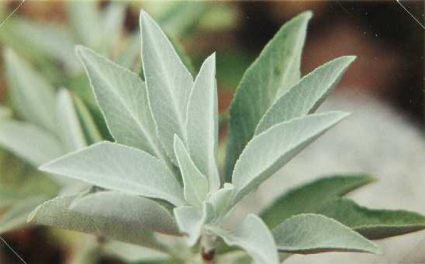
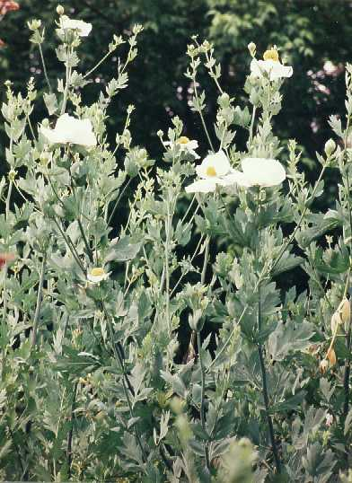
Assessing the Risk
Other factors: Fuel (Southern California Chaparral)
“Fire Adapted Vegetation” NOT “Fire-dependent Ecosystem”
“Sprouters” |  | “Seeders"
Laurel Sumac | Yerba Santa | White Sage | Matilija Poppy
Source: http://www.nps.gov/samo/learn/management/fireecology.htm and http://www.ecnca.org/hiking_trails/fire_ecology_trail.htm

Slide 39
Assessing the Risk
Other factors: Fuel (Southern California Chaparral)
Myth #1: Chaparral needs fire to "renew" and clean out "decadent" or "over-grown" vegetation.
Myth #2: Past fire suppression has built up "unnatural" levels of "fuel" i.e. chaparral.
Myth #3: Large chaparral wildfires are unusual and preventable.
Myth #4: Chaparral is adapted to fire and "needs" to burn frequently.
Myth #5: Chaparral plant species are "oozing combustible resins."
Myth #6: Hot chaparral fires "sterilize" the soil.
Myth #7: Chemicals suppress seed germination under the chaparral canopy
Source: http://www.californiachaparral.org/chaparralmyths.html

Slide 40
Assessing the Risk: Lightning Fires + Drought
Yellowstone National Park (1988)
Fire Policy
1880’s to 1976: Extinguish all lighting fires ASAP
1976 – 1987
“Let nature take it’s course”
235 lighting fires
Typically only 100 acres burned
Policy thought to be a success

Slide 41
Assessing the Risk: Lightning Fires + Drought
Yellowstone National Park (1988)
Dry 1987 – 1988 winter
Dry June & July 1988
Lighting fires began, but no rain
Late July: 17,000 acres burned
Decision made to extinguish all fires.

Slide 42
Assessing the Risk: Lightning Fires + Drought
Yellowstone National Park (1988)
Problems:
Mountain pine beetle infestation
Nine decades of fire suppression = lots of dead vegetation
Moisture levels in dead wood extremely low
High temperatures and lack of summer rain

Slide 43
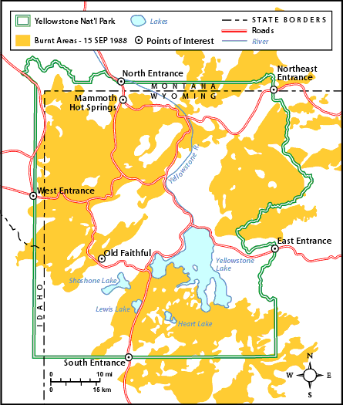
Assessing the Risk: Lightning Fires + Drought
Yellowstone National Park (1988)
Aftermath
793,880 acres of land burned
Source: http://southport.jpl.nasa.gov/pio/srl2/sirc/srl2-yellowstone.html & http://www.cotf.edu/ete/modules/yellowstone/YFsituation.html
Notes:
http://southport.jpl.nasa.gov/pio/srl2/sirc/srl2-yellowstone.html
http://www.cotf.edu/ete/modules/yellowstone/YFsituation.html

Slide 44
Assessing the Risk: Lightning Fires + Drought
Yellowstone National Park (1988)
Aftermath
Appearance of fertile soils and varied vegetation
Grasslands reappeared
Recolonization of tree species
Bears graze more in burn areas
Birds have more dead wood for nests
New vegetation slows/prevents erosion in watersheds
Source: http://southport.jpl.nasa.gov/pio/srl2/sirc/srl2-yellowstone.html
Notes:
http://southport.jpl.nasa.gov/pio/srl2/sirc/srl2-yellowstone.html

Slide 45
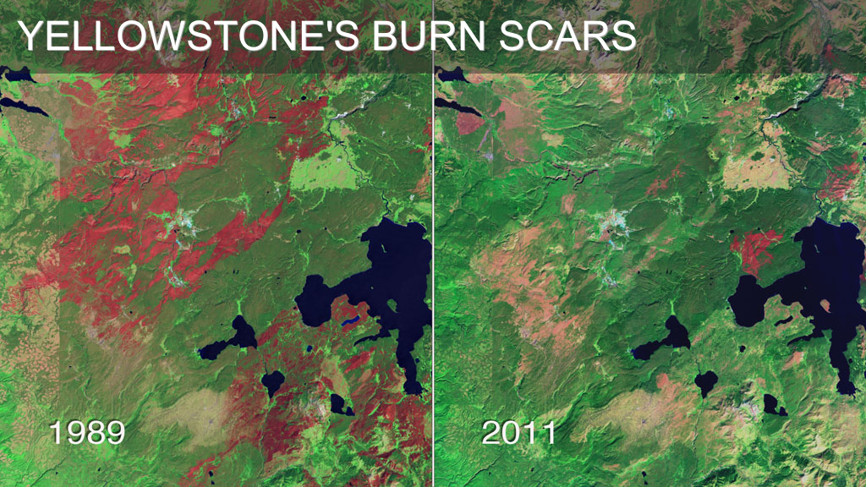
Source: http://svs.gsfc.nasa.gov/vis/a010000/a010800/a010864/index_svs.html

Slide 46
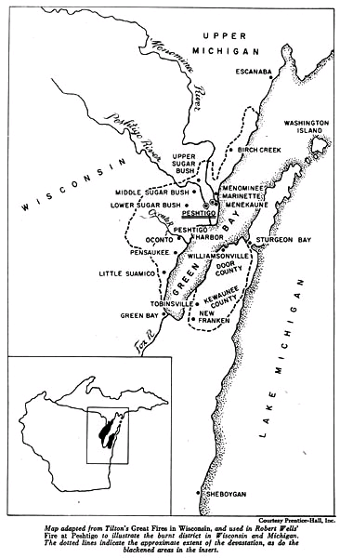
Assessing the Risk: Humans + Drought + Weather
Peshtigo, Wisconsin (1871)
October 8, 1871
Overshadowed by the Great Chicago Fire
covered 2,400 square miles
Sources: http://www.peshtigofire.info/ & Wisconsin Electronic Reader
Notes:
Source: Deana C. Hipke. The Great Peshtigo Fire of 1871. <http://www.peshtigofire.info/>
http://www.peshtigochamber.com/history.cfm

Slide 47
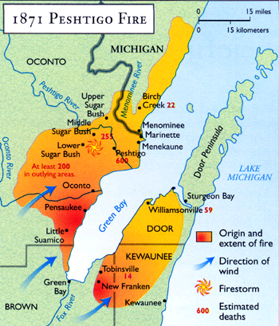
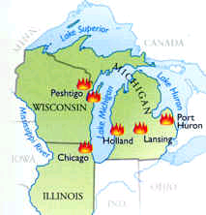
Assessing the Risk: Humans + Drought + Weather
Peshtigo, Wisconsin (1871)
The Cause
Settlement/Industry
Slash and burn techniques
Weather
High temperatures
Drought conditions
Strong low pressure storm
Sources: http://www.angelfire.com/mi2/gfmeteor/fires.htm

Slide 48
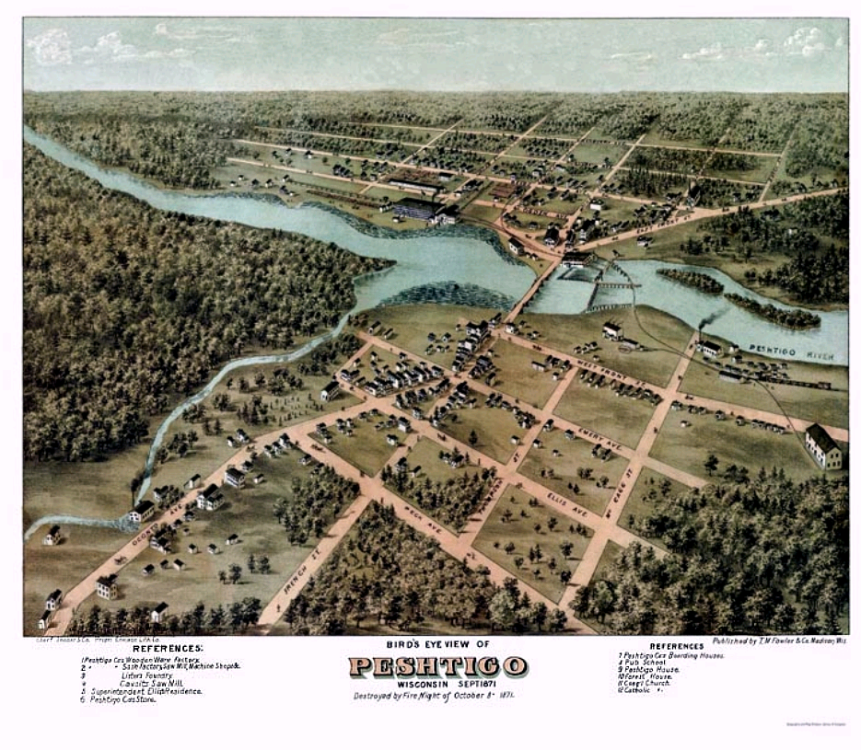
Notes:
http://www.rootsweb.com/~wioconto/PeshtigoPlatDrawing.htm

Slide 49
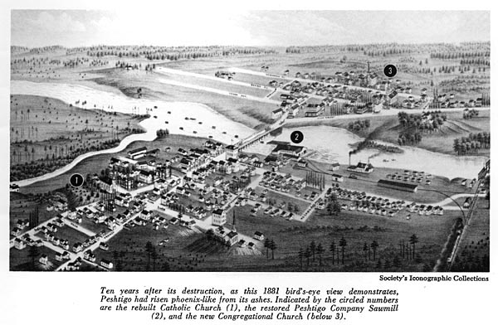
rebuilt Catholic church (the site of the Fire Museum today);
restored Peshtigo Company sawmill;
new Congregational church (this building was moved across the river in 1926 and later became the Fire Museum).
Sources: http://www.peshtigofire.info/ & Wisconsin Electronic Reader

Slide 50
Assessing the Risk: Humans + Drought + Weather
Peshtigo, Wisconsin (1871)
Fire continued to burn until
It reached Green Bay
Winds died down
Rains began
Source: Deana C. Hipke. The Great Peshtigo Fire of 1871. <http://www.peshtigofire.info/>

Slide 51
Assessing the Risk: Humans + Drought + Weather
Peshtigo, Wisconsin (1871)
Aftermath
Est. 1,200 and 2,400 people died
About 800 in Peshtigo
Remainder in surrounding areas
Compare with 250 in Great Chicago Fire
Considered to be the worst recorded forest fire in US history
Source: Deana C. Hipke. The Great Peshtigo Fire of 1871. <http://www.peshtigofire.info/>

Slide 52
Assessing the Risk: Humans + Drought + Weather
Peshtigo, Wisconsin (1871)
Aftermath
New forest management programs
Less wasteful harvesting techniques
Initialization of modern day conservation and environmental principals

Slide 53
Assessing the Risk: Humans + Drought + Weather
The Great Chicago Fire
Pre Fire
Population of 334,000
Center for:
Grain & livestock markets
Railroads
Finance
Sources: http://www.thechicagofire.com/ & http://www.chipublib.org/004chicago/timeline/greatfire.html
Notes:
http://www.thechicagofire.com/
http://www.chipublib.org/004chicago/timeline/greatfire.html

Slide 54
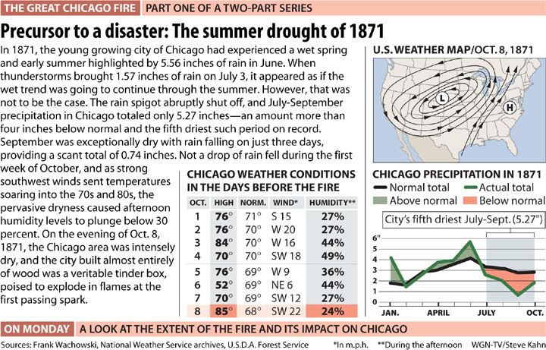

Slide 55
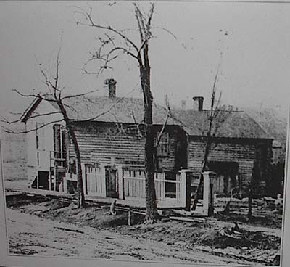
Assessing the Risk: Humans + Drought + Weather
The Great Chicago Fire
October 8, 1871
9 p.m.
Fire breaks out in Patrick O'Leary’s Barn
Gale force winds push fire to the northeast
Sources: http://www.thechicagofire.com/ & http://www.chipublib.org/004chicago/timeline/greatfire.html
Notes:
http://www.thechicagofire.com/
http://www.chipublib.org/004chicago/timeline/greatfire.html

Slide 56
Assessing the Risk: Humans + Drought + Weather
The Great Chicago Fire
October 9, 1871
12 a.m.
Fire jumps the south branch of the Chicago River
1:30 a.m.
business district in flames
Jumps the main river
Sources: http://www.thechicagofire.com/ & http://www.chipublib.org/004chicago/timeline/greatfire.html
Notes:
http://www.thechicagofire.com/
http://www.chipublib.org/004chicago/timeline/greatfire.html

Slide 57
Assessing the Risk: Humans + Drought + Weather
The Great Chicago Fire
October 10, 1871
Rains end fire
3 1/3 miles of the city destroyed
$192 million in property damage
100,000 people left homeless
300 people dead
Sources: http://www.thechicagofire.com/ & http://www.chipublib.org/004chicago/timeline/greatfire.html
Notes:
http://www.thechicagofire.com/
http://www.chipublib.org/004chicago/timeline/greatfire.html

Slide 58
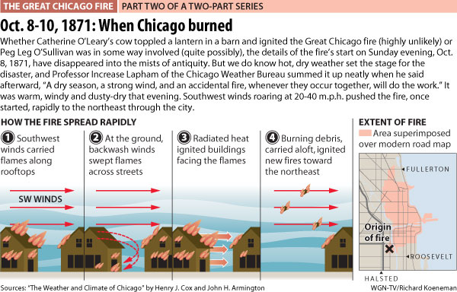

Slide 59
Chicago Fire Panorama
Photograph. Panoramic view looking east along Randolph Street toward the shell of the Court House and City Hall. The nearest cross street is Franklin, while the street at the extreme right corner is Market (now Wacker). Reconstruction is just beginning: a contractor's shack is in the middle ground, and several larger temporary store structures are under construction.
Sources: http://www.chipublib.org/004chicago/timeline/greatfire.html
Notes:
http://www.chipublib.org/004chicago/disasters/great_fire.html
http://www.americaslibrary.gov/jb/recon/jb_recon_chicago_3_e.html

Slide 60
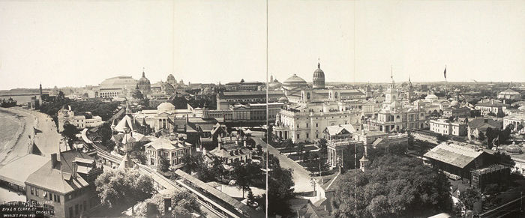
A panoramic view of the 1893 World Fair in Chicago, 22 years after the fire
CREDIT: Hyland, C. C., copyright claimant. "World's Fair, 1893." Copyright June 5, 1933. Taking the Long View: Panoramic Photographs, 1851-1991, Library of Congress.
Notes:
http://www.chipublib.org/004chicago/disasters/great_fire.html
http://www.americaslibrary.gov/jb/recon/jb_recon_chicago_3_e.html

Slide 61
Mapping the Fire
Fire | Time of Starting
A. O'Leary barn | 8:30 pm, October 8
B. Bateham's Mills | 10:00 pm, October 8
C. Parmelee's Stables | 11:30 pm, October 8
D. Gas Works | 12:00 a.m., October 8-9
Conley's Patch | 12:20 am, October 9
E. Court House | 1:30 am, October 9
F. Wright's Stables | 2:30 am, October 9
G. Polk Street | 2:30 am, October 9
H. Northwestern Elevator | 7:00 am, October 9
I. Galena Elevator | 7:00 am, October 9
Source: http://www.chicagohistory.org/fire/conflag/pic-firemap.html
Map is adapted from the one prepared to accompany H.A. Musham's article, "The Great Chicago Fire, October 8-10, 1871," which appeared in Papers in Illinois History and Transactions (Illinois State Historical Society, 1941)

Slide 62
Assessing the Risk: Humans + Drought + Weather
The Great Chicago Fire
Did the cow do it?
Probably not
Michael Ahern, author of the story, admitted he made it up
O’Leary Family in bed asleep
Daniel Sullivan and Dennis Regan
Supposedly saw and reported the fire
May or may not have been in the barn
Source: http://jocofd1.org/firepreventionweek/fireprevweek.htm
Notes:
http://jocofd1.org/firepreventionweek/fireprevweek.htm

Slide 63
Assessing the Risk: Humans + Drought + Weather
The Great Chicago Fire
Why did the fire cause so much damage?
Firefighters fought a fire earlier, exhausted
Fire watchman initially reported the blaze in the wrong location, telegraph operator refused to notify correct station
telegraph operator noticed fire 1 ½ hours earlier but waited for confirmation
One of the fire engines broke down before arriving on scene
Source: http://www.thechicagofire.com/exoneration.php
Notes:
http://www.thechicagofire.com/exoneration.php

Slide 64
Engine 7's members & apparatus, at quarters on East St., circa 1870 (Boston, MA)
Source: http://www.bostonfirehistory.org/modernengine07.html

Slide 65
Assessing the Risk: Winds + Chaparral + Time
Southern California
Long dry season
+ Foehn winds (Santa Anas)
+ Chaparral vegetation
________________________
= Good fire conditions!

Slide 66
Assessing the Risk: Winds + Chaparral + Time
Southern California
October 2003
Dry conditions
Santa Ana Winds
Lots of fuel

Slide 67
Assessing the Risk: Winds + Chaparral + Time
Southern California
October 2003
739,597 acres burned
24 deaths
Four counties involved in the federal disaster declaration (Los Angeles, Riverside, San Diego, Ventura)
Upwards of $4 billion in damages

Slide 68
The Southern California fires on October 25, 2003
A huge wildfire was burning east of the city and has been detected by MODIS and marked with a red outline. The fire producing all the smoke is the Grand Prix Fire and to its east is the Old Fire. Northwest of the city is the smaller Piru Fire.
http://earthobservatory.nasa.gov

Slide 69
The Southern California fires on October 26, 2003
Moving northwest to southeast along the coast, the first cluster of red dots is a combination of the Piru, Verdale, and Simi Incident Fires; the next cluster—to the east of Los Angeles—is the Grand Prix (west) and Old (east) Fires; to their south is the Roblar 2 Fire; next is the Paradise Fire; then the massive Cedar Fire, whose thick smoke is completely overshadowing the coastal city of San Diego; finally, at the California-Mexico border is the Otay Fire. http://earthobservatory.nasa.gov

Slide 70
Haze from the October 2003 wildfires in Los Angeles Harbor. The smoke and ash from the fires not only affected our air quality, but also changed the chemistry of the upper layers in the oceans.
Photo by S. Leyva, 2003

Slide 71
Prepare, Respond, & Recover

Slide 72
PREPARE
Post emergency phone numbers by every phone in your home.
Make sure driveway entrances and your house number or address are clearly marked.
Identify and maintain an adequate water source outside your home, such as a small pond, cistern, well or swimming pool.
Set aside household items that can be used as fire tools: a rake, ax, hand saw or chain saw, bucket and shovel. Select building materials and plants that resist fire.
Regularly clean roofs and gutters.
Source: http://www.redcross.org/prepare/disaster/wildfire

Slide 73
PREPARE
Plan and practice two ways out of your neighborhood in case your primary route is blocked.
Select a place for family members to meet outside your neighborhood in case you cannot get home or need to evacuate.
Identify someone who is out of the area to contact if local phone lines are not working.
Place emergency supplies in car
Source: http://www.redcross.org/prepare/disaster/wildfire

Slide 74
RESPOND
Be ready to leave at a moment’s notice.
Listen to local radio and television stations for updated emergency information.
Always back your car into the garage or park it in an open space facing the direction of escape.
Confine pets to one room so that you can find them if you need to evacuate quickly.
Arrange for temporary housing at a friend or relative’s home outside the threatened area.
Source: http://www.redcross.org/prepare/disaster/wildfire
Notes:
http://www.firewise.org/pubs/protect/

Slide 75
Feb. 6, 2015: The Round fire burning at Wheeler Crest near Bishop Calif. . Firefighters have gained the upper hand on a wind-driven wildfire that destroyed 40 homes, burned nearly 11 square miles and forced about 150 people to leave two small California towns at the eastern base of the Sierra Nevada. (AP)
Source: http://www.foxnews.com/us/2015/02/09/evacuations-remain-after-wildfire-chars-california-towns/

Slide 76
RESPOND
Listen and watch for air quality reports and health warnings about smoke.
Keep indoor air clean by closing windows and doors.
Use the recycle or re-circulate mode on the air conditioner in your home or car.
If you have asthma or another lung disease, follow your health care provider's advice and seek medical care if your symptoms worsen.
Source: http://www.redcross.org/prepare/disaster/wildfire
Notes:
http://www.redcross.org/prepare/disaster/wildfire

Slide 77
RECOVER
STAY SAFE!
Go to a designated public shelter if you have been told to evacuate or you feel it is unsafe to remain in your home. Text SHELTER + your ZIP code to 43362 (4FEMA)
Register on the American Red Cross Safe and Well web site to let your family and friends know you are safe. (https://safeandwell.communityos.org/cms/index.php)

Slide 78
RECOVER
Do not enter your home until fire officials say it is safe.
Use caution when entering burned areas as hazards may still exist, including hot spots, which can flare up without warning.
Avoid damaged or fallen power lines, poles and downed wires.
Source: http://www.redcross.org/prepare/disaster/wildfire
Notes:
http://www.redcross.org/prepare/disaster/wildfire

Slide 79
RECOVER
Returning Home
Return home only when authorities say it is safe.
For several hours after the fire, maintain a "fire watch." Check and re-check for smoke, sparks or hidden embers throughout the house, including the roof and the attic.
Use caution when entering burned areas as hazards may still exist, including hot spots, which can flare up without warning. Evacuate immediately if you smell smoke.
Source: http://www.ready.gov/wildfires
Notes:
http://www.ready.gov/wildfires

Slide 80
Scorched trees and burned vehicles and the remains of homes cover the landscape Thursday in Anderson Springs. The Valley fire that sped through Middletown and other parts of rural Lake County has continued to burn since Saturday despite a massive firefighting effort. Paul Kitagaki Jr. pkitagaki@sacbee.com
Source: http://www.sacbee.com/news/state/california/fires/article35562669.html

Slide 81
RECOVER
Cleaning Your Home
Wear a NIOSH certified-respirator (dust mask) and wet debris down to minimize breathing dust particles.
Discard any food that has been exposed to heat, smoke or soot.
Do NOT use water that you think may be contaminated to wash dishes, brush teeth, prepare food, wash hands, or to make ice or baby formula.
Photograph damage to your property for insurance purposes.
Source: http://www.ready.gov/wildfires
Notes:
http://www.ready.gov/wildfires

Slide 82
Reducing the risk
What, if anything, can be done to prevent this disaster from occurring?

Slide 83
Reducing the risk
What, if anything, can be done to prevent this disaster from occurring?
Don’t build in areas where wildfires are common.
Not really an option . . .

Slide 84
Reducing the risk
Choose a firewise location.
Design and build firewise structures.
Stay on guard with firewise landscaping and maintenance.
Source: http://www.firewise.org/pubs/protect/
Notes:
http://www.firewise.org/pubs/protect/

Slide 85
Reducing the risk
What can be done to reduce the damages caused by this disaster?

Slide 86
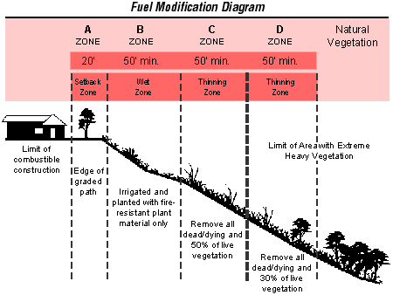
PREPARE: Protecting your Home
Choose a firewise location.
Source: http://www.firewise.org/pubs/protect/

Slide 87
PREPARE: Protecting your Home
Design and build firewise structures.
Use fire-resistant
Roofing materials
Siding
Landscape
Install double-pane or safety glass windows
Spark arresters on chimneys
Source: http://www.firewise.org/pubs/protect/
Notes:
http://www.firewise.org/pubs/protect/

Slide 88
PREPARE: Protecting your Home
Home Ignition Zone: The home in relation to its surroundings within 100 to 200 feet
Source: http://www.firewise.org/wildfire-preparedness/teaching-tools/presentations-and-documents.aspx?sso=0
Notes:
When considering improvements to reduce wildfire vulnerability, the key is to consider the home in relation to its immediate surroundings within 100 to 200 feet. We call this area the Home Ignition Zone. The home’s vulnerability is determined by the exposure of its external materials and design to flames and firebrands during extreme wildfires. The higher the fire intensities within the home ignition zone, and the greater the firebrand exposure from the wildfire, the more you need nonflammable construction materials and a resistant building design.

Slide 89
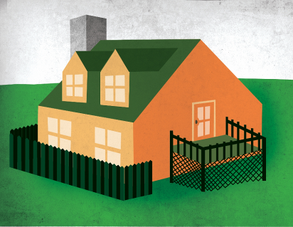
PREPARE: Protecting your Home
The Home Ignition Zone includes the home, in addition to its immediate surroundings up to 200 feet.
If it’s attached to the house, it’s part of the house.
Source: http://www.firewise.org/wildfire-preparedness/teaching-tools/presentations-and-documents.aspx?sso=0
Notes:
Let’s start with the home itself – the center of the home ignition zone 1.
Even if a landscape is designed in perfect compliance with Firewise recommendations, fire may still reach your home. Remember that heavy winds can carry firebrands over the tops of trees to land on a roof. If that were to happen to your home, your home’s exterior must play an important role in preventing ignitions that could lead to total home destruction. When considering improvements to reduce wildfire vulnerability, the key is to consider the home as part of the entire home ignition zone – the house itself and its immediate surroundings within 100 to 200 feet. The home’s vulnerability depends on how much flammable vegetation and other hazards are surrounding it, in relation to the vulnerability of the home’s construction materials. The higher the fire intensities within the home ignition zone, and the greater the firebrand exposure from the wildfire, the more you need non-flammable construction materials and a resistant building design.

Slide 90
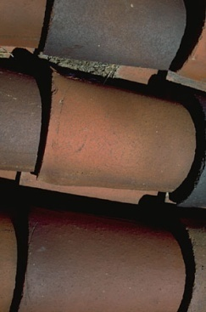
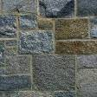
PREPARE: Protecting your Home
Rated roofing materials
Composition shingle, metal, clay or cement tile
Roof assembly
Fire-resistant exterior walls
Stucco, stone, brick, block
Vinyl siding should be supplemented with metal screening
Source: http://www.firewise.org/wildfire-preparedness/teaching-tools/presentations-and-documents.aspx?sso=0
Notes:
Use Rated Roofing Material: The roof can be the part of your home most vulnerable during extreme wildfires. If firebrands fall on a roof with untreated, non-rated roofing, the entire roof can ignite, destroying the home. In contrast, roofing material with a Class A, B, or C rating, such as composition shingle, metal, and clay or cement tile, is fire resistant and will help keep the flame from spreading.
Use Fire-Resistant Building Materials on Exterior Walls: Wall materials that resist heat and flames include cement, plaster, stucco and masonry such as concrete, stone, brick or block. Though some materials, such as vinyl, are difficult to ignite, exposure to extreme heat causes a loss of integrity. These materials may fall away or melt, providing the firebrands with a direct path into the home. If your home has vinyl siding, use metal screening over openings that will become exposed if the siding falls away. However, if an existing home has been constructed with flammable material, such as wood, the hazard can be reduced by reducing vegetation around the home, which we will talk about in a few minutes.

Slide 91
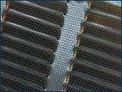
PREPARE: Protecting your Home
Double-paned or tempered glass
Enclose eaves, fascias, soffits, vents
Protect overhangs and attachments
Notes:
Use Double-Paned or Tempered Glass: Exposure to the heat of a wildfire can cause glass on exterior windows to fracture and collapse, allowing firebrands to enter the home. Double pane glass can help reduce this risk by providing an added layer of protection. Tempered glass is the most effective option, as it has a higher heat tolerance and is less likely to break. For skylights, glass is less penetrable than plastic or fiberglass, which can melt at lower temperatures.
Enclose Eaves, Fascias, Soffits, and Vents: Eaves, fascias, soffits, and vents should be ‘boxed’ or enclosed with metal screens to reduce the size of the openings. Vent openings should be screened to help prevent firebrands or other objects larger than 1/8” from entering your home.
Protect Overhangs and Other Attachments: Overhangs and other attachments, such as room additions, bay windows, decks, porches, carports and fences, are often very vulnerable to flames or firebrands. Remove all fuels from around these areas. Box in the undersides of the overhangs, decks and balconies with noncombustible or fire-resistant materials to reduce the possibility of ignition. Make sure fences constructed of flammable materials, such as wood, don’t attach directly to your home. Remember: if it is attached to house, it’s part of your house.

Slide 92
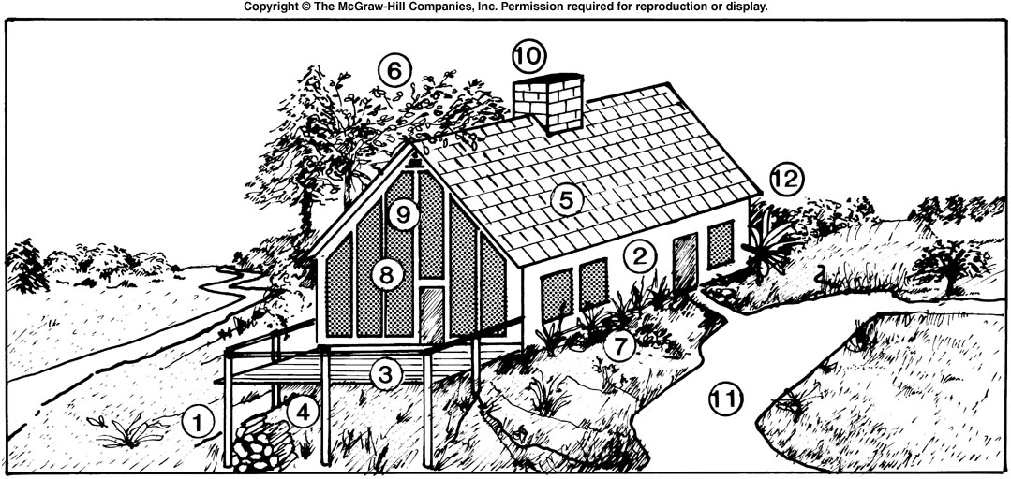
PREPARE: Protecting your Home
Clear vegetation from around house
Stucco/masonry siding
Decks a fire hazard
Don’t store firewood near house
Use fire-resistant roofing material
Trim trees so they don’t touch the roof
Clean leaves/garden debris
gsf
Double pane glass
Spark arrester on chimney
Clear path to/from house
High moisture content plants

Slide 93
PREPARE: Protecting your Home
Landscaping & Maintenance.
Create a safety zone or fire break around your home
Clean gutters, eaves and roof regularly
Don’t stack firewood near your home
Don’t use incinerators near your home
Install smoke detectors
Install fire extinguishers
PRACTICE FIRE DRILLS!
Source: http://www.firewise.org/pubs/protect/
Notes:
http://www.firewise.org/pubs/protect/

Slide 94
PREPARE: Protecting your Home
Home Ignition Zone 1: The home and its immediate surroundings, up to approximately 30 feet.
Low-flammability plants, landscaping materials, accessories
Prune limbs 10 ft. from ground; generous space between trees
Mow, prune, and water regularly
NO firewood or propane tanks
Notes:
NOTE TO PRESENTER: For a plant list for your area, visit www.firewise.org, or contact your state forester, a local landscape specialist, or university extension service.
ZONE 1: 30 feet adjacent to the home (All Hazard Areas)
For all hazard levels, this area should be well-irrigated and free from fuels that may ignite your home, such as dry vegetation, clutter, and debris. Flammable attachments to the home, such as wooden decks, fences, and boardwalks, are considered part of the house. The perimeter should extend 30 feet beyond these attachments.
Lean
Plants in this area should be limited to carefully spaced plantings that are low-growing and free of resins, oils, and waxes that burn easily. For a list of low-flammability vegetation for your area, contact your state forester, forestry office, or local landscape specialist.
Mow the lawn regularly. Prune all trees so the lowest limbs are at least six to 10 feet from the ground.
Space flammable conifer trees generously (approximately 30 feet between crowns) to reduce the risk of crown fire. Remember, trees that hang over the house will deposit leaves and branches on the house and immediate area.
Within five feet of the home, use non-flammable landscaping materials such as rock, pavers, annuals, and high moisture content perennials. Be sure to remove dead leaves and stems immediately.
Clean
Remove dead vegetation, such as leaves and pine needles from gutters, under your deck, and within 10 feet of your home. Be sure to keep the area clean of flammable debris.
This is generally where patio furniture, swing sets, and other accessories are located. If you live in a moderate to high hazard area, consider fire resistant material for these accessories, and be sure to keep the area around them clear of debris. Keep patio cushions inside the house when not in use during periods of high fire potential.
Firewood stacks and propane tanks should not be located in this area. Keep them at least 30 feet from the home.
Green
Water plants and trees regularly to ensure they are healthy and green, especially during the fire season. Mulch also should be kept watered, as it can become flammable when dry.
Consider xeriscaping, especially in areas with low water supply and/or water use restrictions. Xeriscaping is a popular method for conserving water through creative use of landscaping features that are fire resistant, yet require limited irrigation. Contact your local nursery or landscape architect for more information.
ALSO – Propane tanks should not be located in zone 1, nor should stacks of firewood during dry seasons. It’s fine to keep close to the house during wet winter weather, but move it out during the dry seasons – or store it in a fire-resistant container with a lid that has an incline so it doesn’t collect debris.

Slide 95
PREPARE: Protecting your Home
Home Ignition Zone 2: 30 to 100 ft from home
30 ft between tree clusters; 20 ft between individual trees
Fuel breaks
Branches and leaves 6 to 10 feet from ground
Remove heavy accumulation of flammable debris
Notes:
ZONE 2: 30-100 feet from the home (Moderate and High Hazard Areas)
For moderate and high hazard areas, Zone 2 extends 30 feet to 100 feet from the home. Plants in this zone should be low-growing, well-irrigated, and less flammable.
Leave 30 feet between clusters of two to three trees, or 20 feet between individual trees.
Encourage a mixture of deciduous and coniferous trees. Most deciduous trees do not support high intensity fires.
Give yourself added protection with “fuel breaks,” such as driveways, gravel walkways, and lawns.
Prune trees so branches and leaves are at least 6 to 10 feet above the ground. Remove heavy accumulations of flammable debris, such as dried leaves, pine needles, pine cones, etc.

Slide 96
PREPARE: Protecting your Home
Home Ignition Zone 3: 100 to 200 ft from home
Remove heavy accumulation of woody debris
Remove smaller conifers growing between trees
Reduce density of taller trees
Notes:
ZONE 3: 100 to 200 feet from home (High Hazard Areas)
In high hazard conditions, this area should be thinned out as well, though less space is required than in Zone 2. Remove heavy accumulation of woody debris, such as piles of stem wood or branches. Thin trees to remove smaller conifers that are growing between taller trees. Reduce the density of tall trees so canopies are not touching to reduce the ability for high intensity crown fire to reach your home.

Slide 97
PREPARE: Protecting your Home
Some undesirable domestic species
Adenostoma Fasciculatum...Chamise | Eriogonum Fasciculatum...Common Buckwheat
Adenostoma Sparsifolium...Red Shanks | Juniperus species...Juniper
Artemisia Californica...California Sagebrush | Myrtaceae...Eucalyptus
Cendrus Species...Cedar | Pennisetum...Fountain Grass
Cortaderia Selloana...Pampas Grass | Pinus species...Pine
Cupressus species...Cypress | Salvia Mellifera...Black Sage
Dodonea Viscosa...Hopseed Bush
Source: http://www.firewise.org/pubs/protect/

Slide 98
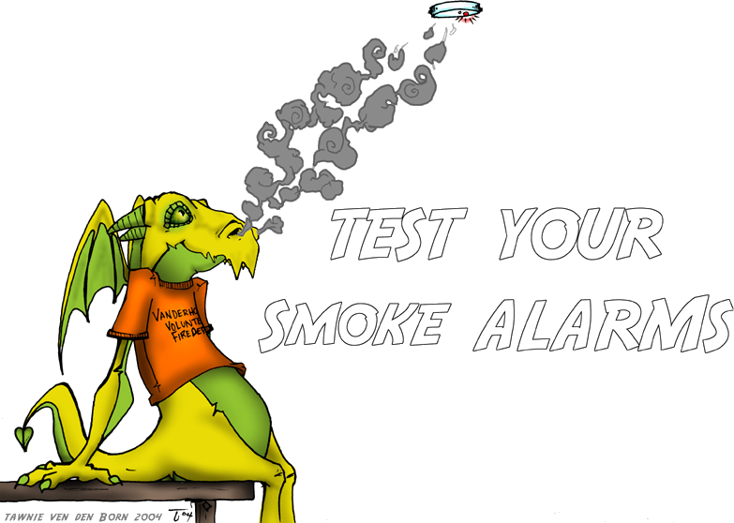
~ end ~
Notes:
http://www.deviantart.com/art/Fire-Prevention-Week-Dragon-11024052

