Slide 1
Plate Tectonics
Subtitle

Slide 2
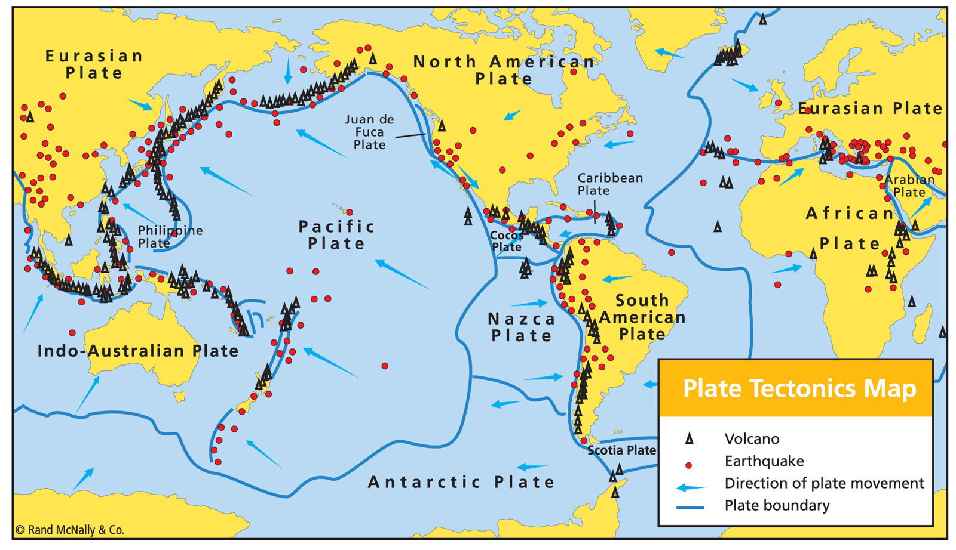
The Theory of Plate Tectonics
Explains the global distribution of
Volcanoes
Earthquakes
Faults
Mountain belts
Features of seafloor
In addition to the evolution of continents and oceans
Synthesis of
Continental Drift,
Sea Floor Spreading &
Paleomagnetism
Source

Slide 3
Putting it all together: The Theory of Plate Tectonics
        Continental Drift
        + Sea-Floor Spreading
        + Paleomagnetism
        = Plate Tectonics

Slide 4
Plate Tectonics
Earth’s lithosphere is broken up into plates
Hot, weak asthenosphere allows for plates to move
Plates are in motion and continually changing in shape and size
  Move very slowly – 5 cm/yr
  Movement is NOT constant – more of stop and go (earthquakes!)

Slide 5
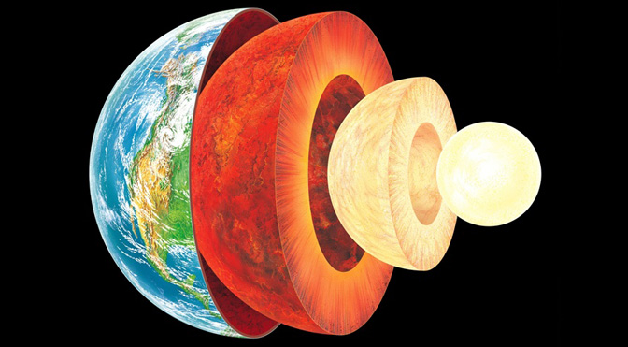
Source: 1

Slide 6
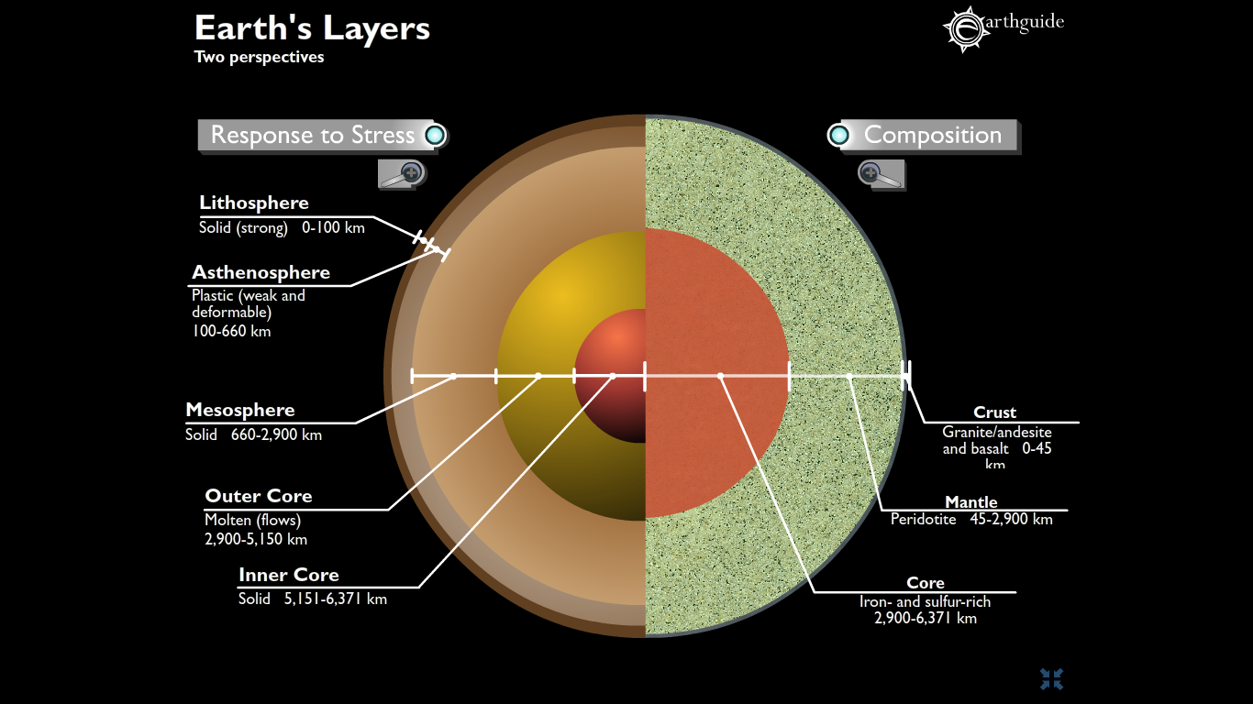
Physical Properties
Composition
Notes:
Source: http://earthguide.ucsd.edu/earthguide/diagrams/layers/

Slide 7
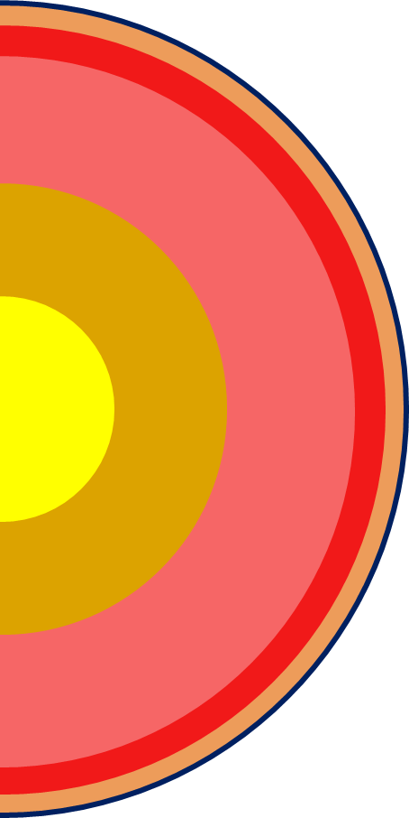
Crust (Continental & Oceanic)
Crust
Lithosphere
Mohorovičić discontinuity
Mohorovičić discontinuity
Mantle: Asthenosphere
Mantle
Transition zone
Mantle: Mesosphere
Core: Outer Core
Core
Core: Inner Core

Slide 8
Crust (Continental & Oceanic)
Continental Crust
Average density: 2.7 g/cc
Average composition: Granodiorite
Thicker & lighter
Lithosphere
Mohorovičić discontinuity
Mantle: Asthenosphere
Transition zone
Mantle: Mesosphere
Oceanic Crust
Average density: 3.0 g/cc
Average composition: Basalt
Thinner & denser
Core: Outer Core
Core: Inner Core

Slide 9
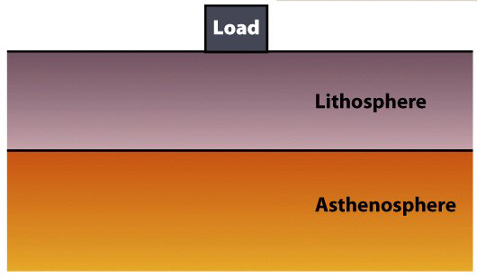
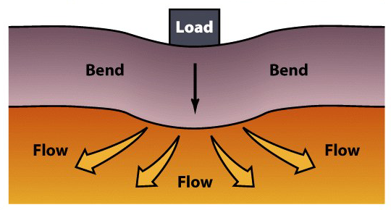
Crust (Continental & Oceanic)
Lithosphere
Includes the crust and upper mantle
Density: varies, ~ 4.4 g/cc
Composition: varies, mostly peridotite
Lithosphere bends elastically when loaded.
Asthenosphere flows plastically when loaded.
Lithosphere
Mohorovičić discontinuity
Mantle: Asthenosphere
Transition zone
Mantle: Mesosphere
Core: Outer Core
Core: Inner Core

Slide 10
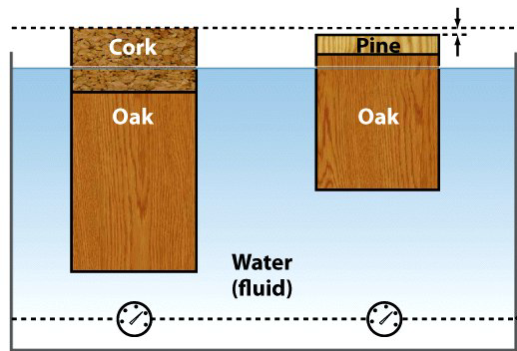
Crust (Continental & Oceanic)
Lithosphere
Floating solids displace water equal to their mass.
Continental Lith. ~ 150 km thick
Granitic crust ~35-40 km thick.
Lighter (less dense)
More buoyant – Floats higher.
Lithosphere
Mohorovičić discontinuity
Mantle: Asthenosphere
Transition zone
Mantle: Mesosphere
Core: Outer Core
Core: Inner Core

Slide 11
Crust (Continental & Oceanic)
Lithosphere
Floating solids displace water equal to their mass.
Oceanic Lith. ~ 7 - 133 km thick
Basaltic crust ~7 - 10 km thick.
Heavier (more dense)
Less buoyant – sinks lower
Lithosphere
Mohorovičić discontinuity
Mantle: Asthenosphere
Transition zone
Mantle: Mesosphere
Core: Outer Core
Core: Inner Core

Slide 12
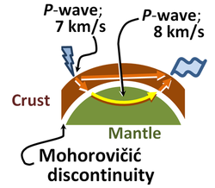
Crust (Continental & Oceanic)
Mohorovičić discontinuity
Boundary between the lithosphere and the mantle. Marked by a change in velocity of the P waves
Lithosphere
Mohorovičić discontinuity
Mantle: Asthenosphere
Transition zone
Mantle: Mesosphere
Core: Outer Core
Core: Inner Core
Notes:
http://en.wikipedia.org/wiki/Mohorovi%C4%8Di%C4%87_discontinuity

Slide 13
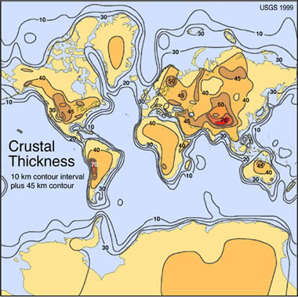
Crust (Continental & Oceanic)
Mohorovičić discontinuity
Lithosphere
Mohorovičić discontinuity
Mantle: Asthenosphere
Transition zone
Mantle: Mesosphere
Core: Outer Core
Core: Inner Core
Notes:
http://en.wikipedia.org/wiki/Mohorovi%C4%8Di%C4%87_discontinuity

Slide 14
Crust (Continental & Oceanic)
Mantle: Asthenosphere
Ductile, highly viscous & mechanically weak layer.
Temperature:
500 to 900 °C (932 to 1,652 °F)
Density: 3.4 – 4.4 g/cc
Composition: Peridotite, Dunite & Eclogite
Lithosphere
Mohorovičić discontinuity
Mantle: Asthenosphere
Transition zone
Mantle: Mesosphere
Core: Outer Core
Core: Inner Core
Notes:
http://en.wikipedia.org/wiki/Asthenosphere
http://pubs.usgs.gov/gip/interior/

Slide 15
Crust (Continental & Oceanic)
Mantle: Transition Zone
Minerals become unstable due to
> T & P & new ones form
These changes in mineralogy may influence mantle convection
Minerals contain a lot of water in their structure – more than all of the oceans combined!
Lithosphere
Mohorovičić discontinuity
Mantle: Asthenosphere
Transition zone
Mantle: Mesosphere
Core: Outer Core
Core: Inner Core
Notes:
http://en.wikipedia.org/wiki/Mantle_%28geology%29
http://pubs.usgs.gov/gip/interior/

Slide 16
Crust (Continental & Oceanic)
Mantle: Mesosphere
Rigid, solid layer.
Temperature:
+4,000 °C (7,230 °F)
Density: 4.4 – 5.6 g/cc
Composition: Uncertain, but likely similar to the asthenosphere and is relatively seismically homogeneous
Lithosphere
Mohorovičić discontinuity
Mantle: Asthenosphere
Transition zone
Mantle: Mesosphere
Core: Outer Core
Core: Inner Core
Notes:
http://en.wikipedia.org/wiki/Mantle_%28geology%29
http://pubs.usgs.gov/gip/interior/

Slide 17

Crust (Continental & Oceanic)
Core: Outer Core
Temperature:
4,300 K (4,030 °C; 7,280 °F) to
6,000 K (5,730 °C; 10,340 °F)
Density: 9.9 – 12.2 g/cc
Composition: Liquid Iron & Nickel
Lithosphere
Mohorovičić discontinuity
Mantle: Asthenosphere
Transition zone
Mantle: Mesosphere
P & S
P
Core: Outer Core
EQ!
P
Core: Inner Core
P
Notes:
http://en.wikipedia.org/wiki/Outer_core
http://pubs.usgs.gov/gip/interior/

Slide 18
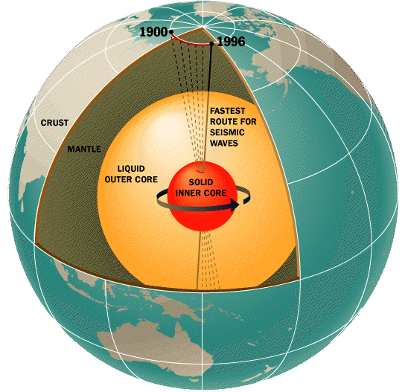
Crust (Continental & Oceanic)
Core: Inner Core
Temperature:
+5,700 K (5,430 °C; 9,800 °F)
Density: 12.8 – 13.1 g/cc
Composition: Solid (?) Iron & Nickel
Responsible for Earth’s magnetic field
Lithosphere
Mohorovičić discontinuity
Mantle: Asthenosphere
Transition zone
Mantle: Mesosphere
Core: Outer Core
Core: Inner Core
Notes:
http://en.wikipedia.org/wiki/Inner_core
http://pubs.usgs.gov/gip/interior/

Slide 19
Crust (Continental & Oceanic)
Core:
Magnetic Reversals
Computer models:
reversal likely when magnetic field lines don’t match up
Mathematical models:
suggest the opposite
Other factors:
Rapid changes in the churning of the liquid of the outer core can weaken the Earth’s magnetic field.
Lithosphere
Mohorovičić discontinuity
Mantle: Asthenosphere
Transition zone
Mantle: Mesosphere
Core: Outer Core
Core: Inner Core
Notes:
http://en.wikipedia.org/wiki/Inner_core
http://pubs.usgs.gov/gip/interior/

Slide 20
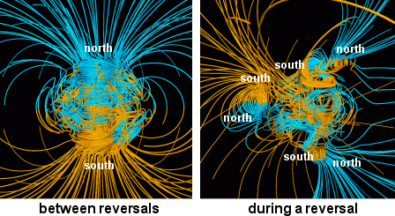
Crust (Continental & Oceanic)
Core:
Reversal rate varies wildly
Last 10 – 20 million years = average rate of 5 times/million years
Cretaceous Normal Synchron (84 – 125 million years ago) = only flipped once or twice
Flips take thousands of years to complete
Last flip? 780,000 years ago
Lithosphere
Mohorovičić discontinuity
Mantle: Asthenosphere
Transition zone
Mantle: Mesosphere
Core: Outer Core
Core: Inner Core
Notes:
http://en.wikipedia.org/wiki/Inner_core
http://pubs.usgs.gov/gip/interior/

Slide 21
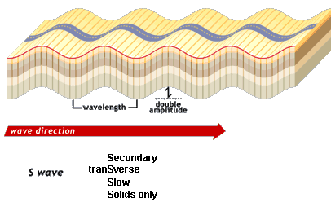
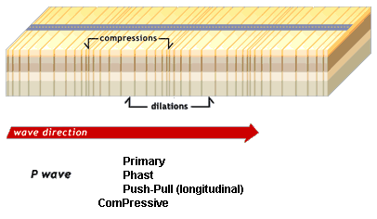
How Do We Know What’s Down There?
P waves
S waves
Primary or Push-Pull waves
Fastest of all waves
Liquids and solids
Secondary or Shear waves
Second fastest of all waves
Solids only
Source: 1

Slide 22
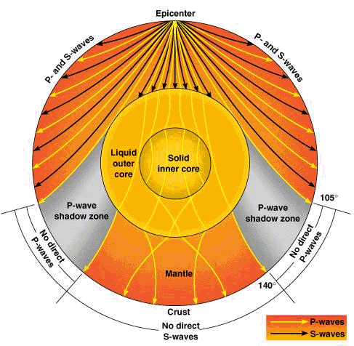
Source: 1

Slide 23
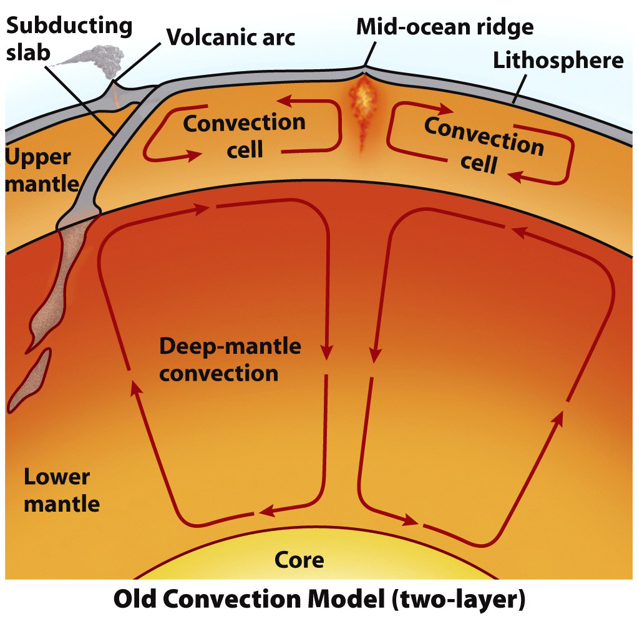
How do the plates move?
Old: Plates are dragged atop a convecting mantle.

Slide 24
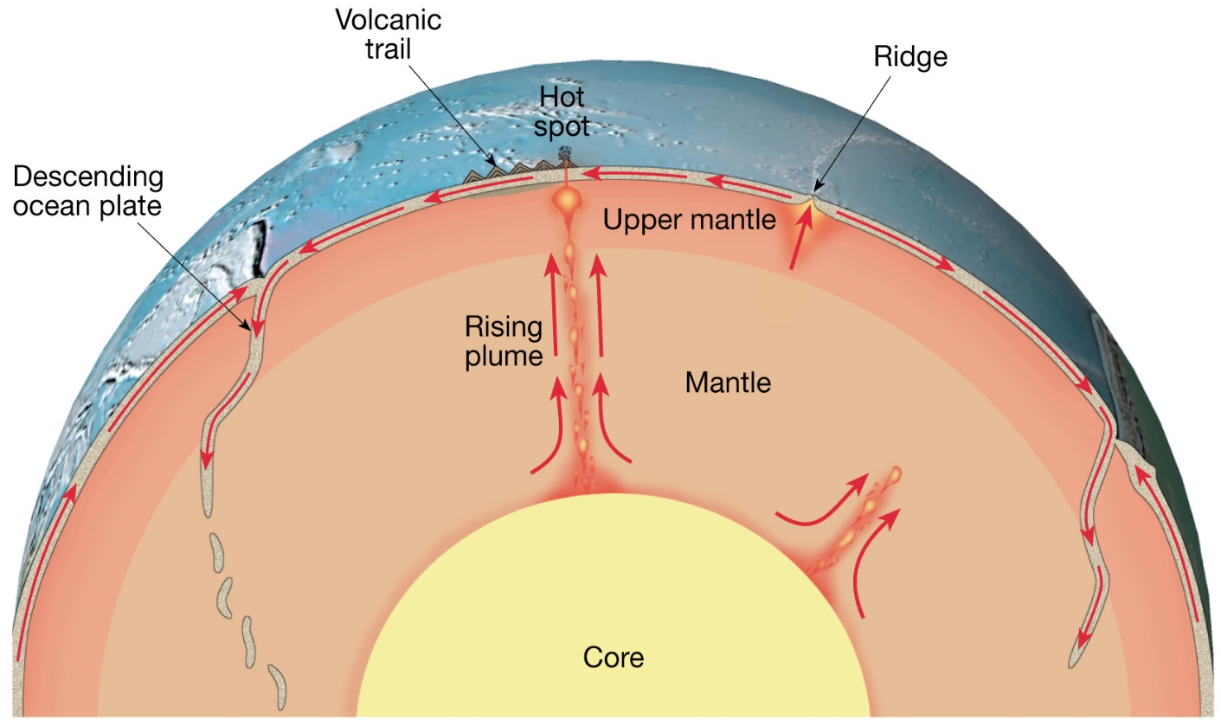
How do the plates move?
New: 2 other forces drive plate motions.
  Ridge-push – Elevated MOR pushes adjacent lithosphere.
  Slab-pull – Gravity pulls a subducting plate downward.
  Convection in the asthenosphere adds or subtracts.

Slide 25
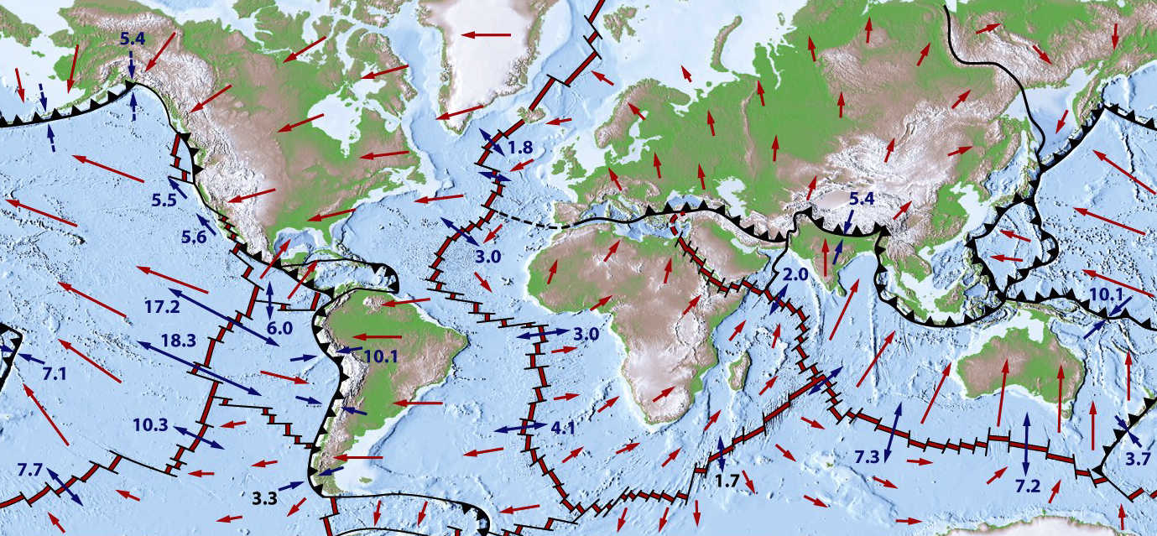
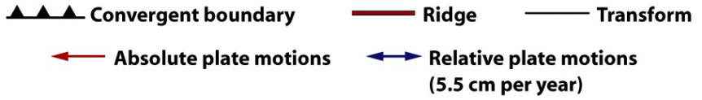

Slide 26
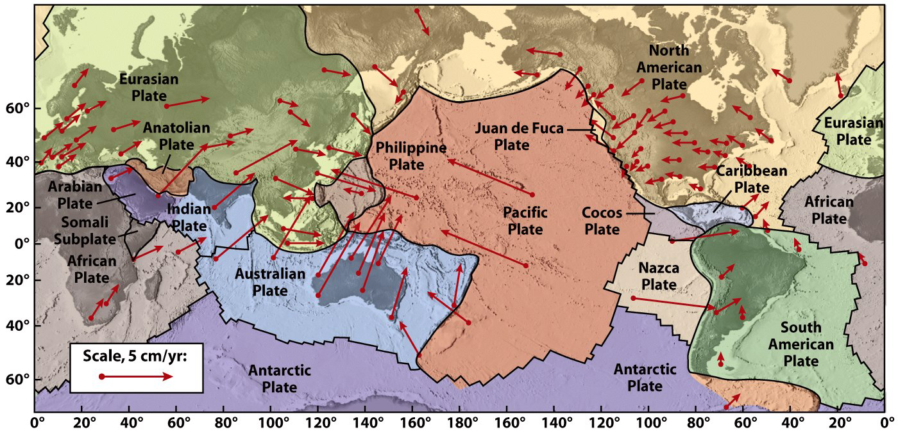

Slide 27
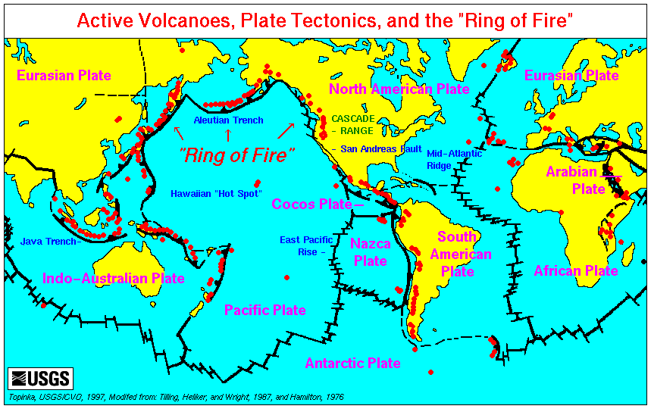
Plate boundaries
  All major interactions among individual plates occur along their boundaries
Source: 1

Slide 28
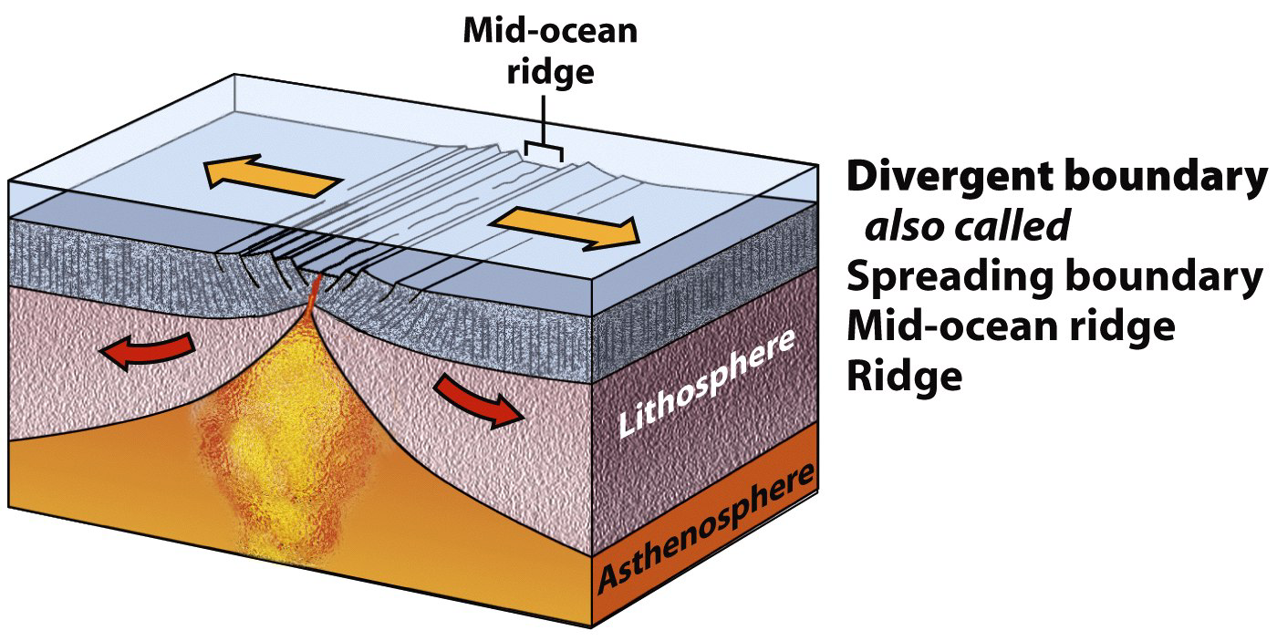
Plate Boundaries: 3 Types

Slide 29
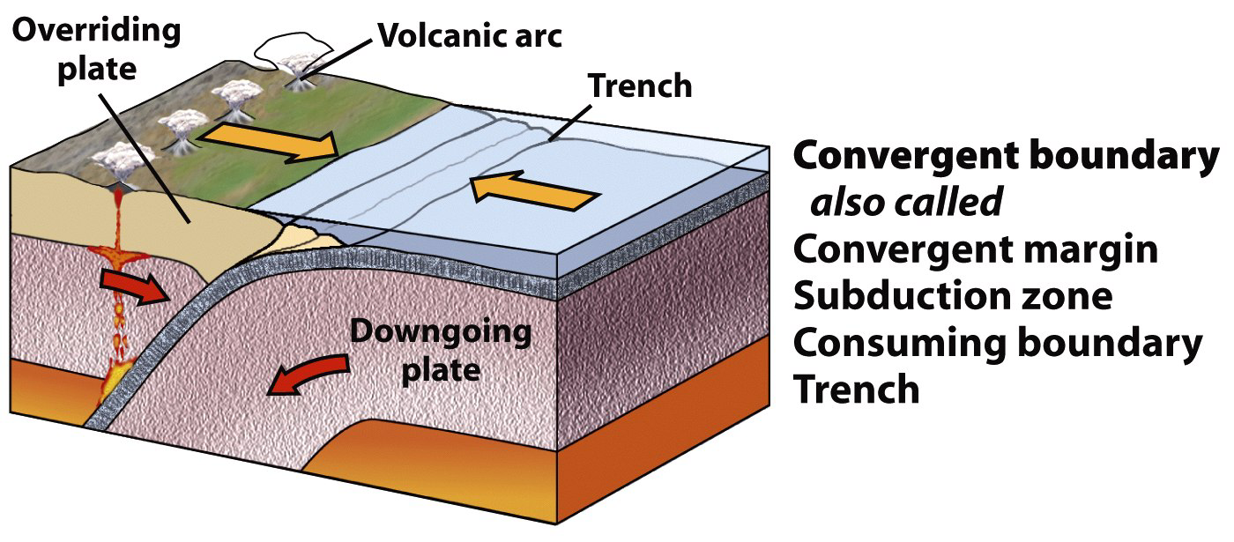
Plate Boundaries: 3 Types

Slide 30
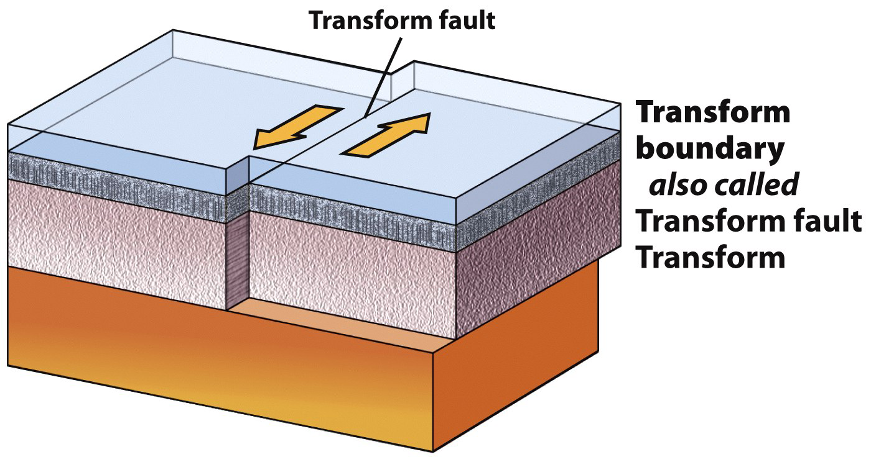
Plate Boundaries: 3 Types

Slide 31
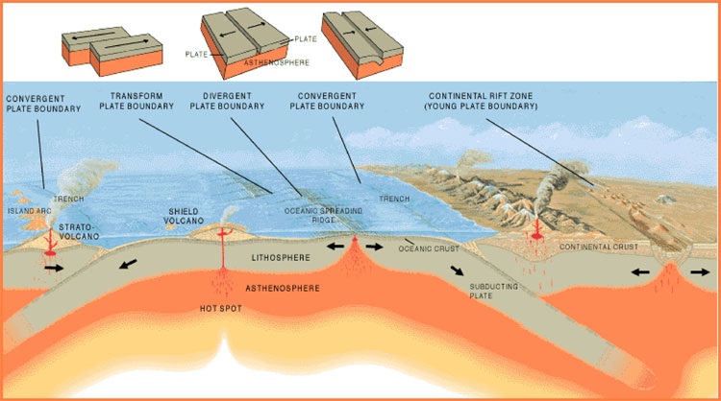
Plate boundaries change over geologic time.
Oceanic plates.
Continental plates.
  Created at MOR spreading centers.
  Destroyed at subduction zones.
  Torn apart at rifts.
  Joined during collision.
Source: 1

Slide 32
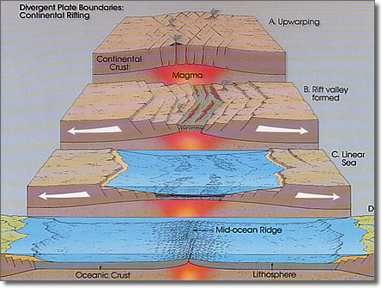
Continental Rifting
  Lithosphere stretches & thins.
  Brittle upper crust faults.
  Ductile lower crust flows.
  Asthenosphere melts.
  Melts erupt, leading to…
  Sea-floor spreading.

Slide 33
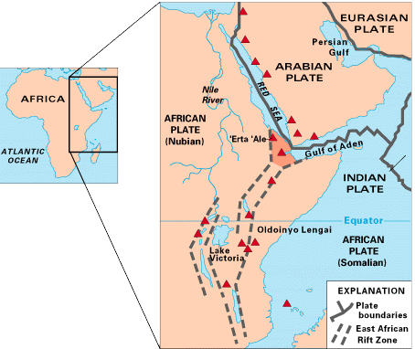
Continental Rifting
Example: East Africa.
  The Arabian plate is
  rifting from the African
  plate.
Source: 1

Slide 34
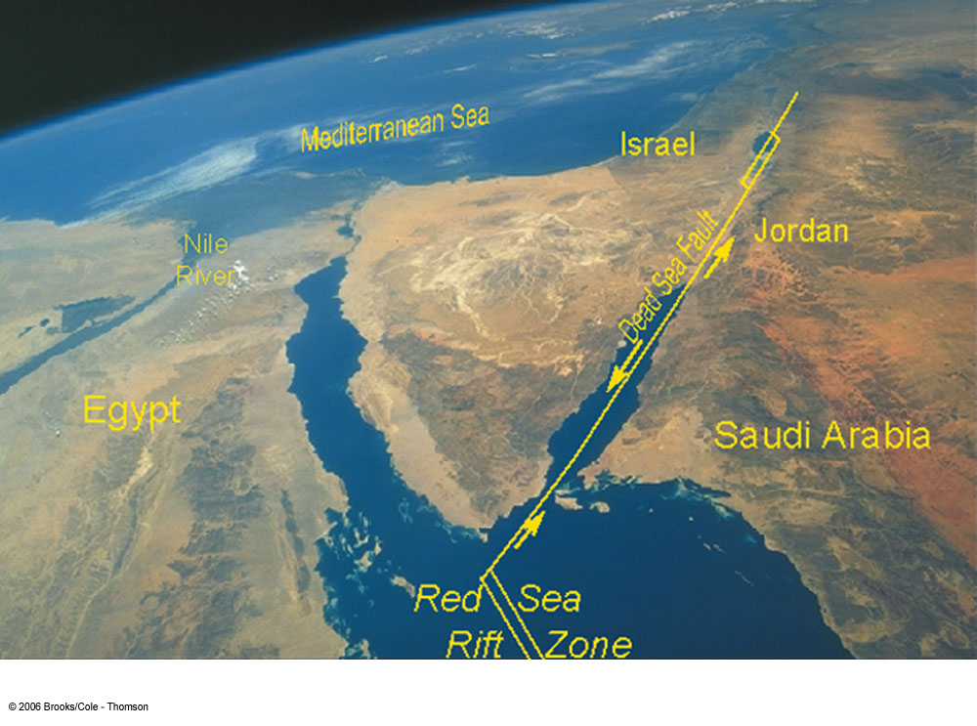

Slide 35
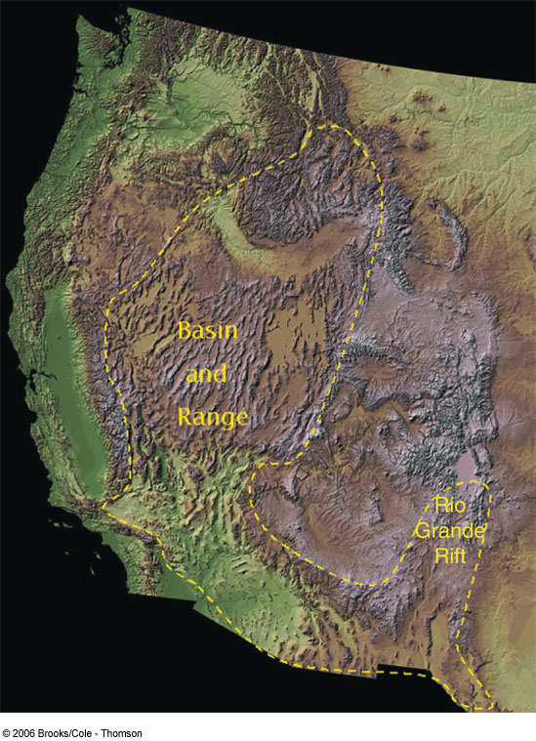
Continental Rifting
Basin and Range
  Region is slowly pulling apart
  No active spreading center

Slide 36
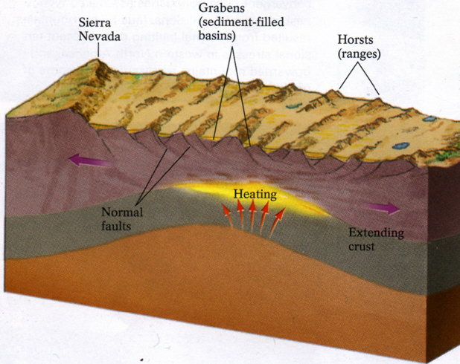
Continental Rifting
Source: 1

Slide 37
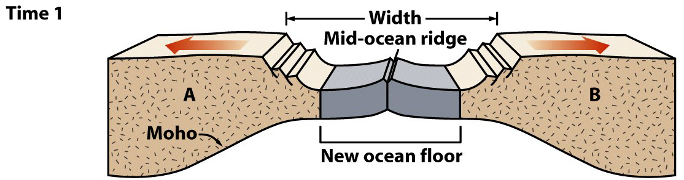
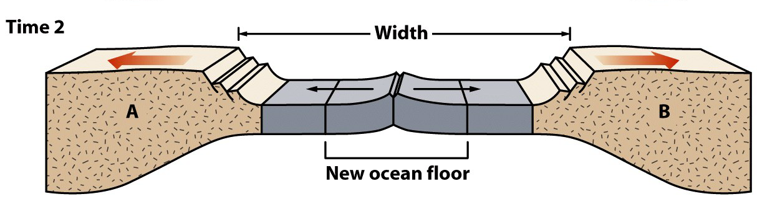
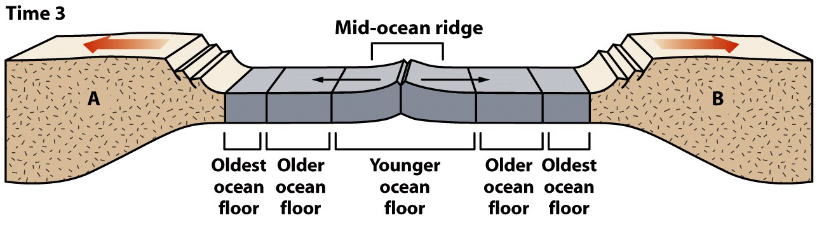
Sea-floor spreading progression

Slide 38
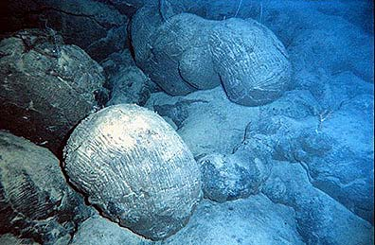
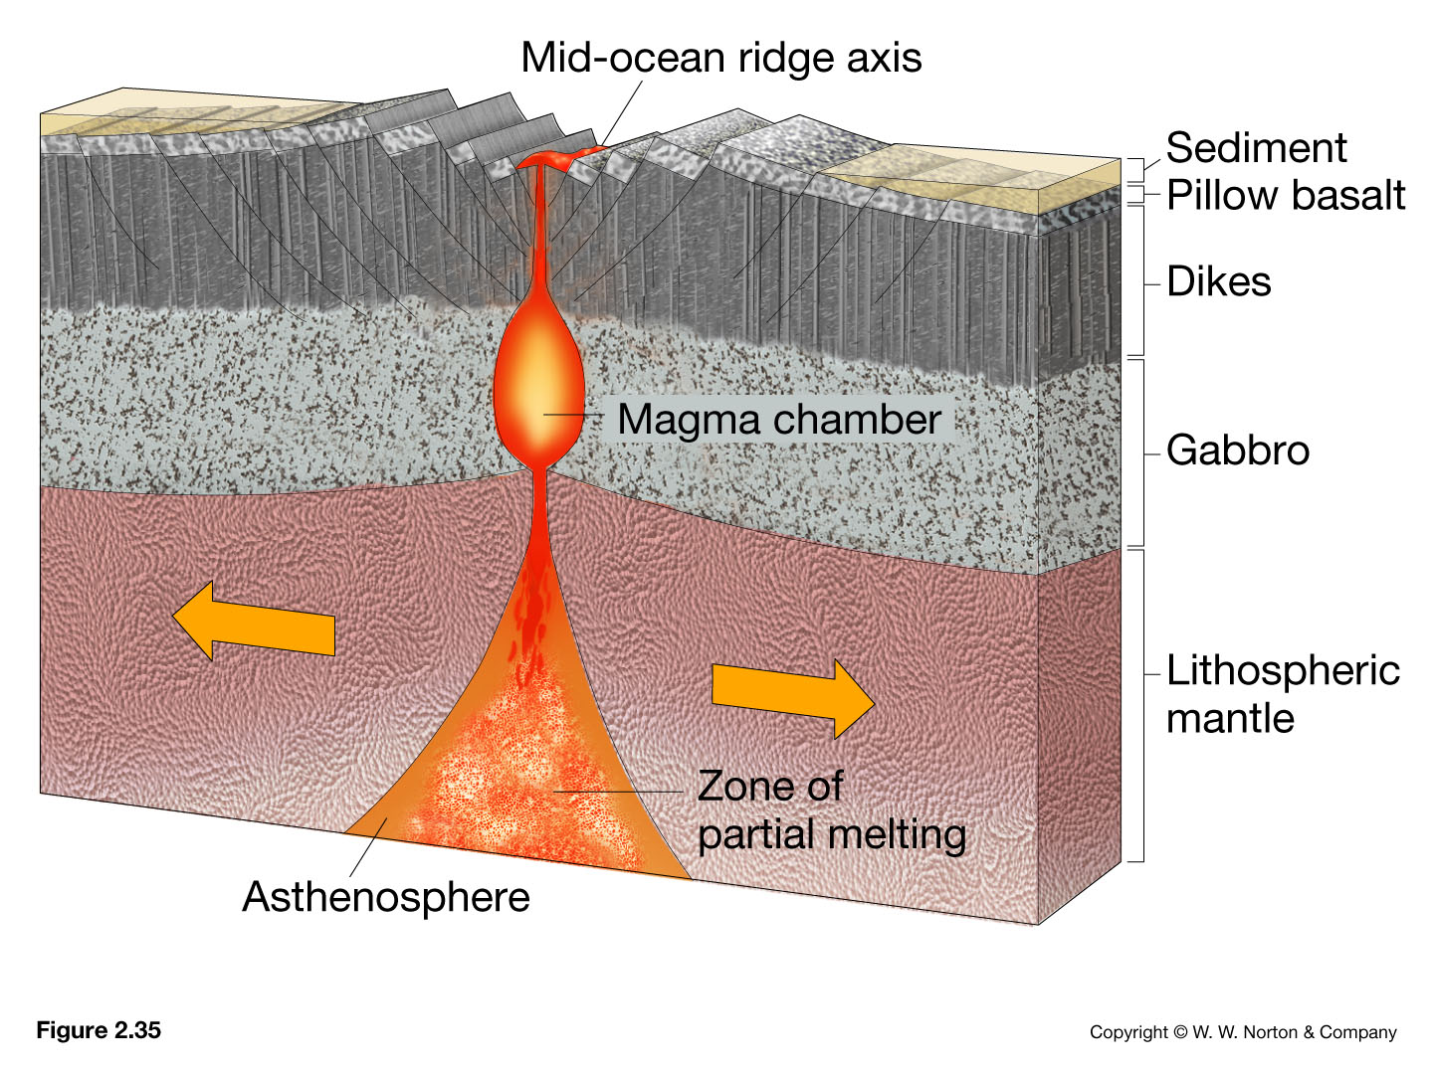
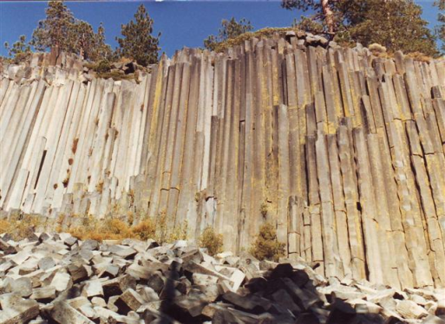
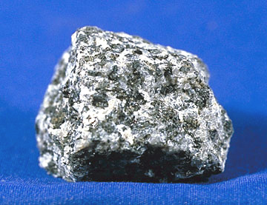
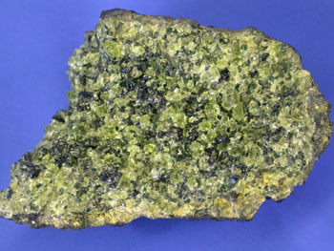
Extrusive igneous rocks
Intrusive igneous rocks
Notes:
Pillow basalts on the south Pacific seafloor -- Courtesy of NOAA. http://www.geology.sdsu.edu/how_volcanoes_work/
www.nationalparklover.com/devils_postpile.htm
www.mii.oeg
http://www.pitt.edu/~cejones/GeoImages/2IgneousRocks/IgneousTextures/1CoarseGrained.html

Slide 39
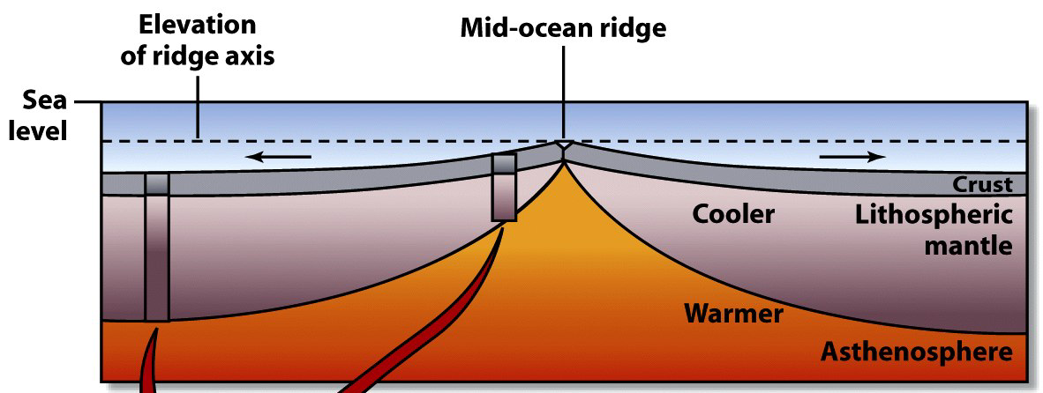
Why Is There A Ridge?
Ridge axis is hot
  Hot is less dense, so rides higher
Crust gets older and colder as it spreads away from axis
  Colder = more dense, sinks lower

Slide 40
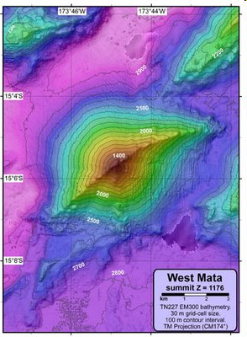
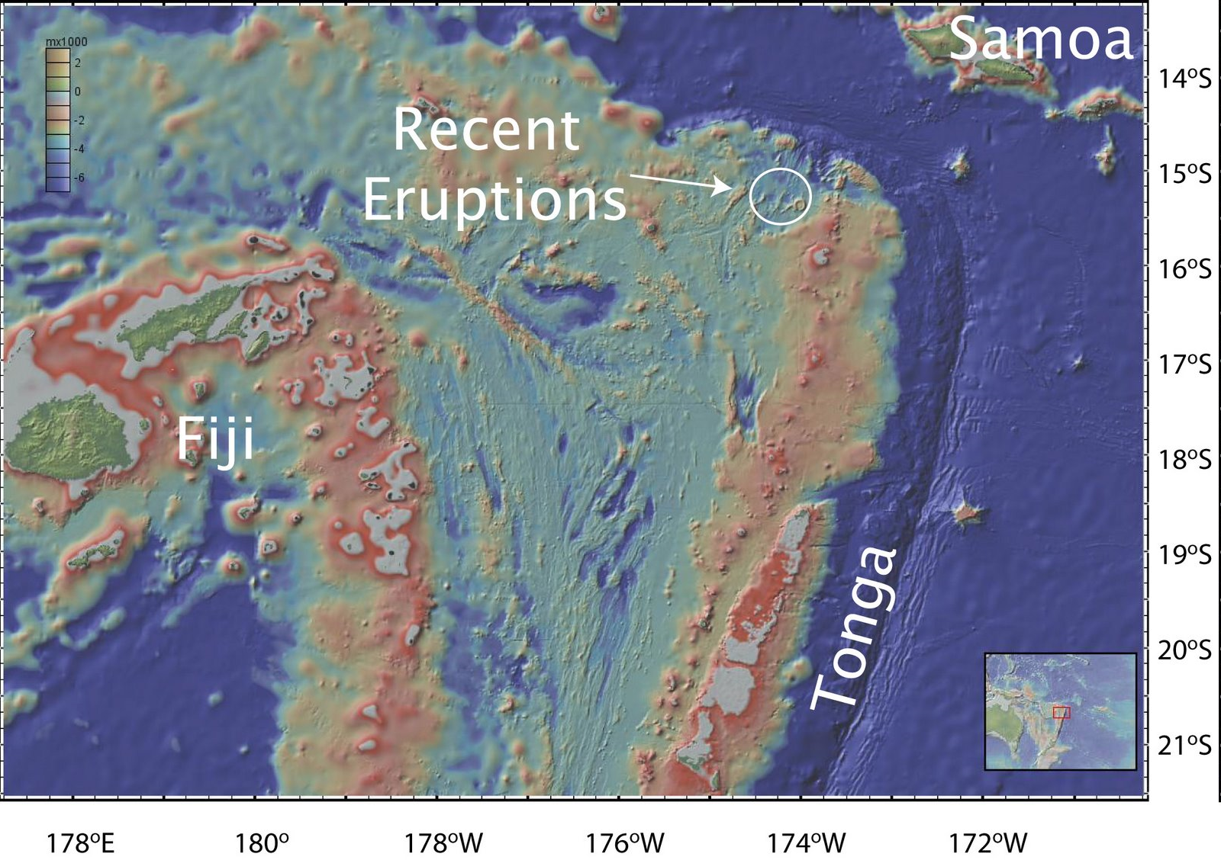
Neovolcanic activity in the NE Lau Basin
source

Slide 41
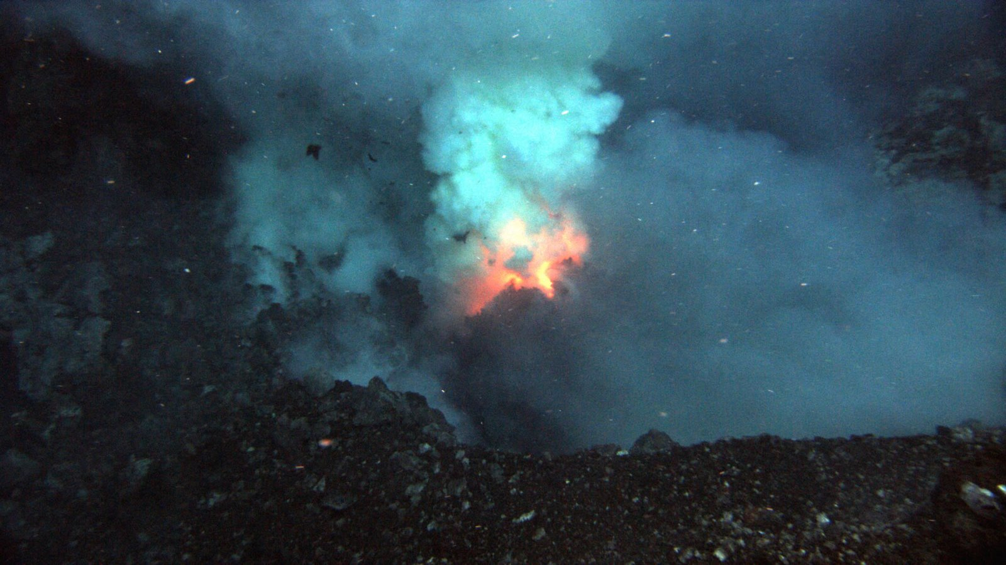
Neovolcanic activity in the NE Lau Basin
source
Prometheus eruptive vent at the summit of West Mata (1208 meters)

Slide 42
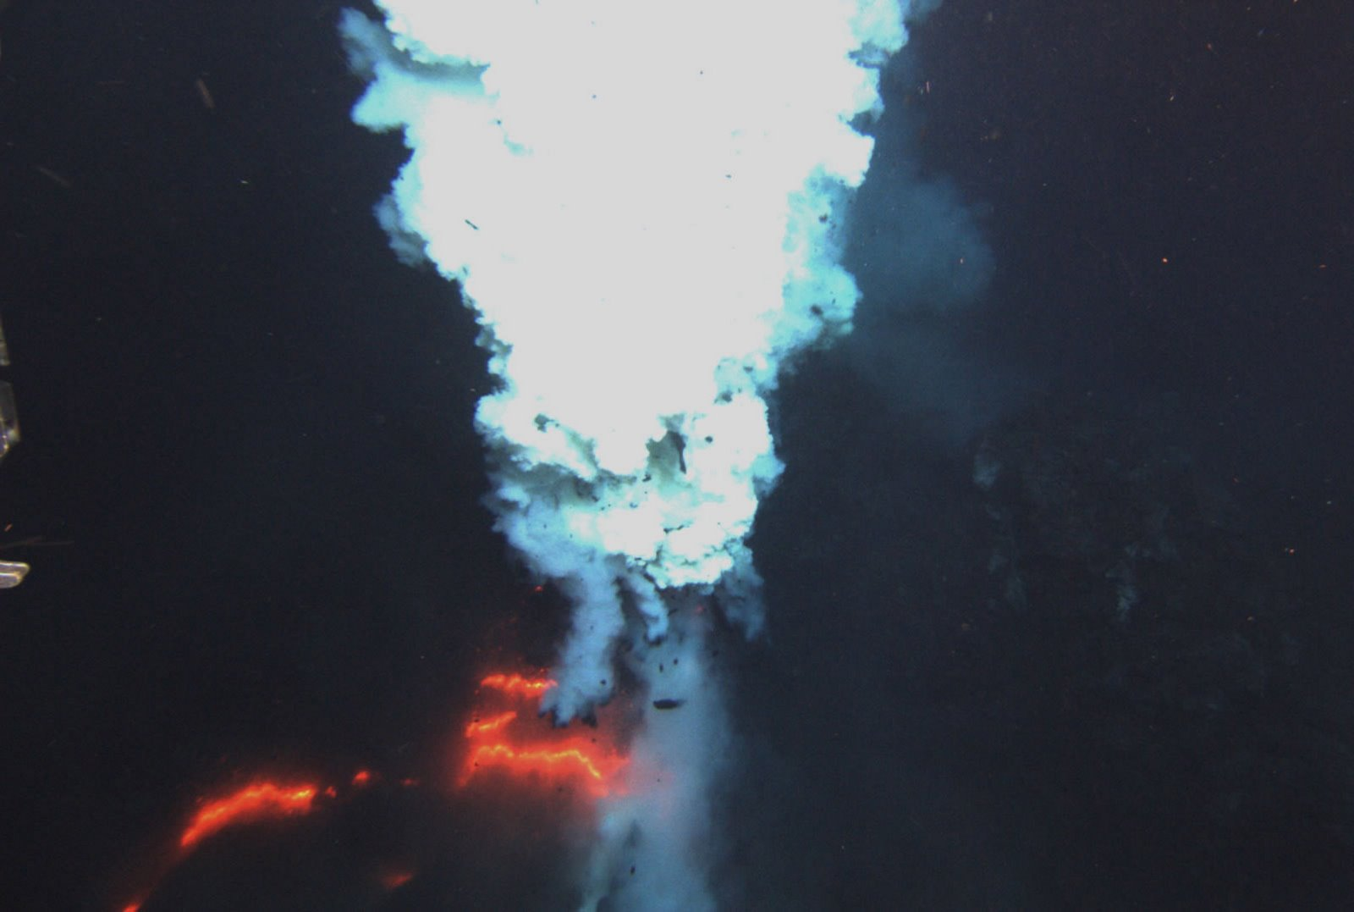
Neovolcanic activity in the NE Lau Basin
source
Hades eruptive vent at the summit of West Mata (1174 meters)

Slide 43
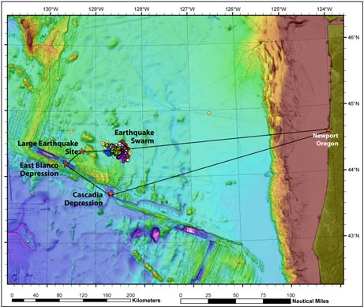
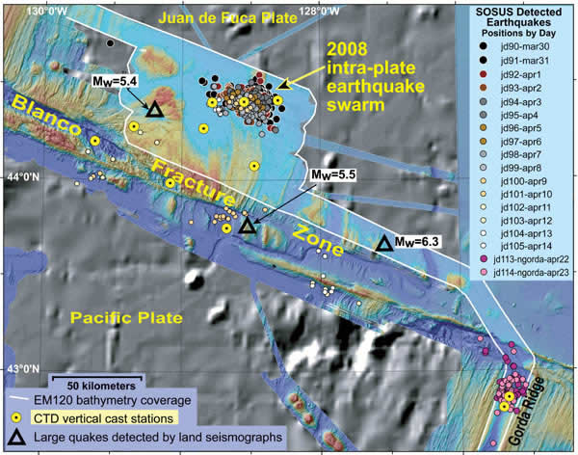
Mysterious "Swarm" of Quakes Strikes Oregon Waters
Colored dots show the earthquake "swarm" that struck waters off the shore of Oregon beginning in March 2008. Scientists are now planning a marine expedition (black line) to help unravel what is causing the mysterious temblors, which were detected by a Cold-War-era system of underwater microphones originally designed to track Russian submarines.
Image courtesy of NOAA Vents Program / Oregon State University CIMRS Program (source)
Updated Earthquake Map (10/27/09): An overall location map of the NE Pacific ocean and tectonic plates.
Quicktime movie: http://www.pmel.noaa.gov/acoustics/images/apr08_webmovie.mov
Image: http://www.pmel.noaa.gov/acoustics/images/or09eqs-swarm-map.html
Notes:
museum

Slide 44
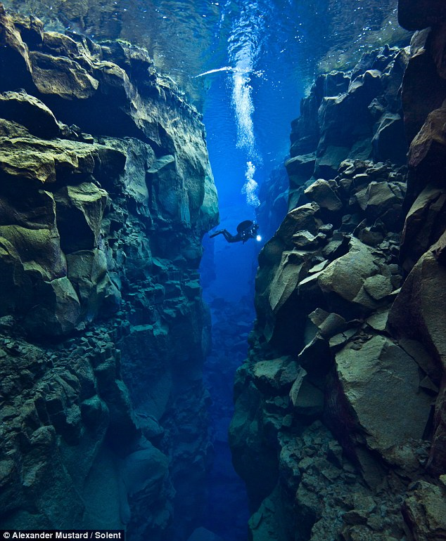
Spreading Apart:
Alex Mustard, dived 80ft into the crevice between the North American and Eurasian plates near Iceland to capture these spectacular photos
source

Slide 45
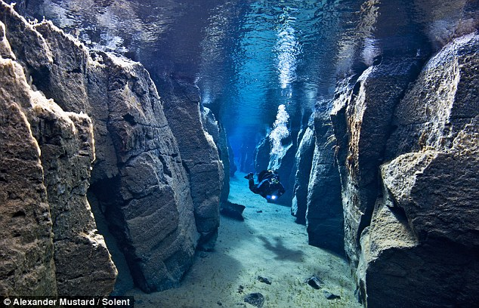
Spreading Apart:

Slide 46
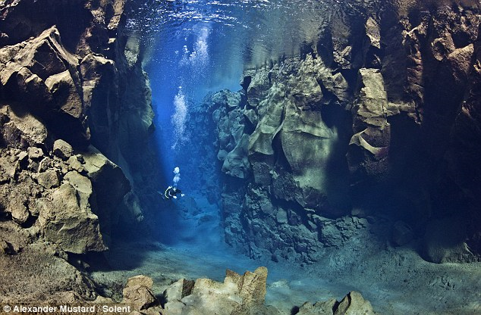
source

Slide 47
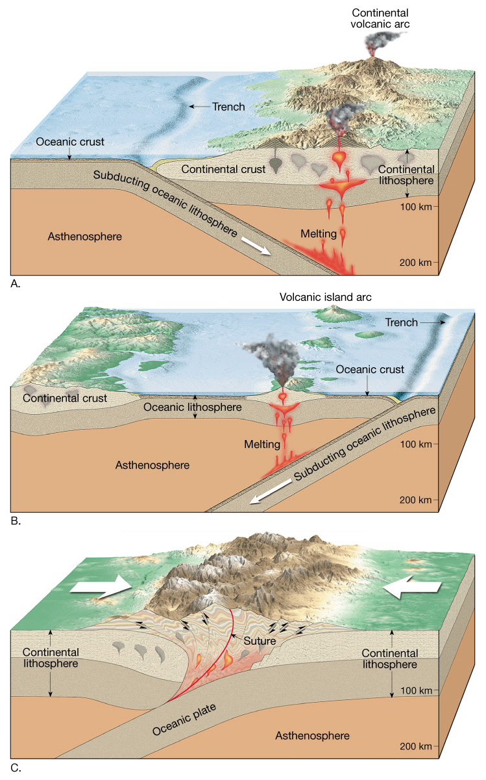
Convergent plate boundaries
Where two plates collide
Types
  Oceanic-continental convergence
  Oceanic-oceanic convergence
  Continental-continental convergence

Slide 48
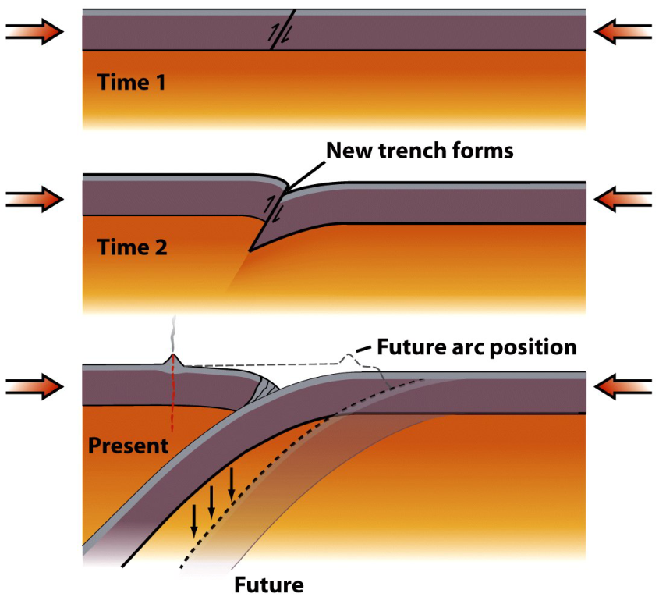
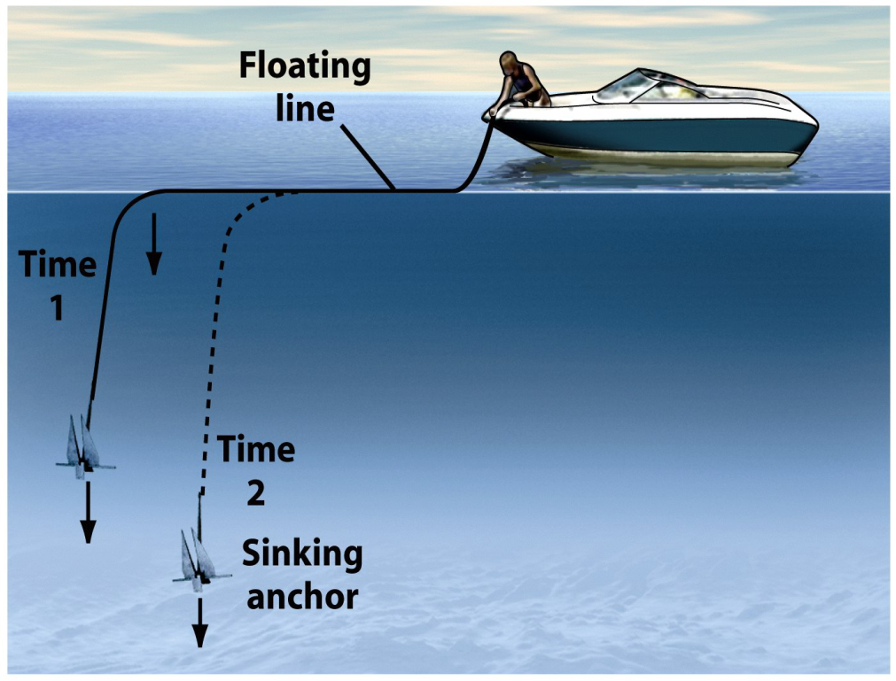
Subduction
Old oceanic lithosphere is more dense than mantle.
A flat-lying oceanic plate won’t subduct.

Slide 49

Subduction
The subducting plate descends at an average of 45°.
Plate descent is revealed by Wadati-Benioff Zone.
Quakes cease below 660 km.

Slide 50

Fate of Subducted Plates?
Plate descent continues past the earthquake limit.
The lower mantle may be a “plate graveyard.”

Slide 51
Subduction
Subduction Zones Produce Volcanic Arcs.
  A curved Earth dictates that volcanic belts are curved.
  Arc type depends on overriding plate.

Slide 52


Subduction
Accretionary prisms – Deformed sediment wedges.
  Sediments scraped off subducting plates are smeared and welded onto the overriding plates.

Slide 53

Ocean-Continent Convergence

Slide 54


Cascade Mountains, Pacific NW

Slide 55

Ocean-Ocean Convergence
Notes:
This figure shows oceanic-oceanic convergence. Reprinted by permission from Tarbuck, E. J., and Lutgens, F. K., Earth Science, 5th Ed. (Fig. 6.11), Merrill Publishing Company, 19133.

Slide 56


Plate Collision
Subduction consumes ocean basins.
Ocean closure ends in continental collision.

Slide 57

Continent Collision: India and Asia

Slide 58

Composite satellite image of the Himalayan range. The top of the picture is directed towards the north northwest. The Tibetan Plateau is near the centre and the Taklamakan plain is visible as the lighter area near the top.
Source: 1

Slide 59

Transform fault boundaries
Plates slide past one another
No new lithosphere is created or destroyed
Most join two segments of a mid-ocean ridge as parts of prominent linear breaks in the oceanic crust known as fracture zones

Slide 60

Transform fault boundaries
Types of transform faults
  Oceanic
  Continental

Slide 61
Oceanic Transforms
The MOR axis is offset by transform faults.
  Offset of linear MOR is geometric necessity on a sphere.
  Transforms bear strong evidence of sea-floor spreading.

Slide 62

Oceanic Transforms
  Older interpretation – Faulting occurs after MOR forms.
  Modern interpretation – Faulting occurs with the MOR.

Slide 63


Transform Boundaries
Continental transforms – Chop continental crust

Slide 64

This bathymetric map of the seafloor shows the Siqueiros transform fault in the eastern Pacific Ocean, illustrating the fragmented structure of the fault line. (Jian Lin, Jack Cook, and Patricia Gregg, Woods Hole Oceanographic Institution)
Source - Visualization of Siqueiros fault

Slide 65

Triple Junctions
Places where 3 plate boundaries coincide.
Multiple boundary combinations occur.
Triple junctions migrate and change across time.
Source: 1

Slide 66
Plate Tectonics
Hot spots
  Caused by rising plumes of mantle material
  Volcanoes can form over them (Hawaiian Island chain)
  Most mantle plumes are long-lived structures and at least some originate at great depth, perhaps at the mantle-core boundary

Slide 67


Slide 68

Volcanism on a tectonic plate moving over a hot spot

Slide 69

The Hawaiian Islands have formed over a stationary hot spot

Slide 70

The Hawaiian Islands have formed over a stationary hot spot
Source: 1

Slide 71
Applications of plate tectonics model to intraplate features
Seamounts and tablemounts
  Subsidence of flanks of mid-ocean ridge
  Wave erosion may flatten seamount

Slide 72


Slide 73


Slide 74
Applications of plate tectonics model to intraplate features
Coral reefs associated with subsiding seafloor
Fringing
Barrier
Atoll

Slide 75

Coral reef development

Slide 76

Coral Reef of South Moloka‘i, Hawai‘i
Aerial photograph of the reef flat off Kamalo, Moloka‘i, showing numerous channels and blue holes (roughly circular, steep-walled depressions) in the reef flat. source

Slide 77


Great Blue Hole, Belize Barrier Reef Reserve System
The Great Blue Hole is a large submarine sinkhole off the coast of Belize. It lies near the center of Lighthouse Reef, a small atoll 70 km from the mainland and Belize City. The hole is circular in shape, over 300 m across and 124 m deep. source

Slide 78


Atolls
Tuanake Atoll in French Polynesia
source
Atafu Atoll, Tokelau, Southern Pacific Ocean (April 6, 2009) source

Slide 79
~ End ~

