Slide 1
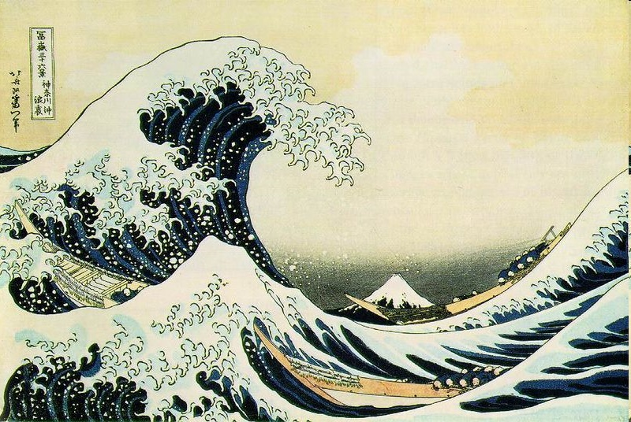
Tsunami!
Japanese painter Katsushita Hokusai painted the Tsunami wave off Kanagawa in 1829-1833

Slide 2
Assessing the risk:
How common is this disaster and where does this disaster normally occur?

Slide 3
What are Tsunami?
Are NOT “tidal waves” !
Caused major displacement of the ocean by:
Earthquakes, Volcanic Eruptions, Submarine landslides, & Impact events

Slide 4
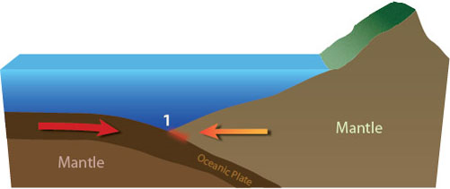
Generation of a Tsunami
Unlike normal ocean waves where their energy dissipates with increasing depths, a tsunami consists of a series of waves that move through the entire water column. Reverse faults are the primary cause of the largest tsunamis. Reverse faults are where two plates collide and one plate is lifted over the other plate. While these plates are generally in constant motion it is at the junction of their boundaries where the plates are locked together and the stress between them begins to build (1).
Sources: 1

Slide 5
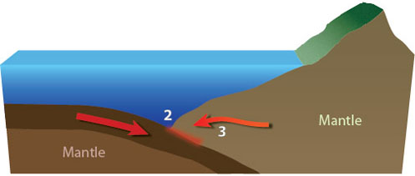
Generation of a Tsunami
As the two plates remain locked together stress continues to build at their intersection. As a result, the sea floor is pulled down (2) with a corresponding rise on the continental side of the fault (3).
Sources: 1

Slide 6
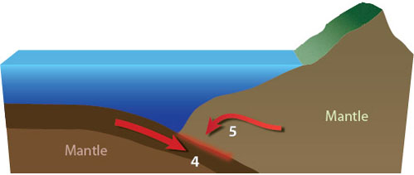
Generation of a Tsunami
Increasing stress between the two locked plates further deepens the sea floor (4) and enhances the bulge on the continental side of the fault (5).
Sources: 1

Slide 7
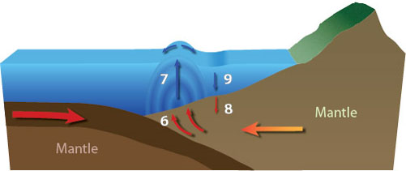
Generation of a Tsunami
At some point, the stress between the two plates becomes too much and the earth between the two plates move releasing the pressure (6). This is felt as an earthquake. As the earth moves it lifts the entire column of water above the fault (7). Conversely, the bulge on the continental side of the fault subsides (8) causing the entire column of water to sink as well (9).
Sources: 1

Slide 8
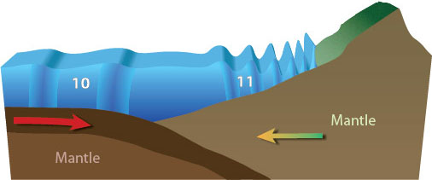
Generation of a Tsunami
As the water seeks to return to a common level waves of rising and lowering water heights through the entire water column (the tsunami) radiate out from source of the earthquake. The depth of water directly effects tsunami waves as they move faster and have much longer wave lengths and periods in deep water (10).
As the tsunami moves into more shallow water the speed of the tsunami diminishes and height of the waves grow (11). When a tsunami finally reaches shore, it may appear as a rapidly rising or falling tide, a series of breaking waves, or even a bore which a step-like wave with a steep breaking front.
Sources: 1

Slide 9
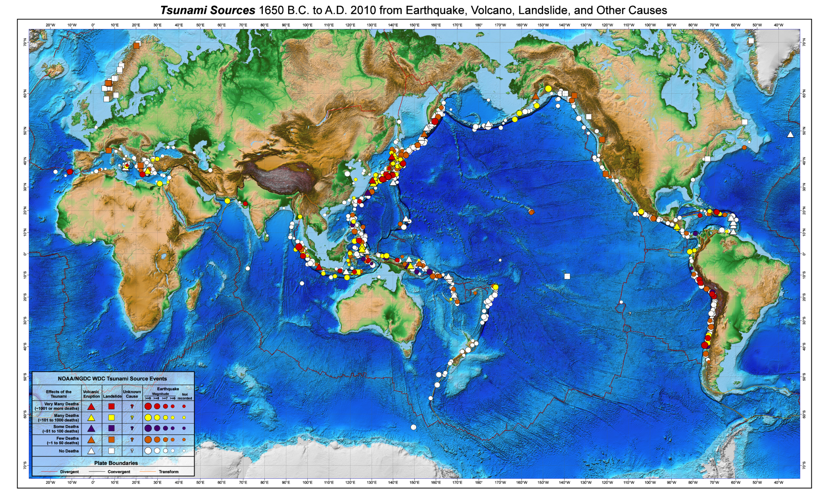
Notes:
http://www.srh.noaa.gov/srh/jetstream/tsunami/images/tsu_source_full.jpg

Slide 10
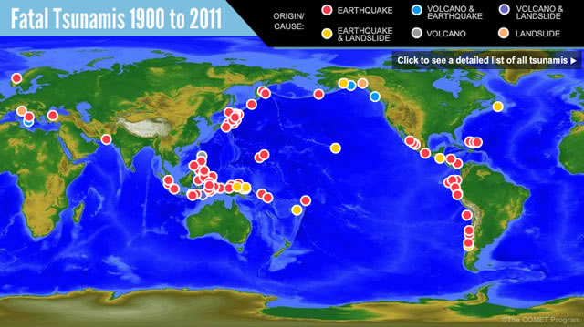
Notes:
http://www.meted.ucar.edu/tsunami/strike/media/graphics/comet_final_map.jpg

Slide 11
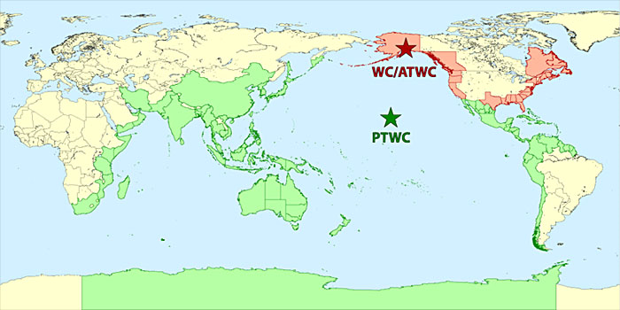
Tsunami Warning Centers
Sources: 1

Slide 12
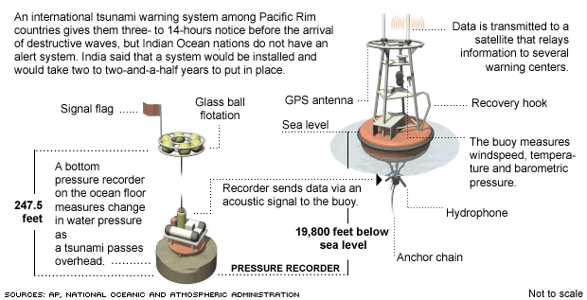
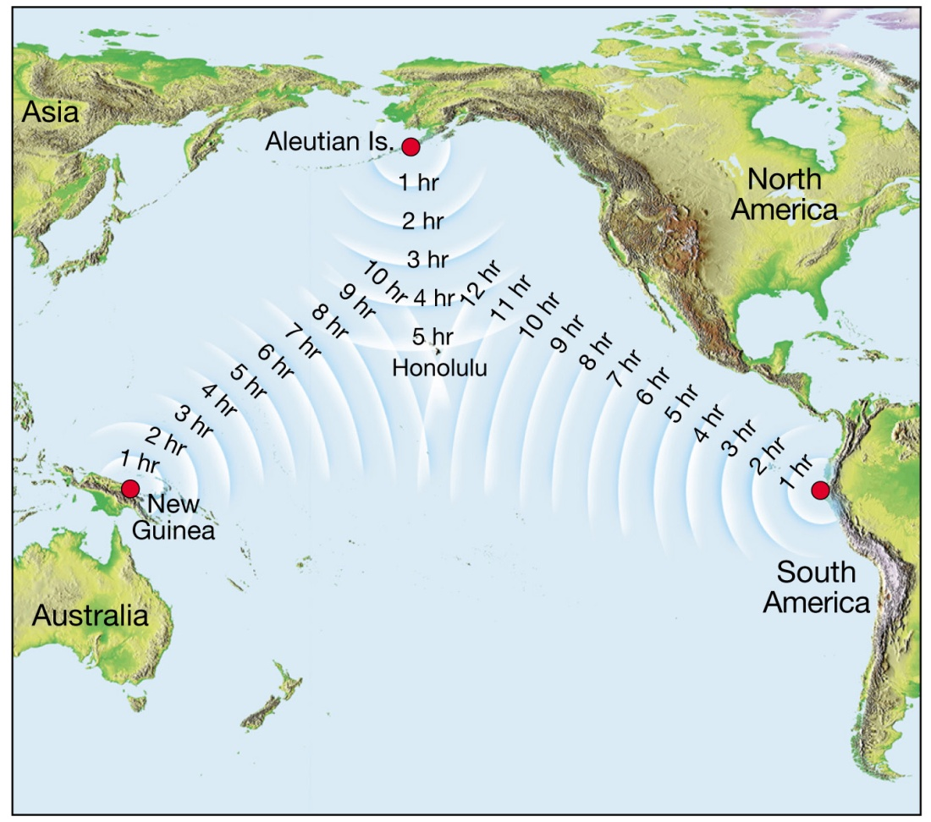
NOAA Pacific Tsunami Warning Center
Dart Mooring System

Slide 13
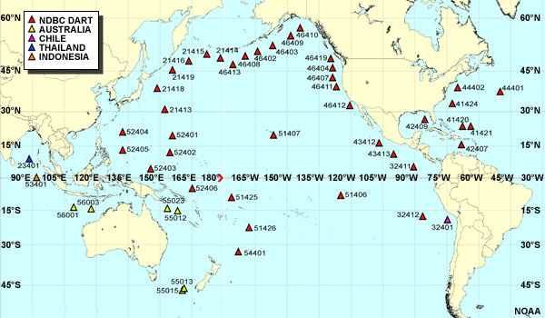
DART buoys
Sources: 1
Notes:
http://www.meted.ucar.edu/tsunami/strike/media/graphics/noaa_DARTlocationsLEGEND.jpg

Slide 14
Assessing the risk:
What are the major causes of damage, destruction, death associated with this disaster?

Slide 15
Assessing the risk: Earthquake generated tsunami
Near epicenter
Distal epicenter
A strong earthquake lasting 20 seconds or more near the coast.
First warning sign is the drawback of water
Less than 20 minutes before the tsunami waves arrive
Arrives as a series of waves
Rises to maximum height as they rush into shallow water
Floods flat coastal areas
Earthquake is too far away to be felt
Notification from tsunami warning center
First warning sign is the drawback of water
Travel 435 mph across the Pacific ocean basin
Arrives as a series of waves
Rises to maximum height as they rush into shallow water
Floods flat coastal areas

Slide 16
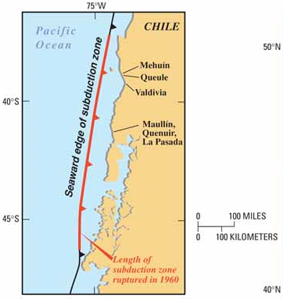
May 22, 1960 “Chilean tsunami”
Result of the largest earthquake ever recorded: 9.5 M
2000 deaths
$550 million in damages (1960 USD)
Sources: 1

Slide 17
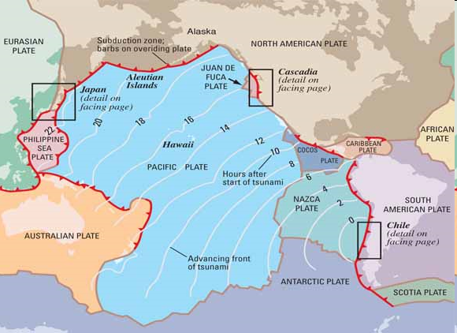
Sources: 1

Slide 18
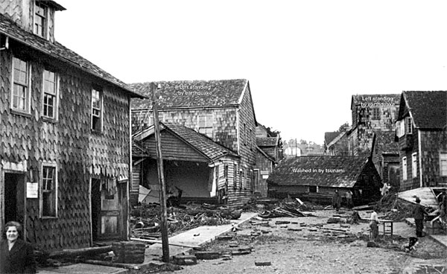
Maullín, Chile - 1960
Many houses in Maullín, Chile, withstood the magnitude 9.5 Chile earthquake of May 22, 1960. The tsunami generated by the quake caused most of the damage shown in this photo, taken between May 23 and June 3, 1960.
Sources: 1

Slide 19
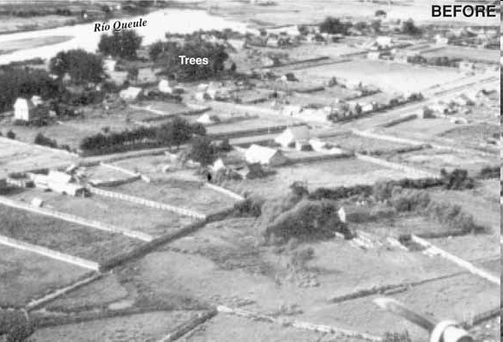
Though a mile from the sea, most of Queule, Chile, was overrun and washed away by the tsunami that followed the 1960 Chile earthquake. From the height of debris tangled in the branches of trees that remained standing after the 1960 tsunami, Wolfgang Weischet, then a geographer at the Universidad Austral de Chile in nearby Valdivia, estimated that water from the tsunami was as much as 13 feet deep in Queule.
Sources: 1

Slide 20
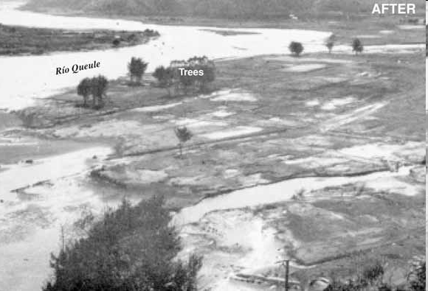
Though a mile from the sea, most of Queule, Chile, was overrun and washed away by the tsunami that followed the 1960 Chile earthquake. From the height of debris tangled in the branches of trees that remained standing after the 1960 tsunami, Wolfgang Weischet, then a geographer at the Universidad Austral de Chile in nearby Valdivia, estimated that water from the tsunami was as much as 13 feet deep in Queule.
Sources: 1

Slide 21
Hilo, Hawaii - 1960
Warning issued
Second wave unexpected
61 deaths
282 seriously injured
Sources: 1

Slide 22
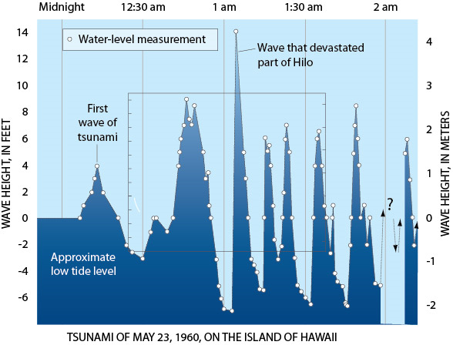
Hilo, Hawaii - 1960
Sources: 1

Slide 23
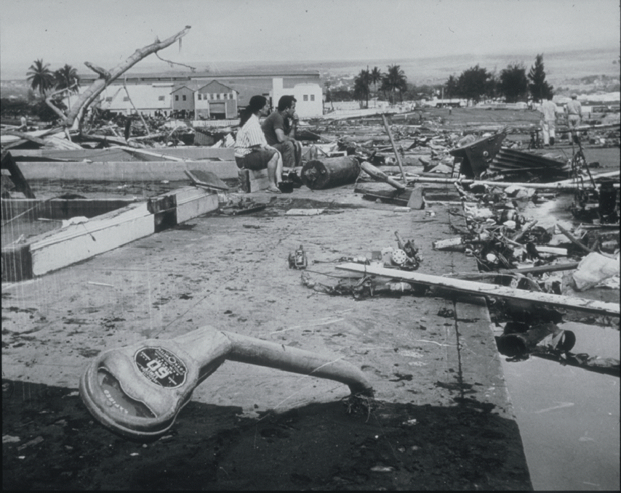
Hilo, Hawaii - 1960
Sources: 1

Slide 24
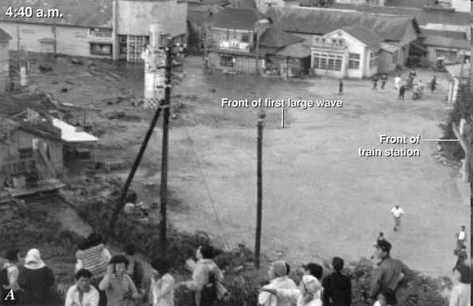
Onagawa, Japan - 1960
Some residents gathered on a hillside as the first large wave poured into town (photos A- C). Almost 3 hours later, crowds remained on this hillside as another wave arrived (D). Sources: 1

Slide 25
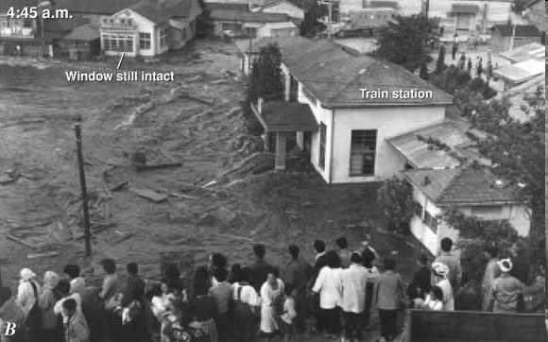
Onagawa, Japan - 1960
Some residents gathered on a hillside as the first large wave poured into town (photos A- C). Almost 3 hours later, crowds remained on this hillside as another wave arrived (D). Sources: 1

Slide 26
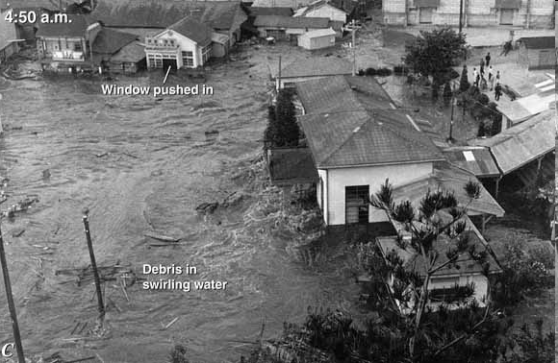
Onagawa, Japan - 1960
Some residents gathered on a hillside as the first large wave poured into town (photos A- C). Almost 3 hours later, crowds remained on this hillside as another wave arrived (D). Sources: 1

Slide 27
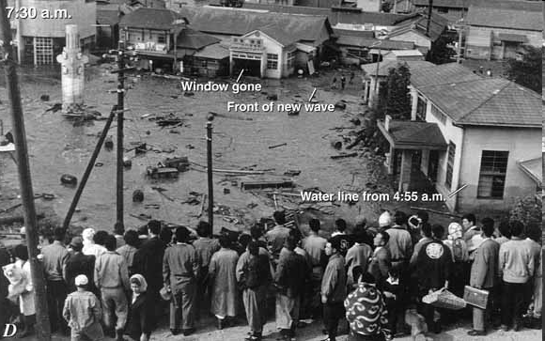
Onagawa, Japan - 1960
Some residents gathered on a hillside as the first large wave poured into town (photos A- C). Almost 3 hours later, crowds remained on this hillside as another wave arrived (D). Sources: 1

Slide 28
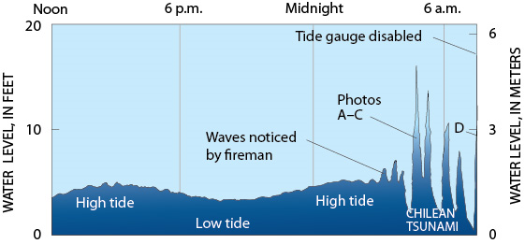
Onagawa, Japan - 1960
Sources: 1

Slide 29
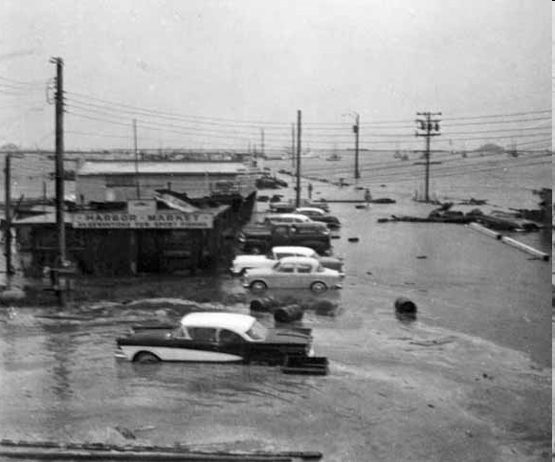
Crescent City, California - 1960
Waterfront area in Crescent City, California, flooded by the 1960 Chilean tsunami. Here, the tsunami caused more than $30,000 in damage, including the sinking of two boats. However, damage was much more severe 600 miles to the south in the Los Angeles area, where the tsunami killed one person and caused from $500,000 to $1,000,000 in damage, including the sinking of 30 boats. Sources: 1

Slide 30
Assessing the risk: Volcanic eruption generated tsunami
Near eruption
Distal eruption
Recovery from eruption (ashfall, pumice, etc.)
Arrives as a series of waves
Rises to maximum height as they rush into shallow water
Floods flat coastal areas
Flood flat coastal areas
First warning sign is the drawback of water
Arrives as a series of waves
Rises to maximum height as they rush into shallow water
Floods flat coastal areas

Slide 31
Assessing the risk: Volcanic eruption generated tsunami
Krakatau - August 26-27, 1883
Eruptions began in May 1883 & intensified on August 26th
August 27th eruptions:
5:30 A.M. – Perboewatan volcano (tsunami generated)
6:44 A.M. – Danan volcano (tsunami generated)
10:02 A.M – largest eruption was heard 3,110 km away in Perth, Western Australia, and the Indian Ocean island of Rodrigues near Mauritius, 4,800 km away. (tsunami generated)
10:41 A.M. – a landslide tore off half of Rakata volcano, causing the final explosion

Slide 32
Assessing the risk: Volcanic eruption generated tsunami
Krakatau - August 26-27, 1883
10:41 A.M. – a landslide tore off half of Rakata volcano, causing the final explosion
“The pressure wave generated by the colossal fourth and final explosion radiated out from Krakatoa at 1,086 km/h (675 mph).[5]:248 It was so powerful that it ruptured the eardrums of sailors 64 km away on ships in the Sunda Strait, and caused a spike of more than 2 1⁄2 inches of mercury 160 km away in pressure gauges attached to gasometers in the Batavia gasworks, sending them off the scale.”

Slide 33
Assessing the risk: Volcanic eruption generated tsunami
Krakatau - August 26-27, 1883
Effects
At least five tsunami were generated with each eruption
Pyroclastic flows, hot ashfall and pumice rained down over the region
Unusually large amount of sulfur dioxide (SO₂) gas were erupted, causing
1884 – the “year without a summer”
Weather patterns continued to be chaotic until 1888
Ash and gases in the atmosphere caused
Darker skies
Red sunsets
Most of the island was blow apart during the final eruption

Slide 34
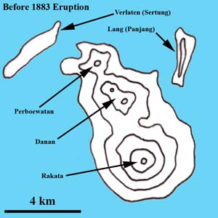
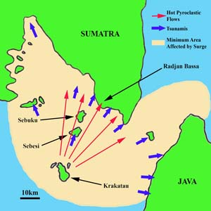
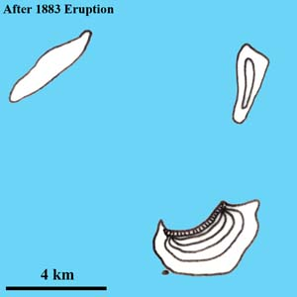
Assessing the risk: Volcanic eruption generated tsunami
Krakatau - August 27, 1883
Notes:
http://www.photovolcanica.com/VolcanoInfo/Krakatau/Krakatau.html

Slide 35
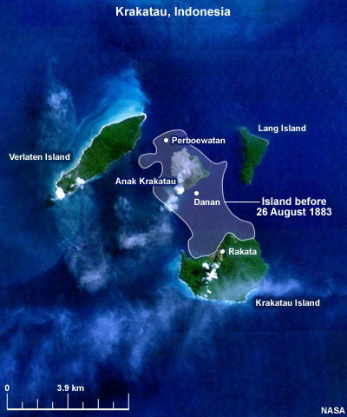
Assessing the risk: Volcanic eruption generated tsunami
Krakatau - August 27, 1883
Notes:
http://www.meted.ucar.edu/tsunami/strike/print_sources.htm#page_5.0.0

Slide 36
Assessing the risk: Submarine landslide generated tsunami
Tsunami generated by landslides are typically local events
The size of the wave is dependent upon how large the landslide is
The largest tsunami recorded is the Lituya Bay, Alaska tsunami

Slide 37
Assessing the risk: Submarine landslide generated tsunami
Strait of Messina, Italy 1908
Cause: earthquake generated a massive underwater landslide
220 lives lost
Over $25,000,000 in damages
Italy:
Eight minutes after the quake a 3 m high wave struck the coast.
“…the strongest waves moved an iron bridge over 98 feet (30 meters) and completely destroyed Reggio Calabria” source
Sicily:
The waves struck without warning
Boats were moved inland and the Port of Messina was destroyed
Notes:
http://www.meted.ucar.edu/tsunami/strike/print_history.htm

Slide 38
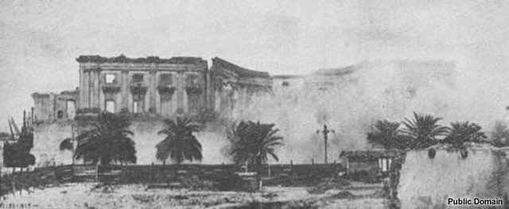
Assessing the risk: Submarine landslide generated tsunami
Italy 1908

Slide 39
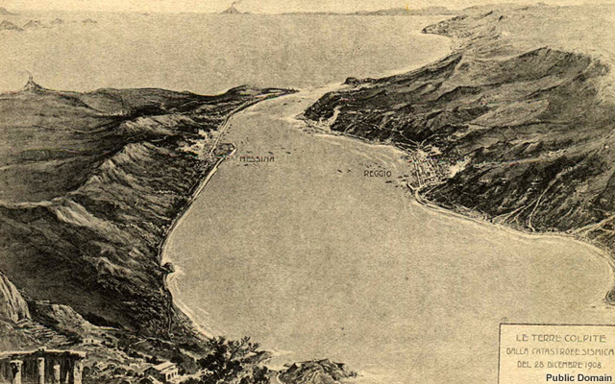
Assessing the risk: Submarine landslide generated tsunami
Messina
Reggio Calabria
Italy 1908

Slide 40
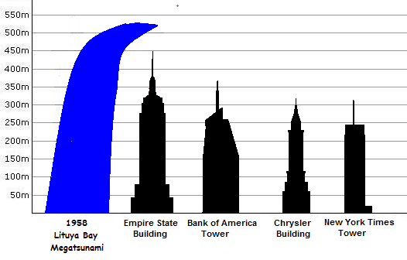
Assessing the risk: Submarine landslide generated tsunami
Lituya Bay megatsunami (07/09/58)
Cause: A 7.8 Mw earthquake on the Fairweather Fault triggered a landslide that caused 30 million cubic meters of rock and ice to fall into the narrow inlet of Lituya Bay, Alaska
Stripped vegetation up to 525 m above the water level.
Wave height estimated to be 30 m
Notes:
https://en.wikipedia.org/wiki/1958_Lituya_Bay_megatsunami
https://sites.google.com/site/tsunamisoceanographyproject/examples/lituya-bay-alaska-1958

Slide 41
Assessing the risk: Submarine landslide generated tsunami
Notes:
https://www.youtube.com/watch?v=SCn480_TUgY

Slide 42
Assessing the risk: Impact event generated tsunami
Impact events are rare
A tsunami will only be generated if the event occurs in the ocean
The wave is formed similar to a person jumping into the water - the size of the wave is dependent upon the size of the impact object
Shockwave animation of a meteor hitting the ocean’s surface: http://www.meted.ucar.edu/tsunami/strike/media/flash/comet_meteor_ocean.swf
Notes:
http://www.meted.ucar.edu/tsunami/strike/media/flash/comet_meteor_ocean.swf

Slide 43
Assessing the risk: Force of a Tsunami
Dynamic vs. Hydrostatic Force
Buoyancy and Funneling
Momentum
Notes:
http://www.meted.ucar.edu/tsunami/strike/media/flash/comet_meteor_ocean.swf

Slide 44
Assessing the risk: Force of a Tsunami Dynamic vs. Hydrostatic Force
Dynamic force – the force pushing on you
Tsunamis move at about 48 kph (30 mph) as they come onshore
Hydrostatic pressure – pressure increases with depth
Notes:
http://www.meted.ucar.edu/tsunami/strike/media/flash/comet_meteor_ocean.swf

Slide 45
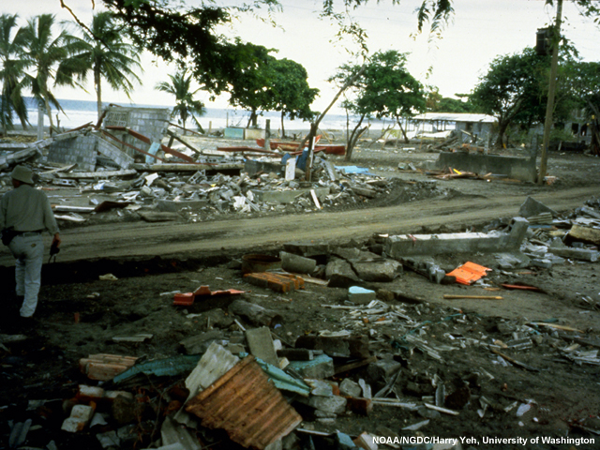
Assessing the risk: Force of a Tsunami Buoyancy and Funneling
Buoyancy – water can lift up and carry objects
Funneling – the force of the water increases as it moves in-between buildings, increasing erosion.
Notes:
http://www.meted.ucar.edu/tsunami/strike/media/flash/comet_meteor_ocean.swf

Slide 46
Assessing the risk: Force of a Tsunami Momentum
Momentum – the power of a moving object
Momentum = mass x velocity
If you run faster, will you change your momentum? (Choose the best answer.)
No, momentum is always the same.
Yes, it would increase.
Yes, it would decrease.
Correct!
Notes:
http://www.meted.ucar.edu/tsunami/strike/media/flash/comet_meteor_ocean.swf

Slide 47
Prepare, Respond, & Recover

Slide 48
PREPARE: Are YOU Ready for a Tsunami?
Before the threat appears...
Learn about tsunami risk in your community or the coastal area you plan to visit.
Sources: 1

Slide 49
PREPARE: Are YOU Ready for a Tsunami?
Communities
Establish a 24-hour warning point and emergency operations center.
Have more than one way to receive tsunami warnings and to alert the public.
Promote public readiness through community education and the distribution of information
Develop a formal tsunami plan, which includes holding emergency exercises.
Read the specific TsunamiReady guidelines.
Sources: 1

Slide 50
RESPOND: Surviving a Tsunami
If on the beach or near the shoreline and you feel a strong earthquake...
EVACUATE TO HIGHER GROUND IMMEDIATELY! Do not wait for a formal warning.
Sources: 1

Slide 51
RESPOND: Surviving a Tsunami
If a tsunami warning is issued...
If you are in school, follow the advice of teachers and other school personnel.
If you are at home, make sure your entire family is aware of the warning.
Your family should evacuate your house if you live in a tsunami evacuation zone.
Sources: 1

Slide 52
RESPOND: Surviving a Tsunami
Heed Natural Warnings
Heed Official Warnings
Expect Many Waves
Head for High Ground and Stay There
Abandon Belongings
Don't Count on the Roads
Go to an Upper Floor or Roof of a Building
Climb a Tree
Climb onto Something that Floats
Expect the Waves to Leave Debris
Expect Quakes to Lower Coastal Land
Expect Company
Sources: 1
Notes:
http://www.srh.noaa.gov/srh/jetstream/tsunami/survive.htm

Slide 53
RECOVER: After a Tsunami
Return home only after local officials tell you it is safe
Go to a designated public shelter if you need to evacuate or you feel it is unsafe to remain in your home. Text SHELTER + your ZIP code to 43362.
Avoid disaster areas
Stay away from debris/critters in the water
Use caution when re-entering buildings or homes & stay out of any building that has water around it.
Check yourself for injuries and get first aid as needed before helping injured or trapped persons.
Sources: 1
Notes:
http://www.ready.gov/tsunamis

Slide 54
Reducing the risk
What, if anything, can be done to prevent this disaster from occurring?

Slide 55
Reducing the risk
What can be done to reduce the damages caused by this disaster?

Slide 56
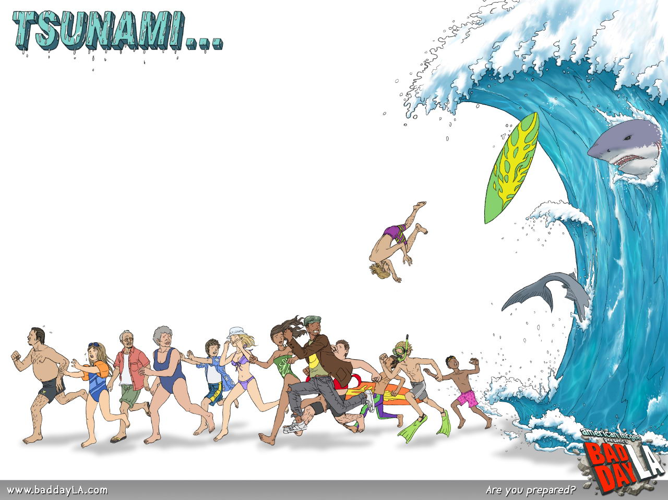
~ end! ~
. . . The end?
Notes:
http://bestgamewallpapers.com/files/bad-day-la/tsunami.jpg

