Slide 1
Volcanic hazards

Slide 2
Assessing the risk:
How common is this disaster and where does this disaster normally occur?

Slide 3
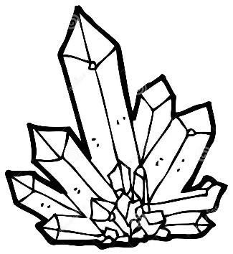
What is magma?
Magma is molten rock, and contains:
Melt
Liquid, composed of mobile ions
Solids
Silicate minerals that have already crystallized from the melt
Volatiles
gases dissolved in the melt, including water vapor (H₂O), carbon dioxide (CO₂), and sulfur dioxide (SO₂)

Slide 4
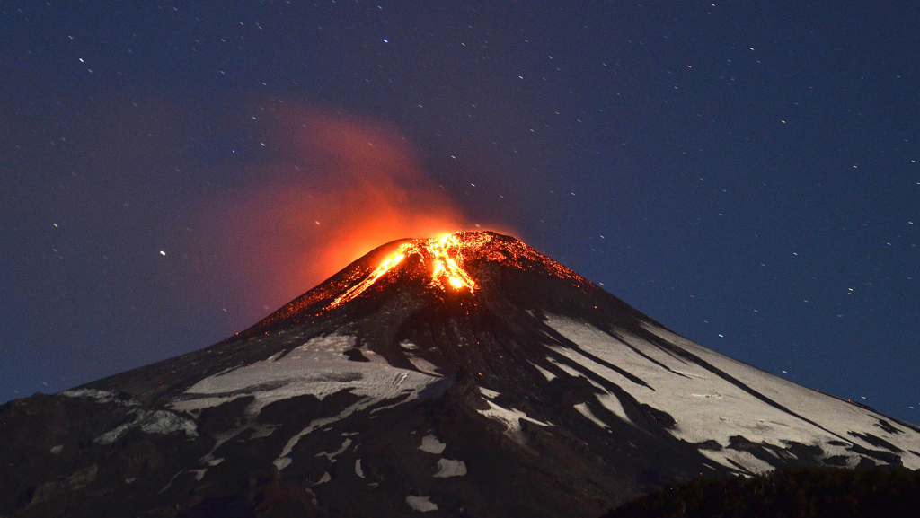
What Creates a Volcano?
First . . . Layers of lava, pyroclastic material, ash or a combination of all build up around a central vent.
Then . . .
Molten rock from the Earth’s interior is ejected via the central vent
Picture of the Villarrica volcano, located near Villarrica 1200 km from Santiago, in southern Chile, which began erupting on March 3, 2015. (Ariel Marinkovic/AFP/Getty Images) source: http://www.vox.com/2015/3/4/8147751/chile-volcano-villarrica

Slide 5
Location, Location, Location
Subduction zones (10%)
Spreading centers (80%)
Hot spots (10%)

Slide 6
Location, Location, Location
Subduction zones (10%)
Stratovolcanoes
Forms the “Ring of Fire”

Slide 7
Location, Location, Location
Spreading Centers (80%)
source
Mid-ocean ridges and rises
Notes:
http://pubs.usgs.gov/gip/dynamic/baseball.html

Slide 8
Location, Location, Location
Hot Spots (10%)
Oceanic hot spot
Basalt erupts at the seafloor, forms a growing mound.
Above sea level = an island.
(Map Source: TASA Graphic Arts, Inc. © 2009)

Slide 9
Location, Location, Location
Hot Spots (10%)
Continental hot spot
Often erupts both basaltic and rhyolitic material.
Basaltic – Makes up the mantle plume.
Rhyolitic – Basalt melts the granitic crust it passes through.

Slide 10
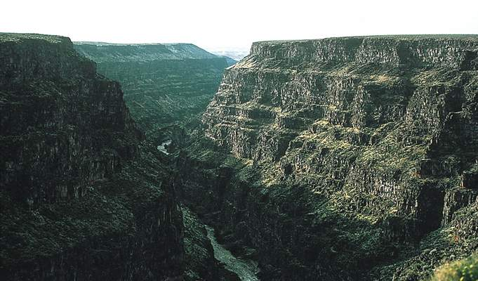
Location, Location, Location
Hot Spots (10%)
Continental hot spot
Also produces flood basalts

Slide 11
Volcanic Eruptions
Factors that determine the violence of an eruption
Temperature of the magma
Composition of the magma
Dissolved gases in the magma
The above three factors actually control the viscosity of a given magma which in turn controls the nature of an eruption

Slide 12
Viscosity, Temperature and Water Content of Magmas
Rock Type | Basalt | Andesite | Rhyolite
SiO₂ content | 45-55% | 55-65% | 65-111%
Magma temperature | 1,000 – 1,250ºC | 800 – 1,000 ºC | 600-900 ºC
Viscosity | Low |  | High
Gas escape from magma | Easy |  | Difficult
Eruptive style | Peaceful |  | Explosive
increasing
increasing
increasing

Slide 13
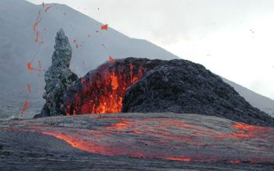
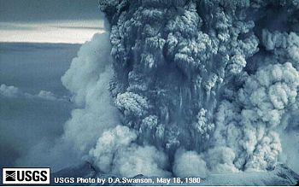
Tectonic Settings of Volcanoes
Why more volcanic activity at spreading centers?
Low SiO₂ content
High temperature
Low pressure as plates pull apart
Why less volcanic activity at subduction zones?
High SiO₂ content
Lower temperatures
Higher pressures
Photo by C. Heliker, 12 September 2003 (source)
source

Slide 14
Types of Volcanoes
Shield
Composite/Stratocone
Cinder cone
Lava dome
Caldera
Fissure Eruptions and Lava Plateaus

Slide 15
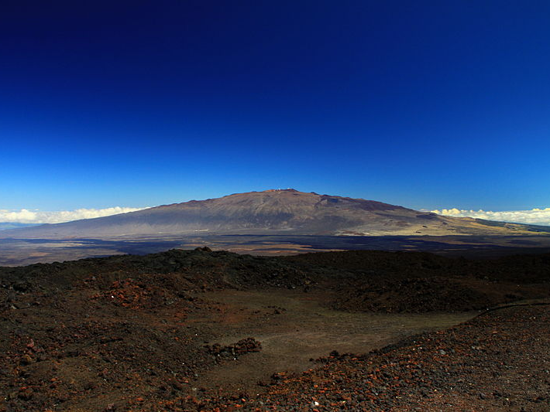
Shield
Broad, slightly domed, very large
Primarily made of basaltic (fluid) lava
Erupts peacefully
Hawaiian Islands (Mauna Kea, pictured)
Source

Slide 16
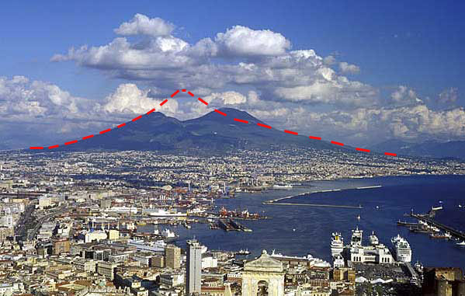
Stratovolcano
Most are adjacent to the Pacific Ocean
Layers of andesitic / rhyolitic lavas & pyroclastics
Erupts explosively
Vesuvius, Naples, Italy
source

Slide 17
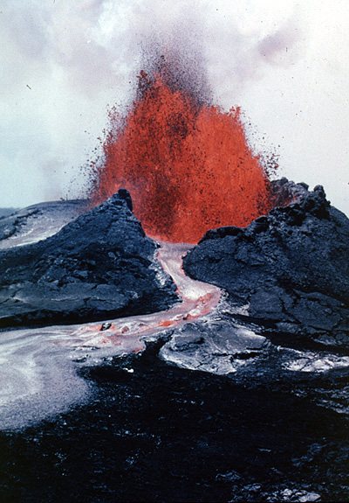
Cinder cone
Built from ejected lava fragments
Steep slope angle
Frequently occur in groups
Pu'u O'o Cinder cone erupting a lava fountain.
Photo, courtesy of the USGS.

Slide 18
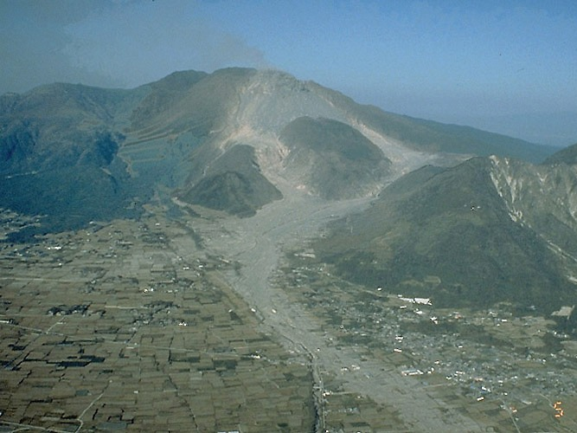
Lava Dome
Unzen lava dome and Mizunashi River Valley
source
Bulbous mass of congealed lava
Most are associated with explosive eruptions of gas-rich magma

Slide 19
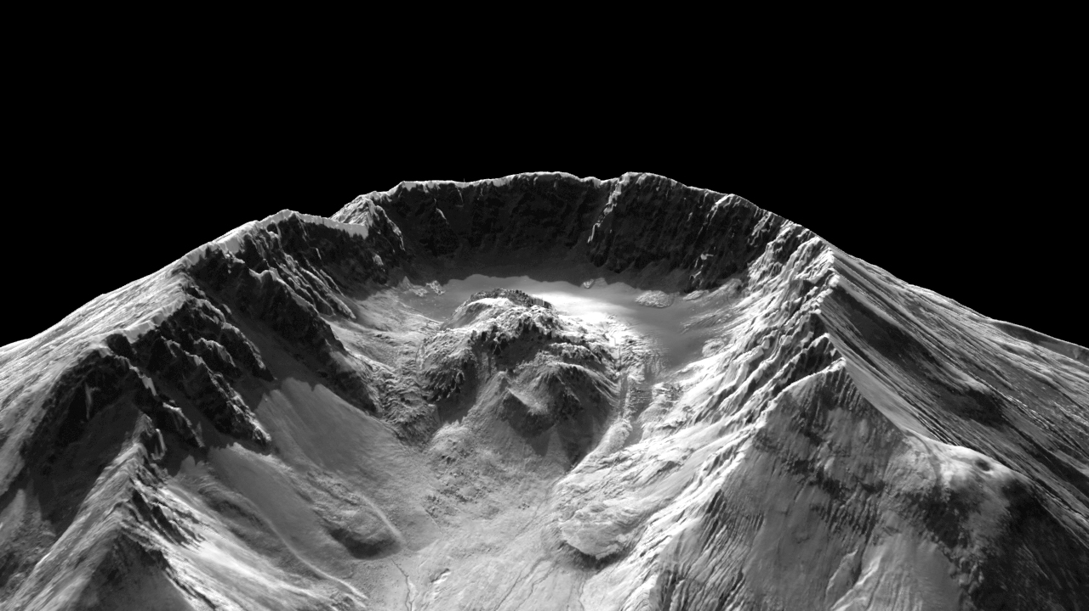
Mt. St. Helens
New Dome
Vent
Rock
Glacier
1980-1986
Dome
http://earthobservatory.nasa.gov/Newsroom/NewImages/images.php3?img_id=16721

Slide 20
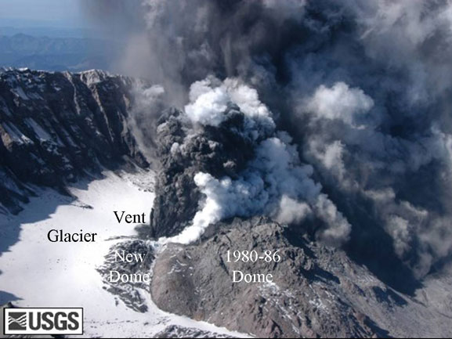
Mt. St. Helens, October 1, 2004
source
Notes:
http://www.nasa.gov/vision/earth/lookingatearth/mshelenslidar.html

Slide 21
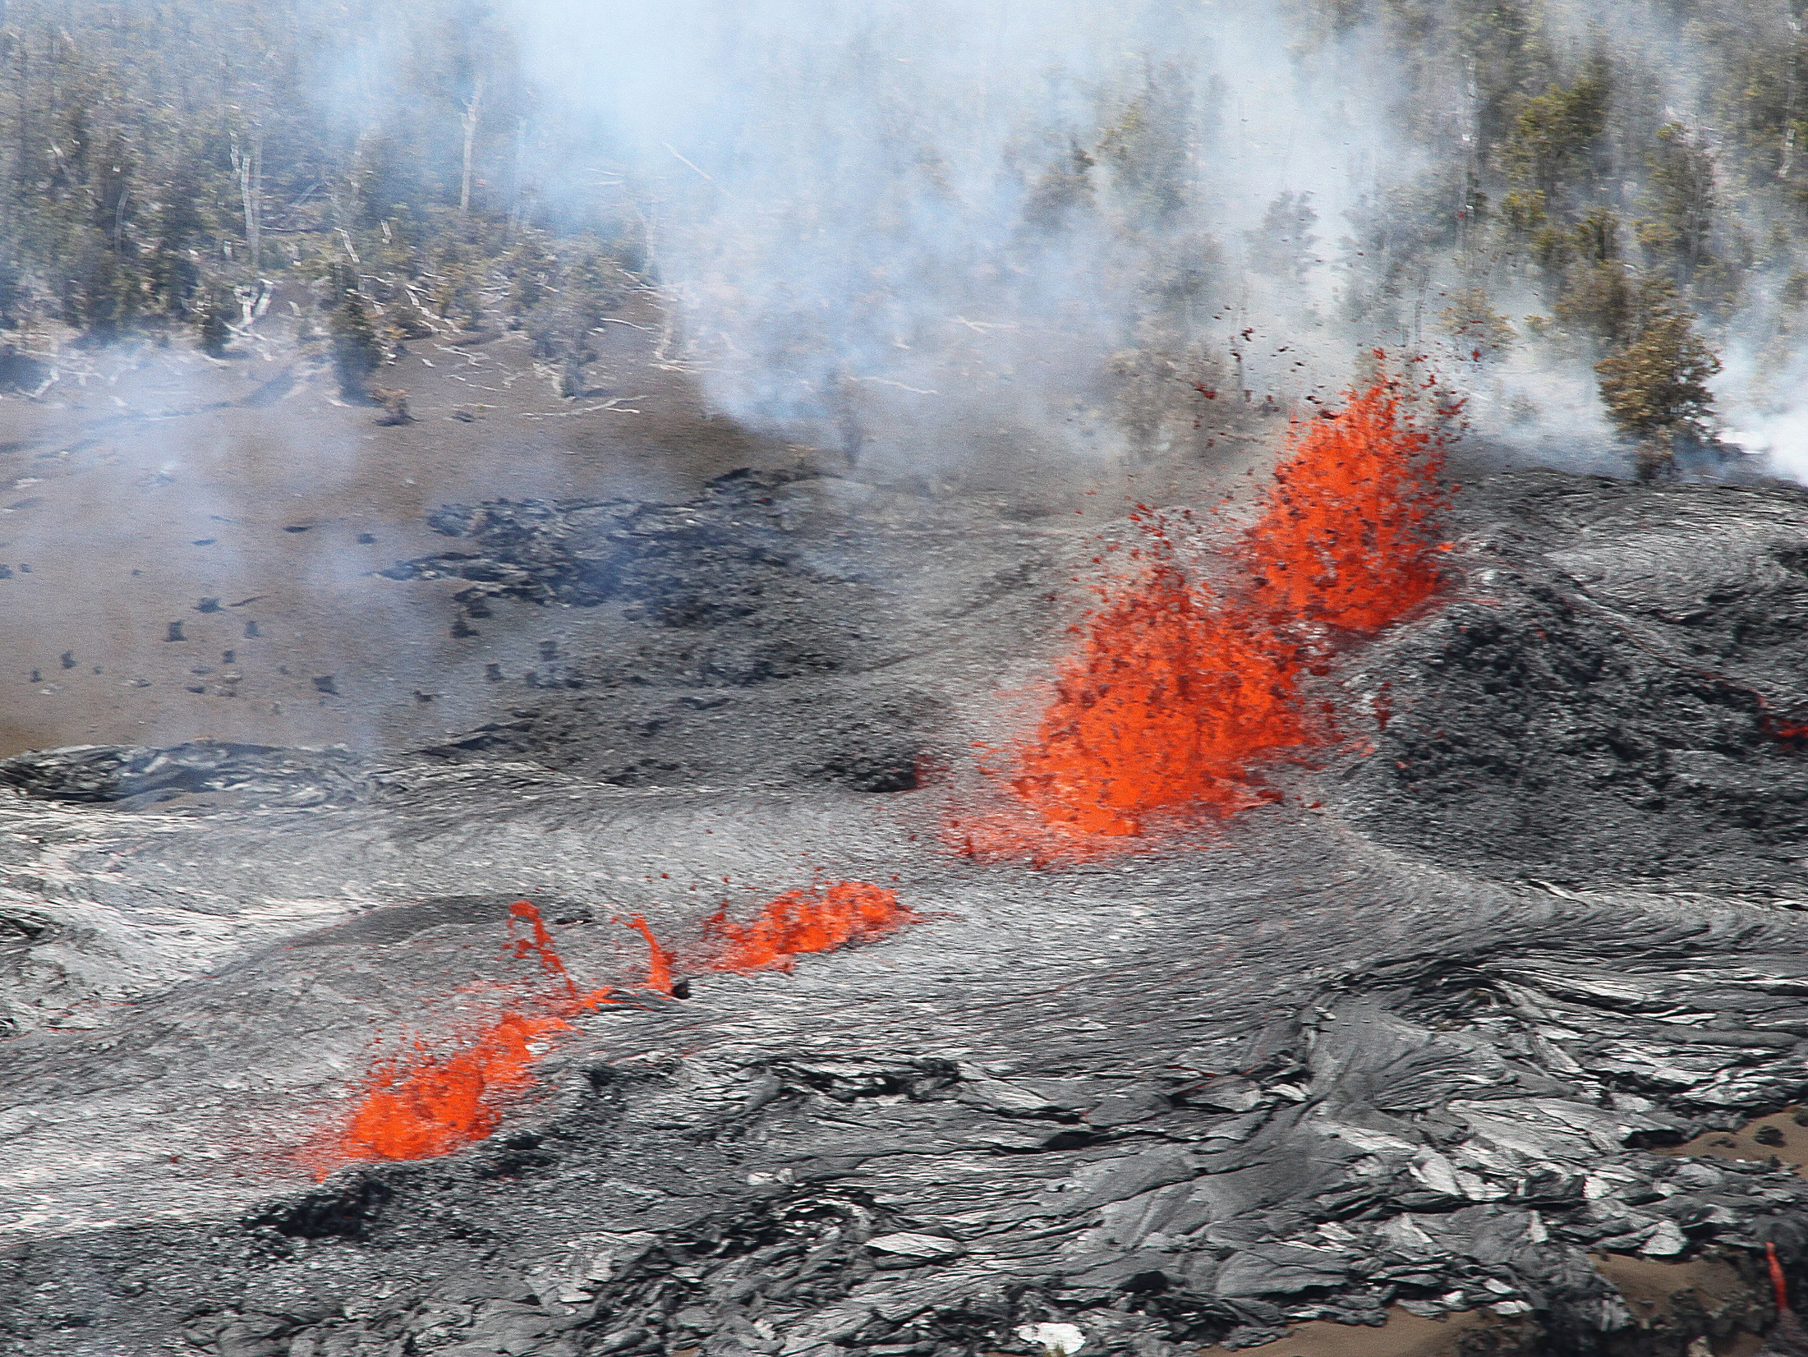
Fissure eruptions and lava plateaus
Basaltic lava extruded from crustal fractures
Incredibly large volumes of lava pour out of fissures over 2-3 million years
Can affect global climate
source

Slide 22
Assessing the risk:
What are the major causes of damage, destruction, death associated with this disaster?

Slide 23
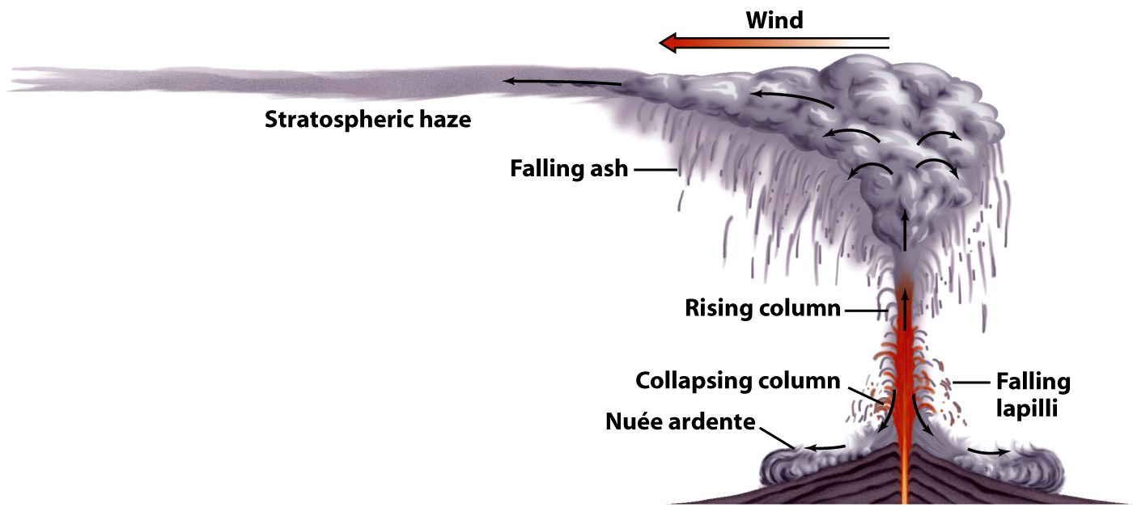
What comes out of a volcano?
Lava Flows
Pyroclastic Debris
Ashfall
Nuée Ardentes
Lahars
Gases
Caldera collapse
source

Slide 24
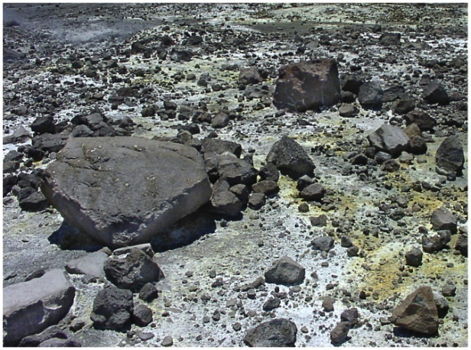
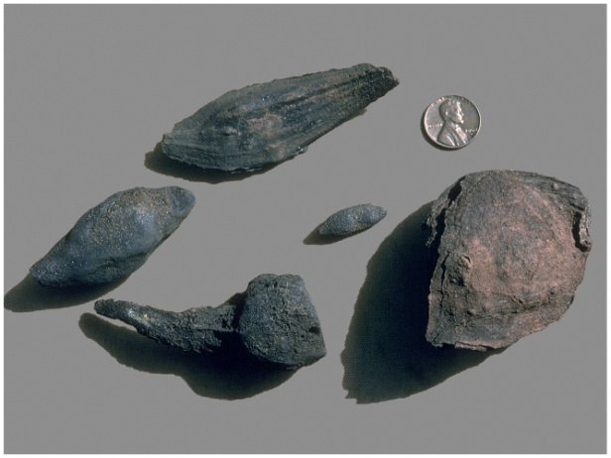
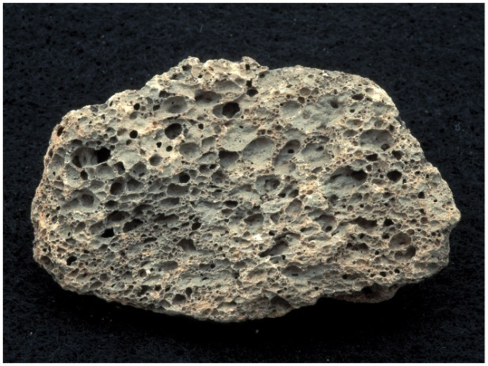
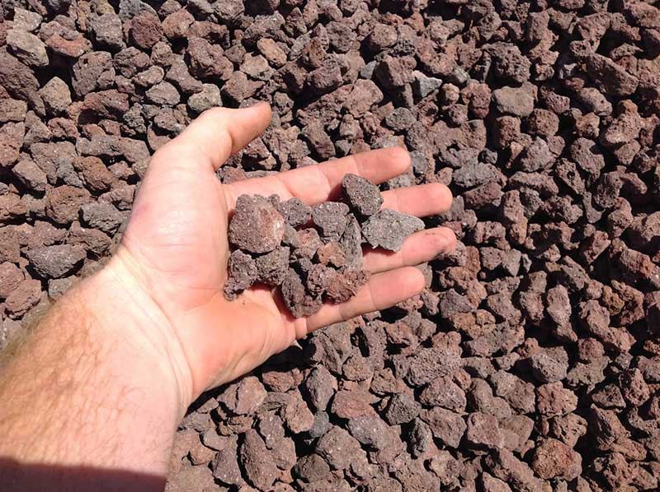
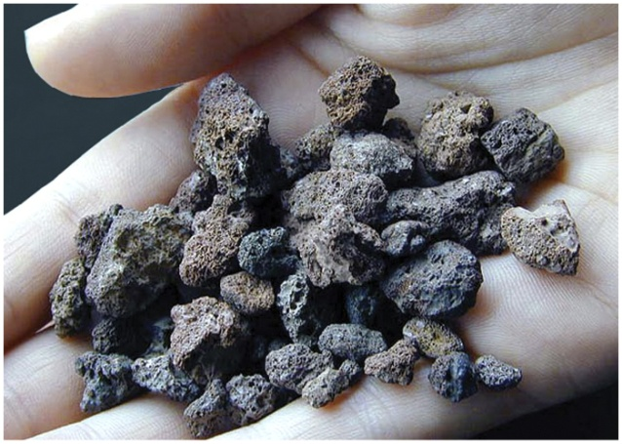
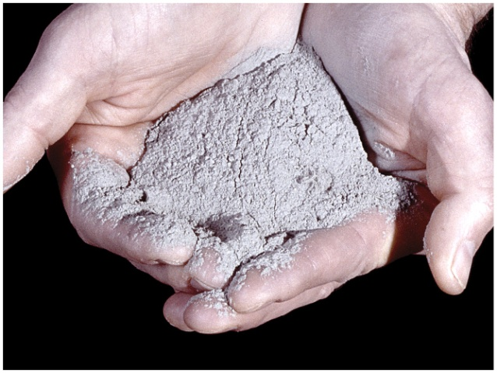
Types Of Pyroclastic Debris
VOLCANIC BLOCK
volcanic bombs
PUMICE
CINDERS
LAPILLI
ASH
Notes:
Suggested tips to give students: Pumice is useful for calluses on your feet, bombs are aerodynamically shaped, welded” tuff” looks soft like a sand hill but is “tough”.

Slide 25
Volcanic Hazards
Direct
Eruptions / Explosions
Lava Flows
Pyroclastic Debris/Flows
Mudflows/Lahars
Gas
Caldera Collapse
Indirect
Tsunami
Famine
Climate change

Slide 26
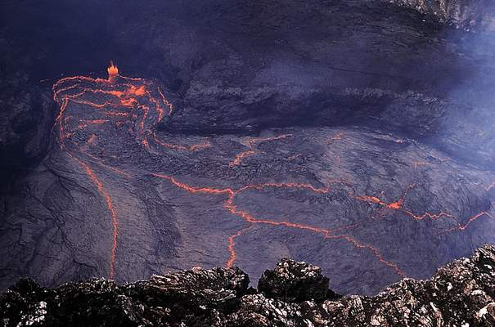
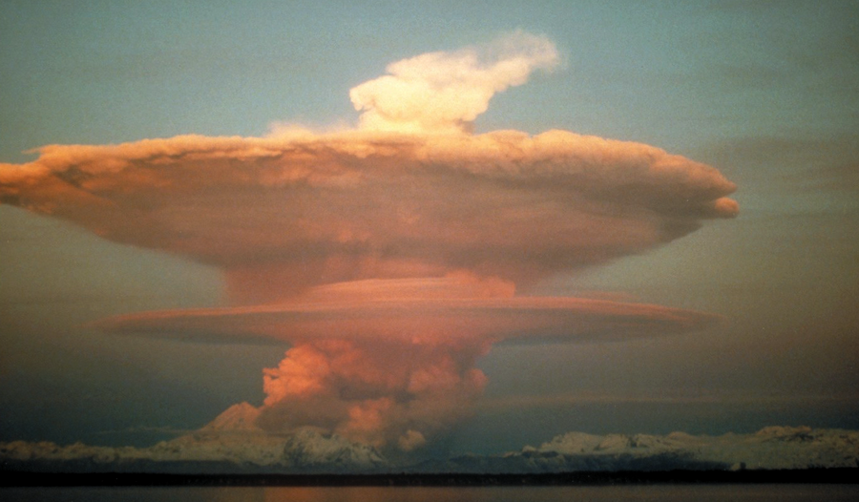
Eruptive Style
Effusive eruptions
Explosive eruptions
Produce lava flows.
Blows up.

Slide 27
Effusive eruptions
Produces lava flows.
Lava flows stream away from vents.
Lava lakes can form around the vent.
Can produce huge lava fountains.
Basaltic composition
Produces shield volcanoes

Slide 28
Explosive eruptions
Produces pyroclastic flows.
Caused by gas pressure in the more viscous magma.
Pressure is released explosively.
Create stratovolcanoes.
May create calderas.
Blanket the landscape with tephra.
Andesitic and rhyolitic compositions.

Slide 29
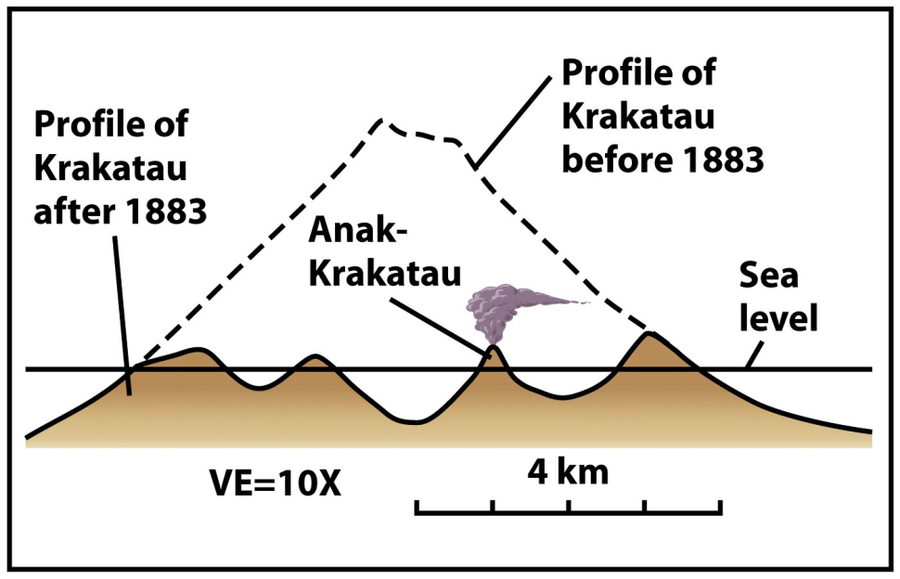
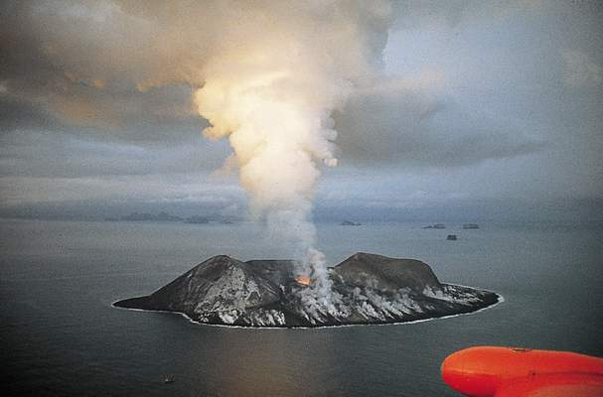
Phreatomagmatic eruptions
Magma interacts with water
Some eruptions can be cataclysmic.
Examples: Santorini, Krakatau.

Slide 30
Controls on Eruptive Style
Viscosity – Controls the ease of lava flow.
Gas Pressure – Greater pressure = explosive style.
Environment – Where eruption occurs important.

Slide 31
Volcanic Hazards
Volcano Fatalities Last 500 Years
Type of Event | 275,000 deaths | 530 Volcanic Events
Pyroclastic flow | 29% | 15%
Tsunami | 21% | 5 %
Lahar | 15 % | 17 %
Indirect (famine) | 23 % | 5 %
Gas | 1 % | 4 %
Lava flow | <1 % | 4 %
Pyroclastic fall (bombs) | 2 % | 21 %
Debris avalanche | 2 % | 3 %
Flood | 1 % | 2 %
Earthquakes | <1 % | 2 %
Lighting | <1 % | 1 %
Unknown | 7 % | 20 %

Slide 32
Notes:
http://vulcan.wr.usgs.gov/LivingWith/VolcanicFacts/deadly_eruptions.html

Slide 33
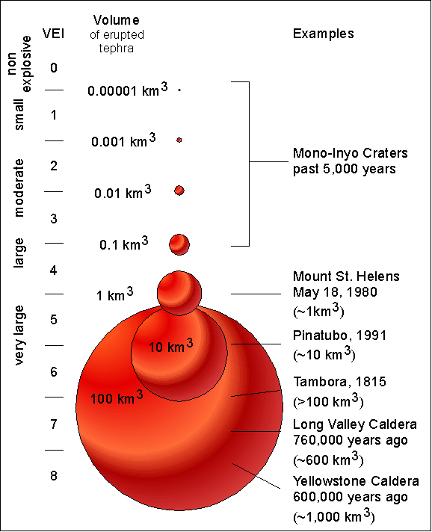
VEI Volcanic Explosivity Index
source

Slide 34
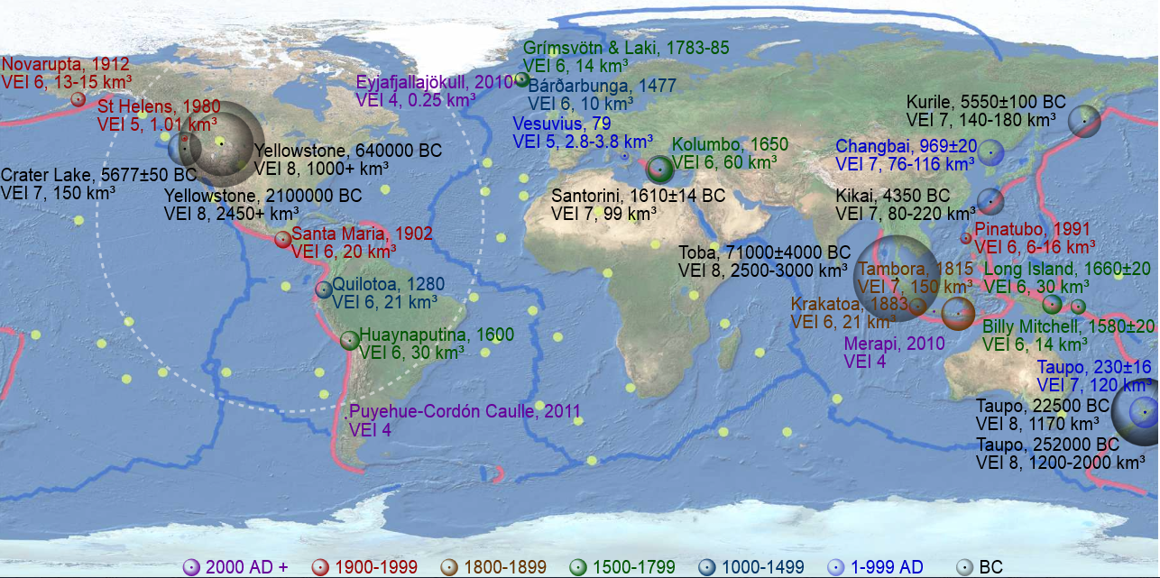
Map of notable volcanic eruptions. The dashed circle shows the equivalent ejection from the Chicxulub impact (200000+ km³). source
Notes:
Map of notable volcanic eruptions. The apparent volume of each bubbles is linearly proportional to the volume of tephra ejected (i.e. their radius is linearly proportional to the cube root of the volume of tephra ejected), colour-coded by time of eruption as in the legend. Pink lines denote convergent boundaries, blue lines denote divergent boundaries and yellow spots denote hotspots. The dashed circle shows the equivalent ejection from the Chicxulub impact (200000+ km³). source

Slide 35
Lava flows
Molten rock that has flowed out onto the Earth’s surface
Cools on surface = extrusive igneous rock

Slide 36
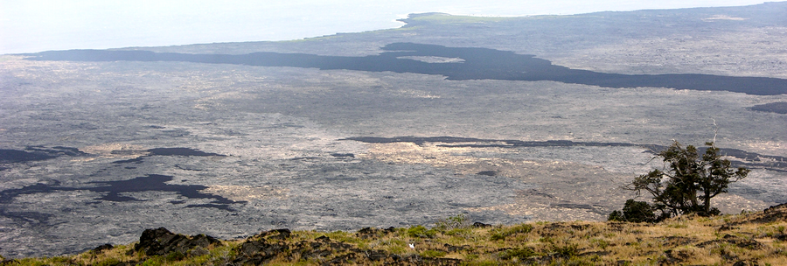
Basaltic Lava Flows
Very hot, low silica, and low viscosity.
They can flow rapidly (up to 100 km/hr) & for long distances (up to several 100 km).

Slide 37
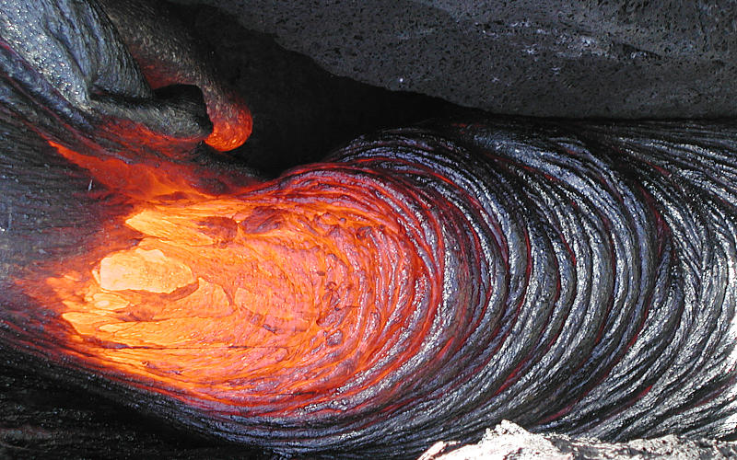
Pahoehoe
Notes:
http://hvo.wr.usgs.gov/multimedia/archive/2001/Feb/3.html

Slide 38
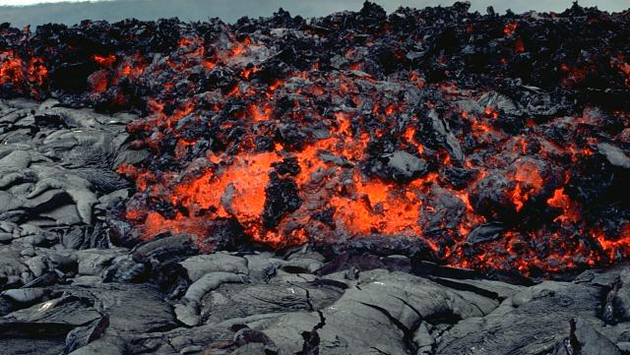
Aa lava (rough, jagged)
Notes:
Photo by Paul Kimberly, 1994 (Smithsonian Institution).
http://volcano.si.edu/learn_galleries.cfm?p=12

Slide 39
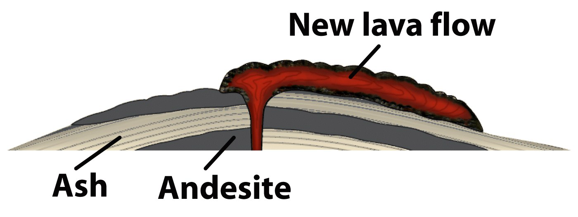
Andesitic Lava Flows
Higher SiO₂ content makes andesitic lavas viscous.
Instead, they mound around the vent and flow slowly, staying near the vent.

Slide 40
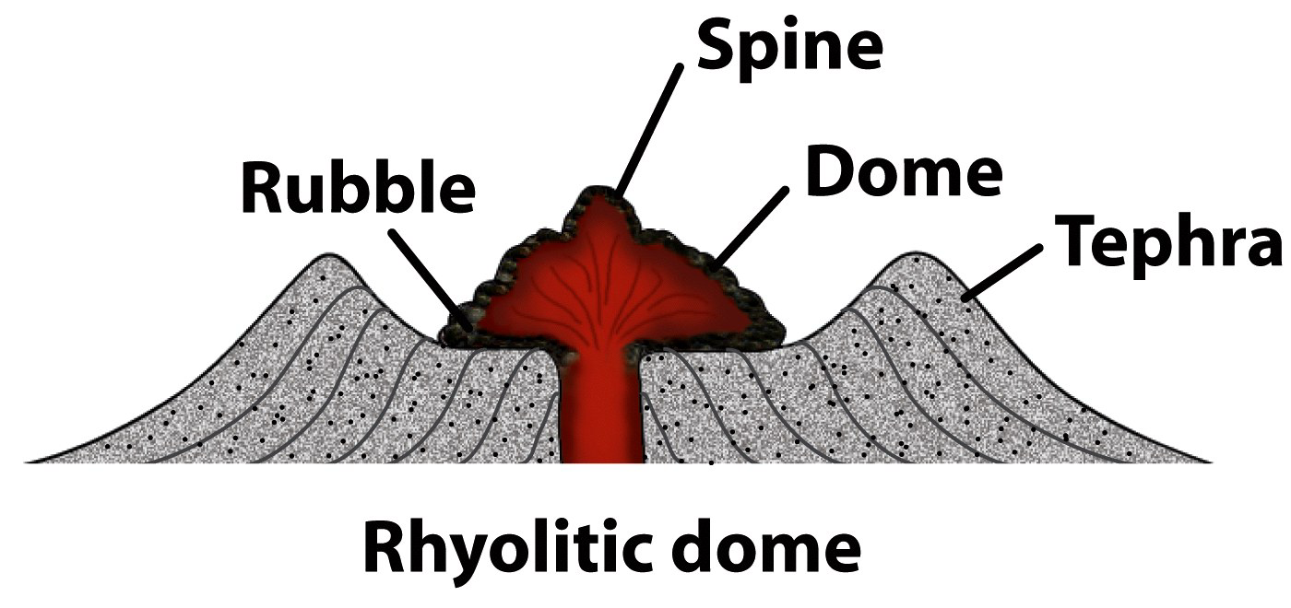
Rhyolitic Lava Flows
Has the highest SiO₂ – the most viscous lava.
Rhyolitic lava rarely flows, plugs the vent as a lava dome.

Slide 41
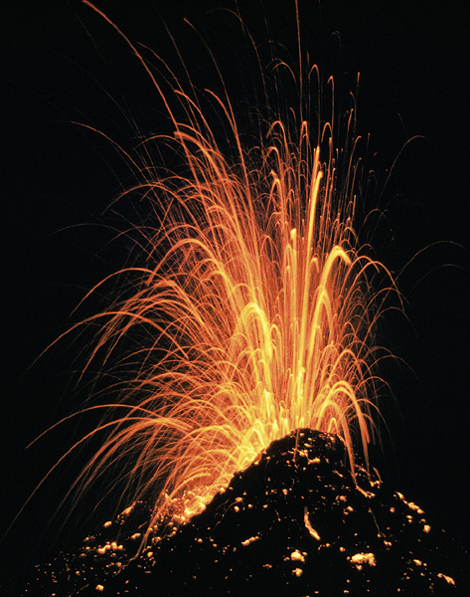
Pyroclastic materials
Ash and dust – fine, glassy
Pumice – from "frothy" lava
Cinders – "pea-sized"
Lapilli – "walnut" size
Particles larger than lapilli
Blocks
Bombs
weblink

Slide 42
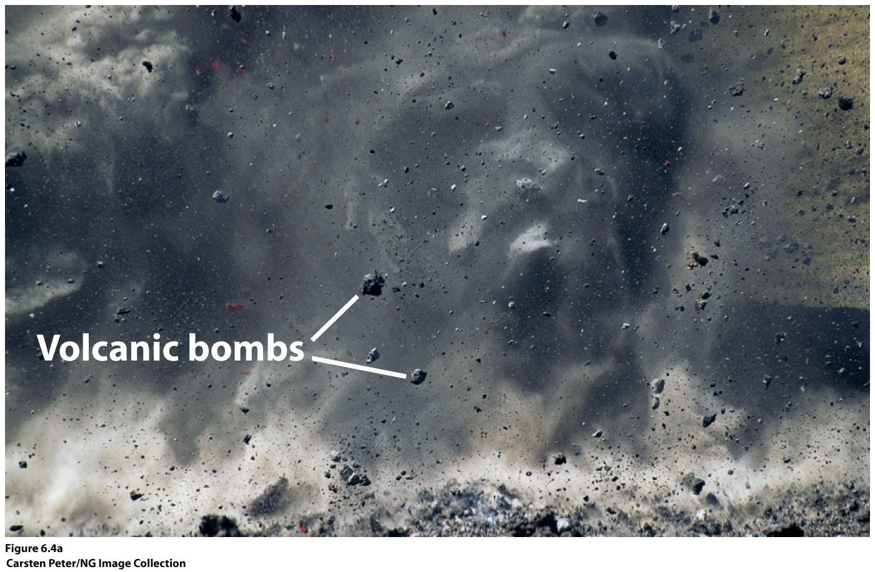

Slide 43
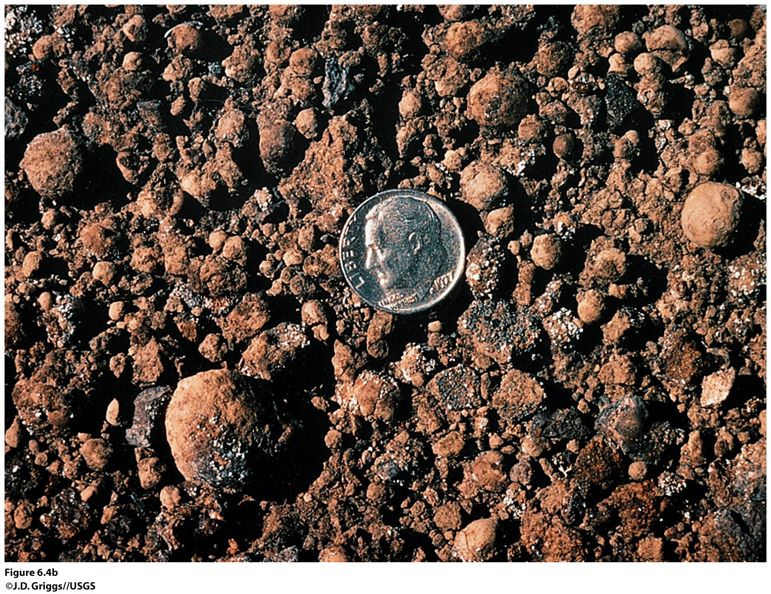

Slide 44
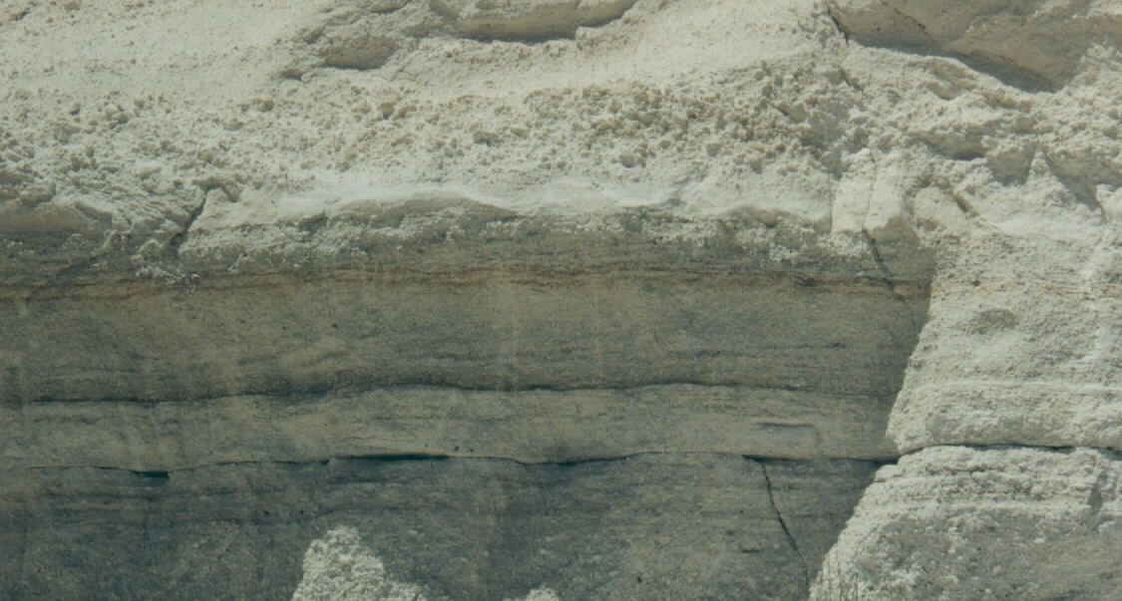
Tephra – pyroclastic debris deposits
Tuff – Lithified ash with or without lapilli.
Air-fall tuff – Accumulations of ash that fall like snow.
source

Slide 45
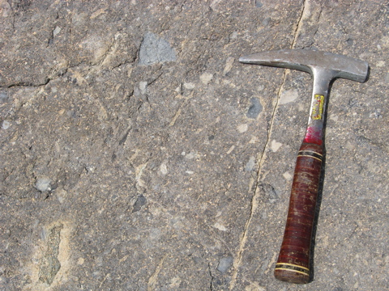
Tephra – pyroclastic debris deposits
Tuff – Lithified ash with or without lapilli.
Welded tuff (ignimbrite) – Tuff that is deposited while hot.
source

Slide 46
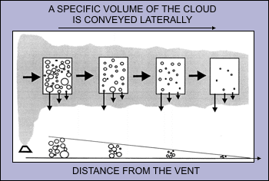
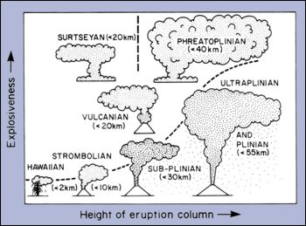
Ashfall
Amount of ash is dependent upon:
Distance from vent
Type of eruption
Size of eruption
Image source

Slide 47
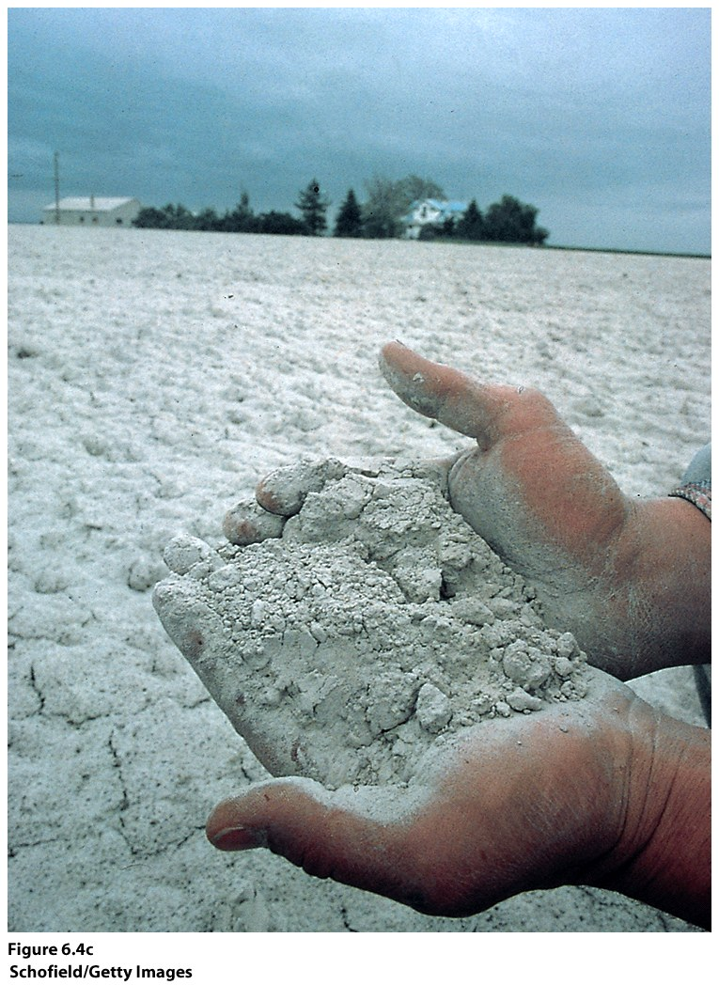
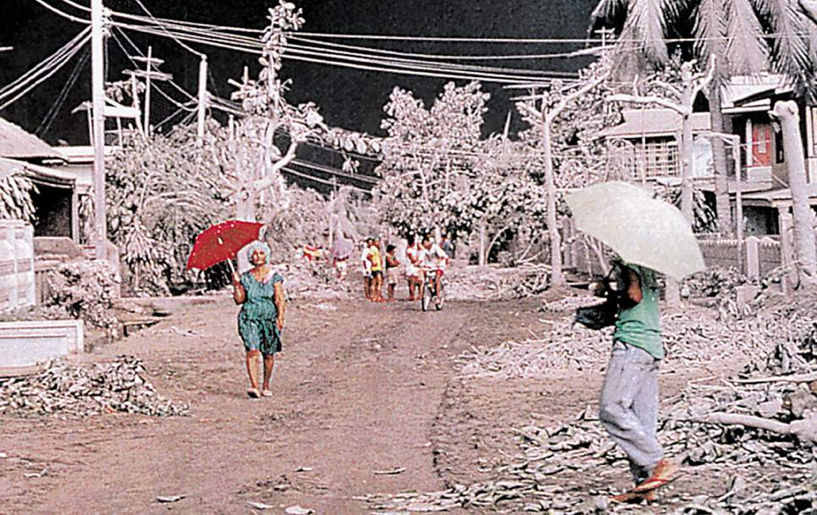
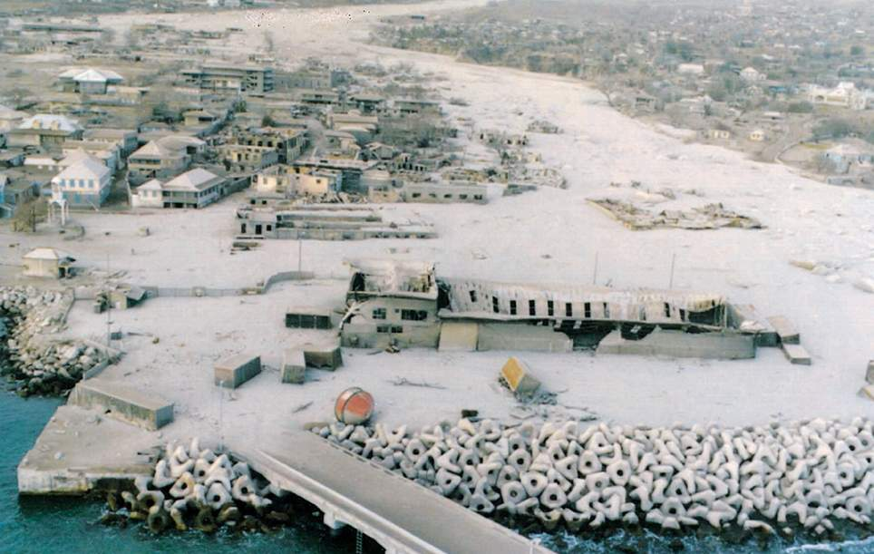
A
S
H
F
A
L
L

Slide 48
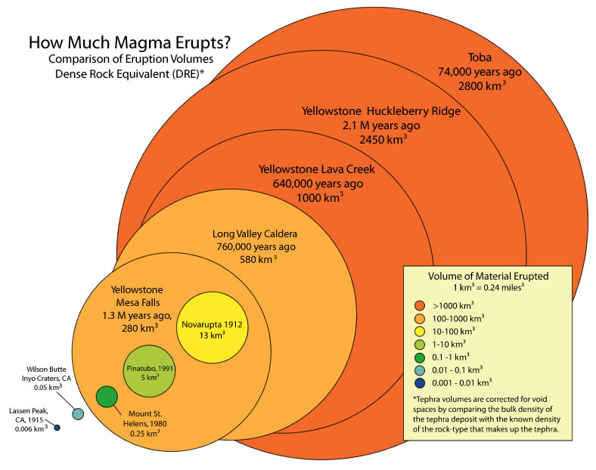
Comparison of eruption sizes using the volume of magma erupted from several volcanoes. Source
Notes:
http://volcanoes.usgs.gov/volcanoes/yellowstone/yellowstone_sub_page_49.html

Slide 49
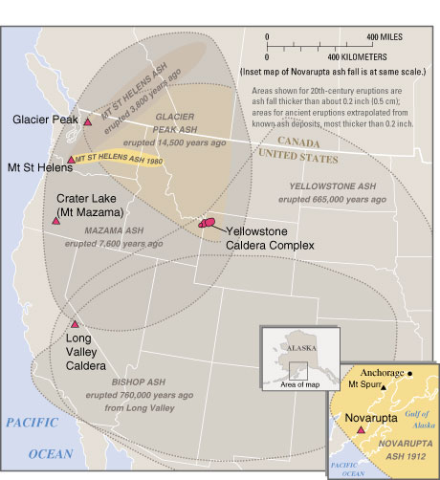
Eruptions of the Yellowstone volcanic system have included the two largest volcanic eruptions in North America in the past few million years; the third largest was at Long Valley in California and produced the Bishop ash bed.
Image source: http://pubs.usgs.gov/fs/fs027-00/
Notes:
http://pubs.usgs.gov/fs/fs027-00/

Slide 50
Source: http://volcanoes.usgs.gov/observatories/cvo/cascade_volcanoes.html
Notes:
http://volcanoes.usgs.gov/observatories/cvo/cascade_volcanoes.html

Slide 51
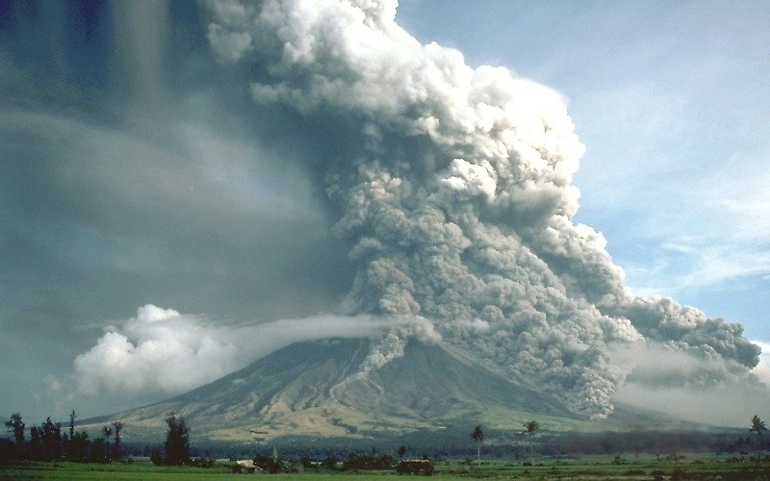
Pyroclastic Flows
Fiery pyroclastic flow made of hot gases infused with ash
Flows down sides of a volcano at speeds up to 200 km per hour & 800º C
Mayon Volcano, Philippines, in 1984
Source
Notes:
https://commons.wikimedia.org/wiki/File:Pyroclastic_flows_at_Mayon_Volcano.jpg

Slide 52
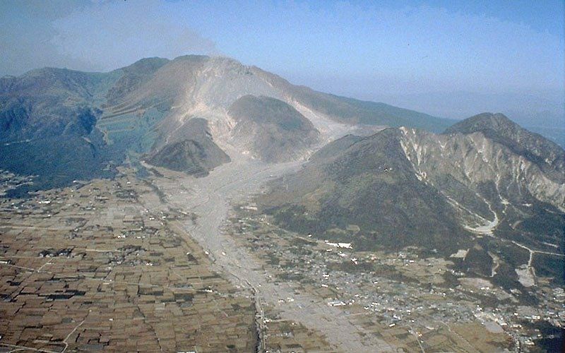
Lahars (mudflows)
How to make a lahar:
Add water + volcanic material = lahar
Water sources:
Melt glaciers
Displace lakes
Rain
Lahars (mudflows)
Mount Unzen, Japan. Note the broad paths of the pyroclastic flows across flat cultivated land. source
Notes:
"Unzen pyroclastic and lahar deposits". Licensed under Public Domain via Wikimedia Commons - https://commons.wikimedia.org/wiki/File:Unzen_pyroclastic_and_lahar_deposits.jpg#/media/File:Unzen_pyroclastic_and_lahar_deposits.jpg

Slide 53
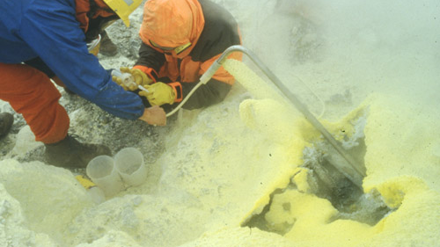
Gases
1 to 5% of magma by weight
Mainly water vapor and CO₂
What type of gas do you thing these geologist are sampling?
Gas sampling at Deformes fumarole, Galeras Volcano, Colombia (1998)
(source / photo by: Stanley Williams)

Slide 54
Indirect – Famine
Laki, Iceland Fissure Eruption of 1783
Large quantities of SO₂ and fluorine
Killed
75% of Iceland’s sheep & horses
50% of Iceland’s cattle
20% of Iceland’s population (due to famine)

Slide 55
Indirect – Famine
Tambora, Indonesia, 1815
Pyroclastic fallout destroyed crops in Indonesia
Affected global climate – 1816 “year without a summer”

Slide 56
Active vs. Extinct
Active
Erupting, recently erupted or likely to erupt.
Dormant
Volcano that has not erupted in 100s to 1000s of years (but could still do so).
Extinct
No longer capable of erupting.
Tectonic changes can shut off the magma “fuel.”
After extinction, erosion takes over.

Slide 57
Prepare, Respond, & Recover

Slide 58
PREPARE
Know your risk! Learn about your community warning systems and emergency plans
Be prepared for the following hazards:
Mudflows and flash floods
Landslides and rockfalls
Earthquakes
Ashfall and acid rain
Tsunamis

Slide 59
PREPARE
Know your risk! Learn about your community warning systems and emergency plans
Be prepared for the following hazards:
Mudflows and flash floods
Landslides and rockfalls
Earthquakes
Ashfall and acid rain
Tsunamis

Slide 60
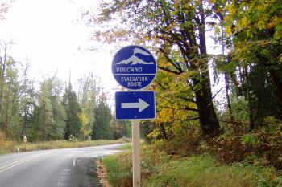
PREPARE
Plan two evacuation routes out of your neighborhood and be familiar with your community's pre-established evacuation routes.
Notes:
http://volcanoes.usgs.gov/volcanoes/mount_rainier/mount_rainier_monitoring_99.html

Slide 61
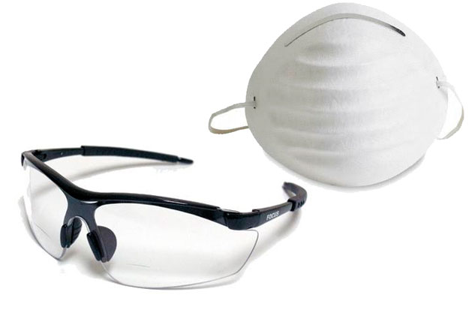
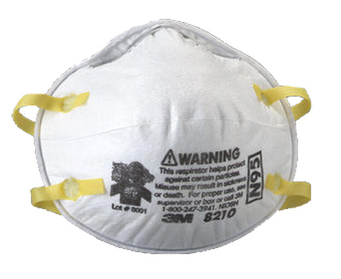
PREPARE
Get goggles and breathing masks (preferably NIOSH-Approved Particulate Filtering Facepiece Respirators) for each member of the household in case of ashfall. Add them to your emergency supply kits at home and in all vehicles.

Slide 62
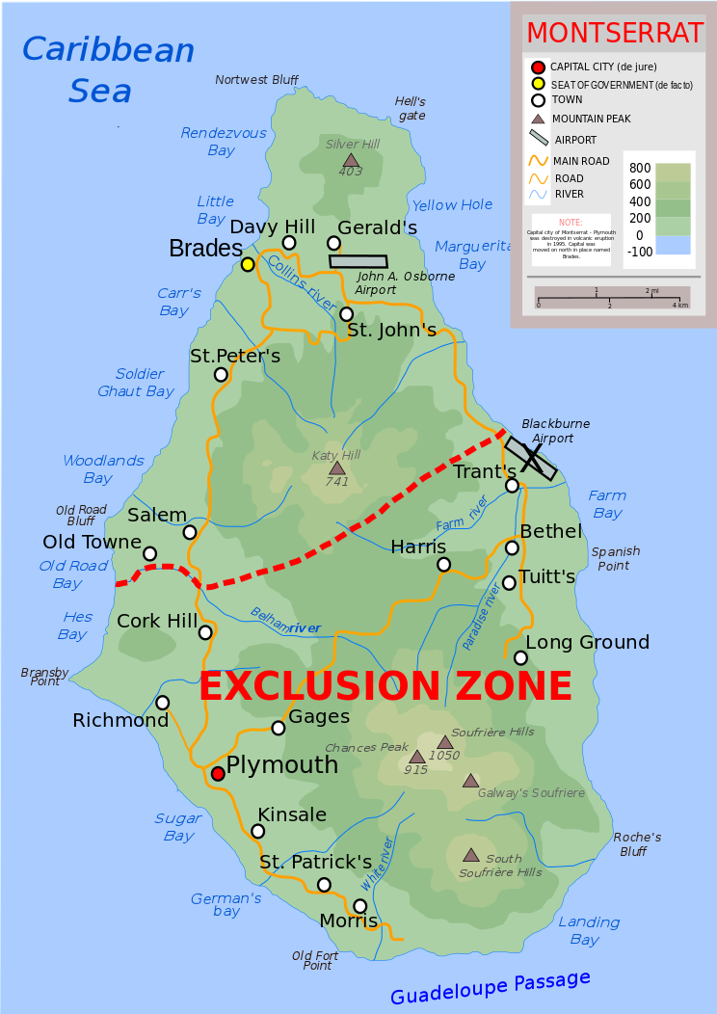
PREPARE
Stay out of the area defined as a restricted zone by government officials.
Effects of a volcanic eruption can be experienced many miles from a volcano.
Topographic map of Montserrat showing the "exclusion zone" due to volcanic activity, and the new airport in the north. The roads and settlements in the exclusion zone have mostly been destroyed. source
Notes:
https://commons.wikimedia.org/wiki/File:Topographic-map-of-Montserrat-en.svg

Slide 63
RESPOND: What To Do During An Eruption
Follow the evacuation order issued by authorities.
Avoid areas downwind and river valleys downstream of the volcano.
Listen to a battery-operated radio or television for the latest emergency information.
Notes:
http://www.redcross.org/prepare/disaster/volcano

Slide 64
RESPOND: What To Do During An Eruption
If caught indoors:
Close all windows, doors, and dampers.
Put all machinery inside a garage or barn.
Bring animals and livestock into closed shelters.
Notes:
http://www.redcross.org/prepare/disaster/volcano

Slide 65
RESPOND: What To Do During An Eruption
If caught outdoors:
Seek shelter indoors.
If caught in a rockfall, roll into a ball to protect your head.
If caught near a stream, be aware of mudflows. Move up slope, especially if you hear the roar of a mudflow.
Notes:
http://www.redcross.org/prepare/disaster/volcano

Slide 66
RECOVER: After a Volcanic Eruption
STAY SAFE!
Go to a designated public shelter if you have been told to evacuate or you feel it is unsafe to remain in your home. Text SHELTER + your ZIP code to 43362 (4FEMA)
Register on the American Red Cross Safe and Well web site to let your family and friends know you are safe. (https://safeandwell.communityos.org/cms/index.php)

Slide 67
Reducing the risk
What, if anything, can be done to prevent this disaster from occurring?

Slide 68
Reducing the risk
What can be done to reduce the damages caused by this disaster?

Slide 69
Reducing The Risk: Eruptions / Explosions
Can’t really stop or prevent
CAN predict!
Stay out of blast/exclusion zone
Evacuate when told to do so

Slide 70
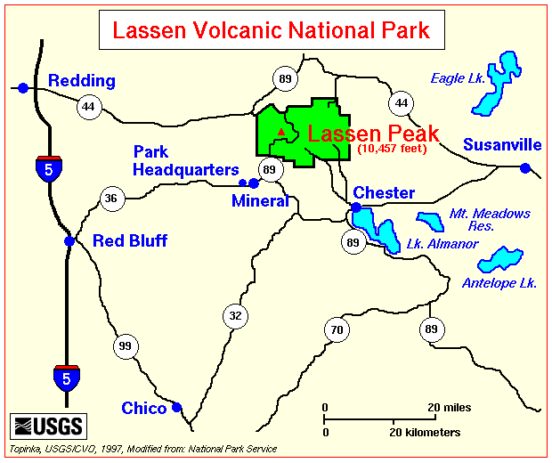
Reducing The Risk: Eruptions / Explosions
Lassen Peak, California, 1914-17
Lava Dome
Formed after Mt. Tehama became extinct & eroded away
Part of the Lassen dome field
Notes:
http://vulcan.wr.usgs.gov/Volcanoes/Lassen/Maps/map_lassen_locale.html

Slide 71
Reducing The Risk: Eruptions / Explosions
Lassen Peak, California, 1914-17
Began erupting May 1914
July 18, 1914 – Huge ash cloud ejected 3,350 m into atmosphere
May 16 – 18, 1915 – Lava oozed out of crater
May 19, 1915 – avalanche of hot rocks combined with snow and triggered a lahar that extended more than 50 km
Eruptions continued through 1917, then ceased

Slide 72
Lassen Peak in June 1915 with Loomis Hot Rock, one of the many large boulders dislodged in the eruption that were too hot to touch for days after, in the foreground (photograph by B.F. Loomis; modern photo)
Notes:
http://en.wikipedia.org/wiki/Lassen_Peak

Slide 73
Notes:
https://farm9.staticflickr.com/8049/8436321240_bb81c49517_z.jpg

Slide 74
1915 eruption column of Lassen Peak
Notes:
http://www.ux1.eiu.edu/~cfrbj/parks/lavo/lavo.html

Slide 75
Lassen Peak in northern California produced a series of eruptions during 1914–17. The largest of those eruptions, on May 22, 1915, blasted rock fragments and pumice high into the air and rained fine volcanic ash as far away as Elko, Nevada, 280 miles (450 km) to the east. This photograph, taken from the town of Red Bluff, 40 miles (65 km) west of the volcano, shows the huge eruption column of ash and gas, which rose to a height of more than 30,000 feet (9,000 m).
(Photograph by R.E. Stinson; courtesy of the National Park Service.)
Notes:
http://pubs.usgs.gov/fs/2014/3119/downloads/fs2014-3119.pdf

Slide 76
Eruptions / Explosions
Mount Saint Helens, Washington
Type: stratovolcano
Notes:
http://en.wikipedia.org/wiki/Mount_St._Helens

Slide 78
Mount St. Helens Eruption
Notes:
http://seattletimes.com/art/news/local/links/sthelens/mountsthelensblast.jpg

Slide 79
Notes:
http://en.wikipedia.org/wiki/File:Msh_may18_sequence.gif

Slide 80
Notes:
http://seattletimes.com/news/local/links/sthelens/blastdirection.html

Slide 81
Ash clouds from Mount St. Helens eruption, May 1980
Notes:
http://seattletimes.com/news/local/links/sthelens/ashplume.html
http://www.ccrh.org/comm/moses/reflections2.html

Slide 82
Notes:
http://seattletimes.com/news/local/links/sthelens/fatalities.html

Slide 83
Mt. St. Helens before the 1980 eruption

Slide 84
Mt. St. Helens following the 1980 eruption

Slide 85
Mt. St. Helens Blast Zone ~ June 28, 2012
© Sonjia Leyva, 2012

Slide 86
Reducing The Risk: Effusive eruptions
Lava flows
Can’t really stop or prevent
Evacuate when told to do so
Divert the flow?

Slide 87
Reducing The Risk: Effusive eruptions
Basaltic Flows
Andesitic Flows
Rhyolitic Flows
Fluid and fast (1–10 kph)
Travels for 10s – 100s of km
Everything in it’s path gets buried or burned
Viscous and slow (1–2 kph)
Travels <10 km
Everything in it’s path gets buried or burned
Viscous and slow (<1 kph)
Builds up to form a dome
Collapse of the dome will form a pyroclastic flow

Slide 88
Reducing The Risk: Effusive eruptions
Nyiragongo, Zaire
Type: Stratovolcano
2002 Eruption
Lavas unusually low in SiO₂
Flowed rapidly through Goma to Lake Kivu
45 people killed

Slide 89
Nyiragongo, Zaire
Notes:
http://www.boston.com/bigpicture/2011/02/nyiragongo_crater_journey_to_t.html

Slide 90
Nyiragongo, Zaire
Notes:
http://www.boston.com/bigpicture/2011/02/nyiragongo_crater_journey_to_t.html

Slide 91
Reducing The Risk: Effusive eruptions
Iceland
Icelandic-type Eruptions - AKA fissure eruptions
Mid-Atlantic Ridge + hotspot

Slide 92
Reducing The Risk: Effusive eruptions
Eldfell Volcano, Iceland
Type: Stratovolcano
Lava Flows of 1973
1/23/73 fissure opened up near the town of Vestmannaeyjar
Lava flows and pyroclastic debris threatened to bury the town
Townspeople sprayed seawater on lava, diverted the flow
Town saved
Notes:
http://en.wikipedia.org/wiki/Eldfell

Slide 93
Heimaey 1973 Eruption
Notes:
http://volcano.und.nodak.edu/vwdocs/volc_images/europe_west_asia/heimaey/heimaey.html
http://pubs.usgs.gov/gip/heimaey/heimaey.pdf
From: Williams, Jr., and Moore, Man Against Volcano: The Eruption on Heimaey, Vestmannaeyjar, Iceland: USGS General Interest Publication, 32p.
One of the most destructive volcanic eruptions in the history of Iceland began in the early morning of January 23, 1973, near the Nation's premier fishing port, the town of Vestmannaeyjar (Vést-mun-ayar), on Heimaey (Háme-a-ay), the only inhabited isle in the Vestmannaeyjar volcanic archipelago. ... The 1973 eruption on Heimaey was also the second major eruption (the other being Surtsey) definitely know to have occurred in Vestmannaeyjar since the settlement of Iceland in the ninth century, although there is evidence of a submarine eruption in the archipelago in September 1896.
The 1973 eruption began just before 1 a.m., January 23, on the eastern side of Heimaey, approximately 1,100 yards from the center of town. A north-northeast-trending fissure rapidly opened to a length of about 1.25 miles, traversing the island from one shore to the other. Spectacular continuous lava fountains (curtain of fire) played in the initial phase of the eruption, but the activity soon consolidated to a small area along the fissure about one-half mile northeast of Helgafell. Also during the first 3 days, submarine volcanic activity occurred just offshore at the north and south ends of the fissure vent. Within 2 days a cinder-spatter cone rose more than 110 yards above sea level and was later named Eldfell or "fire mountain" by the official Icelandic place name committee. The output of lava and tephra (a collective term for fragmental volcanic materials initially airborne, such as ash and bombs) was estimated to be about 130 cubic yards per second. Within a few days after the eruption, strong easterly winds resulted in a major fall of tephra on the town of Vestmannaeyjar, completely burying homes close to Eldfell. By early February the tephra fall slackened markedly, but a massive lava flow approached the eastern edge of the town and threated to fill in the harbor of Iceland's most important fishing port. Also in early February submarine activity just north of the fissure severed an electric power cable and a water pipeline which supplied electrical power and water from the Icelandic mainland.
By the end of February the cinder-spatter cone was more than 200 yards high. The central crater of Eldfell fed a massive blocky (aa lava) flow which moved slowly but relentlessly toward the north, northeast, and east. By early May this flow as 10 to 23 yards high at its front, averaged more than 40 yards thick, and was as much as 110 yards thick in places. Its upper surface was littered with scoria (cinderlike fragments of dark cellular lava) and volcanic bombs, as well as large blocks from the main cone which broke off and were carried along with the flow. The largest block soon was dubbed "Flakkarinn" (The Wanderer). Some of these blocks of welded scoria were about 200 yards square and stood 20 yards above the general lava surface and were rafted more than 1,000 yards. Measurements made from a series of aerial photographs taken from the end of March to the end of April indicated that the lava was flowing as a unit about 1,000 yards long by 1,000 yards wide with an average speed of 3 to 9 yards per day.
As the flow advanced to the north and east, large blocks slumped from the cone on February 19 and 20 and moved toward the southeastern part of town. Also in late March a second large lava flow moved northwest on the west side of the main flow and covered many houses and the town powerplant.
By February 8, lava ejection dropped from about 130 cubic yards per second to 80 cubic yards per second; and by the middle of April to about 7 cubic yards per second. As noted before, easterly winds blew tephra over the town during the early stages of the eruption. By January 29, the thickness of tephra varied from less than 1 yard in the northwest part of town to more than 5 yards in the southeast part.
The eruption stopped in early July 1973; flowing lava was no longer visible, although hidden subsurface flow may have continued for a while. ... According to preliminary estimates about 300 million cubic yards of tephra were deposited on and adjacent to Heimaey. ...
The prolonged destruction related to the course of the eruption was twofold: the highly visible destruction of homes, public buildings and installations, commercial properties, and partial infilling of the harbor by tephra falls and lava flows; and the economic and social impact on the residents of Vestmannaeyjar, local commerce, and the national and international economy of Iceland.
Within 6 hours after the eruption began, nearly all of Heimaey's 5,300 residents had been evacuated safely to the mainland. This rapid evacuation was accomplished through the foresight of the Icelandic State Civil Defnese Organization, which had a continency evacuation plan ready for just such a disaster. The fishing fleet in port expediated the evacuation.
Homes and farmsteads close to the rift were soon destroyed by tephra burial or fire from lava bombs and flows. The heavy tephra fall caused severe property damage a few days after the onset of the eruption. Numerous homes were completely buried by tephra, set afire by glowing lava bombs, or overridden by the advancing front of lava flows. Although many structures collapsed from the weight of the tephra, dozens were saved by crews of volunteers who cleared the roofs of accumulated tephra and tacked corrugated iron "shutters" over the windows. ... By early May, some 300 buildings had been engulfed by lava flows or gutted by fire, and another 60 to 70 homes had been buried completely by tephra.

Slide 94
Reducing The Risk: Effusive eruptions
Eyjafjallajökull, Iceland ("glacier of Eyjafjöll")
Type: Stratovolcano
2010 - Minor eruption, but disrupted air traffic in N. Europe for weeks.
Notes:
http://en.wikipedia.org/wiki/Volcanology_of_Iceland

Slide 95
Reducing The Risk: Effusive eruptions
Bárðarbunga, Iceland
Last Eruption: ongoing, starting August 2014
Type: Subglacial volcano/Icelandic stratovolcano
2014 - August: 1,600 earthquakes preceded the under-ice eruption
Eruption officially ended on February 28, 2015
Notes:
http://en.wikipedia.org/wiki/B%C3%A1r%C3%B0arbunga

Slide 96
Bárðarbunga
Notes:
http://en.wikipedia.org/wiki/B%C3%A1r%C3%B0arbunga
http://mashable.com/2014/09/11/iceland-bardabunga-volcano-eruption-photos/#:eyJzIjoiZiIsImkiOiJfM2RrODdtb3cybWhnZWFweSJ9

Slide 97
Neon Blue Lava Indonesia's Kawah Ijen Volcano
Blue color due to sulfur in the magma.
Notes:
http://www.huffingtonpost.com/2014/01/16/blue-lava-volcano-photos-kawah-ijen-indonesia-_n_4610337.html

Slide 98
Reducing The Risk: Explosive eruptions
Pyroclastic falls, pyroclastic flows, and ashfall
Can’t really stop or prevent
Stay out of blast/exclusion zone
Evacuate when told to do so

Slide 99
Reducing The Risk: Explosive eruptions
Pyroclastic Fall
Pyroclastic Flows
Ash Fall
Ballistic transport of ejecta due to a volcanic eruption
Blocks & Bombs
Lapilli
Cinders
Pumice
Stays relatively close to vent
Mix of hot gasses and ash that flow the volcano’s slopes due to gravity.
Form due to the collapse of the eruption column or of a lava dome
Can travel moderate distances from the vent
Ballistic transport of ejecta due to a volcanic eruption
< 2 mm in diameter
Glass & pulverized rock
Can travel very far from the vent
Notes:
https://en.wikipedia.org/wiki/Pyroclastic_fall
http://volcano.si.edu/learn_galleries.cfm?p=9

Slide 100
Reducing The Risk: Explosive eruptions - Pyroclastic & Ash falls
Damages
Destroys by direct impact (larger particles)
Building collapse due to weight of particles
Inhalation of smaller particles (ash) a health hazard
Notes:
http://volcanoes.usgs.gov/hazards/pyroclasticflow/index.php

Slide 101
Reducing The Risk: Explosive eruptions - Pyroclastic flows
STAY OUT of the exclusion zone!
Take cover if outside
Stay inside unless the building is in danger of collapse

Slide 102
Reducing The Risk: Explosive eruptions - Pyroclastic flows
Damages
Destroy by direct impact.
Bury sites with hot rock debris.
Melt snow and ice to form lahars.
Burn forests, crops, and buildings.
Death due to inhalation of hot ash and gases
Notes:
http://volcanoes.usgs.gov/hazards/pyroclasticflow/index.php

Slide 103
Reducing The Risk: Explosive eruptions - Pyroclastic flows
STAY OUT of the exclusion zone!
. . . Not much else you can do if one is approaching

Slide 104
Reducing The Risk: Explosive eruptions - Ash Fall
Ash from an eruption can cover large areas.
Health Hazards
Economic Hazards
Respiratory problems
Eye problems
Skin irritation
Hazardous driving conditions
Skies darken
Roofs may collapse
Livestock/crops will be covered
Power systems may shut down
Waste-water systems may clog
Air travel disrupted
Notes:
http://volcanoes.usgs.gov/hazards/tephra/

Slide 105
Figure from Johnston, 1997 (source)

Slide 106
Reducing The Risk: eruptions - Ash falls
Cover your mouth and nose.
Wear goggles to protect your eyes.
Keep skin covered to avoid irritation from contact with ash.
Clear roofs of ashfall.
Avoid driving in heavy ashfall.
If you have a respiratory ailment, avoid contact with any amount of ash. Stay indoors until local health officials advise it is safe to go outside.
Remember to help your neighbors who may require special assistance — infants, elderly people, and people with disabilities.

Slide 107
Ash plume eruption on Colima Volcano, Mexico, on February 8, 2015
Lahars from previous eruptions
Notes:
http://earthobservatory.nasa.gov/NaturalHazards/view.php?id=85346&src=nha

Slide 108
Reducing The Risk: Lahars
Lahars can occur without an eruption
Know your risk – find out if you are in a flood/lahar zone
Head to higher ground if a warning is issued.

Slide 109
Reducing The Risk: Lahars
Mount St. Helens, Washington, 1980
Mudflow was caused by the displaced Spirit Lake
Mudflow went 60 miles to the Columbia River
45 million cubic yards sediment entered Columbia River

Slide 110
Notes:
http://www.iris.edu/gifs/slides/sthelens/slideshow/index2.htm

Slide 111
Surface details of the debris (mud) flow on the North Fork of the Toutle River near Coldwater Creek (see map). There is approximately 50 feet of relief between the pond and the mudflow surface.
http://www.iris.edu/gifs/slides/sthelens/slideshow/pages/16.htm
Devastation occurring at the log camp on the South Fork Toutle River - overturned trucks and caterpillers.
http://vulcan.wr.usgs.gov/Volcanoes/MSH/Images/may18_devastation.html
Notes:
http://www.iris.edu/gifs/slides/sthelens/slideshow/pages/16.htm
http://vulcan.wr.usgs.gov/Volcanoes/MSH/Images/may18_devastation.html

Slide 112
Reducing The Risk: Lahars
Nevado Del Ruiz, Colombia
Type: Stratovolcano
2 eruptions on Nov 13, 1985
Summit glaciers melted
Lahars traveled in all directions from the summit
Mud traveling 30 mph and 50 feet deep buries Amero 30 miles away
25,000 killed

Slide 113
Nevada del Ruiz, Columbia Headwaters of Gualí River
source
Notes:
Headwaters of Gualí River. Pumice and meltwater produced by the hot pyroclastic flows and surges swept into gullies and channels on the slopes of Ruiz as a series of small lahars. After descending several thousand meters and eroding loose rock debris from the sides of the volcano, the lahars were funneled into all six major river valleys leading from Ruiz. Here in the headwaters of the Gualí River on the north side of Ruiz, a lahar took several paths on its journey downstream.

Slide 114
Notes:
http://vulcan.wr.usgs.gov/Vhp/C1073/hazard_maps_risk.html

Slide 115
Reducing The Risk: Lahars
Armero, Colombia
74 km from Nevado del Ruiz
Lahar arrived 2 ½ hours after the eruption
No warning, so most o
Armero, Colombia
74 km from Nevado del Ruiz
Lahar arrived 2 ½ hours after the eruption
No warning, so most of the town was swept away
Notes:
http://volcanoes.usgs.gov/Imgs/Jpg/Ruiz/30410135_070_caption.html
http://volcanoes.usgs.gov/Imgs/Jpg/Ruiz/30410135_071_caption.html
http://volcanoes.usgs.gov/hazards/lahar/ruiz.php

Slide 116
Reducing The Risk: Lahars
Disaster due to:
lack of early warnings
unwise land use
& the unpreparedness of nearby communities
Oficina Nacional para la Atencion de Desastres, 1987

Slide 117
Reducing The Risk: Gas
Can occur with or without an eruption
Sensors monitor known areas
Evacuate if told to do so
Install sensors in home

Slide 118
Reducing The Risk: Gas
Lake Nyos, Cameroon
Type of volcanism: Maar
A volcanic crater that is produced by an explosion in an area of low relief, is generally more or less circular, and often contains a lake, pond, or marsh.
Notes:
http://www.geology.sdsu.edu/how_volcanoes_work/Images/Historic/cameroon_l.jpg
http://en.wikipedia.org/wiki/Lake_Nyos

Slide 119
Lake Nyos, Cameroon
Notes:
http://www.geo.arizona.edu/geo5xx/geos577/projects/kayzar/html/lake_nyos_disaster.html

Slide 120
Reducing The Risk: Gas
Cameroon
August of 1984
smaller gas burst from Lake Monoun
37 people killed
August of 1986 Lake Nyos
1 km of CO₂ released
~1700 people killed up to 26 km away from the lake
Notes:
http://vulcan.wr.usgs.gov/Volcanoes/Africa/Maps/map_cameroon_volcanoes.html
http://www.globalchange.umich.edu/globalchange1/current/lectures/kling/killer_lakes/killer_lakes.html

Slide 121
Reducing The Risk: Gas
Cameroon
Only three lakes in the world are known to contain high concentrations of dissolved gas in their bottom waters:
Lakes Nyos and Monoun in Cameroon
and Lake Kivu in East Africa.
Only Lakes Nyos and Monoun are known to have recently released gas resulting in the loss of human life.
Using Science to Solve Problems: The Killer Lakes of Cameroon By Dr. George Kling
Notes:
http://vulcan.wr.usgs.gov/Volcanoes/Africa/Maps/map_cameroon_volcanoes.html
http://www.globalchange.umich.edu/globalchange1/current/lectures/kling/killer_lakes/killer_lakes.html

Slide 122
Reducing The Risk: Gas
Notes:
http://www.atlasobscura.com/places/lake-nyos-the-deadliest-lake-in-the-world

Slide 124
Degassing pump schematic
Notes:
http://en.wikipedia.org/wiki/Lake_Nyos

Slide 125
French scientists working on degassing Lake Nyos
Notes:
http://pagesperso-orange.fr/mhalb/nyos/

Slide 126
Reducing The Risk: Caldera Collapse
Uncommon but extremely dangerous
Evacuate if told to do so

Slide 127
Reducing The Risk: Caldera Collapse
Crater Lake
About 6,850 years ago Mount Mazama erupted
Produced Crater Lake
Eruption released ~12 cubic miles (50 cubic km) of magma to the surface..

Slide 128
Aerial View of Crater Lake
Notes:
http://www.fitpacking.com/2015/CLNP.aspx

Slide 129
Caldera Collapse
Yellowstone, WY
A Hot Spot Volcano
Three very large eruptions in the last 2 million years
2.0, 1.3, and 0.6 million years ago
Still active today

Slide 130
3D image of Yellowstone NP
source

Slide 131
Yellowstone subsurface cross-section schematic oriented SW-NE, depicts rise of magma beneath mantle plus heating and movement of mantle and crustal material. Credit Univ Utah. http://volcanoes.usgs.gov/volcanoes/yellowstone/monitoring_tomography.html
Source

Slide 132
source

Slide 133
Volumes of Yellowstone's giant volcanic eruptions compared with volumes of other major eruptions
Image source

Slide 135
Approximate fallout area

Slide 136
Volcanoes offer many benefits . . .
Agriculture
Tourism
Recreation
Geothermal

Slide 137
. . . but also many hazards

Slide 138
So it’s best to be prepared!

