Slide 1
Natural Disasters Introduction

Slide 2
Focus of this class
Learn about natural disasters, and the geologic processes that are responsible
Examine how natural disasters affect us

Slide 3
. . a systematic process of asking questions about the observable world and then testing the answers to those questions.

Slide 4
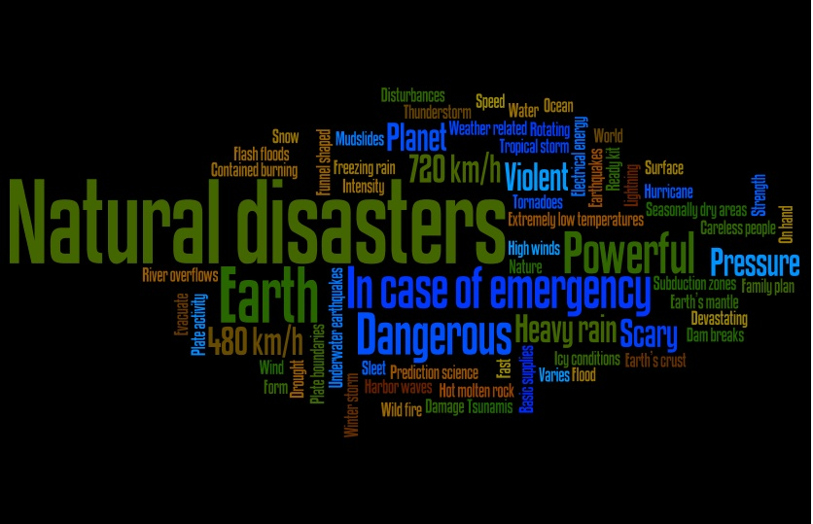
An event of nature that releases energy upon an area, causing destruction of property and loss of human life.

Slide 5
What is a Natural Hazard?
A hazard that arises from geological or weather-related occurrences.
Includes:
Earthquakes
Volcanoes
Floods
Storms / Hurricanes / Tornadoes

Slide 6
Terms to Know
Magnitude - The size of the event
Frequency - How often the event happens
Return Period - The time between two events of the same size

Slide 7
Terms to Know
Disaster - A natural event, such as a flood or earthquake.
Catastrophe - A natural event that causes significant damage to property and harms/kills a large number of people.

Slide 8
Terms to Know
Hazard - Occurs when a natural event is likely to cause harm
Risk - Hazard + recurrence interval + costs
great hazard potential + short recurrence interval + high cost = high risk

Slide 9
Risk Management
Assess
Evaluate
Manage
Measure

Slide 11
Losses from Natural Disasters

Slide 12
Losses - Human Fatalities
Worst Disasters:
Floods
Hurricanes
Earthquakes
Severe Weather
Least:
Tsunami
Volcanic eruptions
Why?

Slide 13
Losses - Human Fatalities
Amount varies from year to year
The population density of a region affects number of fatalities

Slide 14
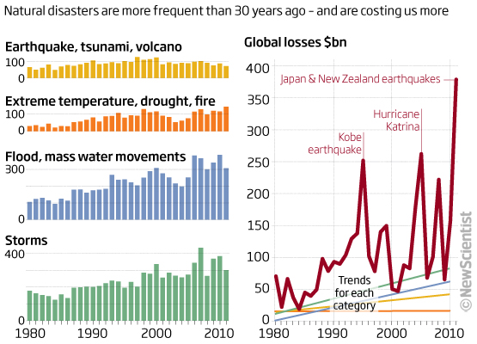
Source

Slide 15
Losses - Economic
Sources:
Buildings, structures
Industry & businesses

Slide 16
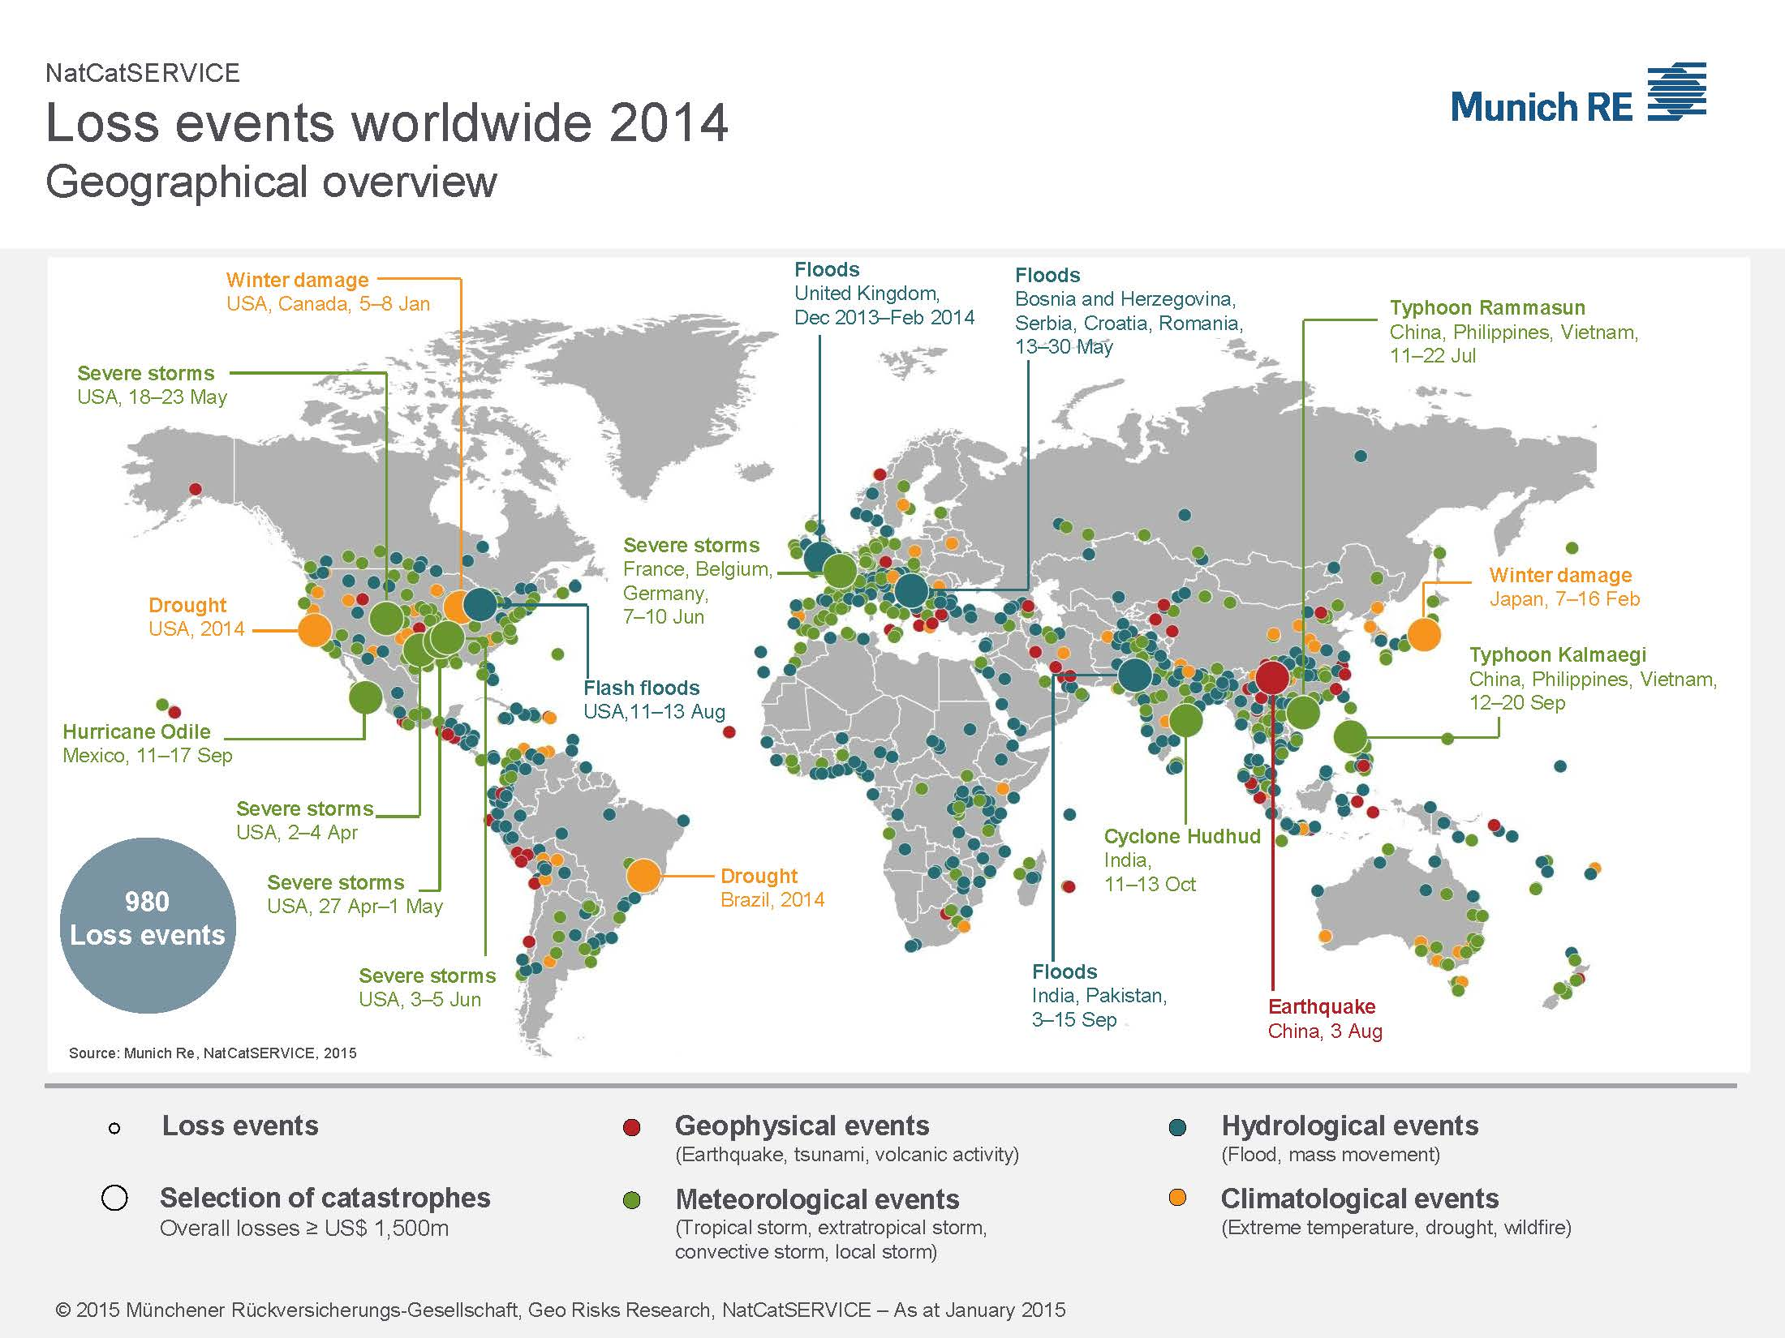
Notes:
http://www.munichre.com/en/reinsurance/business/non-life/natcatservice/significant-natural-catastrophes/index.html

Slide 17
Notes:
http://www.munichre.com/en/reinsurance/business/non-life/natcatservice/significant-natural-catastrophes/index.html

Slide 18
Notes:
http://www.munichre.com/en/reinsurance/business/non-life/natcatservice/significant-natural-catastrophes/index.html

Slide 20
Losses - Economic
Insured Portion of Economic Losses
Amount covered by insurance
Dollar amount lost is different than lives lost

Slide 24
Losses - Economic
Developed Countries
More insurance
Expensive buildings
Less loss of life
Underdeveloped Countries
Less insurance
Inexpensive buildings
More loss of life

Slide 25
How Do Natural Disasters Originate?
Transference of energy from one location or state to another
Internal Sources of Energy
Impact energy from the formation of the planet
Gravitational energy
Radioactive Elements/Internal Heat
External Sources of Energy
The Sun
The Hydrologic Cycle

Slide 26
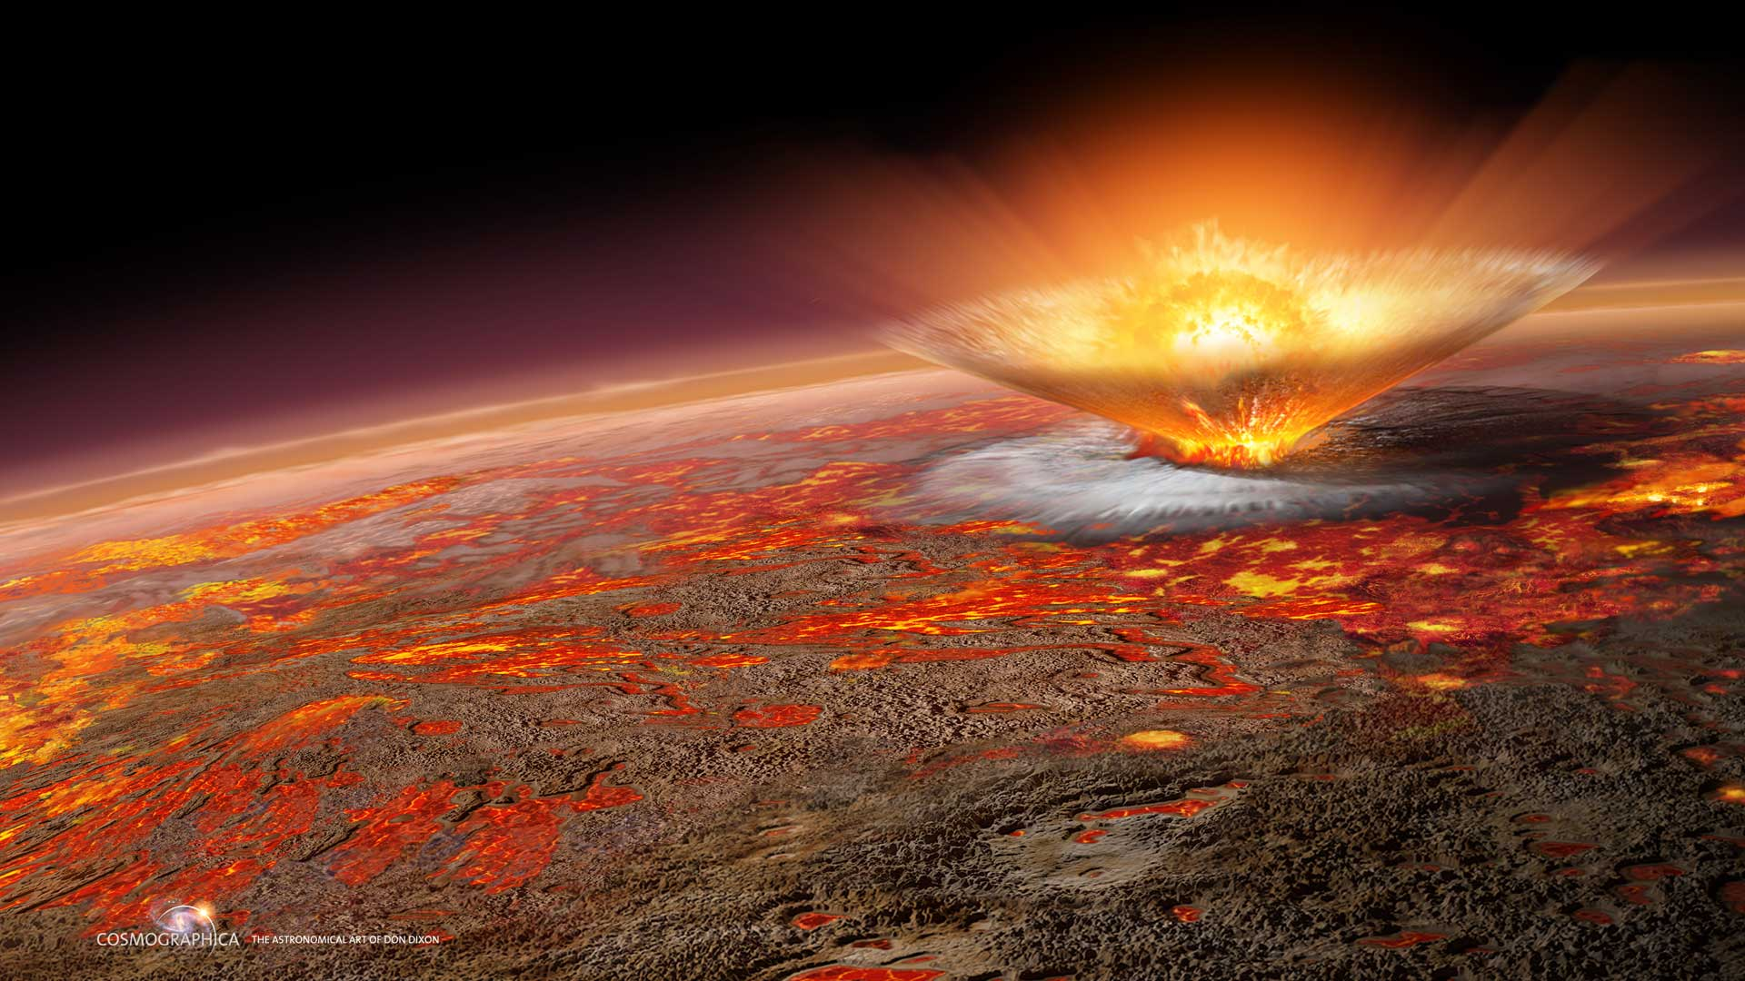
Impact energy from the formation of the planet
Image source

Slide 27
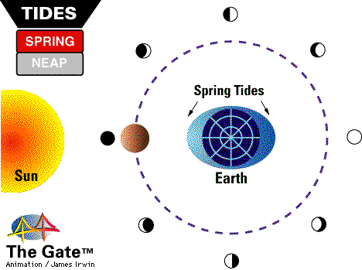
Gravity
Interaction between the sun, moon and Earth produces tidal energy
Image source

Slide 28
External Energy Sources of Disasters
The Sun
Small percentage of total solar energy reaches us
More than 3500x greater than Earth’s interior heat flow

Slide 29
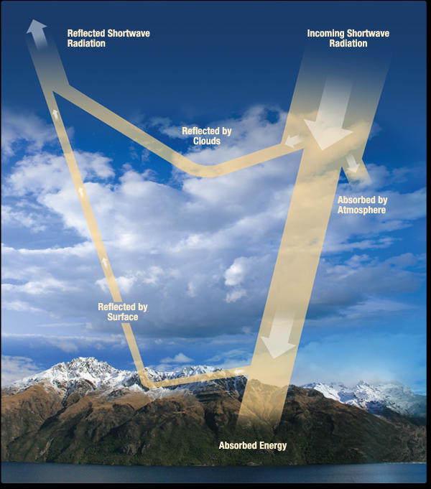
Where does the energy go?
30% ⇨ Albedo (reflection)
47 % ⇨ Absorbed by air, sea and land
23 % ⇨ Evaporation / begin hydrologic cycle
Image source

Slide 30
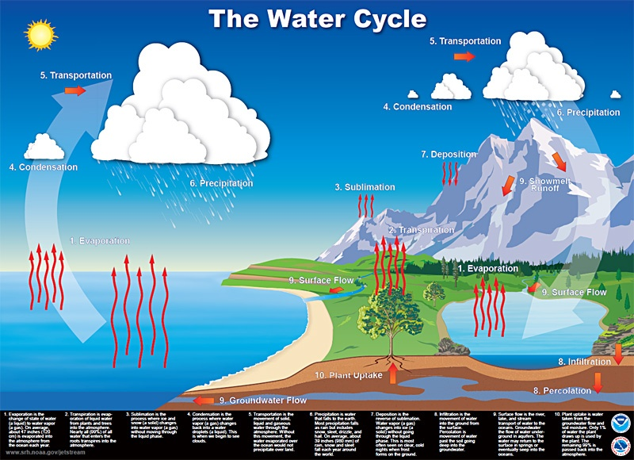
source

Slide 31
Fig. 1-5, p.6
Notes:
FIGURE 1-5. This flowchart indicates interactions between natural hazards. The bolder arrows indicate stronger influences. Can you think of others?

Slide 32
~ End ~

