Slide 1
Impacts of
Climate Change

Slide 2
Assessing the risk
How common is this disaster and where does this disaster normally occur?

Slide 3
Assessing the risk
Weather
  Weather is over a short period of time
  Constantly changing
Climate
  Climate is over a long period of time
  Generalized composite of weather

Slide 4
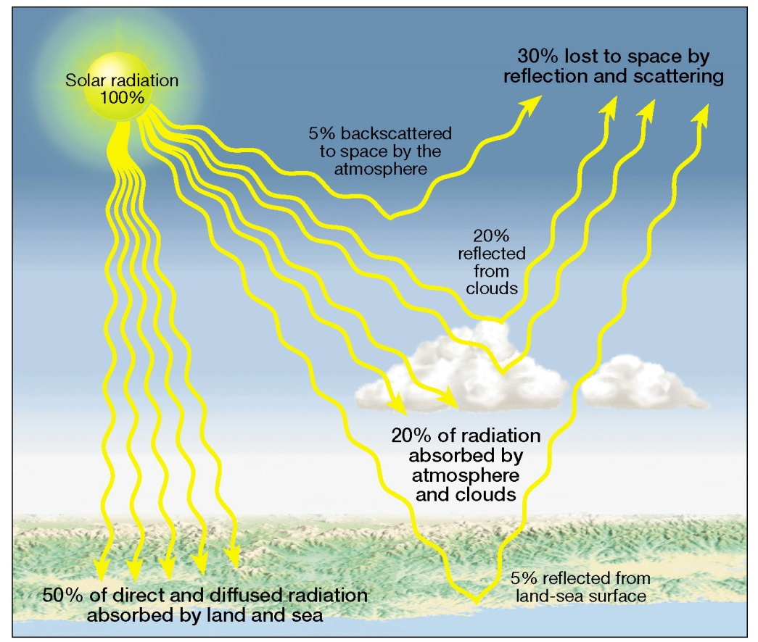
Assessing the risk
Incoming solar radiation
  Reflection – albedo
  (percent reflected)
  Scattering
  Absorption
  Most visible radiation
  reaches the surface

Slide 5
Assessing the risk
Outgoing Radiation
  Earth re-radiates radiation (terrestrial radiation) at the longer wavelengths
  Terrestrial radiation is absorbed by
    Carbon dioxide and
    Water vapor in the atmosphere
    Lower atmosphere is heated from Earth's surface
  The greenhouse effect

Slide 6
Assessing the risk:
Causes of Global Climate Change
Milankovitch cycles
  Eccentricity – 100,000 to 400,000 year periods
  Obliquity – every 41,000 years
  Processional of equinoxes – every 23,000 years
Notes:
http://www.ngdc.noaa.gov/paleo/ctl/

Slide 7
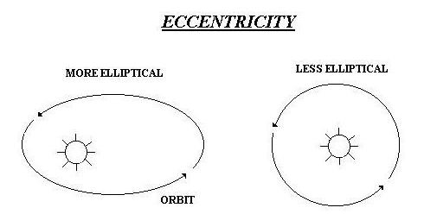
Assessing the risk:
Causes of Global Climate Change
Eccentricity
Shape of Earth’s orbit changes from circular to elliptical over 100,000 years.
  More circular: stable climate
  More elliptical: strong climate variations
Notes:
http://www.nature.nps.gov/views/KCs/Milankovitch/Milankovitch.htm#
http://www.indiana.edu/~geol105/images/gaia_chapter_4/milankovitch.htm

Slide 8
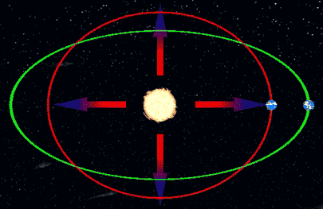
Eccentricity t
warmer
cooler
Notes:
http://www.nature.nps.gov/views/KCs/Milankovitch/Milankovitch.htm#

Slide 9
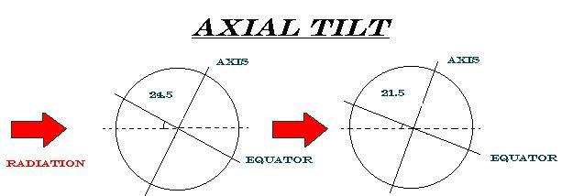
Assessing the risk:
Causes of Global Climate Change
Obliquity
The degree to which the axis tilts varies from 21.5° to 23.5° over 41,000 years
  More tilt: poles receive more sunlight
  Less tilt: poles receive less sunlight
Notes:
http://www.nature.nps.gov/views/KCs/Milankovitch/Milankovitch.htm#
http://www.indiana.edu/~geol105/images/gaia_chapter_4/milankovitch.htm

Slide 10
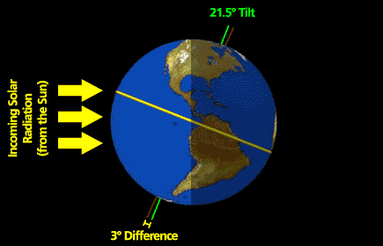

Slide 11
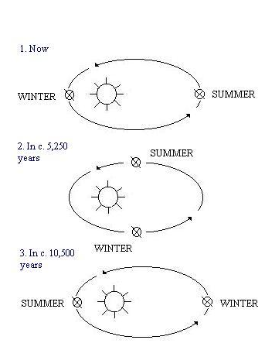
Assessing the risk:
Causes of Global Climate Change
Precession of the equinoxes
As the Earth spins, it wobbles a bit
  N Pole currently points towards Polaris (the North Star) but shifts to point towards Vega over 23,000 years
Notes:
http://www.nature.nps.gov/views/KCs/Milankovitch/Milankovitch.htm#
http://www.indiana.edu/~geol105/images/gaia_chapter_4/milankovitch.htm

Slide 12
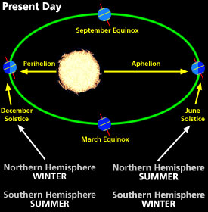
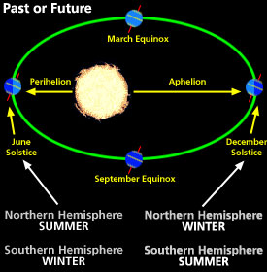

Slide 13
Assessing the risk:
Causes of Global Climate Change
Volcanic Eruptions
  Cooling
    Tambora, Indonesia – 1815 “year without a summer”
    Mount Toba, present day Sumatra - 73,000 years ago accelerated glaciation
Warming
  Pinatubo – 1991 eruption of SO₂ lead to winter warming
  Flood basalts
Notes:
http://www.gsfc.nasa.gov/gsfc/service/gallery/fact_sheets/earthsci/volcano.htm
http://earthobservatory.nasa.gov/Features/Volcano/

Slide 14
Assessing the risk:
Causes of Global Climate Change
  Changes in ocean circulation
    Changes to Thermohaline current
    Position of the continents
Notes:
http://www.gsfc.nasa.gov/gsfc/service/gallery/fact_sheets/earthsci/volcano.htm

Slide 15
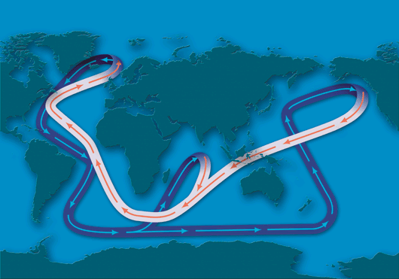
THE GLOBAL OCEAN CONVEYOR
The global ocean circulation system, often called the Ocean Conveyor, transports heat throughout the planet. White sections represent warm surface currents. Purple sections represent deep cold currents. (Illustration by Jayne Doucette, WHOI)
Notes:
http://www.whoi.edu/page.do?pid=83339&tid=3622&cid=9986
Abrupt Climate Change: Should We Be Worried?

Slide 16
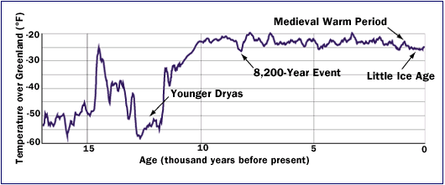
Assessing the risk:
Causes of Global Climate Change
The Younger Dryas
  about 12,700 years ago, average temperatures in the North Atlantic region abruptly plummeted nearly 5°C and remained that way for 1,300 years before rapidly warming again.
Notes:
http://www.whoi.edu/page.do?pid=83339&tid=3622&cid=9986

Slide 17
Assessing the risk:
Causes of Global Climate Change
The 8,200-Year Event
  A similar abrupt cooling occurred 8,200 years ago.
  It was not so severe and lasted only about a century.
  But if a similar cooling event occurred today, it would be catastrophic.
Notes:
http://www.whoi.edu/page.do?pid=83339&tid=3622&cid=9986

Slide 18
Assessing the risk:
Causes of Global Climate Change
The Medieval Period
  An abrupt warming took place about 1,000 years ago.
  It was not nearly so dramatic as past events, but it nevertheless allowed the Norse to establish settlements in Greenland.
Notes:
http://www.whoi.edu/page.do?pid=83339&tid=3622&cid=9986

Slide 19
Assessing the risk:
Causes of Global Climate Change
The Little Ice Age
  The Norse abandoned their Greenland settlements when the climate turned abruptly colder 700 years ago.
  Between 1300 and 1850, severe winters had profound agricultural, economic, and political impacts in Europe.
Notes:
http://www.whoi.edu/page.do?pid=83339&tid=3622&cid=9986

Slide 20
Assessing the risk:
Causes of Global Climate Change
Warming
cooling
More circular orbit
Less tilt: poles receive more sunlight
Increase in SO₂ due to volcanic eruptions
More elliptical orbit
More tilt: poles receive less sunlight
Increase in dust/gasses due to volcanic eruptions
Changes in thermalhaline currents

Slide 21
Assessing the risk:
Effects of Global Climate Change
Warming
cooling
Rise in temperatures globally
Melting of ice caps leads to rising sea levels
Ecosystem shifts
Extinction of some species and development of new ones
Drop in temperatures globally
Ice cap growth leads to the lowering of sea levels
Ecosystem shifts
Extinction of some species and development of new ones

Slide 22
Assessing the risk: The current situation
“Ice Ages” are periods of time when long term cooling of the Earth’s temperatures leads to the development of ice sheets on the poles.
  Glacial Periods – times within an ice age where temperatures are cool
  Interglacials – times within an ice age where temperatures are warm

Slide 23
Assessing the risk: The current situation
“Ice Ages” are periods of time when long term cooling of the Earth’s temperatures leads to the development of ice sheets on the poles.
  Last ice age began 2.6 million years ago
  Last Glacial Period was from 110,000 to ~11,000 years ago
  We are currently in an interglacial period.

Slide 24
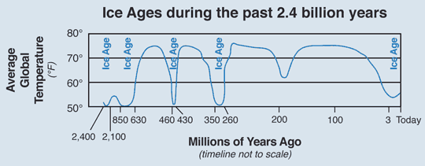
Simplified chart showing when the five major ice ages occurred in the past 2.4 billion years of Earth’s history. Modified from several sources including Dynamical Paleoclimatology: Generalized Theory of Global Climate Change, 2002, by Barry Saltzman.
Notes:
http://geology.utah.gov/map-pub/survey-notes/glad-you-asked/ice-ages-what-are-they-and-what-causes-them/

Slide 25
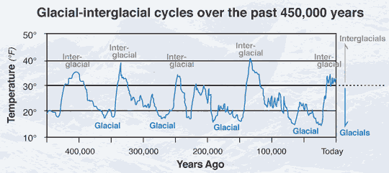
Four fairly regular glacial-interglacial cycles occurred during the past 450,000 years. The shorter interglacial cycles (10,000 to 30,000 years) were about as warm as present and alternated with much longer (70,000 to 90,000 years) glacial cycles substantially colder than present.
Notes:
http://geology.utah.gov/map-pub/survey-notes/glad-you-asked/ice-ages-what-are-they-and-what-causes-them/

Slide 26
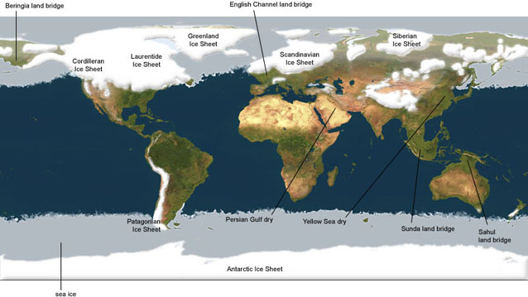
Last Glacial Maximum
Notes:
http://www.planetaryvisions.com/Project.php?pid=2226

Slide 27
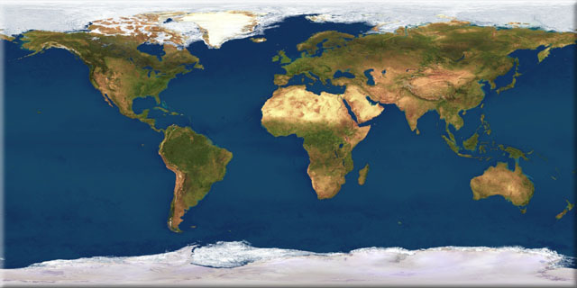
Today
Notes:
http://www.planetaryvisions.com/Project.php?pid=2226

Slide 28
Assessing the risk
What are the major causes of damage, destruction, death associated with this disaster?

Slide 29
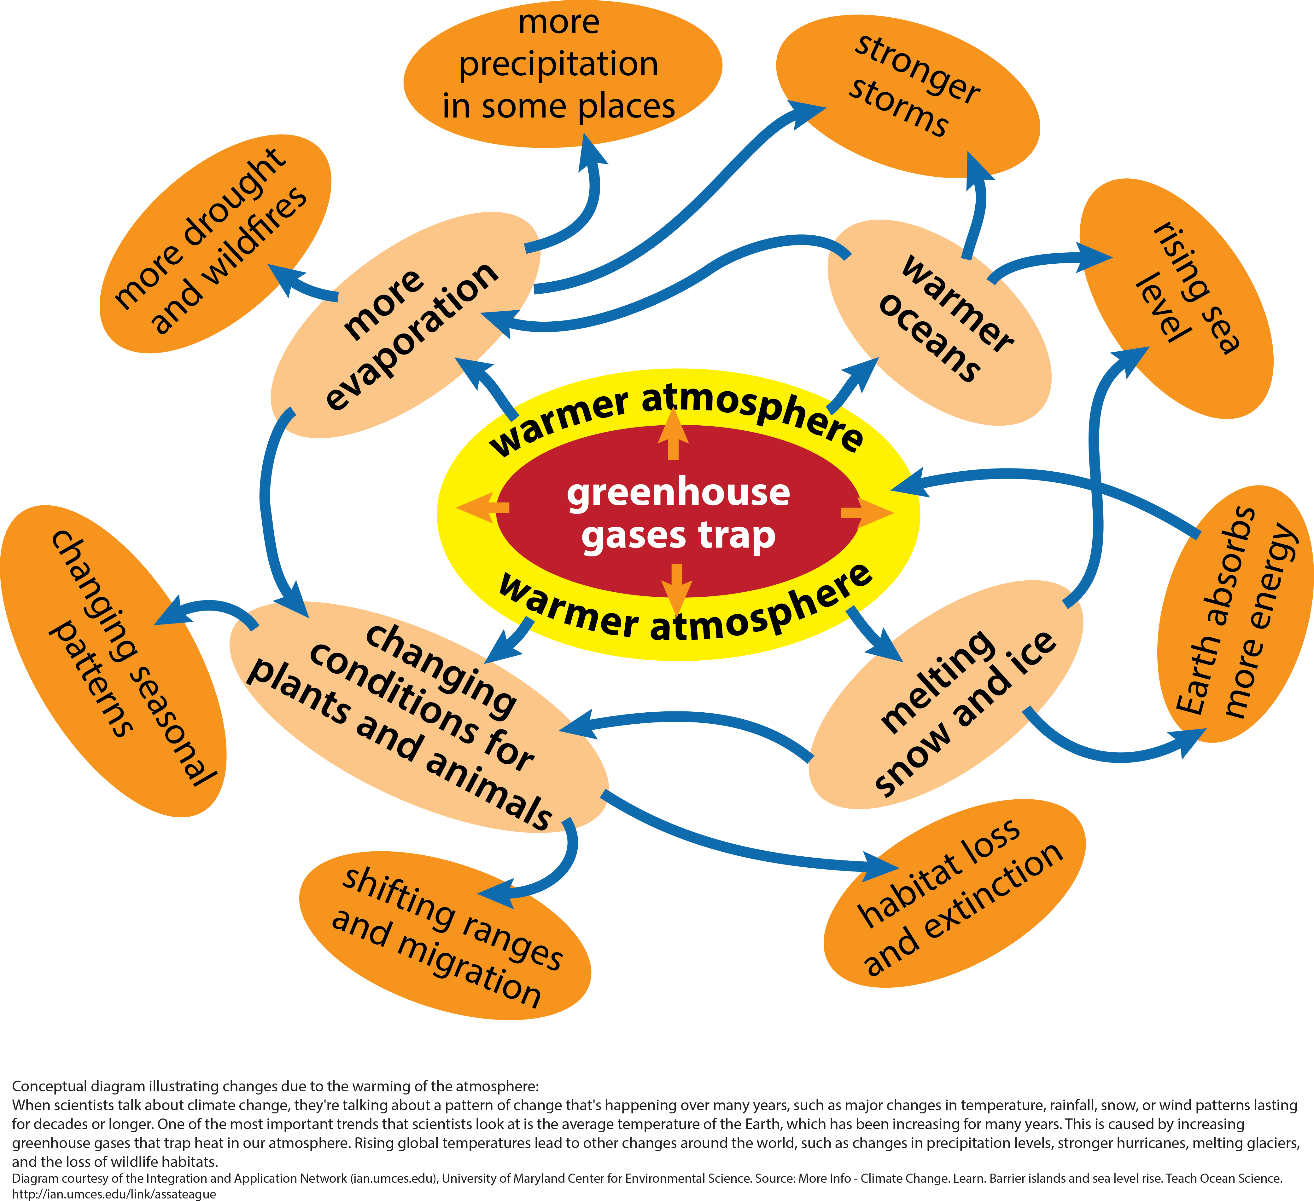
Notes:
http://www3.epa.gov/climatechange/kids/basics/concepts.html

Slide 30
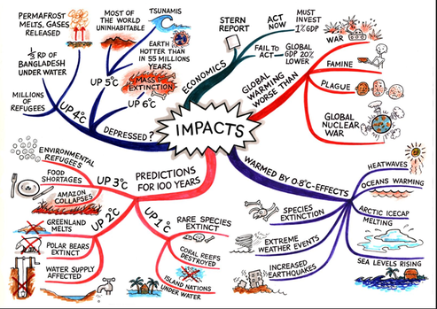
Notes:
http://thebritishgeographer.weebly.com/the-impacts-of-climate-change1.html

Slide 31
Assessing the risk:
Possible effects of global warming
Higher temperatures
More droughts
Wilder weather
Change to rain/snow pattern
Less snowpack
Shrinking sea ice
Melting glaciers
Thawing permafrost
Increased ocean acidity
Warmer oceans
Rising sea levels
Notes:
http://www3.epa.gov/climatechange/kids/impacts/signs/index.html

Slide 32
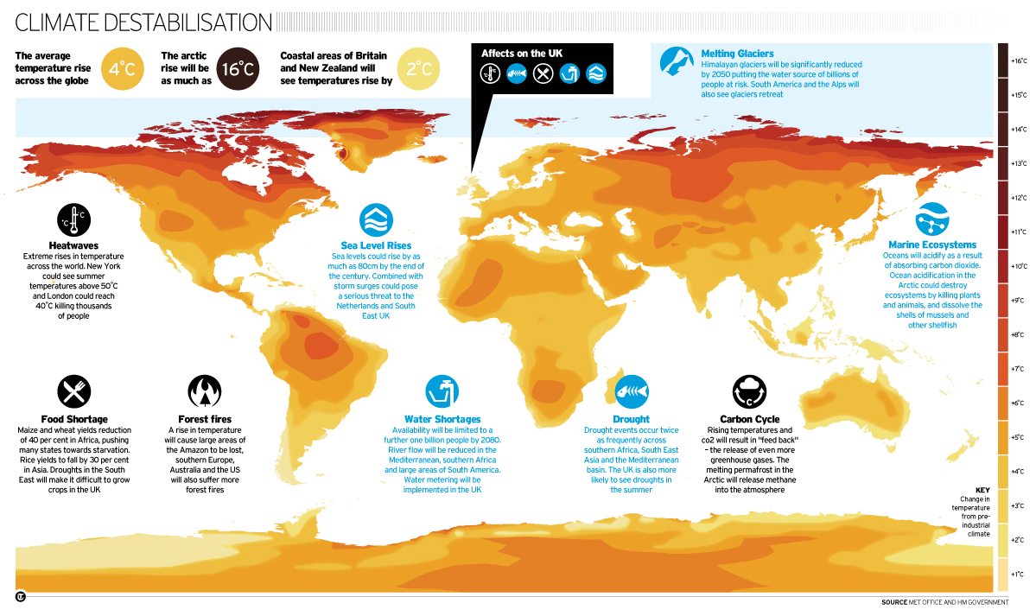
Notes:
http://i.telegraph.co.uk/multimedia/archive/01508/Climate-ChangeNEW_1508747a.jpg

Slide 33
Assessing the risk:
Possible impacts of global warming
Health
  Increased global temperatures means more heatwaves
  It also means an increase in water and vector-born illnesses
  Will also lead to an increase in pollution, pollen, and ozone.
In 2013, malaria caused an estimated 584 000 deaths, mostly among African children.
Notes:
http://www3.epa.gov/climatechange/kids/impacts/effects/health.html
http://www.who.int/mediacentre/factsheets/fs094/en/

Slide 34
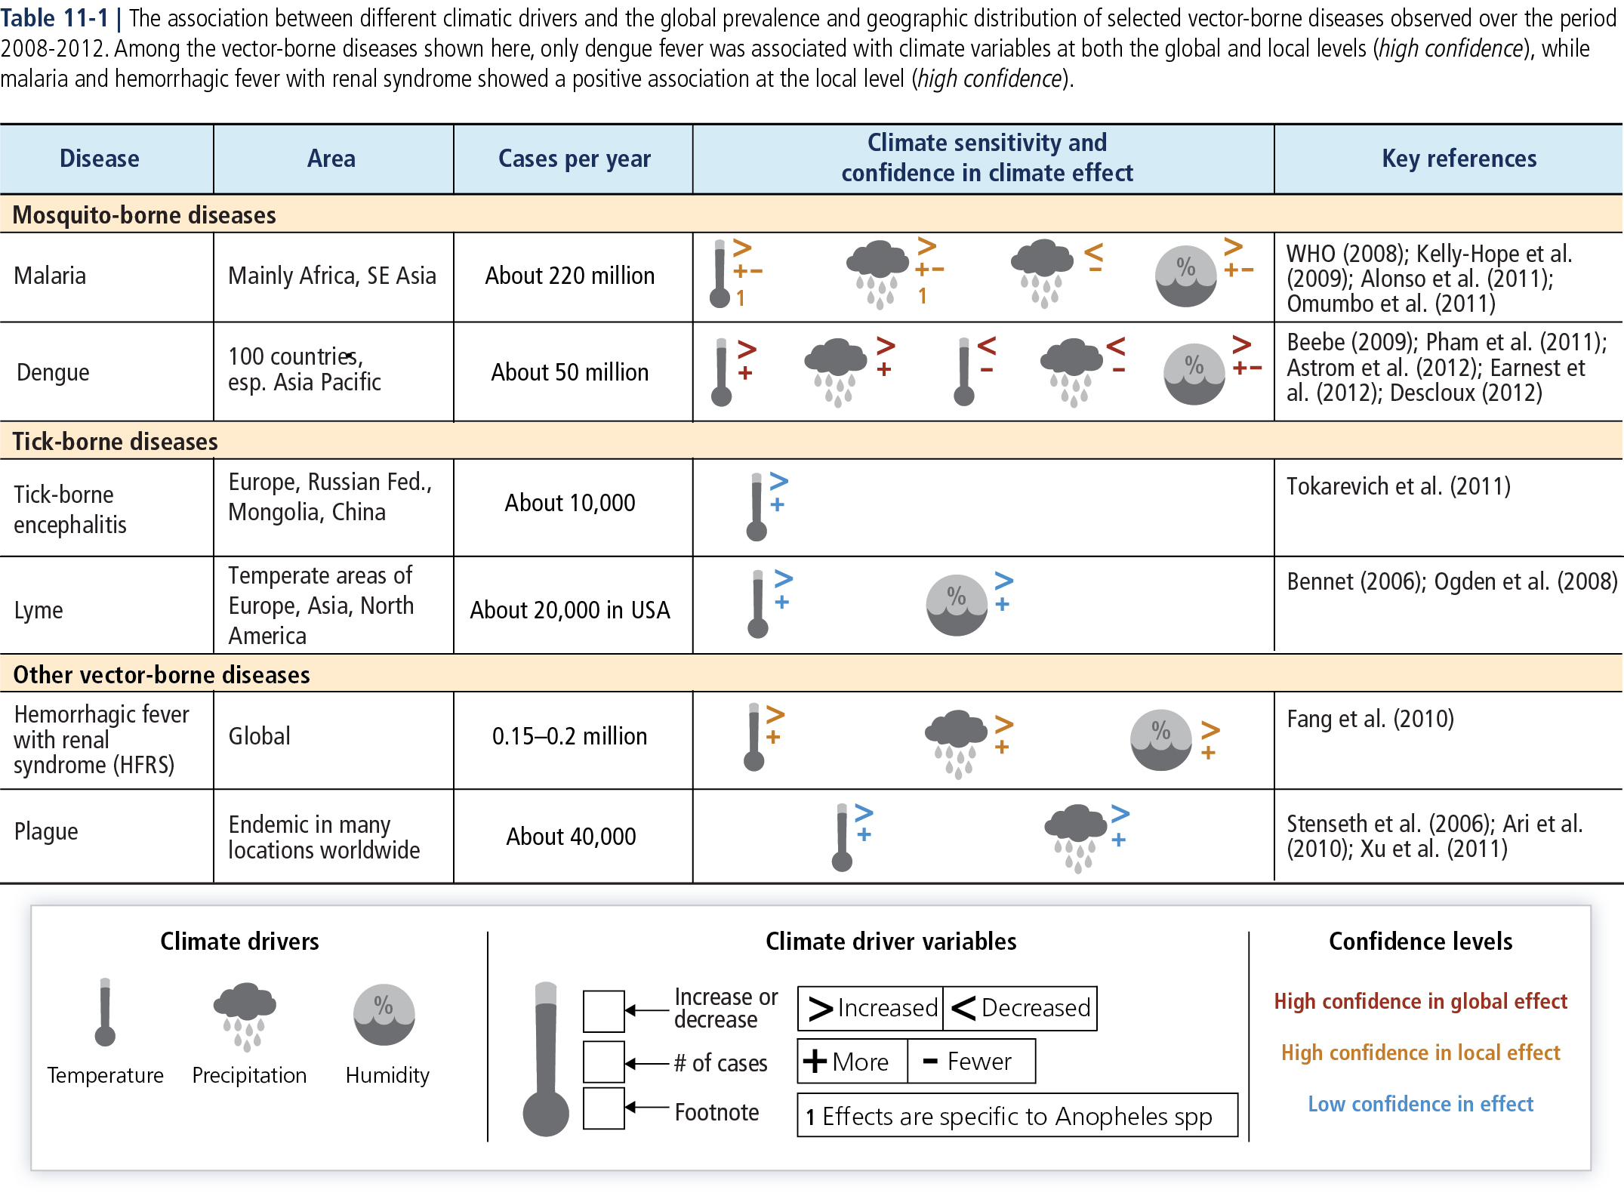
Notes:
http://ipcc-wg2.gov/AR5/report/graphics/Ch11

Slide 35
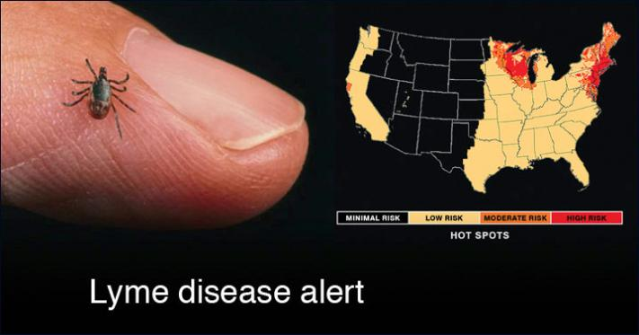
Warmer temperatures are contributing to the range expansion and severity of tick-borne Lyme disease.
Notes:
https://www.edf.org/climate/8-global-warming-effects-may-surprise-you

Slide 36
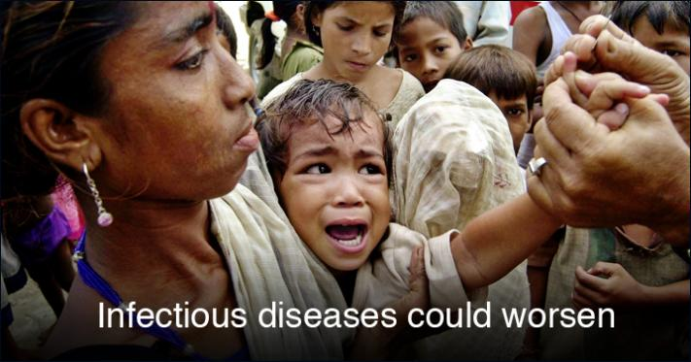
In Bangladesh, a rise in water temperature has been observed to increase the risk of a cholera outbreak by two to five times.
Notes:
https://www.edf.org/climate/8-global-warming-effects-may-surprise-you

Slide 37
Assessing the risk:
Possible impacts of global warming
Agriculture
  Plants need specific conditions to grow
  Crops now grown in certain areas may not be able to with higher temperatures
  Areas that were too cold may now be suitable for crops
Shift in crop-growing regions will result in lack of income/jobs in some areas, and an increase in income/jobs in others.
Notes:
http://www3.epa.gov/climatechange/kids/impacts/effects/agriculture.html

Slide 38
Assessing the risk:
Possible impacts of global warming
Agriculture
  Crops currently affected:
    Coffee
    Chocolate
    Grapes
    Wheat, rice, and other cereal crops

Slide 39
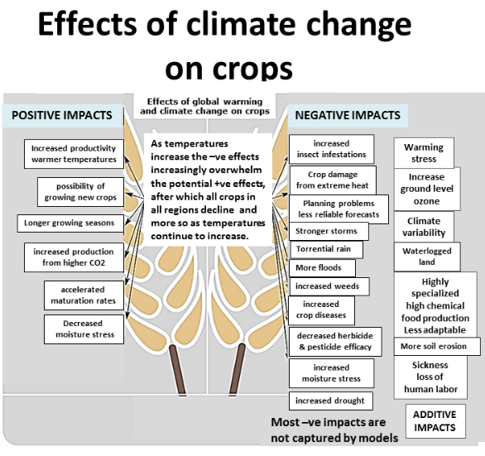
Notes:
http://www.climatechange-foodsecurity.org/science.html

Slide 40
Assessing the risk:
Possible impacts of global warming
Energy
  Temperature increases will result in the increased need for air conditioning
  Changes to rain/snow patterns may cause some areas to dry up, and others to have too much water.
Areas dependent on hydroelectric power will need another source if rivers dry up.
Notes:
http://www3.epa.gov/climatechange/kids/impacts/effects/energy.html

Slide 41
Assessing the risk:
Possible impacts of global warming
Water Supplies
  Temperature increases, droughts and changes to rain/snow patterns may cause some areas to dry up.
  Reduced snow and ice packs will also restrict the amount of water in rivers & streams
Lack of water will lead to conflicts as areas fight to have water resources under their control.
Water conservation measures may not be enough.
Notes:
http://www3.epa.gov/climatechange/kids/impacts/effects/water.html

Slide 42
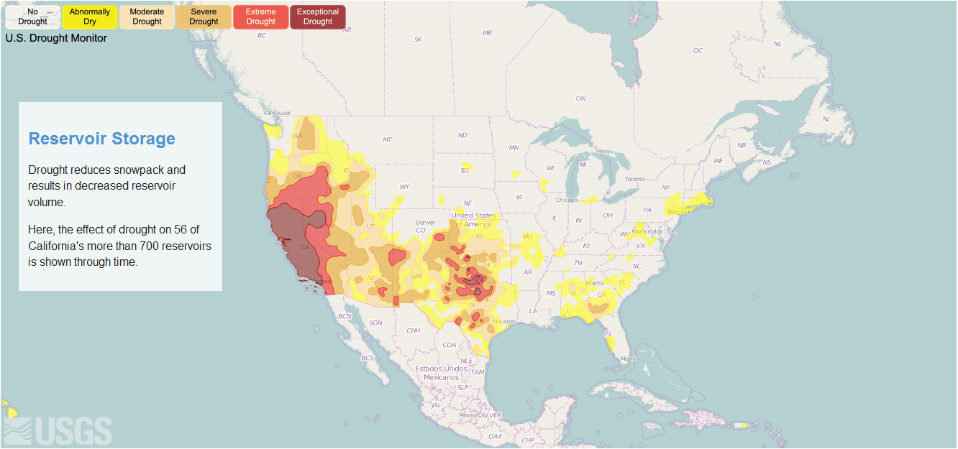
Notes:
http://cida.usgs.gov/ca_drought/

Slide 43
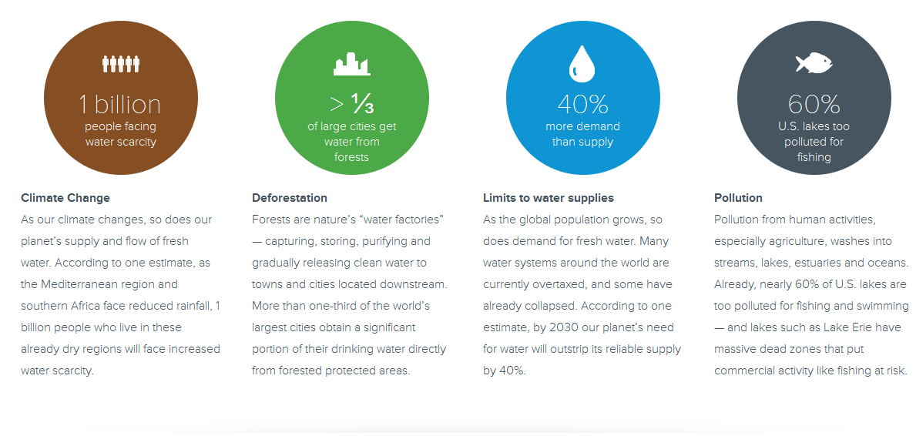
Notes:
http://www.conservation.org/what/Pages/fresh-water.aspx

Slide 44
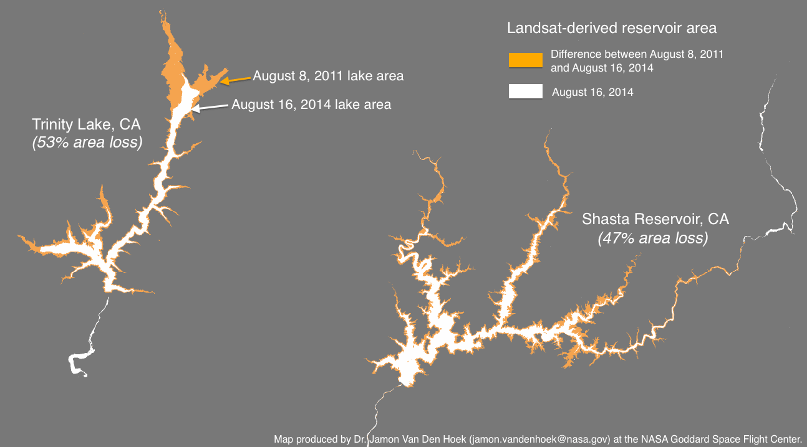
Notes:
http://cida.usgs.gov/ca_drought/

Slide 45
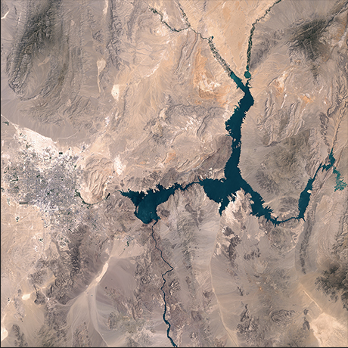
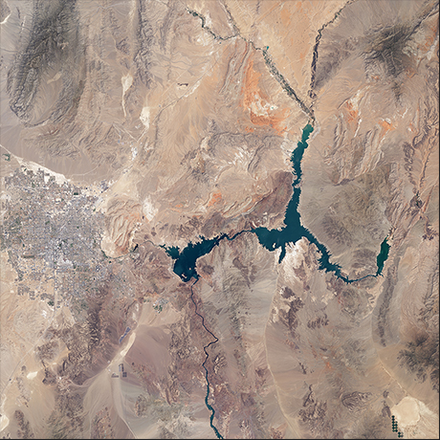
Shrinking Lake Mead, Nevada-Arizona border
Persistent drought has dropped Lake Mead’s water level to its lowest since the reservoir lake was created in the 1930s. The water’s elevation, measured near Hoover Dam, declined by about 120 feet (37 meters) between the time of the 2000 image and that of the 2015 image and is down by some 142 feet (43 meters) from full capacity.
Notes:
http://climate.nasa.gov/state_of_flux#Lake-Mead-930px.jpg

Slide 46
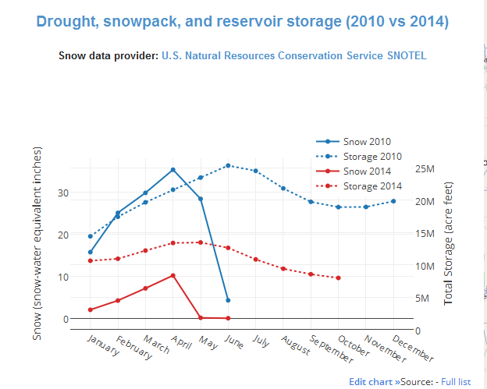
Notes:
http://cida.usgs.gov/ca_drought/

Slide 47
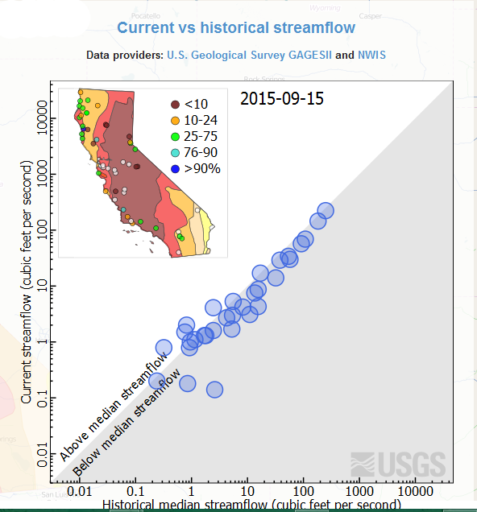
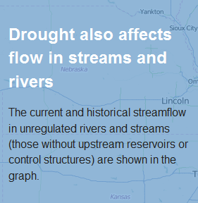
Notes:
http://cida.usgs.gov/ca_drought/

Slide 48
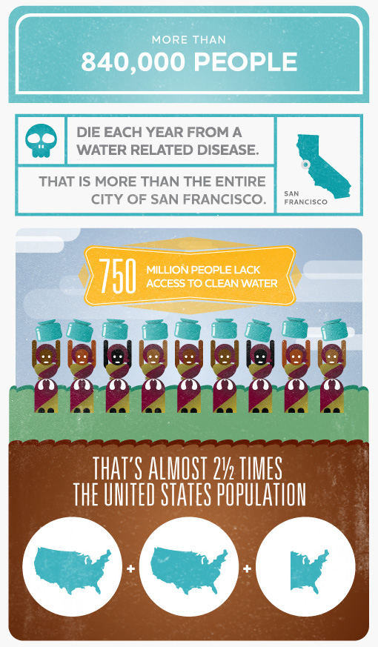
Every minute a child dies of a water-related disease
Women and children spend 140 million hours a day collecting water
1 in 9 people lack access to safe water
More people have a mobile phone than a toilet
For every $1 spent on water and sanitation there is a $4 economic return
Notes:
http://water.org/water-crisis/water-facts/water/

Slide 49
Assessing the risk:
Possible impacts of global warming
Plants, Animals, and Ecosystems
  Plants and animals need specific climatic conditions to live.
  Both will shift towards the poles to meet these needs.
  Some habitats will be gone, others will cover a wider area.
Some plants are blooming before the pollinating insects arrive, reducing the amount of fruit created and starving out some insect species.
Notes:
http://www3.epa.gov/climatechange/kids/impacts/effects/ecosystems.html

Slide 50
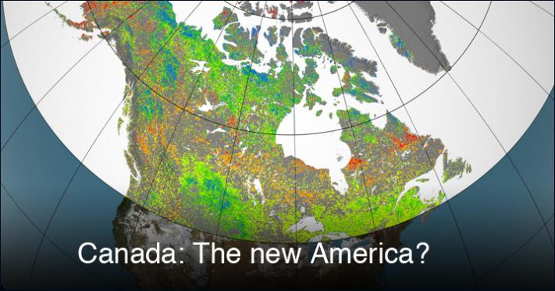
Lush vegetation growth typically associated with the United States is now becoming more common in Canada
Notes:
https://www.edf.org/climate/8-global-warming-effects-may-surprise-you

Slide 51
Assessing the risk:
Possible impacts of global warming
Forests
  Trees and other species living in forests will slowly move toward the poles.
  Lack of water & increased temperatures dry out the forest, making it vulnerable to pests.
The drying out of the forests will lead to an increased amount of wildfires.
Notes:
http://www3.epa.gov/climatechange/kids/impacts/effects/ecosystems.html

Slide 52
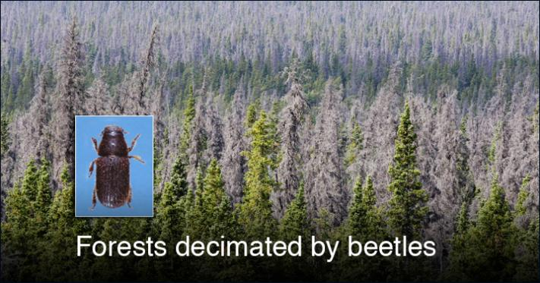
Since 1996, bark beetles have decimated an area roughly the size of Washington State. One reason: Recent winters haven't been cold enough to kill off the beetles.
Notes:
https://www.edf.org/climate/8-global-warming-effects-may-surprise-you

Slide 53
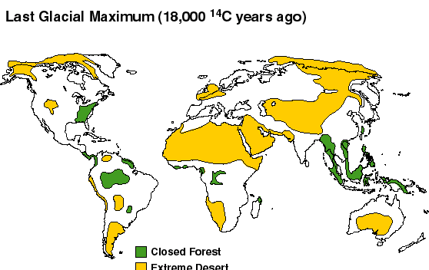
Notes:
http://www.esd.ornl.gov/projects/qen/nerc.html

Slide 54
Assessing the risk:
Possible impacts of global warming
Coastal regions
  Rising sea levels inundate these low-lying areas.
  Increased storms will cause erosion to the coastline.
  Lack of water in streams will reduce the amount of sediment reaching the beaches, which will increase the amount of coastal erosion.
  Disruption and degradation of wetland areas.
In 2010, 123.3 million people, or 39 percent of the nation’s population lived in counties directly on the shoreline.
Notes:
http://www3.epa.gov/climatechange/kids/impacts/effects/coastal.html

Slide 55
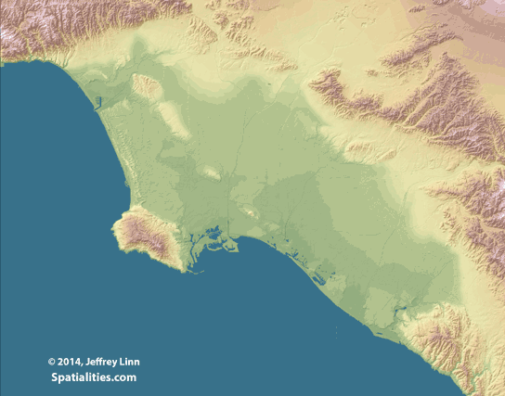
Progressive Sea Level Rise In The LA Basin
Notes:
http://spatialities.com/category/sea-level-rise-maps/

Slide 56
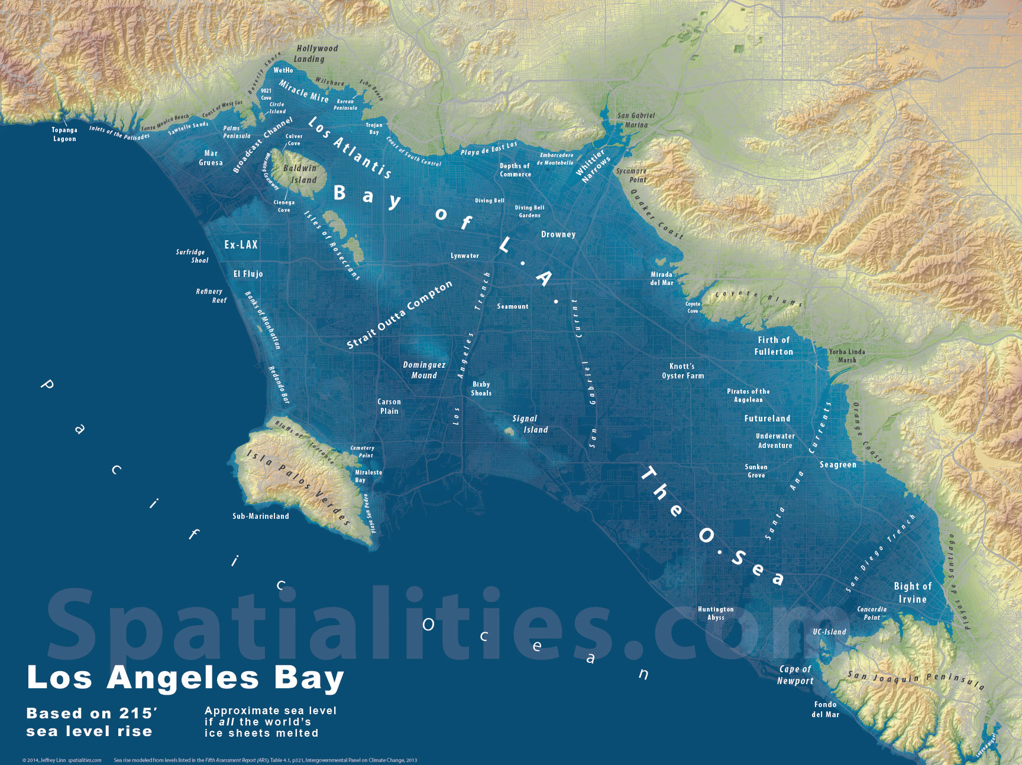
Progressive Sea Level Rise In The LA Basin
Notes:
http://spatialities.com/category/sea-level-rise-maps/

Slide 57
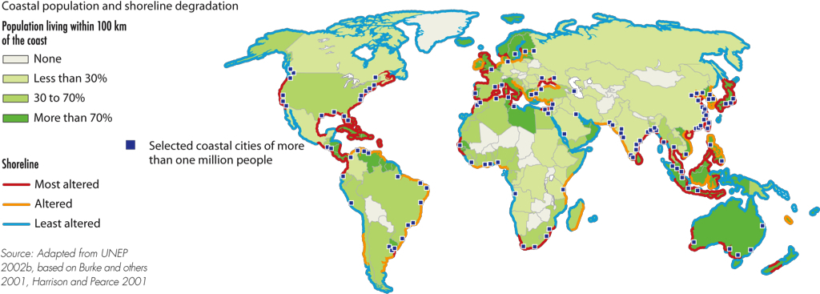
Assessing the risk:
Possible impacts of global warming
Source: http://www.grida.no/graphicslib/detail/coastal-population-and-shoreline-degradation_16b9
Notes:
http://www.grida.no/graphicslib/detail/coastal-population-and-shoreline-degradation_16b9

Slide 58
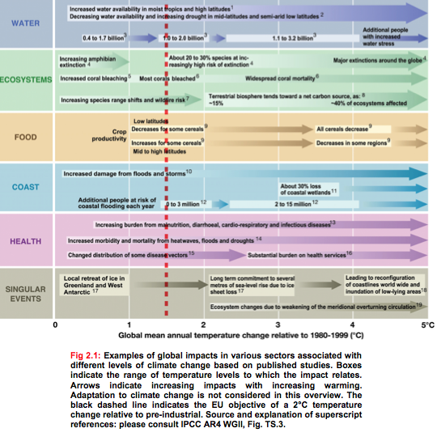
Notes:
http://thebritishgeographer.weebly.com/the-impacts-of-climate-change1.html

Slide 59
Reducing the risk
What, if anything, can be done to prevent this disaster from occurring?

Slide 60
What, if anything, can be done to prevent this disaster from occurring?
Honestly? Not much
Our planet is in an interglacial period, and is naturally warming up.
Human dependency on fossil fuels and unsustainable lifestyles is making the problem worse.

Slide 61
Reducing the risk
What can be done to reduce the damages caused by this disaster?

Slide 62
What can be done to reduce the damages caused by this disaster?
Health
  Have a plan for long-term heat waves
  Increased temperatures will lead to increased pollution and ozone levels
  Vector control to reduce the risk of malaria, etc.
  Increase access to:
    Clean water
    Sanitation
    Health care
Notes:
http://www.livescience.com/35635-climate-change-health-countdown.html

Slide 63
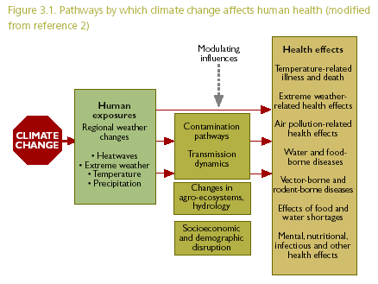
Notes:
http://www.who.int/globalchange/summary/en/index2.html

Slide 64
What can be done to reduce the damages caused by this disaster?
Agriculture
  Cultivar adjustment
  Planting date adjustment
  Combined planting date and cultivar adjustment
  Irrigation optimization
  Fertilizer optimization
Notes:
http://www.elsevier.com/connect/how-will-climate-change-affect-food-security

Slide 65
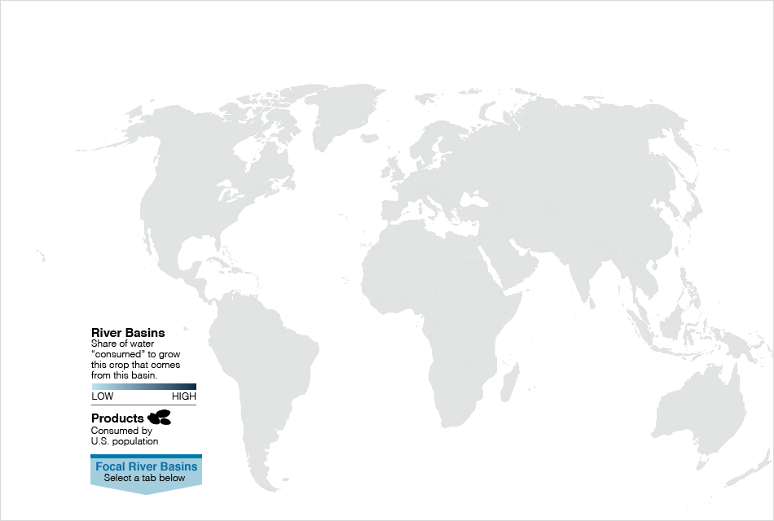
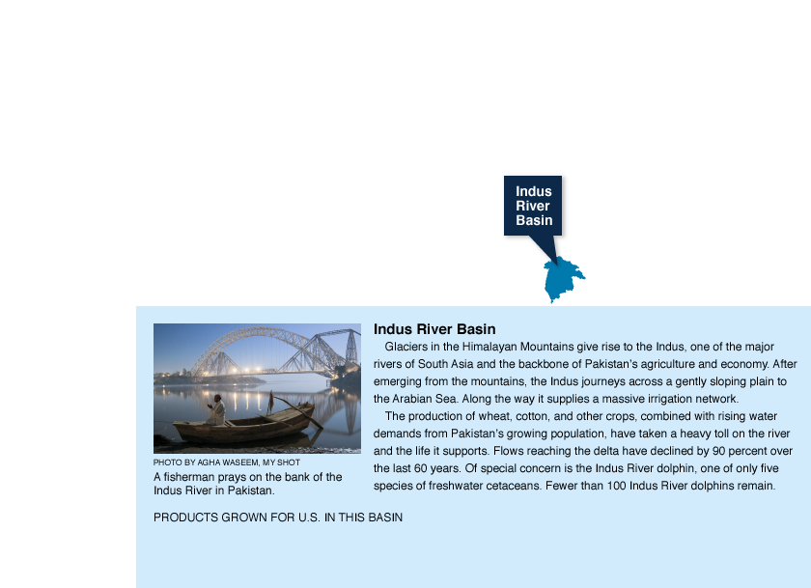
The Global Water Footprint of Key Crops
Notes:
http://environment.nationalgeographic.com/environment/freshwater/global-water-footprint/

Slide 66
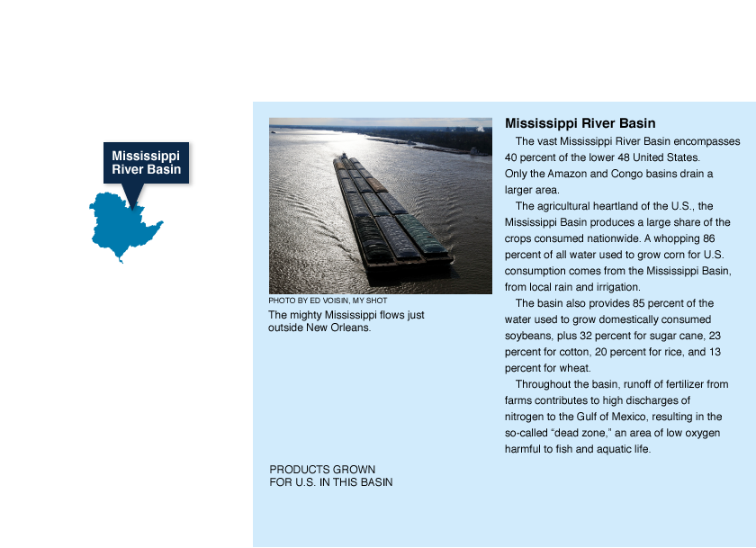
The Global Water Footprint of Key Crops
Notes:
http://environment.nationalgeographic.com/environment/freshwater/global-water-footprint/

Slide 67
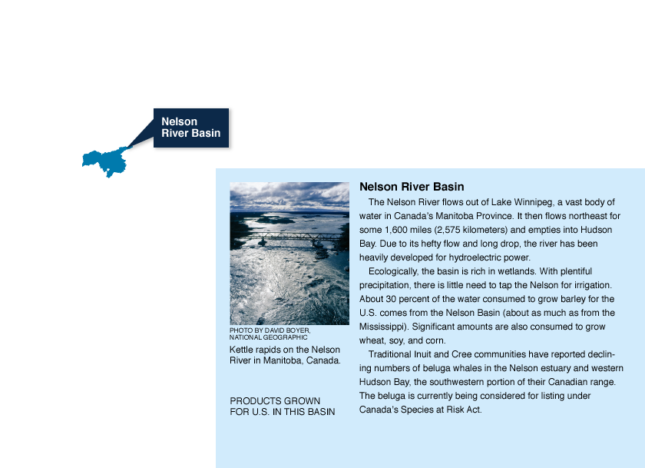
The Global Water Footprint of Key Crops
Notes:
http://environment.nationalgeographic.com/environment/freshwater/global-water-footprint/

Slide 68
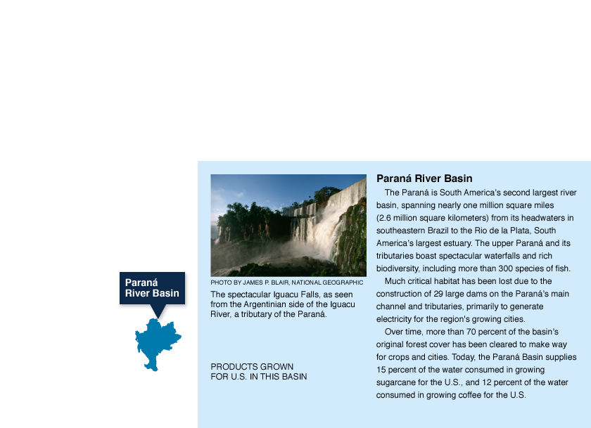
The Global Water Footprint of Key Crops
Notes:
http://environment.nationalgeographic.com/environment/freshwater/global-water-footprint/

Slide 69
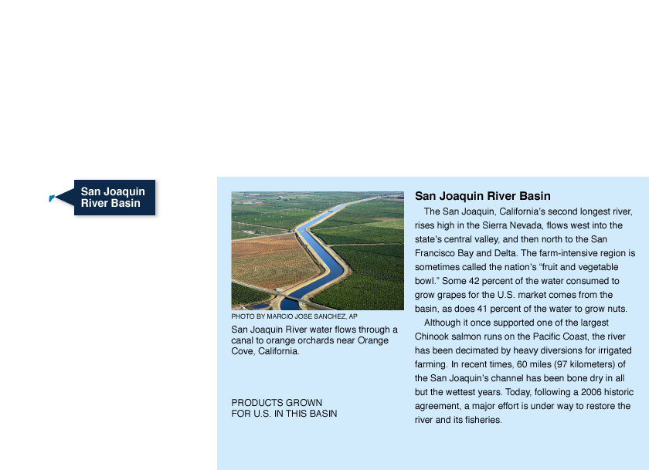
The Global Water Footprint of Key Crops
Notes:
http://environment.nationalgeographic.com/environment/freshwater/global-water-footprint/

Slide 70
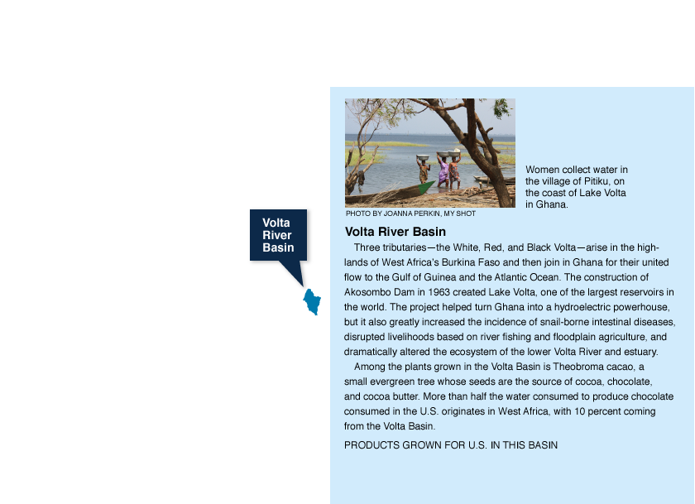
The Global Water Footprint of Key Crops
Notes:
http://environment.nationalgeographic.com/environment/freshwater/global-water-footprint/

Slide 71
What can be done to reduce the damages caused by this disaster?
Energy
  Eliminate dependency on hydroelectric power and fossil fuels
  Reduce, reuse, recycle
  Focus on renewable energy source
  Use resources wisely

Slide 72
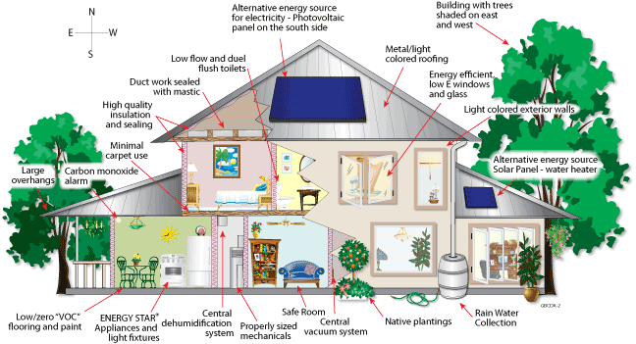
Notes:
http://innov8tiv.com/lamudi-kenya-talks-rise-green-buildings-household-appliances/

Slide 73
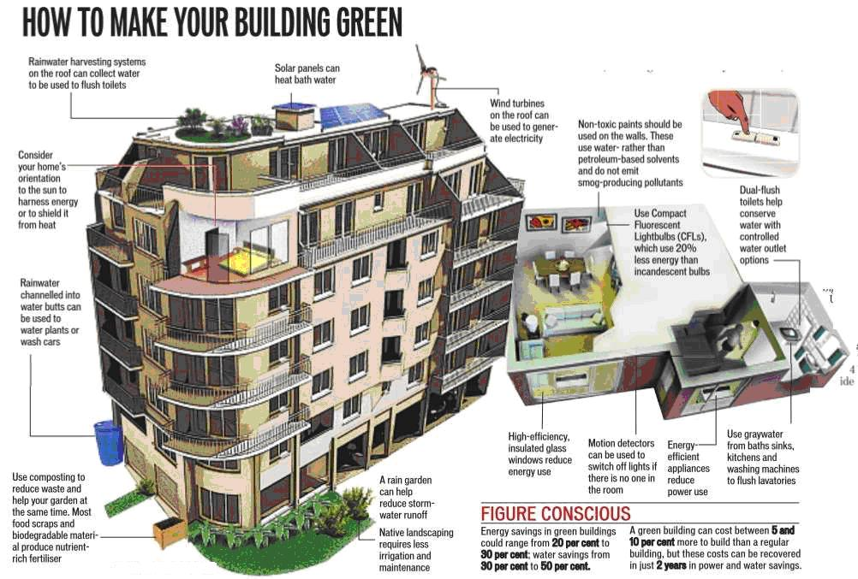
Notes:
http://innov8tiv.com/lamudi-kenya-talks-rise-green-buildings-household-appliances/

Slide 74
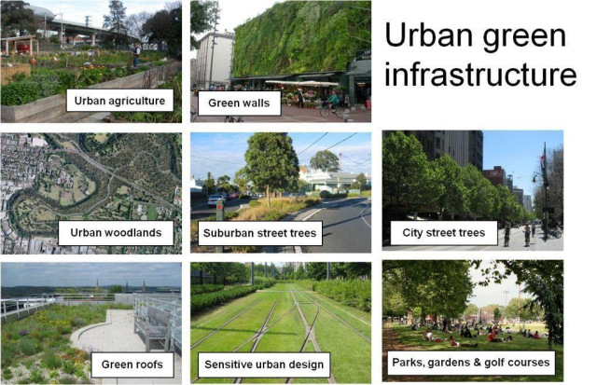
Notes:
http://thegirg.org/

Slide 75
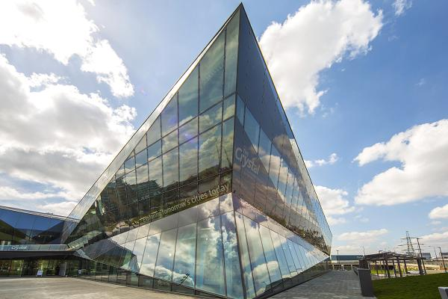
The Crystal, London, UK
Electricity generated by photovoltaic solar
Lighting is a combination of LED and fluorescent lights and daylight.
The building's roof collects rainwater, while sewage is treated, recycled and re-used onsite.
Notes:
http://www.cnbc.com/2014/08/11/ten-of-the-worlds-most-sustainable-buildings.html?slide=3

Slide 76
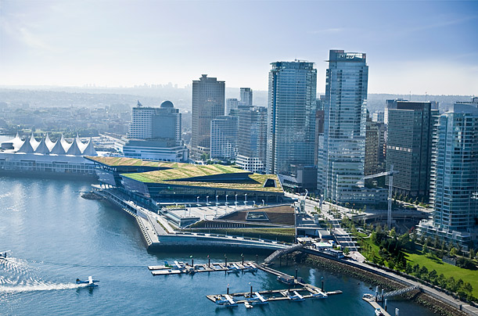
Vancouver Convention Centre West, Vancouver
A 6-acre living roof hosts 400,000 indigenous plants
CO₂, VOC and humidity sensors
Heating and cooling are provided by seawater heat pumps powered by hydroelectricity.
Notes:
http://content.time.com/time/photogallery/0,29307,2065341_2265680,00.html

Slide 77

Kiowa County Schools, Greensburg, KA
Design optimizes day lighting & natural ventilation
Reducing the urban-heat-island effect through open area allocation and diverse landscaping.
A 50-kilowatt wind turbine outside the school provides a portion of the building's energy needs, with the rest coming from a wind farm located outside the town
Notes:
http://content.time.com/time/photogallery/0,29307,2065341_2265666,00.html

Slide 78

Milano Santa Monica, Milano Italy
Includes an apartment complex, schools, sporting facilities, and a shopping center.
Photovoltaic panels shade sun-facing windows & generate energy
Solar water heaters help to further increase efficiency.
Vegetation on the outside helps to insulate the interiors while providing fresh air.
Notes:
http://inhabitat.com/milano-santa-monica-by/

Slide 79

Solar Airport, Kuwait
Foster & Partners . . . [has] unveiled plans to build a massive solar-powered international airport in Kuwait. Although that country doesn't have its own green building standard, the firm is shooting to bring this crazy-shaped project in line with LEED Gold standards
Notes:
http://inhabitat.com/7-gorgeous-green-buildings-in-the-middle-east/masdar-city-tafline-laylin-1-2/?extend=1

Slide 80
What can be done to reduce the damages caused by this disaster?
Water Supplies
  Determine a region’s water needs and resources
  Use water wisely
  Have a plan for water shortages

Slide 81

Notes:
http://cowichanbaywater.com/conservation-tips

Slide 82

Green Infrastructure
Green infrastructure uses vegetation, soils, and natural processes to manage water and create healthier urban environments.
Rainwater harvesting systems collect and store rainfall for later use. When designed appropriately, rainwater harvesting systems slow and reduce runoff and provide a source of water. These systems may be particularly attractive in arid regions, where they can reduce demands on increasingly limited water supplies.
Notes:
http://water.epa.gov/infrastructure/greeninfrastructure/gi_what.cfm

Slide 83

Green Infrastructure
Green infrastructure uses vegetation, soils, and natural processes to manage water and create healthier urban environments.
Rain gardens (also known as bioretention or bioinfiltration cells) are shallow, vegetated basins that collect and absorb runoff from rooftops, sidewalks, and streets. Rain gardens mimic natural hydrology by infiltrating and evapotranspiring runoff.
Notes:
http://water.epa.gov/infrastructure/greeninfrastructure/gi_what.cfm

Slide 84

Green Infrastructure
Green infrastructure uses vegetation, soils, and natural processes to manage water and create healthier urban environments.
Bioswales are vegetated, mulched, or xeriscaped channels that provide treatment and retention as they move stormwater from one place to another. As linear features, vegetated swales are particularly suitable along streets and parking lots.
Notes:
http://water.epa.gov/infrastructure/greeninfrastructure/gi_what.cfm

Slide 85

Green Infrastructure
Green infrastructure uses vegetation, soils, and natural processes to
manage water and create healthier urban environments.
Permeable pavements are paved surfaces that infiltrate, treat, and/or store rainwater where if falls. These pavements are particularly cost effective where land values are high and where flooding or icing is a problem.
Notes:
http://water.epa.gov/infrastructure/greeninfrastructure/gi_what.cfm

Slide 86

Green Infrastructure
Green infrastructure uses vegetation, soils, and natural processes to
manage water and create healthier urban environments.
Green Parking - Many of the green infrastructure elements described above can be seamlessly integrated into parking lot designs. Benefits include urban heat island mitigation and a more walkable built environment.
Notes:
http://water.epa.gov/infrastructure/greeninfrastructure/gi_what.cfm

Slide 87

Green Infrastructure
Green infrastructure uses vegetation, soils, and natural processes to
manage water and create healthier urban environments.
Green roofs are covered with growing media and vegetation that enable rainfall infiltration and evapotranspiration of stored water.
Notes:
http://water.epa.gov/infrastructure/greeninfrastructure/gi_what.cfm

Slide 88

Green Infrastructure
Green infrastructure uses vegetation, soils, and natural processes to
manage water and create healthier urban environments.
Urban Tree Canopy - Many cities set tree canopy goals to restore some of the benefits provided by trees. Trees reduce and slow stormwater by intercepting precipitation in their leaves and branches.
Notes:
http://water.epa.gov/infrastructure/greeninfrastructure/gi_what.cfm
http://www.phillywatersheds.org/what_were_doing/green_infrastructure/tools/stormwater_tree_trench

Slide 89

Green Infrastructure
Green infrastructure uses vegetation, soils, and natural processes to
manage water and create healthier urban environments.
Land Conservation - Protecting open spaces and sensitive natural areas within and adjacent to cities can mitigate the water quality and flooding impacts of urban stormwater while providing recreational opportunities for city residents.
Greenways & Blueways
Notes:
http://water.epa.gov/infrastructure/greeninfrastructure/gi_what.cfm
https://www.portlandoregon.gov/transportation/50518

Slide 90
What can be done to reduce the damages caused by this disaster?
Plants, Animals, and Ecosystems
  Habitat loss is inevitable. Preserving and protecting habitats will make adaptation easier.
  Be a citizen scientist: keep records of the seasonal changes you see in nature, animal habits, etc.
Notes:
http://www3.epa.gov/climatechange/kids/solutions/prepare/ecosystems.html

Slide 91

Colorado River Delta, Mexico
Much of the water is diverted for agricultural and domestic use, mostly on the U.S. side of the border.
March 23, 2014, the gates of Morelos Dam on the Arizona-Mexico border were lifted to allow a "pulse flow" of water into the final stretch of the Colorado River
Saving the Colorado River Delta, One Habitat at a Time : http://news.nationalgeographic.com/news/special-features/2014/12/141216-colorado-river-delta-restoration-water-drought-environment/
Notes:
http://news.nationalgeographic.com/news/special-features/2014/12/141216-colorado-river-delta-restoration-water-drought-environment/
http://news.nationalgeographic.com/news/2014/03/140322-colorado-river-delta-pulse-flow-morelos-dam-minute-319-water/

Slide 92


The Elwha River, NW Washington
Hydroelectric dam was built to power economic development and water for domestic use
Prevented:
Sediments from reaching the ocean
Salmon migration
Health of wetlands
Dams were destroyed in 2014
Notes:
http://news.nationalgeographic.com/news/2014/08/140826-elwha-river-dam-removal-salmon-science-olympic/

Slide 93
What can be done to reduce the damages caused by this disaster?
Forests
  Practice good forest management.
  Understand how wildfires work in each region, and respond accordingly.
  Reduce clear-cut logging and other undesirable harvesting methods
Notes:
http://www3.epa.gov/climatechange/kids/solutions/prepare/ecosystems.html

Slide 94

Nakauvadra Community Based Reforestation Project, Fiji
Conservation groups work with landowners to:
Reforest 2,805 acres of degraded grasslands with hardwood timber and native species.
Develop new livelihood activities, such as beekeeping and fish and poultry cottage industries, and has provided training to farmers on sustainable agricultural practices.
Notes:
http://www.conservation.org/projects/pages/sustainable-development-for-fiji-people-sovi-basin.aspx

Slide 95
What can be done to reduce the damages caused by this disaster?
Coastal areas
  Move cities inland
  Take steps to reduce coastal erosion
  Take steps to protect wetlands

Slide 96
What can be done to reduce the damages caused by this disaster?
Coastal areas
  In terms of the overall cost of damage, the cities at the greatest risk are:
          1) Guangzhou 6) Nagoya
          2) Miami 7) Tampa
          3) New York 8) Boston
          4) New Orleans 9) Shenzen
          5) Mumbai 10) Osaka
How many of these cities are in the U.S.?
Notes:
http://www.worldbank.org/en/news/feature/2013/08/19/coastal-cities-at-highest-risk-floods

Slide 97
What can be done to reduce the damages caused by this disaster?
Coastal areas
  The 10 most vulnerable cities when measured as percentage of GDP as:
          1) Guangzhou 6) Zhanjing
          2) New Orleans 7) Mumbai
          3) Guayaquil, Ecuador 8) Khulna, Bangladesh
          4) Ho Chi Minh City 9) Palembang, Indonesia
          5) Abidjan 10) Shenzen
How many of these cities are in the U.S.?
Notes:
http://www.worldbank.org/en/news/feature/2013/08/19/coastal-cities-at-highest-risk-floods

Slide 98

If global carbon emissions continue on current trends and sea levels are affected by climate change about as much as expected, about 2.6 percent of the global population (about 177 million people) will be living in a place at risk of regular flooding.
Notes:
http://www.nytimes.com/2014/09/24/upshot/flooding-risk-from-climate-change-country-by-country.html?_r=0

Slide 99
What can be done to reduce the damages caused by this disaster?
Coastal areas
  Hard structures such as sea walls, groins, etc., increase erosion
  Hybrid engineering combines permeable structures (local materials such as bamboo, twigs or other brushwood) with engineering techniques
  Result? The restoration of
    Mangrove forests in Indonesia
    Salt marshes in the Netherlands
Notes:
http://www.worldbank.org/en/news/feature/2013/08/19/coastal-cities-at-highest-risk-floods
http://www.wetlands.org/LinkClick.aspx?fileticket=BbYkE6slq3M%3d&tabid=56

Slide 100

Mangrove Forests = "Roots of the Sea"
Nurseries for fish
Store massive amounts of carbon
Buffer against erosion,
Act as a sort of filter along waterways
“Mangroves are the best and cheapest way to
protect coastal areas from waves,” said Wetlands International Indonesia’s director Nyoman Suryadiputra.
Notes:
http://www.mangroveactionproject.org/cbemr/
http://news.mongabay.com/2012/09/mangroves-protect-coastal-areas-against-storm-damage/

Slide 101

Wetlands
Nurseries for fish
Store massive amounts of carbon
Buffer against erosion,
Act as a sort of filter along waterways
Absorb the energy of waves
Break up the flow of stream or river currents
Notes:
http://water.epa.gov/type/wetlands/shoreline_erosion.cfm
http://ian.umces.edu/imagelibrary/displayimage-search-0-8555.html

Slide 102


Slide 103

How a waterfront homeowner can protect his property & help nature
Notes:
Diagram from http://ian.umces.edu/link/tos_barrier_trends

Slide 104

It’s always S.E.P.*
Somebody Else’s Problem
Notes:
http://norrinraddajl.blogspot.com/2010_03_01_archive.html

